Slide 1
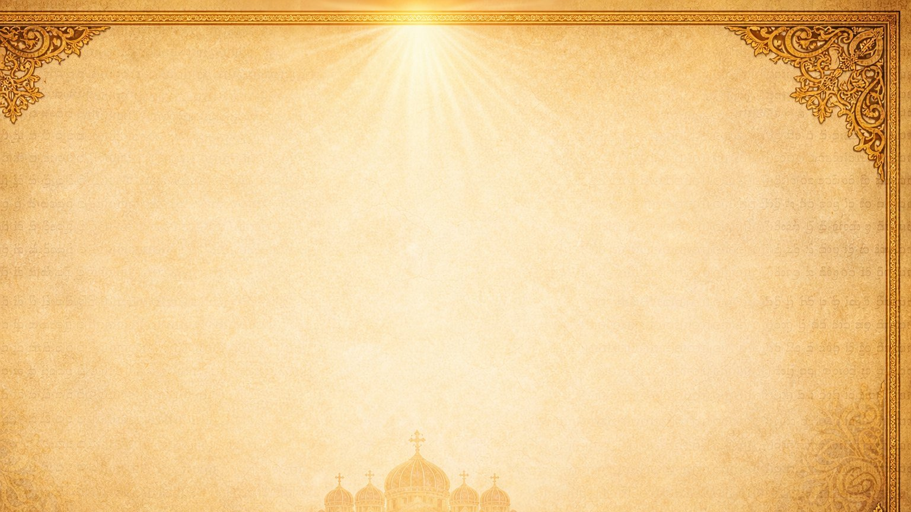
Trinitarianism and Monotheism
One God in Three Hypostases
“I and My Father are one.”
John 10:30
By Dn Yonnas
Debre Nazreth St. Mary & St. Gabriel Ethiopian Orthodox Tewahedo Church
Scripture references: OSB/NKJV wording where quoted • Source: Week 19 lesson article, “Trinitarianism and Monotheism.”

Slide 2
Lesson Objectives
One God: Oriental Orthodoxy is fully monotheistic
Three Hypostases: We believe in the Father, Son, and Holy Spirit
Unity without separation: distinct, but never divided
A revealed mystery: known through Scripture and the Church
The Trinity at work: creation, salvation, and sanctification
Our response: worship, faith, prayer, and holy living
Scripture references: OSB/NKJV wording where quoted • Source: Week 19 lesson article, “Trinitarianism and Monotheism.”
Notes:
Slide 2: Lesson Objectives

Slide 3
Introduction — Why This Lesson Matters
Many people misunderstand Christianity and accuse Christians of worshiping three gods.
The Church teaches clearly:
We believe in One God.
The One true God exists eternally as the Father, the Son, and the Holy Spirit.
This is revealed by God through Holy Scripture and preserved in the faith of the Church.
Scripture references: OSB/NKJV wording where quoted • Source: Week 19 lesson article, “Trinitarianism and Monotheism.”
Notes:
Slide 3: Introduction — Why This Lesson Matters

Slide 4
Our Faith Begins with One God
The Christian faith is completely monotheistic.
“Hear, O Israel: The Lord our God, the Lord is one.”
Deuteronomy 6:4
“You believe that there is one God. You do well.”
James 2:19
The Orthodox Creed also begins: “Truly we believe in one God…”
Scripture references: OSB/NKJV wording where quoted • Source: Week 19 lesson article, “Trinitarianism and Monotheism.”
Notes:
Slide 4: Our Faith Begins with One God

Slide 5
The Trinity Is Not Polytheism
We do NOT believe in:
One God
One divine essence
Three Hypostases
Father, Son, and Holy Spirit
We confess:
Three gods
Three separate divine beings
One God divided into parts
One Person merely pretending to be three persons
Scripture references: OSB/NKJV wording where quoted • Source: Week 19 lesson article, “Trinitarianism and Monotheism.”
Notes:
Slide 5: The Trinity Is Not Polytheism

Slide 6
Christ Reveals the Trinity
“Go therefore and make disciples of all the nations, baptizing them in the name of the Father and of the Son and of the Holy Spirit.”
Matthew 28:19
Father, Son, Holy Spirit
“In the name”
Shows distinction
Three Hypostases
Revealed by Christ
Shows unity
One divine Name
One God
One Name, Three Hypostases.
Scripture references: OSB/NKJV wording where quoted • Source: Week 19 lesson article, “Trinitarianism and Monotheism.”
Notes:
Slide 6: Christ Reveals the Trinity

Slide 7
What Does “Hypostasis” Mean?
Hypostasis is a Greek theological term.
In Orthodox teaching, it refers to a real personal distinction within the One God.
It can be understood as a distinct personal reality or personal property within the one divine nature.
The Three Hypostases are not separate gods; they are the eternal personal realities of the One God.
The Father • The Son • The Holy Spirit
Scripture references: OSB/NKJV wording where quoted • Source: Week 19 lesson article, “Trinitarianism and Monotheism.”
Notes:
Slide 7: What Does “Hypostasis” Mean?

Slide 8
The Three Hypostases
The Father
The Son
The Holy Spirit
The origin, source, and fountainhead.
The Word, the divine intellect, begotten of the Father.
The giver of life, proceeding from the Father, the Spirit of life.
These names are not human inventions. Christ Himself gives them in Matthew 28:19.
Scripture references: OSB/NKJV wording where quoted • Source: Week 19 lesson article, “Trinitarianism and Monotheism.”
Notes:
Slide 8: The Three Hypostases

Slide 9
Important Precaution
When we speak about the Father, Son, and Holy Spirit, we must be careful.
The Father as “more divine”
The Son as “less divine”
The Holy Spirit as a lesser force
Equal in:
We reject:
Honor
Divinity
Essence
Eternity
Glory and Worship
Scripture references: OSB/NKJV wording where quoted • Source: Week 19 lesson article, “Trinitarianism and Monotheism.”
Notes:
Slide 9: Important Precaution

Slide 10
No Separation in the Trinity
The Father, Son, and Holy Spirit are distinct, but never separated.
The Son is in the Father. The Father is in the Son. The Holy Spirit is with the Father and the Son.
The Three are always united in essence, will, power, and divine action.
“I am in the Father, and the Father in Me.”
John 14:10
Scripture references: OSB/NKJV wording where quoted • Source: Week 19 lesson article, “Trinitarianism and Monotheism.”
Notes:
Slide 10: No Separation in the Trinity

Slide 11
No One Comes Before the Other in Time
The Father never existed without the Son or the Holy Spirit.
There was never a time when the Father was without His Word or without His Spirit.
There was never a time when the Son or the Holy Spirit did not exist.
Like a candle: flame and light come together; neither precedes the other.
Likewise, the Father, Son, and Holy Spirit are eternal together.
Source: Week 19 lesson article, “Trinitarianism and Monotheism.”
Notes:
Slide 11: No One Comes Before the Other in Time

Slide 12
Analogy of Man
A human person has:
What this helps show:
Inner existence
Intellect
Life or liveliness
Unity and distinction
The mind is not separated from the person
God remains greater than every comparison
Every analogy is limited. We use it humbly, not as a full explanation of God.
Source: Week 19 lesson article, “Trinitarianism and Monotheism.”
Notes:
Slide 12: Analogy of Man

Slide 13
Analogy of the Sun
The sun can help us understand unity and distinction.
Disc of fire
Light
Heat
Distinct in effect
Not separated from the sun
A limited analogy for the Trinity
The sun has:
The point:
Likewise, the Father, Son, and Holy Spirit are distinct, but not separated.
Source: Week 19 lesson article, “Trinitarianism and Monotheism.”
Notes:
Slide 13: Analogy of the Sun

Slide 14
The Role of the Holy Trinity in Our Life
The Trinity is not only a doctrine to memorize. The Holy Trinity is active in our salvation.
The Father
wills and sends
The Son
redeems and restores
The Holy Spirit
sanctifies and gives life
Scripture references: OSB/NKJV wording where quoted • Source: Week 19 lesson article, “Trinitarianism and Monotheism.”
Notes:
Slide 14: The Role of the Holy Trinity in Our Life

Slide 15
The Work of the Father
Chose us in Christ
Destined us in love to be His children
Called us
Created all things
Receives us when we repent
“He chose us in Him before the foundation of the world.”
Ephesians 1:4
Related references: Ephesians 1:3–5 • Romans 8:30
Scripture references: OSB/NKJV wording where quoted • Source: Week 19 lesson article, “Trinitarianism and Monotheism.”
Notes:
Slide 15: The Work of the Father

Slide 16
The Work of the Son
Gives life
Redeems us
Forgives sins
Restores the image of God in man
Became man for our salvation
“In Him was life, and the life was the light of men.”
John 1:4
“In Him we have redemption through His blood, the forgiveness of sins.”
Ephesians 1:7
Scripture references: OSB/NKJV wording where quoted • Source: Week 19 lesson article, “Trinitarianism and Monotheism.”
Notes:
Slide 16: The Work of the Son

Slide 17
The Work of the Holy Spirit
Gives new birth
Sanctifies us
Convicts the world of sin
Comforts us
Raises our worship to God
“Unless one is born of water and the Spirit, he cannot enter the kingdom of God.”
John 3:5
“He will convict the world of sin.”
John 16:8
Scripture references: OSB/NKJV wording where quoted • Source: Week 19 lesson article, “Trinitarianism and Monotheism.”
Notes:
Slide 17: The Work of the Holy Spirit

Slide 18
The Trinity in Baptism
“In the name of the Father and of the Son and of the Holy Spirit.”
Matthew 28:19
In Orthodox life, baptism is not only symbolic.
It is the new birth by water and the Spirit.
Through baptism, we are united to Christ, receive new life, and enter the life of the Church.
Scripture references: OSB/NKJV wording where quoted • Source: Week 19 lesson article, “Trinitarianism and Monotheism.”
Notes:
Slide 18: The Trinity in Baptism

Slide 19
Common Misunderstandings to Avoid
False: Christians believe in three gods.
Truth: We believe in One God.
False: The Three are just three names for one Person.
Truth: They are three real Hypostases.
False: The Son and Holy Spirit are created beings.
Truth: They are eternal and divine.
False: The Trinity can be fully explained by human logic.
Truth: The Trinity is a divine mystery revealed by God.
Scripture references: OSB/NKJV wording where quoted • Source: Week 19 lesson article, “Trinitarianism and Monotheism.”
Notes:
Slide 19: Common Misunderstandings to Avoid

Slide 20
Orthodox Summary
We worship One God.
This One God is not alone or lifeless.
He is eternally Father, Son, and Holy Spirit.
The Father is the source.
The Son is begotten of the Father.
The Holy Spirit proceeds from the Father.
They are distinct in Hypostasis, but one in essence, divinity, glory, and worship.
Scripture references: OSB/NKJV wording where quoted • Source: Week 19 lesson article, “Trinitarianism and Monotheism.”
Notes:
Slide 20: Orthodox Summary

Slide 21

The Foundation — The Nicene Creed
(Excerpt from the Nicene-Constantinopolitan Creed)
The Nicene Creed:
“We believe in one God, God the Father Almighty, Maker of heaven and earth, and of all things visible and invisible.
And in one Lord Jesus Christ, the only-begotten Son of God, begotten of the Father before all worlds; Light of Light, very God of very God, begotten, not made, being of one essence with the Father; by whom all things were made;
Who for us men and for our salvation came down from heaven, and was incarnate of the Holy Spirit and of the Virgin Mary, and became man;
And was crucified for us under Pontius Pilate, and suffered and was buried;
And the third day He rose again, according to the Scriptures;
And ascended into heaven, and sits at the right hand of the Father;
And He shall come again with glory to judge the living and the dead; whose kingdom shall have no end.
And we believe in the Holy Spirit, the Lord, the Giver of Life, who proceeds from the Father; who with the Father and the Son together is worshipped and glorified; who spoke by the prophets.
And in one holy catholic and apostolic Church.
We acknowledge one baptism for the remission of sins.
We look for the resurrection of the dead, and the life of the world to come. Amen.”
The Nicene Creed is the official statement
of faith of the Church.
It clearly defines what we believe about God, especially about: The Trinity.
The Creed was established during two major Church councils:
First Council of Nicaea
First Council of Constantinople
The purpose was to:
Defend the truth about Christ
Reject false teachings (like denying Christ’s divinity)
Unite the Church in one clear belief

Slide 22
Practical Application
Because God is Trinity:
We worship one God with reverence: Father, Son, and Holy Spirit, one in essence and glory.
We pray in a Trinitarian way: to the Father, through the Son, in the Holy Spirit.
We live in communion: because God Himself is eternal love and communion.
We guard the true faith: rejecting confusion, false teaching, and the idea of “three gods.”
We confess with confidence: the faith revealed by Christ, taught by the apostles, and preserved by the Church.
We seek holiness: allowing the Holy Spirit to sanctify us and draw us into the life of God.
Scripture references: OSB/NKJV wording where quoted • Source: Week 19 lesson article, “Trinitarianism and Monotheism.”
Notes:
Slide 21: Practical Application

Slide 23
Discussion Questions
Why do some people misunderstand the Trinity as belief in three gods?
How does Matthew 28:19 show both unity and distinction?
Why is it important to say the Father, Son, and Holy Spirit are distinct but not separated?
Which analogy helps you most: man, the sun, or the candle? Why?
How does the doctrine of the Trinity affect the way we pray and worship?
Scripture references: OSB/NKJV wording where quoted • Source: Week 19 lesson article, “Trinitarianism and Monotheism.”
Notes:
Slide 22: Discussion Questions

Slide 24
Memory Verse Review
“I and My Father are one.”
John 10:30
Reflection Question
What does this verse teach us about the unity of the Father and the Son?
Scripture references: OSB/NKJV wording where quoted • Source: Week 19 lesson article, “Trinitarianism and Monotheism.”
Notes:
Slide 23: Memory Verse Review

Slide 25
Conclusion
We believe in One God in Three Hypostases.
We do not worship three gods.
We worship the Father, the Son, and the Holy Spirit: one in essence, divinity, glory, and worship.
The Trinity is a mystery, but it is not confusion.
It is the true faith revealed by Christ, taught by the apostles, preserved by the Church, and confessed in the Orthodox Creed.
Scripture references: OSB/NKJV wording where quoted • Source: Week 19 lesson article, “Trinitarianism and Monotheism.”
Notes:
Slide 24: Conclusion

Slide 26
Closing Statement
Final takeaway:
The Holy Trinity teaches us that God is One, eternal, living, loving, and revealed to us as Father, Son, and Holy Spirit.
To know the Trinity is not only to know a doctrine; it is to enter the life, worship, and salvation given to us by the One true God.
Scripture references: OSB/NKJV wording where quoted • Source: Week 19 lesson article, “Trinitarianism and Monotheism.”

