Slide 1
The Book Of Ephesians
By Dn Yonnas

Slide 2
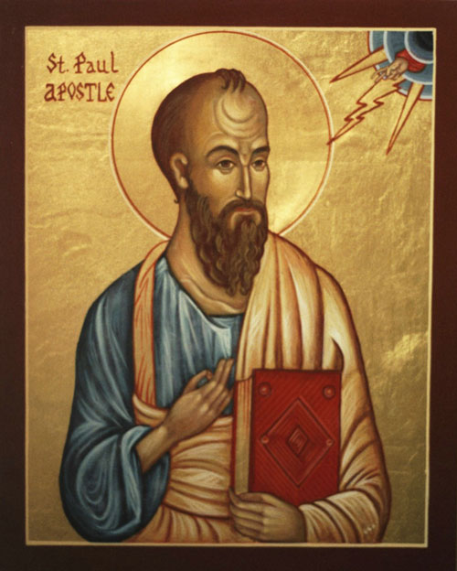
Context And Background
Author: St. Paul the Apostle
Context: Written c. 60–62 AD during his first imprisonment in Rome; one of the "Prison Epistles."
Audience: The local Church in Ephesus and an Encyclical (universal) message to the Body of Christ throughout the ages.
The Purpose: The "Icon" of the New Creation
The Ontological Unity: To reveal the Church not merely as a group, but as the fullness of Christ—His living Body and the Holy Temple where God dwells.
The Reconciliation: To proclaim the "Mystery" hidden from ages: that Jews and Gentiles are joined into One New Humanity, destroying the "middle wall of partition."
The Liturgical Life: To instruct the baptized in the Way of Holiness, transitioning from the old man to the new man in Christ.
The Ascetic Struggle: To equip the faithful for Spiritual Warfare, providing the "Armor of God" to stand firm against the powers of darkness.

Slide 3
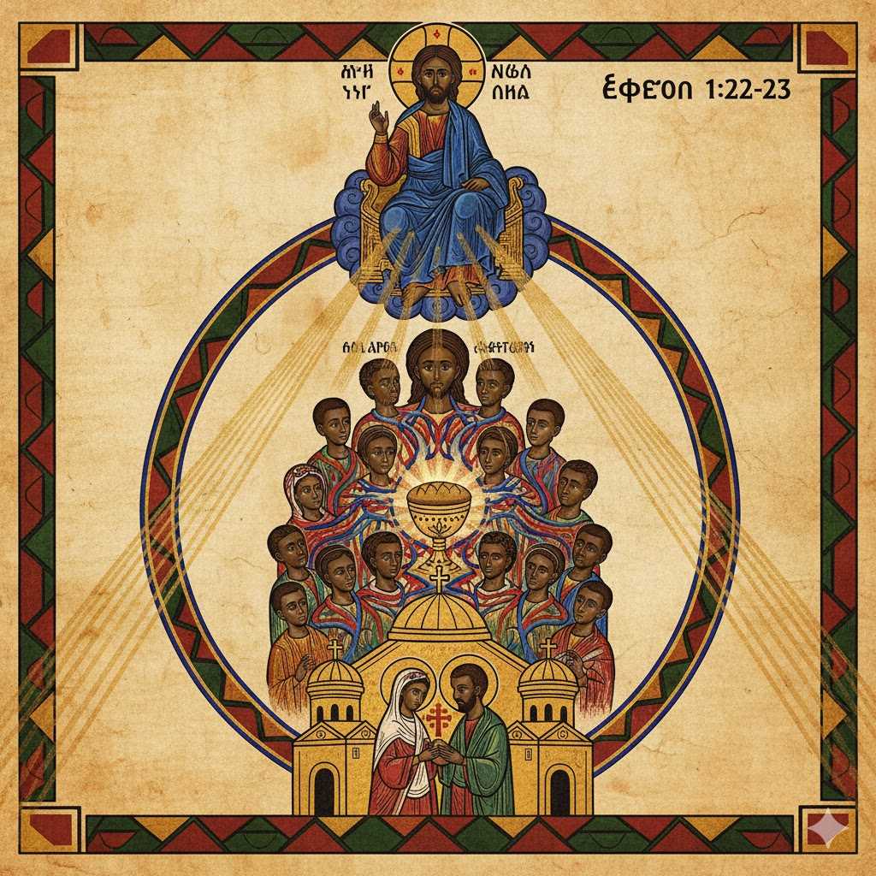
The Central Revelation: The Church
The central revelation of Ephesians is the Church.
Not merely “individual spirituality,” but the mystery of Christ and His Body.
Oriental Orthodox emphasis:
The Church is a living reality, not an idea.
Christ is the Head, the Church is His Body.
Bible verses (KJV):
Ephesians 1:22–23
“And hath put all things under his feet, and gave him to be the head over all things to the church,
Which is his body, the fulness of him that filleth all in all.”

Slide 4
The Church as Body and Bride
Paul uses "Theophanic" images to show that salvation is a communal reality, not a private one.
The Body and the Head (Eph 1:22–23)
Theological Point: The Church is the "Fullness" of Christ. As a body cannot live without a head, and a head is not complete without its members, Christ chooses to be "completed" by us.
The Bride and the Bridegroom (Eph 5:23–32)
Theological Point: This is the "Great Mystery." It reveals that the goal of human life is a Sacramental Union. Just as a husband and wife become "one flesh," the Church becomes "one spirit" with Christ.
Bible verses (KJV):
Ephesians 1:22–23
“And hath put all things under his feet, and gave him to be the head over all things to the church,
Which is his body, the fullness of him that filleth all in all.”
Ephesians 5:23
“For the husband is the head of the wife, even as Christ is the head of the church: and he is the saviour of the body.”
The Definition
A theophany is a "God-showing." When we say an image is "theophanic," we mean it isn't just a metaphor or a pretty picture; it is a description of how God’s Uncreated Light and presence break into our world.

Slide 5
The Body and the Head: Organic Unity
While we often think of "the Body" as a metaphor for teamwork, the biblical context is more organic and vital.
Life-Source: A body without a head is a corpse. By calling Christ the "Head," Paul is saying that the Church’s very life, direction, and "nervous system" come from Him.
Interdependence: In a body, a toe cannot claim to be independent of the lungs. This shatters the idea of "private" Christianity. If one part of the body suffers, the whole system feels the stress.
The "Fullness": Ephesians 1:23 calls the Church "the fullness of him who fills all in all." This suggests that Christ chooses to manifest His presence on Earth through this collective group, rather than appearing as a solo actor.

Slide 6
The Bride and the Bridegroom: Covenantal Intimacy
If the "Body" emphasizes unity and function, the "Bride" emphasizes love and identity.
Sacrificial Devotion: Paul points out that Christ "gave himself up" for the Bride (Eph 5:25). This moves salvation away from a legal transaction and into the realm of a marriage covenant.
The Process of Sanctification: The text describes Christ "washing" the Bride with the word to present her "without stain or wrinkle." This shows that the Church’s holiness isn't a DIY project; it is the result of Christ’s ongoing care for His people as a whole.
The "Great Mystery": Paul explicitly says that human marriage is a "signpost" pointing toward this deeper reality. The ultimate goal of history is the union of the Creator with His creation.
In the King James Version (KJV), Ephesians 5:25 reads:
"Husbands, love your wives, even as Christ also loved the church, and gave himself for it;"

Slide 7
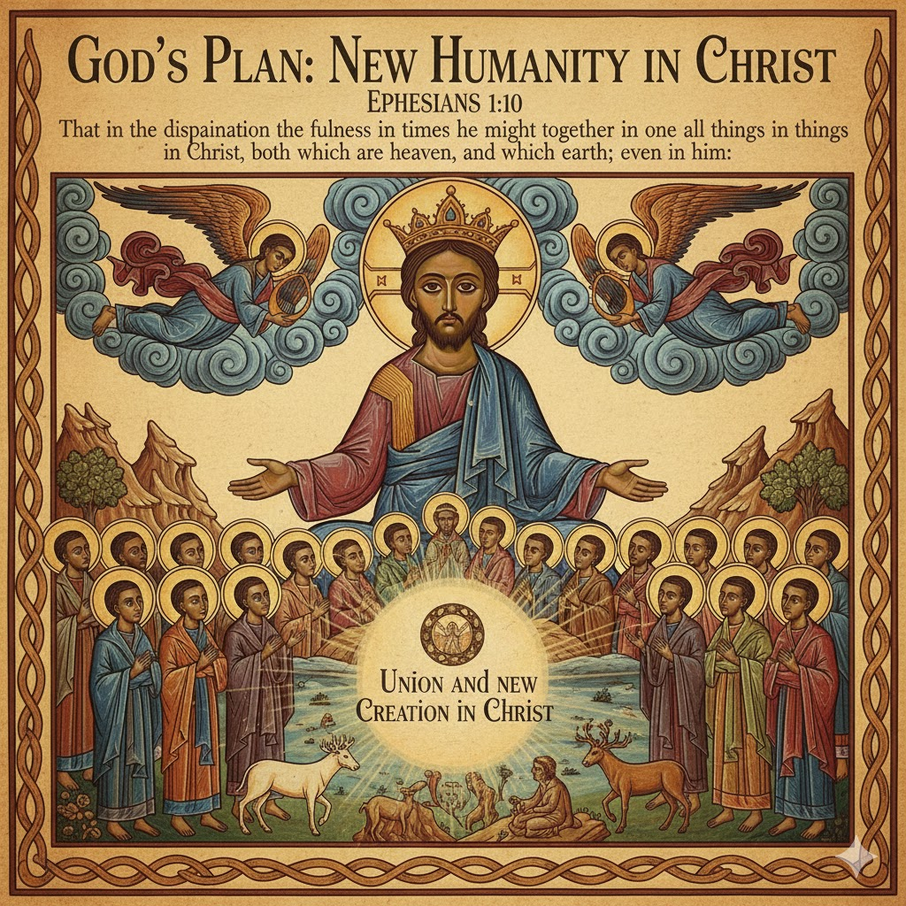
The Core Message
God’s plan is to gather all things into Christ.
The Church is the visible sign of that gathering.
Salvation is not only forgiveness
Salvation is new creation, union, and a new humanity in Christ.
Bible verses (KJV):
Ephesians 1:10 — “That in the dispensation of the fulness of times he might gather together in one all things in Christ, both which are in heaven, and which are on earth; even in him:”

Slide 8
Grace In an Orthodox Understanding
Ephesians teaches grace clearly:
“By grace you have been saved…” (Eph 2:8)
Oriental Orthodox clarity:
Grace is God’s life and power given to heal and transform.
Grace does not cancel obedience; it creates and empowers it.
Ephesians 2:8–10 (grace → created for good works)
Ephesians 1:4 (called to be holy)

Slide 9
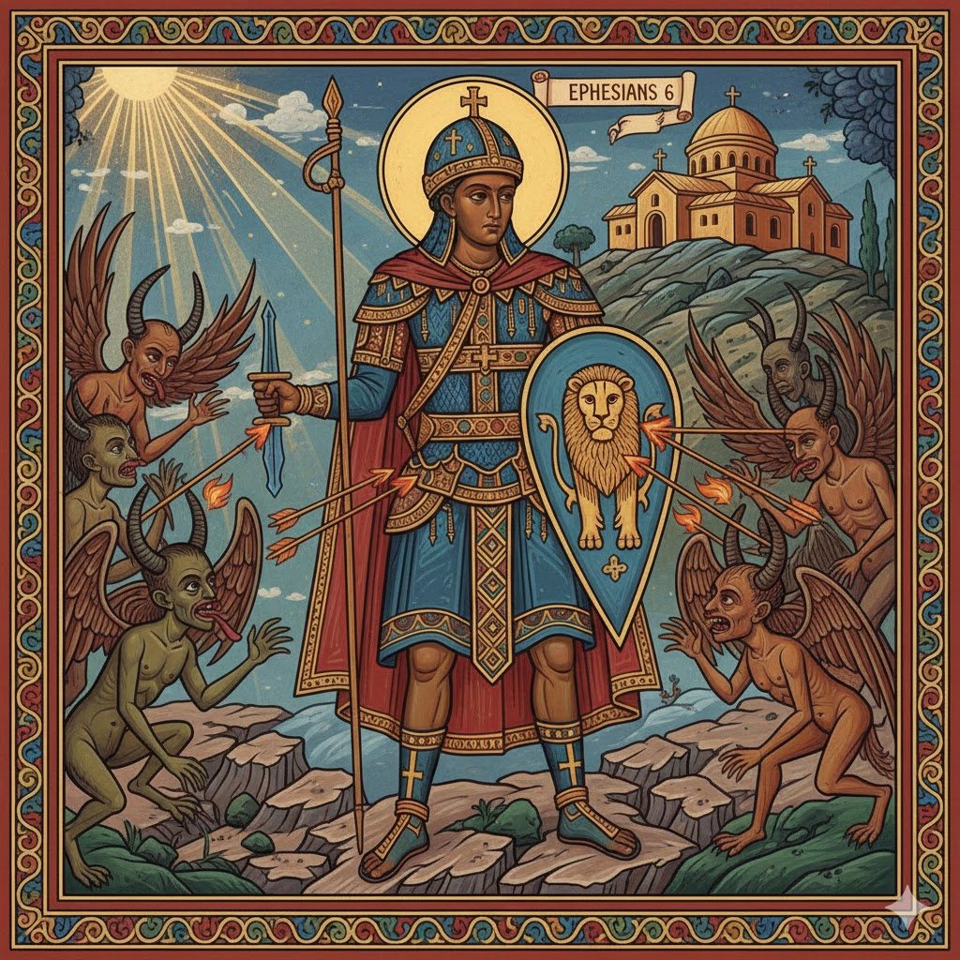
The Structure Of Ephesians
Ch. 1–3: Identity (What God has done in Christ)
Ch. 4–5: Life (How the Church must live)
Ch. 6: Spiritual Warfare (How believers stand and endure)

Slide 10
1. Chapters 1–3: The Divine Identity (The "Indicative")
Before St. Paul gives a single command, he spends three chapters explaining what God has already finished.
The Theology: You are adopted, redeemed, and sealed.
The Shift: We move from being "dead in trespasses" to being seated in "heavenly places."
The Goal: To understand that the Church is not a human invention, but a divine mystery revealed.

Slide 11
Chapters 4–5: The Christian Life (The "Imperative")
Key Verse: Ephesians 4:1 — "I therefore... beseech you that ye walk worthy of the vocation wherewith ye are called."
The Transition: The word "therefore" is the hinge. Because of who you are (Ch. 1–3), this is how you must live (Ch. 4–5).
The Practice: This isn't about "getting" saved; it's about "walking" out the salvation you already have. It covers unity, purity, and the "Body and Bride" relationships in the home and church.

Slide 12
Chapter 6: The Spiritual Warfare (The "Endurance")
Key Verse: Ephesians 6:10–11 — "Finally, my brethren, be strong in the Lord... Put on the whole armour of God."
The Reality: A "worthy walk" inevitably triggers opposition.
The Strategy: Notice that the armor is mostly defensive. The goal isn't to "win" a new victory (Christ already did that in Ch. 1), but to stand and hold the ground Christ has already won.

Slide 13
Identity: Our Blessings In Christ (Eph 1)
Paul names spiritual blessings:
Chosen for holiness (1:4)
Adopted as children (1:5)
Redeemed (1:7)
Sealed with the Holy Spirit (1:13–14)
Key idea: Your identity is not your past. Your identity is Christ.
Key verses: Ephesians 1:4, 1:7, 1:13–14
Ephesians 1:4 — “According as he hath chosen us in him before the foundation of the world, that we should be holy and without blame before him in love:”
Ephesians 1:5 — “Having predestinated us unto the adoption of children by Jesus Christ to himself, according to the good pleasure of his will,”
Ephesians 1:7 — “In whom we have redemption through his blood, the forgiveness of sins, according to the riches of his grace;”
Ephesians 1:13–14 — “In whom ye also trusted, after that ye heard the word of truth, the gospel of your salvation: in whom also after that ye believed, ye were sealed with that holy Spirit of promise, Which is the earnest of our inheritance until the redemption of the purchased possession, unto the praise of his glory.”

Slide 14
Paul's Prayer for illumination
St. Paul prays that the Church receives:
The Spirit of Wisdom & Revelation: To know God not as a concept, but through a living relationship (Colossians 2:3).
The Enlightened "Eyes of the Heart": To perceive our Hope (calling), our Inheritance (the Kingdom), and the Power of the Resurrection.
The Orthodox Way of Knowing: Theology is not a trophy for the proud; it is a gift received through Prayer and Humility.
Bible verses (KJV):
Ephesians 1:17–19
“That the God of our Lord Jesus Christ, the Father of glory, may give unto you the spirit of wisdom and revelation in the knowledge of him:
The eyes of your understanding being enlightened; that ye may know what is the hope of his calling, and what the riches of the glory of his inheritance in the saints,
And what is the exceeding greatness of his power to us-ward who believe, according to the working of his mighty power,”
The Orthodox Way: Prayer over Pride
Theology as Doxology: As the Desert Fathers taught, "If you are a theologian, you will pray truly; and if you pray truly, you are a theologian."
Humility: Knowledge without prayer leads to pride. Revelation is a gift received on one's knees, not a trophy won by the intellect.

