Slide 1
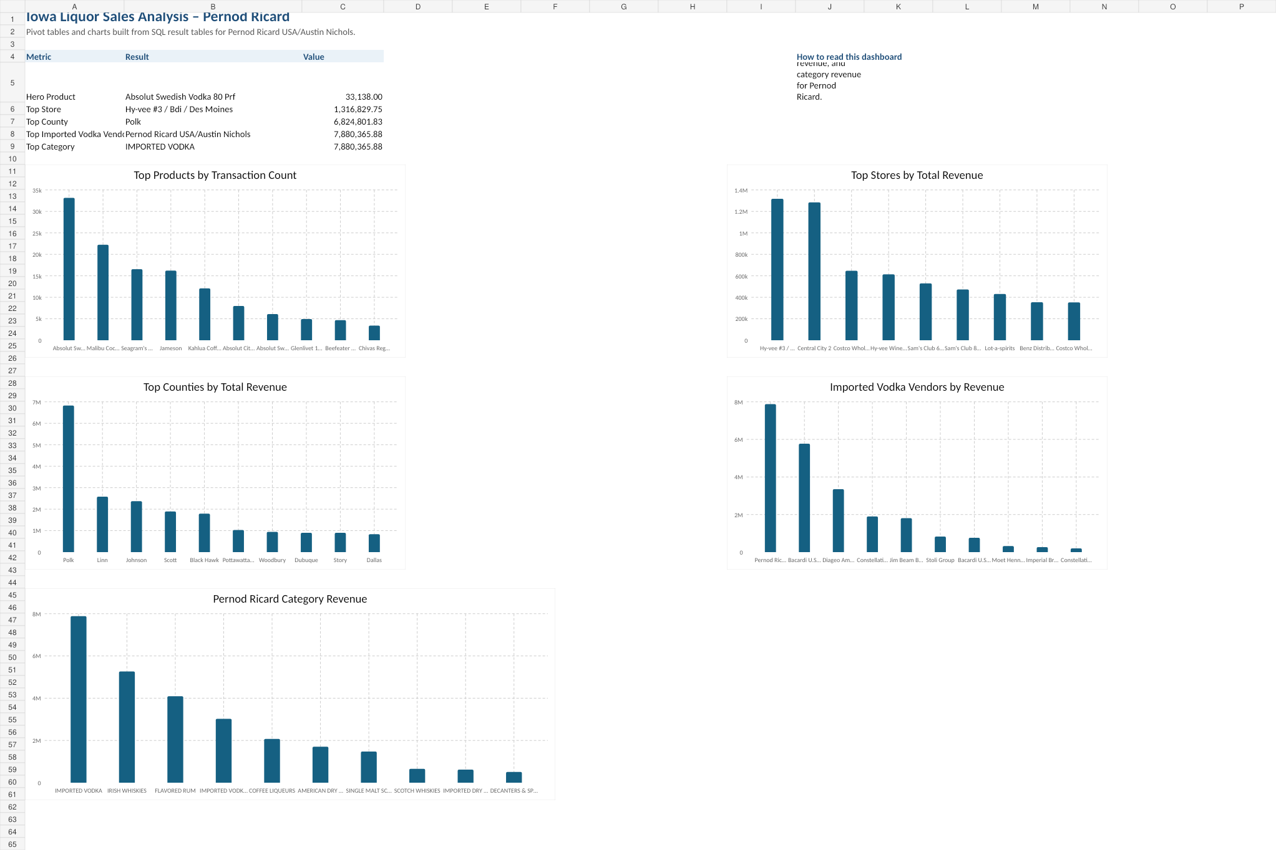
Iowa Liquor Sales Analysis
Pernod Ricard
• Vendor focus: Pernod Ricard • Database: sales, products, stores, and counties
Prepared by Kidus Tesema
Year Up United – Data Analytics

Slide 2
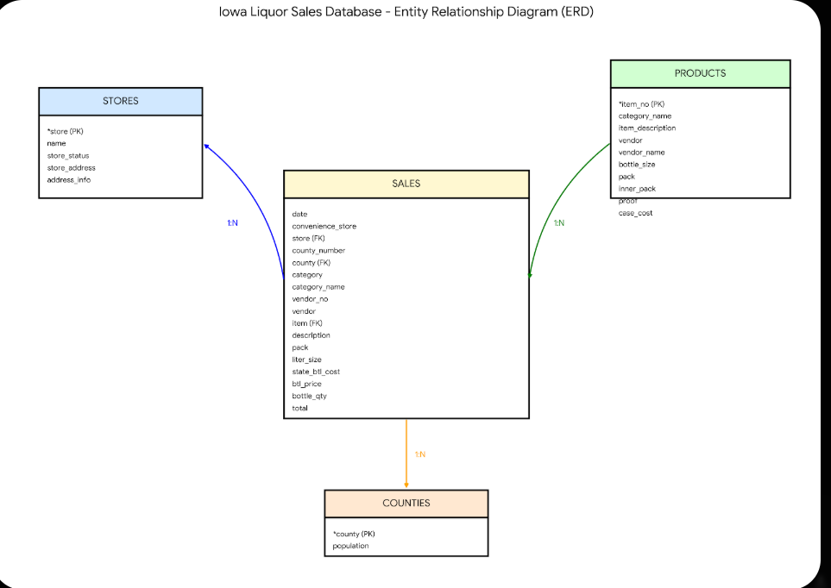
INTRODUCTION
Project scope and data model
Goal: evaluate Pernod Ricard performance in the Iowa liquor market using tested SQL outputs and Excel summaries.
• The analysis focused on 17 completed SQL questions covering transactions, products, stores, counties, joins, aggregation, and subqueries. • The sales table is the core fact table, while products, stores, and counties enrich each transaction with product, location, and population context. • The project was designed to answer three business questions: what sells best, where revenue is strongest, and where competition or growth pressure appears.
Entity relationship diagram (ERD)
Total revenue
Avg. bottle price
$28.16M
$18.08
Q4 2014 sales rows
Stores > $2k
24,150
1,015

Slide 3
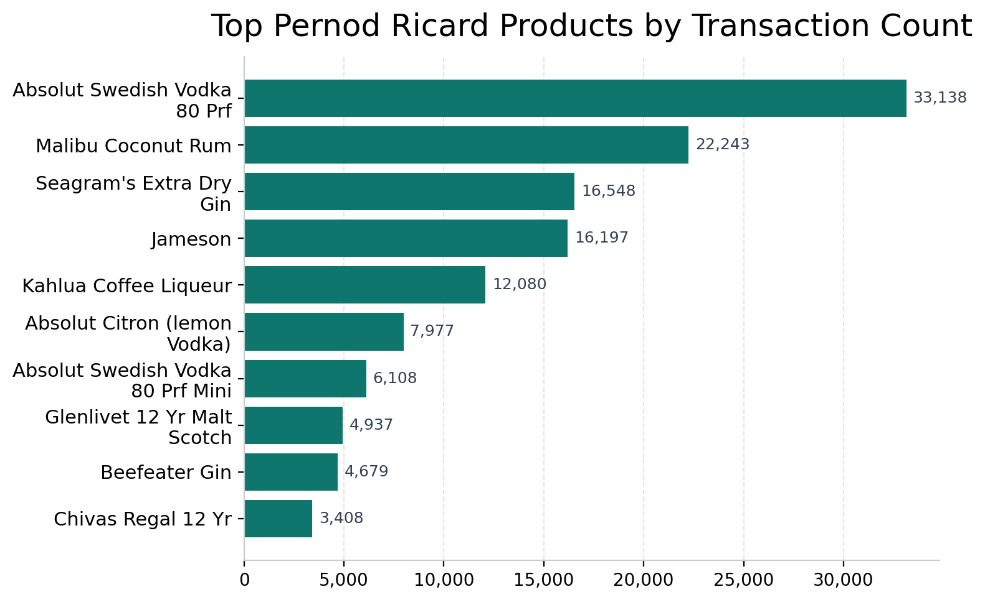
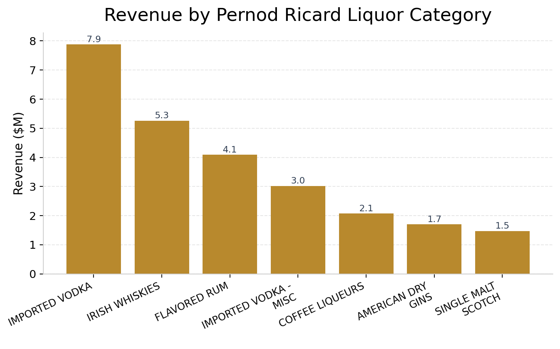
STRENGTHS
Product demand and category leadership
The charts below show that Pernod Ricard has a clear hero product and a strong category mix led by imported vodka.
Top products by transaction count
Revenue by Pernod Ricard liquor category
• Absolut Swedish Vodka 80 Prf is the hero product with 33,138 transactions and 365,020 bottles sold. • Imported Vodka is the largest revenue category at $7.88M, followed by Irish Whiskies at $5.26M and Flavored Rum at $4.09M. • This mix shows a strong core business with room to use leading products as anchors for cross-category growth.

Slide 4
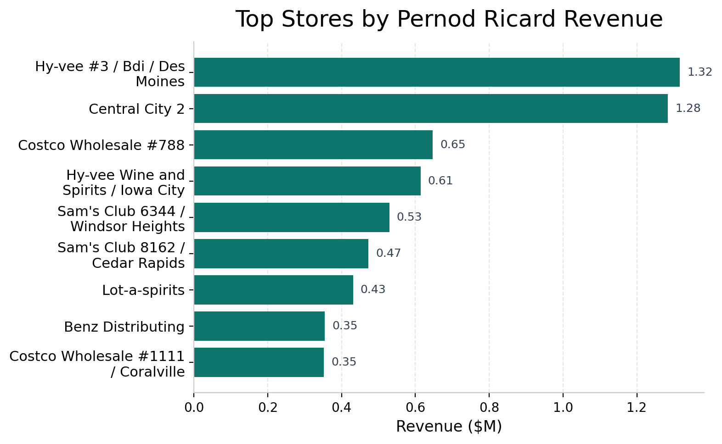
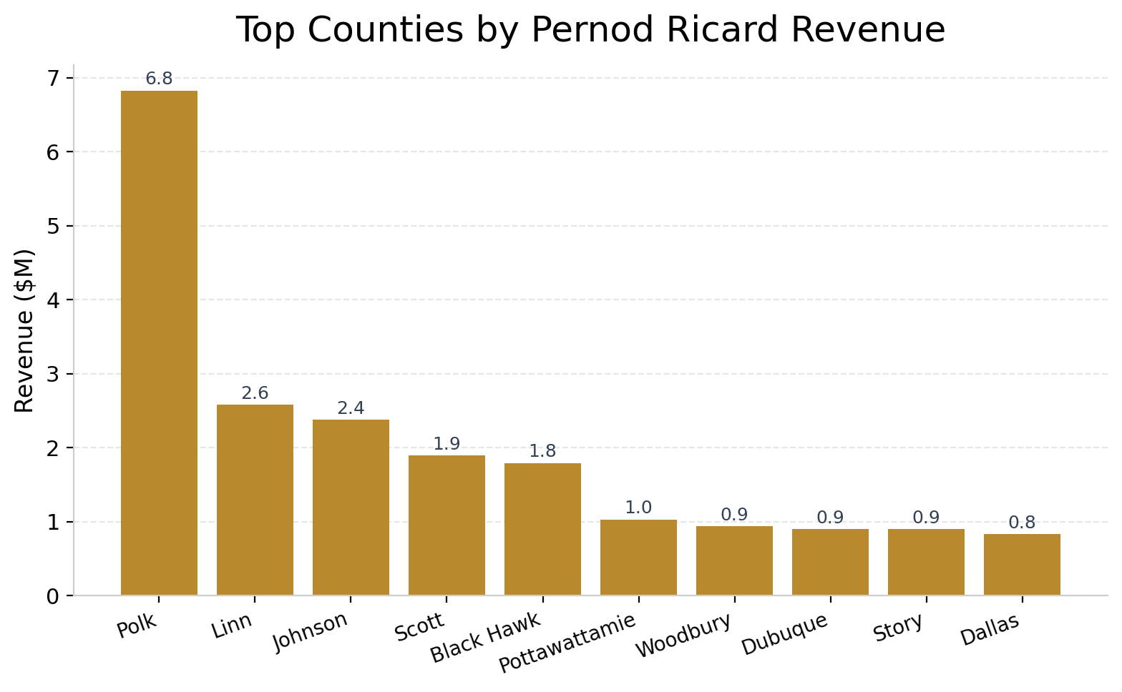
STRENGTHS + OPPORTUNITY
Retail footprint and geographic strongholds
Store and county results show where Pernod Ricard already performs well and where field execution can be concentrated for the biggest payoff.
Top stores by total revenue
Top counties by total revenue
• Hy-Vee #3 / BDI / Des Moines is the strongest retail partner at $1.32M in revenue. • Polk County is the geographic stronghold at $6.82M, with Linn and Johnson forming the next highest cluster. • No county above 10,000 population had zero Pernod Ricard sales, which means the brand already has statewide reach in larger population centers.

Slide 5
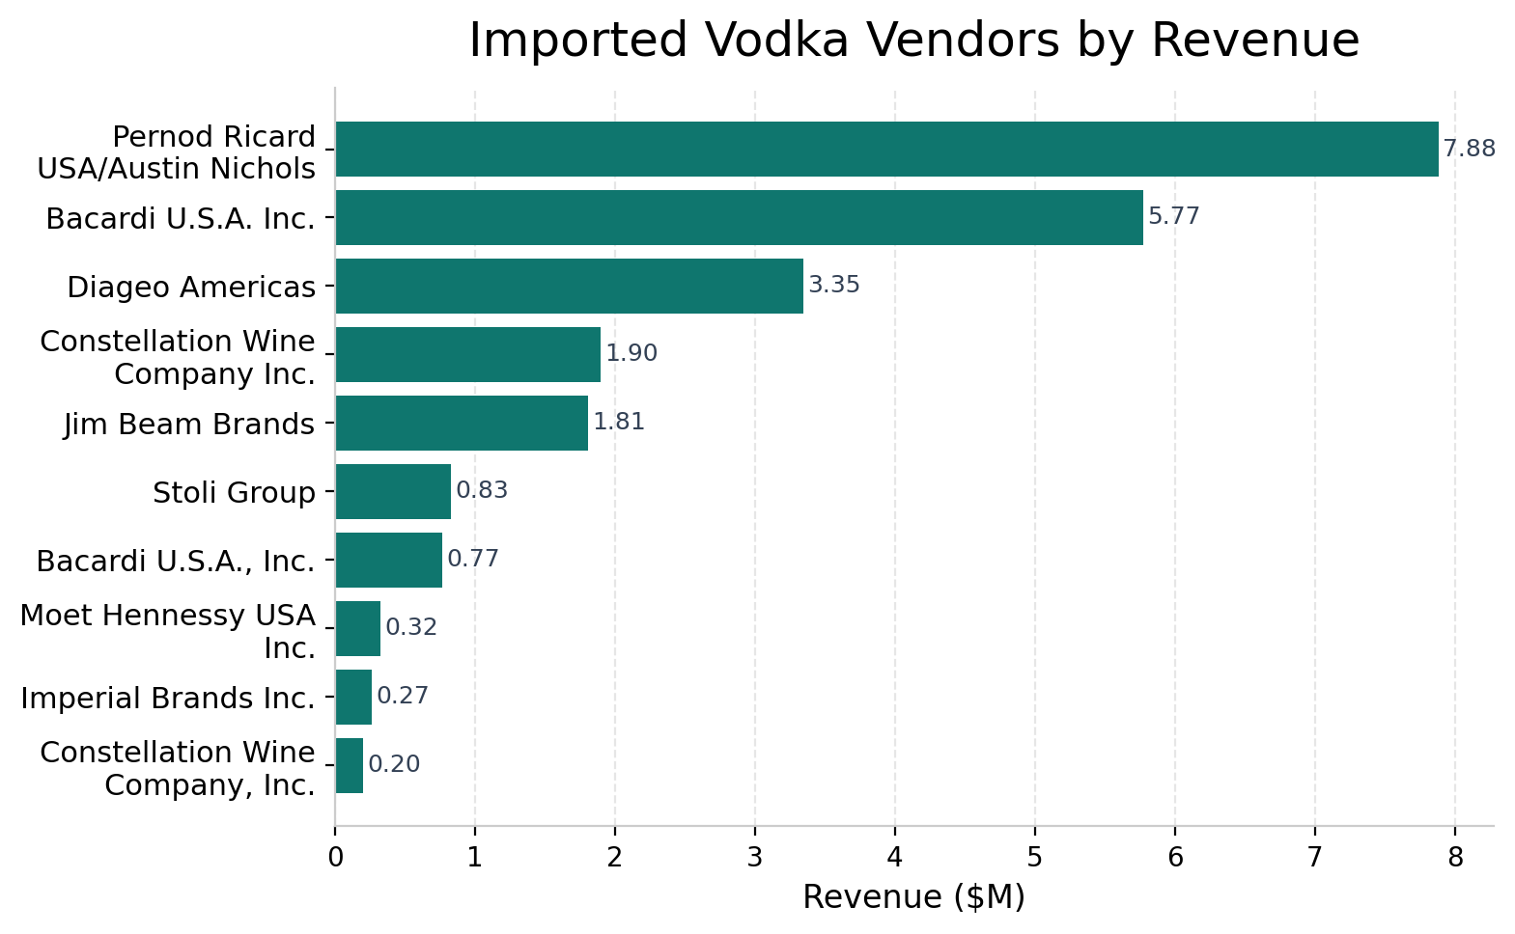
THREATS + OPPORTUNITIES
Competitive pressure and market expansion signals
Imported vodka leadership is strong, but the category remains contested and growth depends on defending share while broadening the mix.
Imported vodka vendors by revenue
Opportunities
• The $10–$20 state-bottle-cost segment produced 94,416 rows, making mid-tier promotions a practical growth lever. • Irish Whiskies and Flavored Rum already contribute meaningful revenue and can reduce overreliance on one lead category. • Urban markets such as Des Moines and Iowa City are ideal for targeted display, pricing, and inventory support.
Threats
• Bacardi ($5.77M) and Diageo ($3.35M) are the closest revenue competitors inside imported vodka. • Imported Vodka contributes about 28% of total Pernod Ricard revenue, creating category concentration risk. • Polk County alone drives roughly 24% of revenue, so performance is sensitive to a small set of large markets.

Slide 6
SWOT ANALYSIS
What the Iowa results say strategically
The project findings can be condensed into a simple SWOT view for management discussion.
Strengths
Weaknesses
• Category leader in imported vodka revenue ($7.88M). • Hero product with high recurring demand: Absolut Swedish Vodka 80 Prf. • Strong urban partners and broad coverage across larger counties.
• Revenue is concentrated in one lead category and one lead county. • Large performance gap between the top partner stores and the rest of the network. • A long tail of smaller markets contributes less to total growth.
Opportunities
Threats
• Use mid-tier pricing activity to design promotions and shelf strategy. • Expand secondary categories such as Irish Whiskies and Flavored Rum. • Deepen execution in Des Moines and Iowa City where velocity is already proven.
• Bacardi and Diageo continue to pressure share in imported vodka. • Substitute vodka categories can dilute growth if focus stays too narrow. • Heavy reliance on a few large markets raises performance volatility.

Slide 7
SUMMARY + RECOMMENDATIONS
Where Pernod Ricard should focus next
The analysis points to a defend-and-expand strategy: protect the strongest business, then grow the next most attractive pockets.
Summary
Executive dashboard snapshot
• Pernod Ricard generated $28.16M in total revenue with an average bottle price of $18.08. • The business is anchored by Absolut Swedish Vodka 80 Prf, imported vodka leadership, and a strong footprint in Polk County and major urban stores. • The biggest strategic need is to grow without becoming too dependent on one category or one geography.
Recommendations
• Defend imported vodka share in top accounts through pricing, displays, and shelf availability. • Use leading products to pull up adjacent categories such as Irish Whiskies and Flavored Rum. • Prioritize Des Moines, Polk County, Linn, and Johnson for targeted promotions and inventory planning.
Bottom line: Pernod Ricard is well-positioned in Iowa, with the clearest upside coming from focused urban execution and balanced category growth.

