Slide 1
EmporiUm Sales Analysis
Len Jensen • South Region Stores
Store 852: Charleston, SC | Store 853: Greenville, SC
Kidus Tesema
Year Up United • Capstone 2
Notes:
Introduce the project: sales analysis for Len Jensen, focusing on Charleston and Greenville stores.

Slide 2
Analysis Scope & Business Questions
The notebook filters the project data to Len Jensen’s two assigned stores.
SCOPE
QUESTIONS
Manager: Len Jensen
Region: South
Director: Andy Gisselquist
Which store performs better by total sales?
How does monthly revenue trend over time?
Who are the top customers using rewards IDs?
Which product categories drive the most revenue?
Where should marketing focus next quarter?
Assigned Stores
852 Charleston, South Carolina
853 Greenville, South Carolina
Capstone 2 • EmporiUm Sales Analysis • Len Jensen
2
Notes:
Explain that the analysis filters the store and sales data to Len Jensen and answers the main capstone questions.

Slide 3
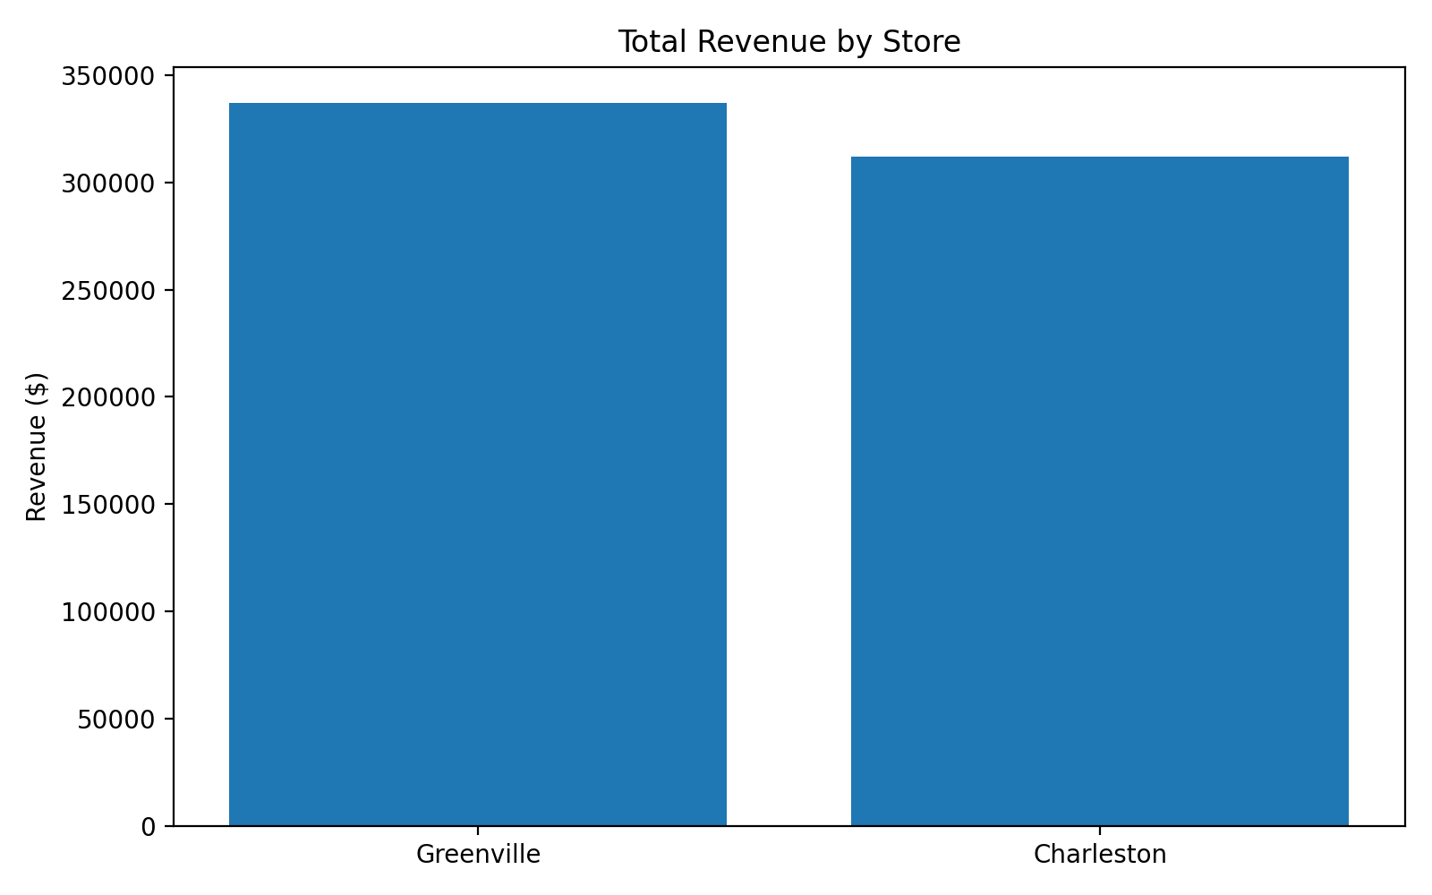
Executive Snapshot
Total performance for Len Jensen’s stores across January 2022–December 2025.
$648.8K
$337.0K
$311.8K
4,472
Total revenue
Greenville revenue
Charleston revenue
Transactions
Key takeaway
Greenville is the stronger store overall, but Charleston is close enough that targeted support could close the gap. Technology & Accessories dominates revenue and should lead the next marketing push.
Capstone 2 • EmporiUm Sales Analysis • Len Jensen
3
Notes:
Summarize the headline numbers: total revenue, Greenville ahead of Charleston, and total transactions.

Slide 4
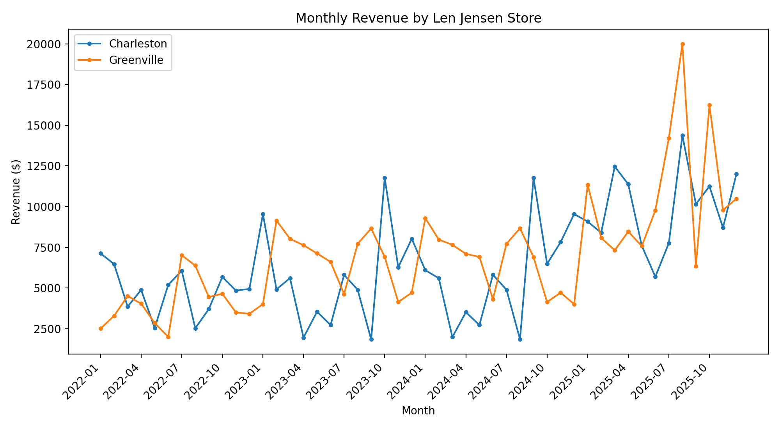
Monthly Revenue Trend
Revenue varies month to month, with both stores showing strong late-period activity.
What this means
Greenville finishes ahead in total revenue.
Both stores have seasonal spikes, useful for campaign timing.
Marketing should target high-revenue months and repeat the strongest category offers.
Capstone 2 • EmporiUm Sales Analysis • Len Jensen
4
Notes:
Walk through the monthly revenue line chart and describe seasonality and differences between stores.

Slide 5
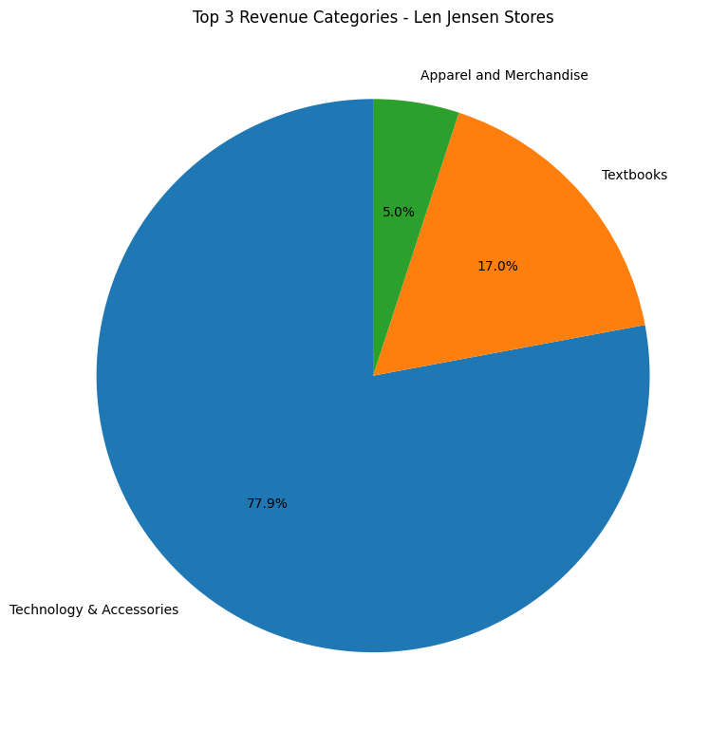
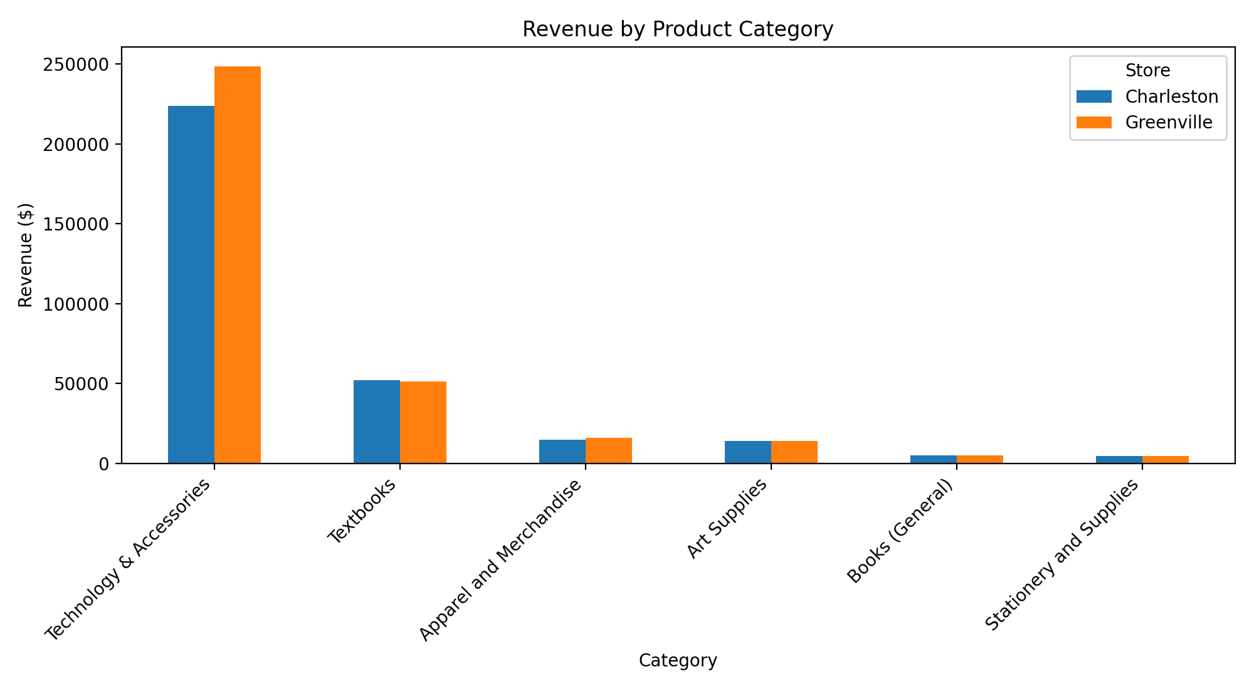
Category Drivers
Technology & Accessories is the largest revenue category in both stores.
Technology & Accessories = 77.9% of Len Jensen revenue
Capstone 2 • EmporiUm Sales Analysis • Len Jensen
5
Notes:
Explain that Technology & Accessories is the dominant revenue driver and compare both stores by category.

Slide 6
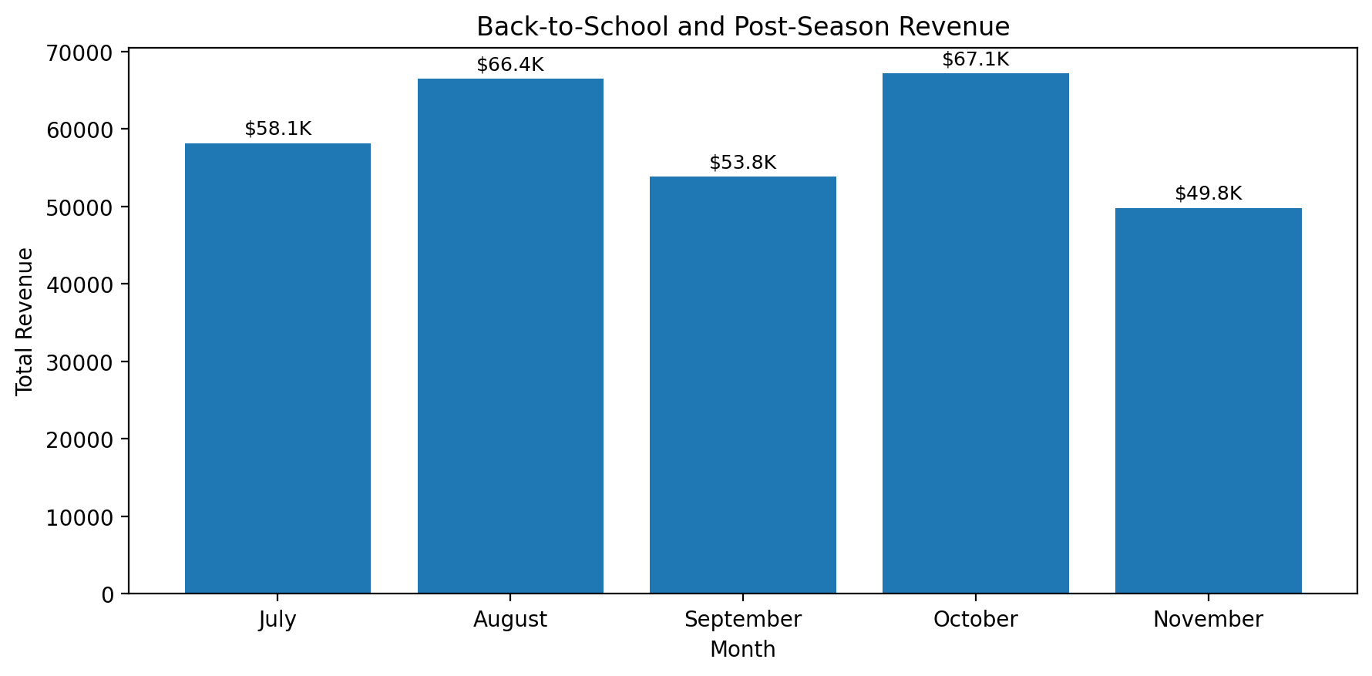
Back-to-School & Post Back-to-School: Clearance & Shelf Turnover Season
After the school rush, October–November can turn leftover demand and discounted inventory into additional revenue.
Key insight
October is the highest month in the period shown, at about $67.1K.
This suggests sales do not stop after back-to-school; clearance, restock, and late student purchases keep demand active.
Post-season promotions can help move products off shelves before they become slow inventory.
Recommendation
Run a 2–3 week “after back-to-school sale” in October.
Bundle Technology & Accessories with Textbooks and Apparel to increase basket size.
Use clearance messaging: “limited stock,” “last chance,” and “student essentials still available.”
Post-season focus: move remaining inventory, protect revenue after the school rush, and create demand for follow-up purchases.

Slide 7
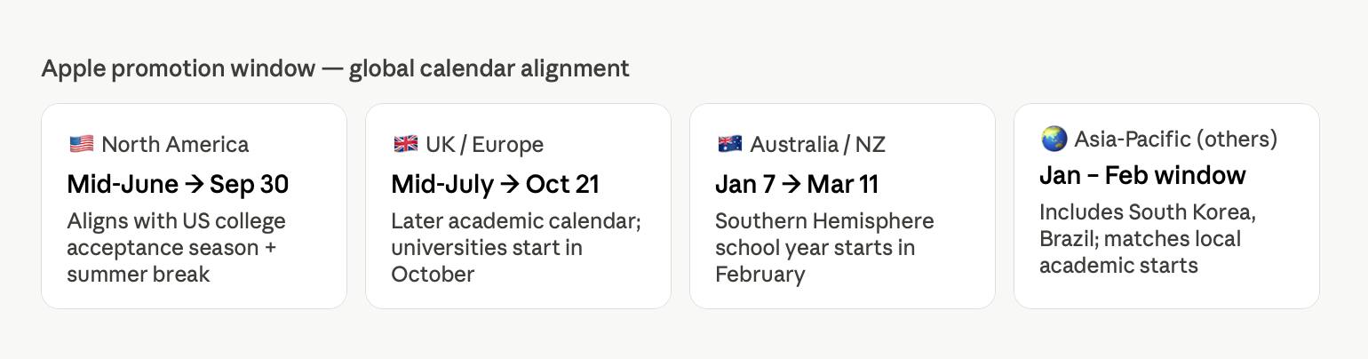

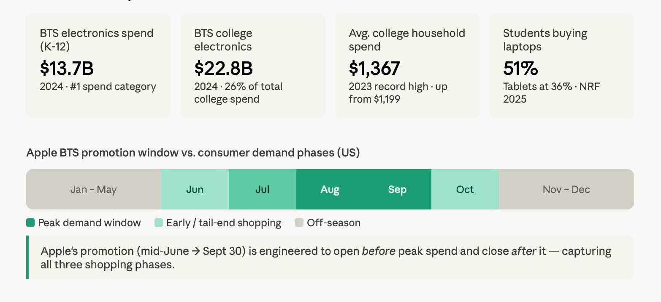

Slide 8
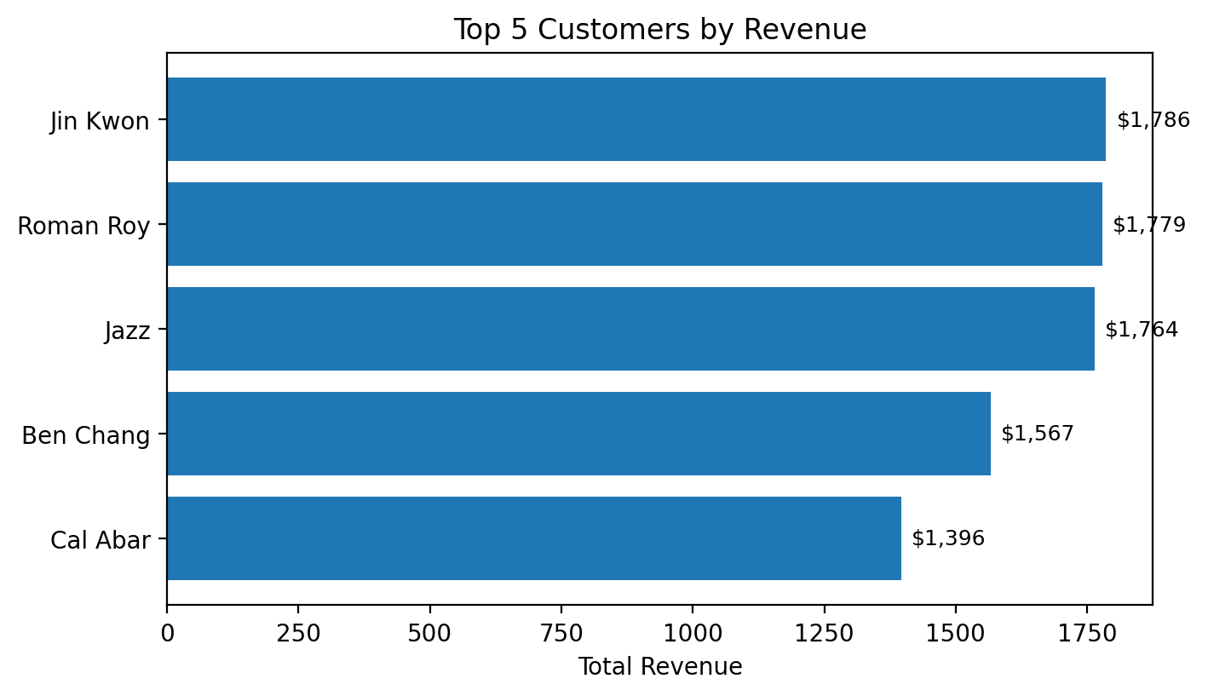
Top Five Customers
Highest revenue customers across Len Jensen’s Charleston and Greenville stores.
#1: Jin Kwon
$1,786.05 total revenue
1. Jin Kwon: $1,786
2. Roman Roy: $1,779
3. Jazz: $1,764
4. Ben Chang: $1,567
5. Cal Abar: $1,396
Insight & action
• Create VIP offers for top customers during back-to-school.
• Send early access discounts after the season to keep shelves moving.
• Use loyalty rewards to increase repeat purchases.
Data source: StoreSales + customer_list filtered to Len Jensen stores

Slide 9
SWOT Analysis
SWOT summarizes what the marketing team can act on next quarter.
Strengths
Weaknesses
• Greenville leads total revenue
• Tech category is a clear winner
• Both stores have strong transaction volume
• Charleston trails Greenville
• Revenue depends heavily on tech
• Lower categories contribute little revenue
Opportunities
Threats
• Back-to-school tech bundles
• Cross-sell stationery, books, and supplies
• Rewards offers for top customers
• Over-reliance on one category
• Competitor promotions on tech gear
• Seasonal demand can fluctuate
Capstone 2 • EmporiUm Sales Analysis • Len Jensen
6
Notes:
Use SWOT to organize the business interpretation: strengths, weaknesses, opportunities, and threats.

Slide 10
Recommendation for Next Quarter
Focus marketing where the data shows the biggest return and the clearest growth path.
Recommended focus:
“Based on the data, I recommend using the strongest category to drive traffic, then bundling lower-performing categories to increase basket size.”
Run a South Region back-to-school Technology & Accessories campaign, led by Greenville and supported with targeted growth promotions in Charleston.
WHY
Greenville has the highest total revenue ($337.0K).
Technology & Accessories drives almost three-fourths of revenue.
Next step: launch campaign + compare next quarter results.
Bundles can lift smaller categories such as books, stationery, and art supplies.
Capstone 2 • EmporiUm Sales Analysis • Len Jensen
7
Notes:
End with the recommendation: a South Region back-to-school tech campaign plus bundles to grow smaller categories.

