Slide 1
Compiler
Lab 2: NFA to DFA

Slide 2
Objective
The goal of labs 2 and 3 is to implement the subset construction algorithm (NFA to DFA).
The goal of lab 2 is to implement e-closure and move functions
ε-closure(s) = {s} ∪ {t | s →_{ε} … →_{ε} t} ε-closure(T) = ∪_{s∈T} ε-closure(s) move(T,a) = {t | s →_{a} t and s ∈ T}

Slide 3
Getting Started
Download the template file (lab2.tar.gz) from Blackboard

Slide 4
Description of Closure
ε-closure(s) = {s} ∪ {t | s →_{ε} … →_{ε} t}
A set of NFA states that can be reached from s only by ε transitions
ε-closure(T) = ∪_{s∈T} ε-closure(s)
A set of NFA states that can be reached from the states in T only by ε transitions
move(T,a) = {t | s →_{a} t and s ∈ T}
A set of NFA states that can be reached from the states in T by input a

Slide 5
ε-closure and move Examples
ε-closure({0}) = {0,1,3,7} move({0,1,3,7},a) = {2,4,7} ε-closure({2,4,7}) = {2,4,7} move({2,4,7},a) = {7} ε-closure({7}) = {7} move({7},b) = {8} ε-closure({8}) = {8} move({8},a) = ∅
a
1
2
ε
start
ε
a
b
b
0
3
4
5
6
a
b
ε
7
b
8
a
a
b
a
none
0
1
3
7
2
4
7
7
8
Also used to simulate NFAs

Slide 6
Given Classes
Edge
Represents an edge in the graph by (from, to, input)
Getter functions
Overloaded operators: <<, <
Graph
Represents the graph by a collection of edges
Edges are stored in a vector
Read an input file
Each line of the input file represents an edge
The format of one line is “from to input”
The input is optional. If it is not present, it means an empty string
Overloaded operator: <<
Set
Inherited from the standard set class
Overloaded operators: <<, ==, |, |=
Operators | and |= are implementation of union

Slide 7
Test Input
ε
a
2
3
ε
ε
ε
ε
start
a
b
b
0
1
6
7
8
9
10
ε
ε
b
4
5
0 1
0 7
1 2
1 4
2 3 a
3 6
4 5 b
5 6
6 1
6 7
7 8 a
8 9 b
9 10 b
ε

Slide 8
Lab Assignment
Implement the following three functions and submit the source code file (Graph.cpp) to Blackboard.
Set Graph::getEClosure(int s)
Set Graph::getEClosure(Set T)
Set Graph::move(Set T, char a)

Slide 9
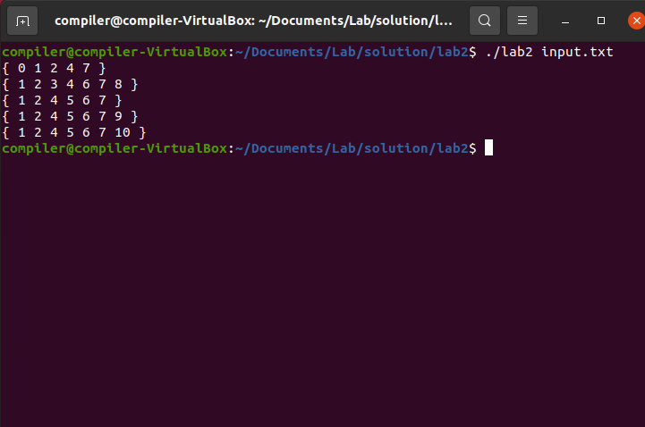
Expected Result

