Slide 1
Compiler
Lab 3: NFA to DFA

Slide 2
Objective
The goal of labs 2 and 3 is to implement the subset construction algorithm (NFA to DFA).

Slide 3
Getting Started
Download the template file (lab3.tar.gz) from Blackboard

Slide 4
The Subset Construction Algorithm
Initially, ε-closure(s₀) is the only state in Dstates and it is unmarked while there is an unmarked state T in Dstates do mark T for each input symbol a ∈ Σ do U := ε-closure(move(T,a)) if U is not in Dstates then add U as an unmarked state to Dstates end if Dtran[T,a] := U end do end do

Slide 5
Subset Construction Example
ε
a
2
3
ε
ε
ε
ε
start
a
b
b
0
1
6
7
8
9
10
ε
ε
b
4
5
ε
Dstates A = {0,1,2,4,7} B = {1,2,3,4,6,7,8} C = {1,2,4,5,6,7} D = {1,2,4,5,6,7,9} E = {1,2,4,5,6,7,10}
State | Input a | Input b
A | B | C
B | B | D
C | B | C
D | B | E
E | B | C

Slide 6
Subset Construction Example
b
2
b
a
b
start
a
b
b
0
1
3
4
a
a
a
Dstates 0 = {0,1,2,4,7} 1 = {1,2,3,4,6,7,8} 2 = {1,2,4,5,6,7} 3 = {1,2,4,5,6,7,9} 4 = {1,2,4,5,6,7,10}
State | Input a | Input b
0 | 1 | 2
1 | 1 | 3
2 | 1 | 2
3 | 1 | 4
4 | 1 | 2

Slide 7
Lab Assignment
Implement the subset construction algorithm in the main.cpp file by using the three functions implemented in lab 2.
Submit the source code (main.cpp) to Blackboard.

Slide 8
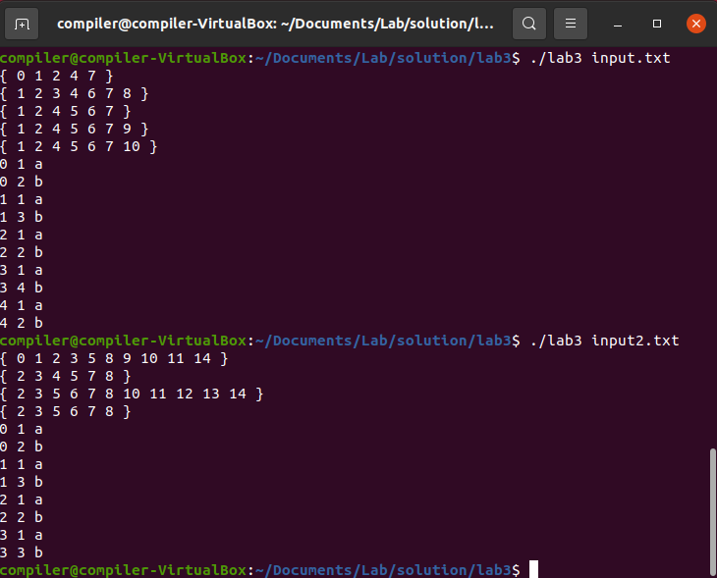
Expected Results

