Slide 1
Compiler
Lab 4: LL(1) Parser

Slide 2
Objective
The goal of labs 4 and 5 is to implement the LL(1) parser.
The goal of lab4 is to implement FIRST and FOLLOW functions

Slide 3
Getting Started
Download the template file (lab4.tar.gz) from Blackboard

Slide 4
FIRST
FIRST(α) = the set of terminals that begin all strings derived from α FIRST(a) = {a} if a ∈ T FIRST(ε) = {ε} FIRST(A) = ∪_{A→α} FIRST(α) for A→α ∈ P FIRST(X₁X₂…X_{k}) = if for all j = 1, …, i-1 : ε ∈ FIRST(X_{j}) then add non-ε in FIRST(X_{i}) to FIRST(X₁X₂…X_{k}) if for all j = 1, …, k : ε ∈ FIRST(X_{j}) then add ε to FIRST(X₁X₂…X_{k})

Slide 5
FOLLOW
FOLLOW(A) = the set of terminals that can immediately follow nonterminal A FOLLOW(A) = for all (B → α A β) ∈ P do add FIRST(β)\{ε} to FOLLOW(A) for all (B → α A β) ∈ P and ε ∈ FIRST(β) do add FOLLOW(B) to FOLLOW(A) if B ≠ A for all (B → α A) ∈ P do add FOLLOW(B) to FOLLOW(A) if B ≠ A if A is the start symbol S then add $ to FOLLOW(A)

Slide 6
Given Classes
Prod
Represents the production rules of the given grammar
Rules are stored in a vector
Read an input file
Each line of the input file represents a production rule
The format of one line is “L R” that means a derivation L=>R
Overloaded operator: <<
Set
Inherited from the standard set class
Overloaded operators: <<, ==, |, |=
Operators | and |= are implementation of union

Slide 7
Test Input
expr → term rest rest → + term rest | - term rest | ε term → id
E → TR R → +TR | -TR | ε T → a
| b
E TR
R +TR
R –TR
R
T a
T b

Slide 8
Lab Assignment
Implement the following two functions
Submit the source code (Prod.cpp) to Blackboard
Set Prod::getFirst(string a)
Set Prod::getFollow(char A)

Slide 9
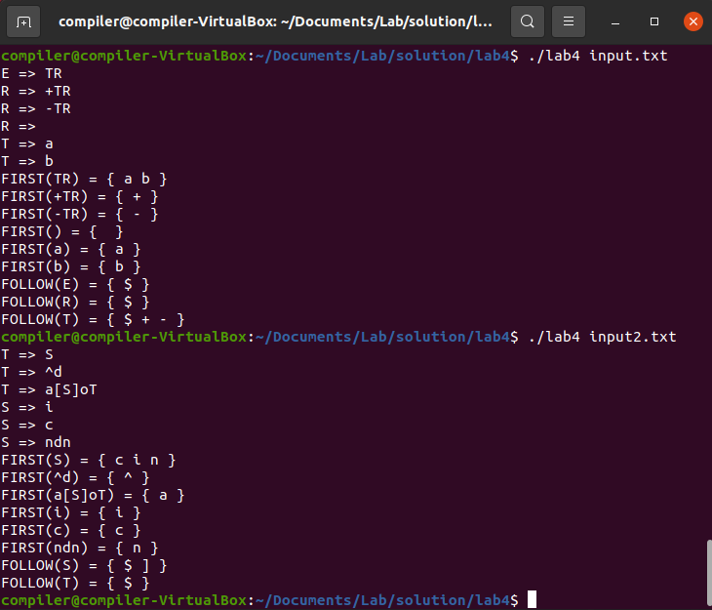
Expected Results

