Slide 1
Compiler
Lab 5: LL(1) Parser

Slide 2
Objective
The goal of labs 4 and 5 is to implement the LL(1) parser.
The goal of lab5 is to implement the parsing table.

Slide 3
Getting Started
Download the template file (lab5.tar.gz) from Blackboard

Slide 4
Constructing a Predictive Parsing Table
for each production A → α do for each a ∈ FIRST(α) do add A → α to M[A,a] if a ≠ ε enddo if ε ∈ FIRST(α) then for each b ∈ FOLLOW(A) do add A → α to M[A,b] if b ≠ ε enddo endif enddo Mark each undefined entry in M error

Slide 5
Given Classes
Parser
Represents an LL(1) parser
The parsing table is implemented as a 2-D array, M.
Functions for interchanging the symbol and the index of the array are provided by the Prod class.
Prod
Represents the production rules of the given grammar
Rules are stored in a vector
Read an input file
Each line of the input file represents a production rule
The format of one line is “L R” that means a derivation L=>R
Overloaded operator: <<
Set
Inherited from the standard set class
Overloaded operators: <<, ==, |, |=
Operators | and |= are implementation of union

Slide 6
Test Input
A → α | FIRST(α) | FOLLOW(A)
E → T E_{R} | ( id | $ )
E_{R} → + T E_{R} | + | $ )
E_{R} → ε | ε
T → F T_{R} | ( id | + $ )
T_{R} → * F T_{R} | * | + $ )
T_{R} → ε | ε
F → ( E ) | ( | * + $ )
F → id | id
E → T E_{R} E_{R} → + T E_{R} | ε T → F T_{R} T_{R} → * F T_{R} | ε F → ( E ) | id
 | id | + | * | ( | ) | $
E | E → T E_{R} |  |  | E → T E_{R}
E_{R} |  | E_{R} → + T E_{R} |  |  | E_{R} → ε | E_{R} → ε
T | T → F T_{R} |  |  | T → F T_{R}
T_{R} |  | T_{R} → ε | T_{R} → * F T_{R} |  | T_{R} → ε | T_{R} → ε
F | F → id |  |  | F → ( E )

Slide 7
Lab Assignment
Implement the following function
Submit the source code (Parser.cpp) to Blackboard
void Parser::initTable(Prod* prod)

Slide 8
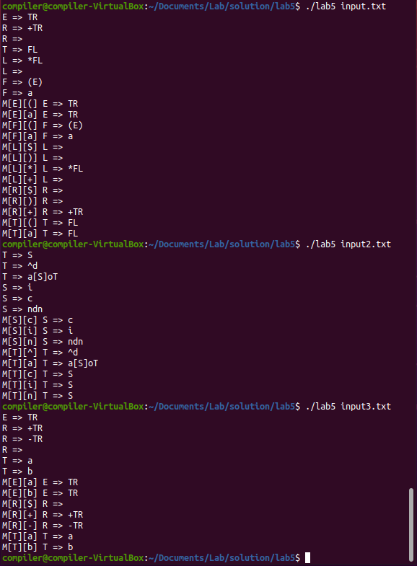
Expected Results

