Slide 1
Compiler
Lab 8: Translation

Slide 2
Objective
The goal of lab8 is to learn how to implement syntax-directed translation using flex and bison.

Slide 3
Getting Started
Download the template file (lab8-1.tar.gz) from Blackboard and uncompress them. tar xvfz lab8-1.tar.gz cd lab8-1 make ./lab test.prog

Slide 4
Lab 8-1
Translate assign and print statements to the intermediate code for an abstract stack machine
lvalue a
push 10
:=
print a
a := 10
print a

Slide 5
Generic Instructions for Stack Manipulation
push v push constant value v onto the stack rvalue l push contents of data location l lvalue l push address of data location l pop discard value on top of the stack := the r-value on top is placed in the l-value below it and both are popped copy push a copy of the top value on the stack + add value on top with value below it pop both and push result - subtract value on top from value below it pop both and push result
*, /, … ditto for other arithmetic operations <, &, … ditto for relational and logical operations

Slide 6
Generic Control Flow Instructions
label l label instruction with l goto l jump to instruction labeled l gofalse l pop the top value, if zero then jump to l gotrue l pop the top value, if nonzero then jump to l halt stop execution jsr l jump to subroutine labeled l, push return address return pop return address and return to caller
print l print variable l
# comment if a line begins with #

Slide 7
lab.l
%option noyywrap
%{
#include <stdio.h>
#include <string.h>
#define YY_DECL int yylex()
#include "lab.tab.h"
%}
%%
[ \t] ; // ignore all whitespace
"print" {return T_PRINT;}
[0-9]+ {yylval.num = atoi(yytext); return T_NUM;}
[A-Za-z]([A-Za-z]|[0-9])* {strcpy(yylval.name, yytext); return T_ID;}
\n {return T_NEWLINE;}
":=" {return T_ASSIGN;}
%%

Slide 8
lab.y – part 1
%{
#include <stdio.h>
#include <stdlib.h>
extern int yylex();
extern int yyparse();
extern FILE* yyin;
void yyerror(const char* s);
%}
%union {
int num;
char name[80];
}
%token<num> T_NUM
%token<name> T_ID
%token T_PRINT
%token T_ASSIGN
%token T_NEWLINE
%start start

Slide 9
lab.y – part 2
%%
start:
| start line
;
line: T_NEWLINE
| stmt T_NEWLINE
;
stmt: T_ID T_ASSIGN {printf("lvalue %s\n", $1);} expr {printf(":=\n");}
| T_PRINT T_ID {printf("print %s\n", $2);}
;
expr: T_NUM {printf("push %d\n", $1);}
;
%%

Slide 10
lab.y – part 3
int main(int argc, char **argv) {
if(argc < 2) {
printf("An input program is required\n");
exit(0);
}
if(!(yyin = fopen(argv[1], "r"))) {
printf("File not open: %s\n", argv[1]);
exit(0);
}
do {
yyparse();
} while(!feof(yyin));
return 0;
}
void yyerror(const char* s) {
fprintf(stderr, "Parse error: %s\n", s);
exit(1);
}

Slide 11
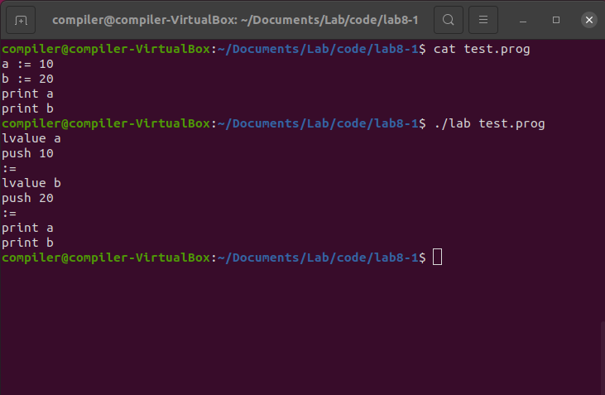
Result

Slide 12
Lab Assignment
Add implementation of expr statements
You will have to add tokens, regular expressions, production rules, semantic actions, etc.
Use the grammar in the following slide
keep in mind that the grammar is not actual code for bison
Use the template file (lab8-a.tar.gz)
Submit your lab.l and lab.y to Blackboard

Slide 13
Production Rules for expr
expr → term moreterms moreterms → + term { print(‘+’) } moreterms moreterms → - term { print(‘-’) } moreterms moreterms → ε term → factor morefactors morefactors → * factor { print(‘*’) } morefactors morefactors → div factor { print(‘/’) } morefactors morefactors → mod factor { print(‘%’) } morefactors morefactors → ε factor → ( expr ) factor → num { print(‘push ’ || num.value) } factor → id { print(‘rvalue ’ || id.lexeme) }

Slide 14
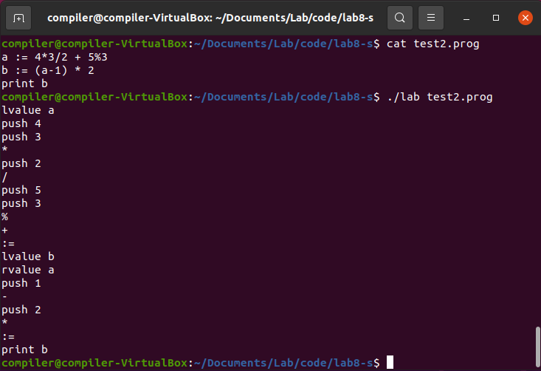
Expected Result

