Slide 1
Compiler
Lab 6: Flex

Slide 2
Objective
The goal of lab 6 is to get familiar with flex.

Slide 3
Getting Started
Download the template files (lab6-1.tar.gz and lab6-a.tar.gz) from Blackboard and uncompress them. tar xvfz lab6-1.tar.gz tar xvfz lab6-a.tar.gz

Slide 4
Lab6-1
%{
#include <stdio.h>
int count0;
int count1;
%}
%%
[ \t] ;
"0" { printf("zero"); count0++; }
"1" { printf("one"); count1++; }
"q" { printf("0: %d, 1: %d\n", count0, count1); exit(0); }
%%
void main(int argc, char** argv)
{
count0 = 0;
count1 = 0;
if(argc>1)
yyin = fopen(argv[1], "r");
else yyin = stdin;
yylex();
}

Slide 5
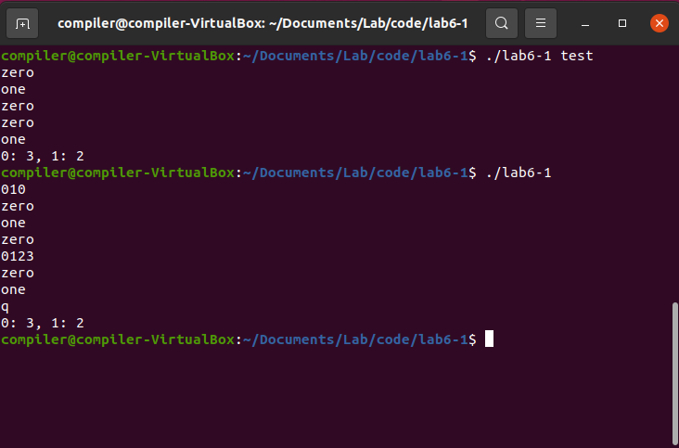
Lab6-1

Slide 6
Lab Assignment
Take a C source code file and replace all of “int” with “long” and “float” with “double”.
The input is from a file.
Use the template file (lab6-a.tar.gz).
Submit your source code to Blackboard.

Slide 7
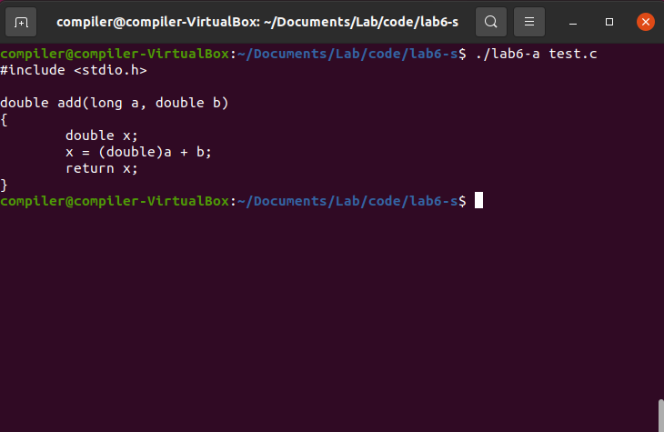
Expected Results

