Slide 1
Compiler
Lab 7: Bison

Slide 2
Objective
The goal of lab7 is to get familiar with bison.

Slide 3
Getting Started
Download the template file (lab7-1.tar.gz) from Blackboard and uncompress them. tar xvfz lab7-1.tar.gz cd lab7-1 make ./lab7-1 test

Slide 4
Lab 7-1
Implement a binary integer translator.
S → S B { S.val = S.val * 2 + B.val } S → B { S.val = B.val } B → 0 { B.val = 0 } B → 1 { B.val = 1 }

Slide 5
Lab 7-1
%{
#include <stdio.h>
#include <stdlib.h>
FILE* yyin;
int yylex(void);
void yyerror(const char* s);
%}

Slide 6
Lab 7-1
%%
F:
| F L
;
L: S '\n' { printf("Value = %d\n", $1); }
S: S B { $$ = $1 * 2 + $2; }
| B { $$ = $1; }
;
B: ‘0’ { $$ = 0; }
| ‘1' { $$ = 1; }
;
%%
S → S B { S.val = S.val * 2 + B.val } S → B { S.val = B.val } B → 0 { B.val = 0 } B → 1 { B.val = 1 }

Slide 7
Lab 7-1
int main(int argc, char **argv) {
if(argc < 2) {
printf("An input program is required\n");
exit(0);
}
if(!(yyin = fopen(argv[1], "r"))) {
printf("File not open: %s\n", argv[1]);
exit(0);
}
do {
yyparse();
} while(!feof(yyin));
fclose(yyin);
return 0;
}
int yylex(void)
{
return fgetc(yyin);
}
void yyerror(const char* s) {
fprintf(stderr, "Parse error: %s\n", s);
exit(1);
}

Slide 8
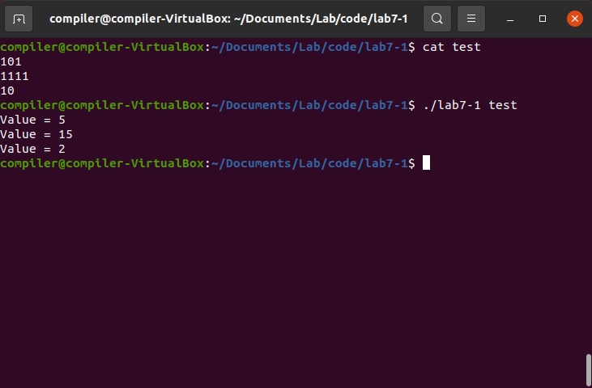
Lab 7-1

Slide 9
Lab Assignment
Define the semantic rule of interpreting the robot instructions.
Use the template file (lab7-a.tar.gz).
Submit your source code to Blackboard.
(2,1)
B
(0,0)
N
(-1,0)
W
(2,0)
S
N
E
E
E
(-1,-1)
(0,-1)
(1,-1)
(2,-1)

Slide 10
Multiple Attributes
%{
#include <stdio.h>
#include <stdlib.h>
#include <string.h>
FILE* yyin;
int yylex(void);
void yyerror(const char* s);
%}
%union {
struct {
int x;
int y;
} pos;
struct {
int dx;
int dy;
} dis;
}
%type<pos> S;
%type<dis> I;
%%
F:
| F L
;
L: S '\n' { printf("Position = %d, %d\n", $1.x, $1.y); }

Slide 11
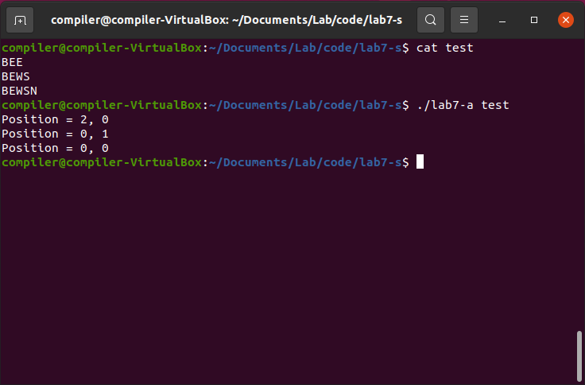
Expected Results

