Slide 1
Compiler
Lab 10: Intermediate-Code Generation

Slide 2
Objective
The goal of lab10 is to learn how to translate if statement

Slide 3
Translation of Conditional Branch
rvalue A
gofalse out
lvalue B
push 1
:=
label out
if A then B:=1

Slide 4
Translation of Conditional Branch (Translation Schemes)
stmt → if expr { out := newlabel(); print(‘gofalse ’ || out) } then stmt { print(‘label ’|| out) }
code for expr
gofalse out
code for stmt
label out

Slide 5
Lab Assignment
Add implementation of the if statement
You will have to add tokens, regular expressions, production rules, semantic actions, etc.
You will also need to add newlabel function
Declaration at the first section and implementation at the last section
Use the template file lab10-a.tar.gz
Submit your lab.l and lab.y to Blackboard

Slide 6
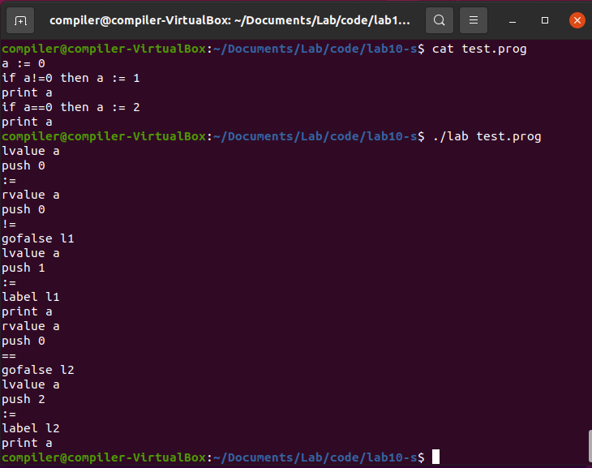
Expected Result

