Slide 1
Compiler
Lab 9: Translation

Slide 2
Objective
The goal of lab9 is to learn how to implement syntax-directed translation using flex and bison.

Slide 3
Getting Started
Download the template file (lab9-1.tar.gz) from Blackboard and uncompress them. tar xvfz lab9-1.tar.gz cd lab9-1 make ./lab test.prog

Slide 4
Operator Precedence in flex
%token<num> T_NUM
%token<name> T_ID
%token T_PRINT
%token T_ASSIGN
%token T_PLUS T_MINUS T_MULTIPLY T_DIVIDE T_MOD
%token T_NEWLINE
%left T_PLUS T_MINUS
%left T_MULTIPLY T_DIVIDE T_MOD
.
.
.
expr: expr T_PLUS expr { printf(“+”); }
.
.
.

Slide 5
Production Rules for expr
expr → num
expr → id
expr → ( expr )
expr → expr + expr
expr → expr - expr
expr → expr * expr
expr → expr / expr
expr → expr % expr

Slide 6
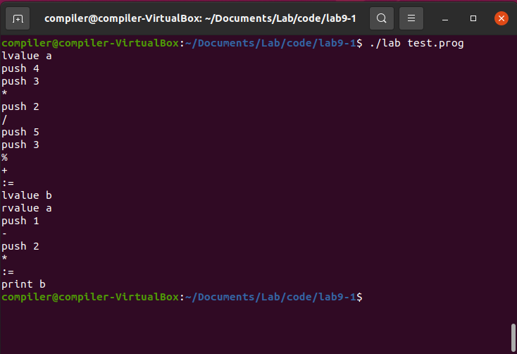
Expected Result

Slide 7
Lab Assignment
Add implementation of the following binary operators to the expr statement
Logical operators: & (and), | (or), ^ (xor)
Relational operators: ==, !=, <=, <, >=, >
Logical unary operator: ~ (not)
The precedence is given in the following slide
You will have to add tokens, regular expressions, production rules, semantic actions, etc.
Use the template file lab9-a.tar.gz
Submit your lab.l and lab.y as plain text to Blackboard

Slide 8
Operator Precedence
Precedence (smaller higher) | Operator
1 | ~
2 | * / %
3 | + -
4 | <= < >= >
5 | == !=
6 | &
7 | ^
8 | |

Slide 9
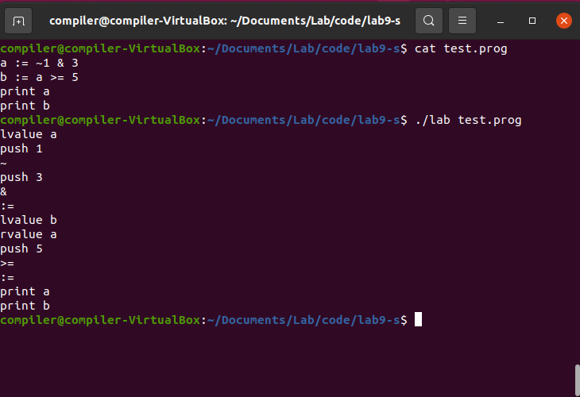
Expected Result

