Slide 1

Going “meta”: Trends in Multispecies Studies
Jeremy H. Kidwell
c/w: nuclear bacteria and syringes

Slide 2
Frolicking with Fungi, Fishes and Fusion
Like critical animal studies, multispecies studies is about scholarship that emerges from immersion in creaturely lives
There are some points of departure (cf. “Multispecies Studies” van Dooren, Kirksey and Münster, Environmental Humanities (2016) 8 (1): 1–23)
Expanding the “taxonomic scope”: attending to bacteria, fish, parasites, meta-organisms like volcanoes and oceans and “abiotic liveliness” like machines, nuclear radiation and garbage dumps.
Webs of entangled being: “a multispecies approach focuses on the multitudes of lively agents that bring one another into being through entangled relations that include, but always also exceed, dynamics of predator and prey, parasite and host, researcher and researched, symbiotic partner, or indifferent neighbor” (impacts here of Deleuze, new materialism / ontologies, affect theory, actor-network theory, STS, etc.)

Slide 3
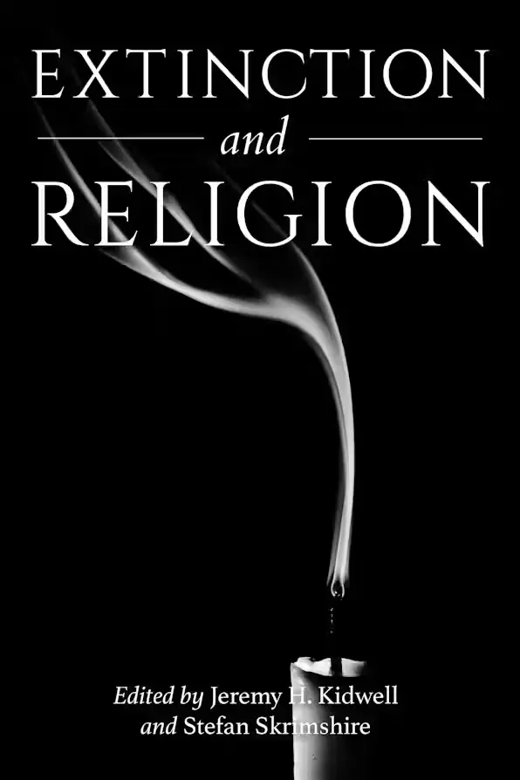
Disrupting Disciplinarity
Multispecies studies has also offered a home for scholars in arts & humanities to participate in trans-disciplinary scholarship, e.g. engagements with, ethnography, science studies, etho-ethnology, etc. and establishing new cross-cutting themes, e.g. extinction studies.

Slide 4

Radical Reflections
Working with performance art and forms of co-creation
Note: Please consider joining the Birmingham Multispecies Forum!
Caitlin Berrigan offering her own blood as fertilizer to a dandelion plant

Slide 5
What For the Humanities?
Re-politicising the humanities (cf. Isabelle Stengers, “Cosmopolitics”)
Challenging neoliberal notions of social justice (cf. Celermajer et al, “Multispecies justice” 2022), governance and research methodologies (cf. Bastian et al, Participatory Research in More-than-Human Worlds, 2016)
Expanding concepts of culture and cultural production
Disrupting narrow concepts of animality, working as “ontological amphibians” (cf Evan Kirksey, Emergent Ecologies)
Reframing “the human,” esp. formulations of embodiment, collectivity, cognition and temporality

Slide 6
Multispecies methodologies for dangerous times
Experimental research and interdisciplinarity has reached meme-level zeitgeist, but it is unclear whether British HEI infrastructure will offer safe harbour for “undisciplined” academics, especially if our scholarship takes us away from status quo compliance into more political action-focused directions.
Is it safe to challenge disciplinary orthodoxies?
Michelle Bastian in “Philosophy Disturbed” (2018): “To disturb the coherence of the discipline is thus to be excluded from it” (see also Isabelle Stengers and Vinciane Despret Women Who Make a Fuss (2014)

Slide 7
Multispecies methodologies for dangerous times
The journey of “leaving, transversing and circling back”
Leaving: In the early stages of my own career, being unable to make my interests congruent with accepted patterns, meant that the question of ‘how is this philosophy?’ was very raw. So much so that it seemed easier to give up claiming that I was still somehow a philosopher and instead present myself as an interdisciplinary scholar

Slide 8
Multispecies methodologies for dangerous times
Transversing: “In one project that looked at participatory research with non-humans, a group of us found ourselves in North Devon engaging in a range of activities with/in the River Torridge. This included testing for the mixing of salt and sweet water at the river mouth, searching through culm grasslands for the river’s source, wild swimming, and playing poohsticks. We had a lot of fun, and we also learned things, discussed ideas, argued about concepts, and refined approaches to problems. All of these activities are parts of our normal research work, but still our location opened us up to concerns that we could potentially be read as academics using taxpayers’ money to fund a jolly. In particular we noted that certain activities opened us up to this more than others. Salinity testing, as fellow participant Niamh Moore observed, looked like a legitimate and appropriate activity in the field because it appeared scientific. But the poetry recital offered by artist Timothy Collins while we were wild-swimming did not so easily read as ‘proper’ research. As the geographers J.D. Dewsbury and Simon Naylor note, ‘much work in the social history of science has paid attention to the theme of bodies in the field—in particular, who is allowed to conduct fieldwork, who isn’t, how one acts in the field to produce information that is trustworthy and replicable, how one deals with other bodies that shouldn’t be in the fieldsite, and so on’. Humanities scholars, including philosophers, arguably form part of the set that is to be excluded, or are simply assumed not to be interested. There is thus a lack of readily-available legitimating structures or frame- works for this kind of work”
“…this lack of structures or frameworks for moving between such sites raises questions about how one’s expertise is to be mobilized. Indeed, finding yourself in a new place can feel as though you have strayed outside the boundaries where your expertise makes sense”

Slide 9
Multispecies methodologies for dangerous times
Returning: “while the idea of leaving the discipline of philosophy was enticing, I had actually been moving in a more transverse fashion, operating across my old competencies while working to develop new ones. This became particularly clear when I moved to writing up. Here I was confronted most strongly with the disciplinarity that remained. The flexible academic identity that I had so eagerly constructed throughout the development and running of my projects ran up against the inflexibility of norms around writing style, evidentiary proof and what counts as a significant contribution. I had previously felt troubled about adapting methods from sociology and anthropology, such as qualitative interviews, focus groups and short-term ethnography. There had been some territoriality, particularly from anthropologists who held the notion of ethnography particularly dear, but in general I had been encouraged to look for ways of making these methods my own. When I came to writing up, however, I found I couldn’t, and in fact didn’t want to, write like a social scientist. I wasn’t sure if I could prove I had a representative sample, or that I had immersed myself sufficiently with my so- called ‘informants’. Despite it all, the veneer of the interdisciplinary scholar fell away and I wanted what I did to be philosophy somehow, although admittedly a significantly reworked version of it.”

