Slide 1
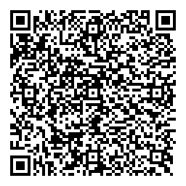
Quick plug!
UOB Staff Neurodiversity Network (I’m a founder and co-chair)
A non-hierarchical network for any + all neurodivergent staff (we interpret “staff” in the widest possible way).
Join our Teams site here →
Also we have a Discord
Regular anti-socials, body doubling, advocacy around support including OH, A2W, adjustments, etc etc. neurodiversity celebration week

Slide 2

Can Autistic persons be known?
A phenomenological query by an unconventionally autistic philosopher
Jeremy H. Kidwell
10 June 0002025

Slide 3
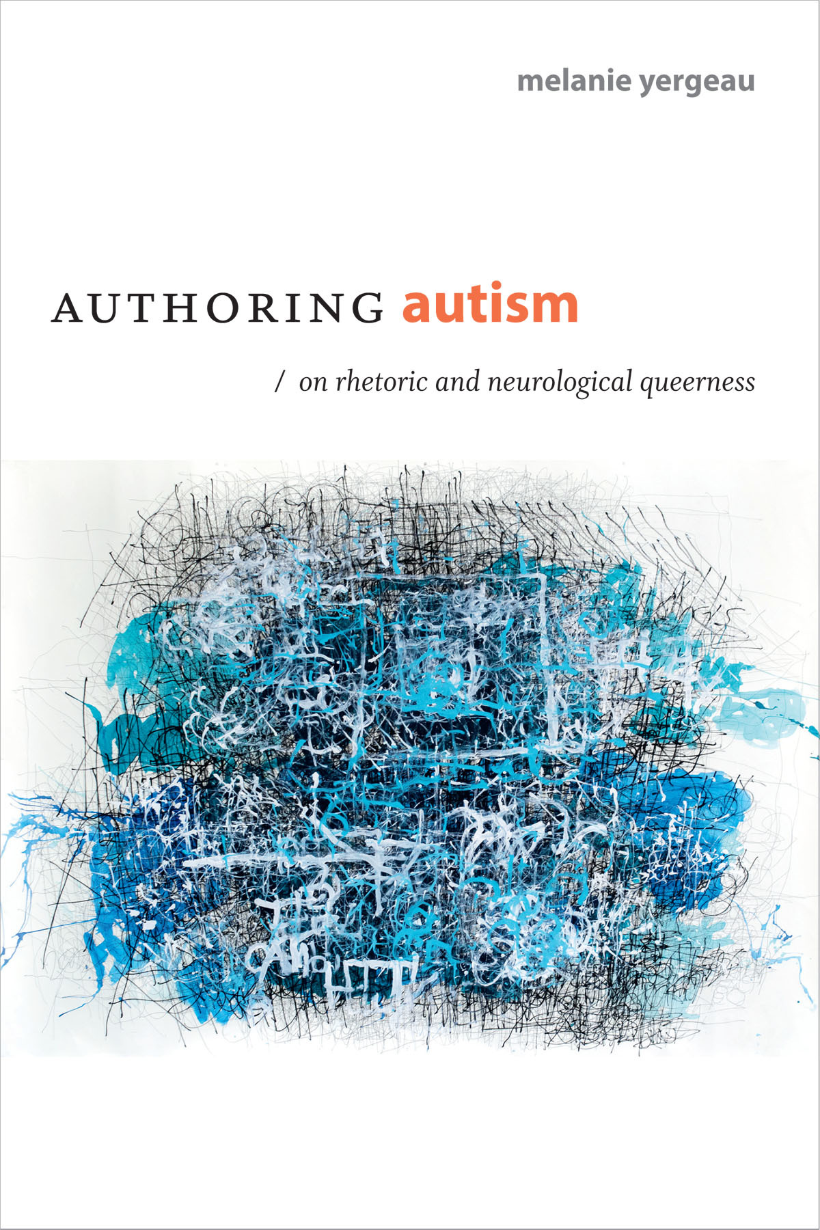

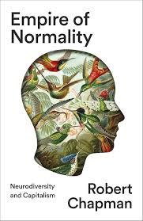
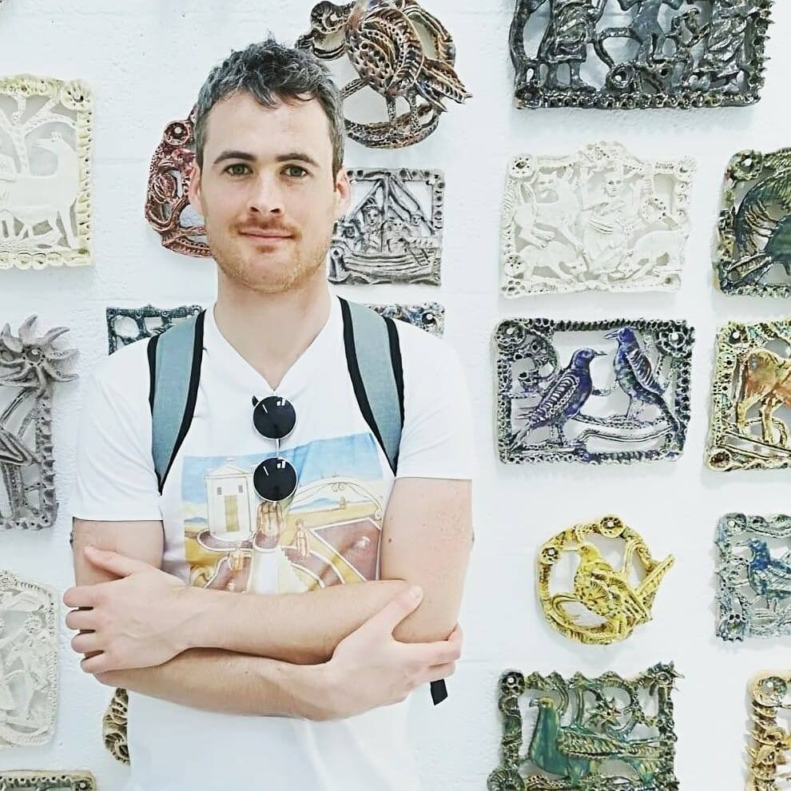

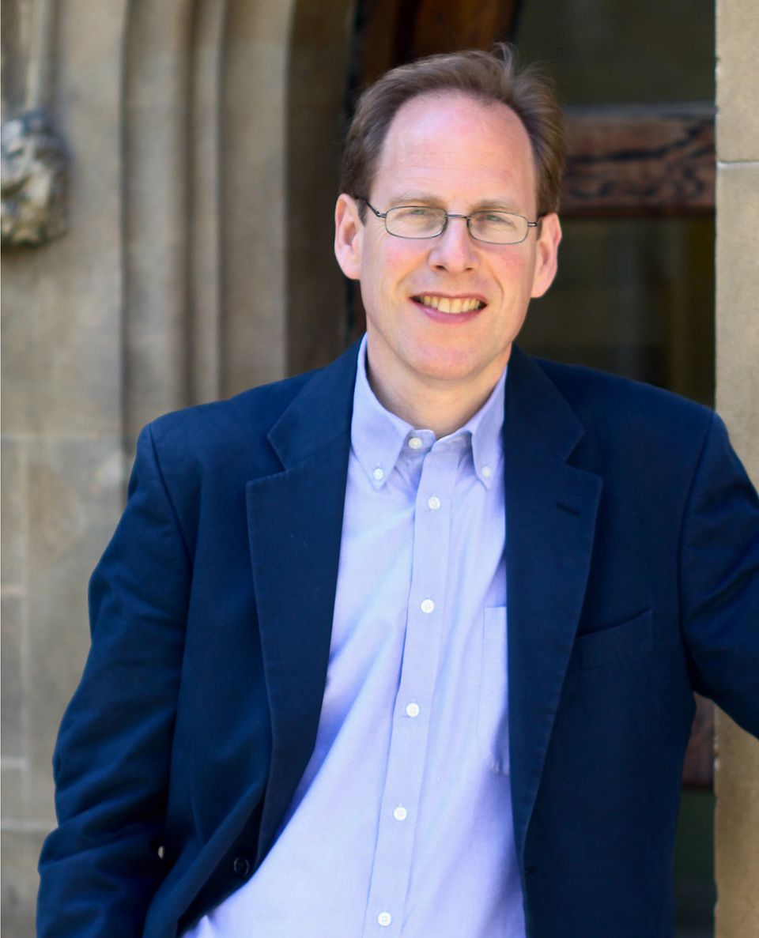
Constructing Autistic subjectivity

Slide 4
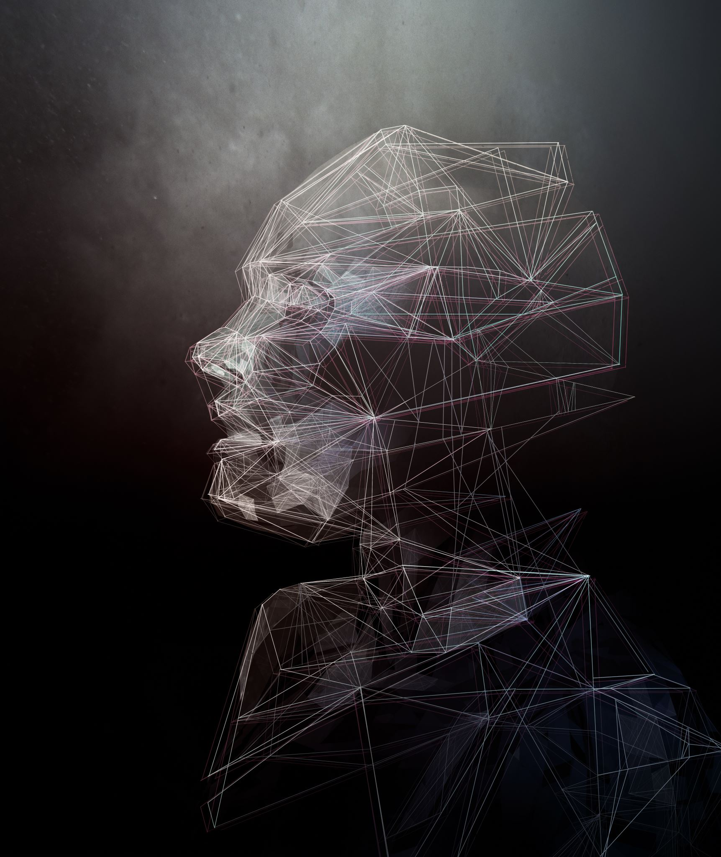
Neuro-minorities remain A theoretical Outlier
Imagine if constructions of the feminine subject were drawn by male observers…
Constructions of the Black subject by white observers…
Constructions of queer subjectivity by straight observers…
Constructions of deaf subjectivity by hearers (check out “Deaf President Now!”)
But one finds ongoing skepticism about so-called “self-diagnosis”
By and large theoretical conceptions of autistic subjectivity are written by or adjudicated by non-autistic scholars (assisted by non-scholar reference panels), caregivers and mental health professionals
There’s a huge opportunity for trans-disciplinary collaborative research into self-fashioning and complex identies!

Slide 5
Autism Studies and Phenomenology
Zahavi, Dan (2001). “Beyond Empathy: Phenomenological Approaches to Intersubjectivity,” Journal of Consciousness Studies, 8, No. 5–7, 2001, pp. 151–67.
Zahavi, D., & Parnas, J. (2003). Conceptual problems in infantile autism research: Why cognitive science needs phenomenology. Journal of Consciousness Studies, 10(9–10), 53–71.
Gallagher, S. (2004). Understanding interpersonal problems in autism: Interaction theory as an alternative to theory of mind philosophy. Philosophy, Psychiatry, & Psychology, 11(3), 199–217. https://doi.org/10.1353/ppp.2004.0063
James Aho and Kevin Aho, Body Matters: A Phenomenology of Sickness, Disease, and Illness, (Lexington Books, 2008).
Thomas Fuchs, “Subjectivity and Intersubjectivity in Psychiatric Diagnosis,” Psychopathology 4 (2010): 268-274.
Zahavi, D. (2010). Complexities of self. Autism, 14(5), 547–551. https://doi.org/10.1177/1362361310370040.
Maria Nilsson, Peter Handest, Lena Nylander, Lennart Pedersen, Jessica Carlsson, and Sidse Arnfred, “Arguments for a Phenomenologically Informed Clinical Approach to Autism Spectrum Disorder,” Psychopathology 3 (2019): 153-160.
Jonathan Green and Nicola Shaughnessy, “Autistic phenomenology: past, present, and potential future,” Frontiers in Psychology (2023), vol. 14: 10.3389/fpsyg.2023.1287209.

Slide 6
Why Phenomenology?
A philosophical method that investigates the structures of consciousness as they are lived and experienced from the first-person perspective. It theorizes subjectivity not as an isolated interiority but as the dynamic horizon through which phenomena are disclosed, shaped by intentionality, embodiment, and temporality.
Autism, schizophrenia and other “disorders of the mind” conceived as a “loss of self and the world” (Needleman, 1968, p. 388)
This focus on bottom-up empirical definitions from inside the self foregrounds lived experience and pays very close attention to the complexities of how we can connect across the lived experiences of others in intersubjective ways.
Only recently applied to mental health, disability, animal studies, etc. (cf. critical phenomenology)
Not hostile to bio-psycho-medical theory and outsider perspectives (cf. neo-phenomenology)

Slide 7
Korper / Leib
When it comes to describing the structures of our everyday perceptions, phenenologists starting with Edmund Husserl (1859-1938) describe embodiment as consisting of two ways of thinking: using the almost-but-not-quite synonymous German terms korper and leib.
The two concepts refer, as Slatman suggests, to "two different ways in which a person’s body can appear (erscheinen).”
Korper is the measurable body, the one that psychologists seek to describe with experiments. Our senses are usually associated with korper, along with other physical aspects of the body, such as muscles, bones, and sensory systems.
However, we can account for some perceptions as feelings, which locates them within leib, which is, "the body as a subject, a zero-point for perception and action"
50 Concepts for a Critical Phenomenology, (Northwestern University Press, 2020), p. 203.

Slide 8
The ineffability of the self
We are coherent subjects, but cannot fully understand ourselves:
Psychoanalytic questions about whether individuals have access to unconscious part of ourselves (Freud, Lacan)
Hermeneutics highlights ways the self is mediated through language, history, and interpretation, making it never fully transparent to itself
But if we could get past those barriers to self-understanding would we find a subjectivity that is coherent, stable or otherwise perspicacious?
Kierkegaard (and other existentialists) - the subject is opaque to itself because it is always in the process of becoming and is shaped by anxiety, freedom, and finitude.
Marx, Focault, and Derrida: The subject is not a stable, autonomous entity but is constructed through discourse, power relations, and différance, as subjects we are decentered and fragmented, always constituted by forces beyond our control or full understanding

Slide 9
Ineffability and subjectivity
Quite a lot of autism research methodologically disregards more radical accounts of indeterminacy
Our everyday philosophies also tend to assume that we can know our fundamental selves, or that if they are obscure to us that we can engage in a process of self-discovery that will result in coherent or complete self-understanding
But in light of emerging trans-diagnostic discoveries and questions about the coherence of our clinical definitions of autism, there are opportunities to reconstitute
But also the pragmatic task, the quest to know oneself is a key part of ethics. Can we affirm it as valid even if the camoflauged and traumatized self remains obscured under layers of trained non-authentic behaviour? And what consequences does this have for ethics and clinical research into autistic experience and wellbeing?

Slide 10
Recap
My work is driven by a curiosity about the explanatory frameworks we use to establish and unpack subjectivity, especially in the context of difference (e.g. across forms of embodied, gendered, racialized or species difference) and the ways that we theorise subjectivity.
Phenomenology presses us to start with and linger upon the various ways subjectivity is experienced internally from inside. It then moves on quickly to anticipate the ways that we compose one another through acts of grace, violence, apprehension and rumination. This grants us a self-conscious account of the limits to our abilities to observe the experience of the other.
In terms of discarded features of subjectivity, this also takes us into spaces of religious experience and spiritual ontologies, not just whether religion has measurable impacts on wellbeing, but also on whether it can be seen to carry us into unique rhetorical domains in understanding “mental illness” and neurodivergence.
“In avoiding the eyes of ­ others, I am indeed missing out on ­things. In this regard, researchers are right: there is much that I do not learn or experience when I avert my eyes. And yet—­ there is much that I do learn, do experience, do feel and intimate and express and attract and repel. I might not know or recognize your face, but I know your scent, what you wore last Thursday, the exact date on which we first met, the rhythm of your pace, the resting cut of your hair against your shoulder, the pulsing force field of the space between our bodies. ­ There are intimacies and knowledges that exceed the eye-­ to-­ eye, that exceed the I-­ to-­ I. We might call this the ga(y)ze, the queering of field, reference, and looking... What is neuroqueer referentiality? If we disregard spectra and poles, how else might we index and disorient our relations? How to queer us and them?” (Yergeau, 211-212)

Slide 11
POSSIBILITIES FOR THE Research NETWORK?
Collaborative phenomenological / ethnographic inquiry (constructive philosophy + qualitative) into
Reshaping clinical autism definitions in light of self-diagnosis and trans-diagnostic discoveries
Phenomenological subjectivity as it surfaces in lay knowledge and self-construction of autistic identity, esp. in relation to self-diagnosis, popular culture, subculture and “worldbuilding”
Complex and liminal subjectivity wrt/ concealed, layered or ineffable personal identities: unmasking and navigating camouflaging as an adult (phenomenological question: do we have access to ourselves, and if we do not… how might this awareness reshape the way we think about clinical and experimental approaches to autism research)
Autistic spirituality, esp. in light of self-fashioned spiritualities, new religious movements, autistic semiotics, especially in the lives of autistic carers and autistic professionals (e.g. psychologists, pastors, social workers)
Pluralistic framings of autism seen in historical theology of disability esp. in Islam, Christianity and Buddhism

