Slide 1

How to survive (and thrive!) as a neurodivergent researcher
Jeremy H. Kidwell, PhD, FHEA

Slide 2
Format for today
About 40 minutes of talking with a short chat at the end – I’ll respond to questions you submit (using https://vevox.com) as we go along
This will be recorded with a follow-on workshop where you can ask prepared questions in a few weeks.
Feel free to pop up your hand any time if you want a clarification that feels urgent or time-sensitive. I may defer my answers to some questions, but I'll let you know if this is the case.
Feedback after the session is VERY welcome.

Slide 3
Goals for the session
Tell you about my journey as a researcher
Talk about ways being neurodivergent made that journey unique
Identify alternatives to pathologising and superhero language: difference and diversity
c/w: discussion of lived experience of sensory trauma, depression & anxiety, probably some profanity

Slide 4
About me
I’m Jeremy!
An interdisciplinary theologian, eco-philosopher, hacker & activist
I approach my research in unconventional ways
I tend to be “undisciplined” in the way I occupy fields of research
Hyperacoustic, APD, misophonia, vivid sensory world and stress
“medication resistant” anxiety and depression
Autistic, late- & self-diagnosed, still sorting out unmasking
Getting to the bottom of what is going on with myself has taken 25+ years
Not anti-social, not “under-developed,” not a big fan of DSM

Slide 5
I experience the pathologized traits of autism in my own ways
CPTSD from sensory overstimulation, so always hypervigilant
Oversaturation from vivid world, so I retreat (discreetly) when overloaded
Things can seem out of control, so I lead; create policy and facilitate processes of participatory deliberation through workshops
Unconventional so I emphasise creative approaches
Bottom-up, so my research is problem-focused and interdisciplinary
Denied access to accessible technologies, so I make my own tools
School and University were very hard for me: veering towards excruciating and traumatic. None of the adults around me knew this was going on because masking.

Slide 6

Finding your way
Redefine tasks, workflows, outcomes and measures of success.

Slide 7
Part 1: two sides of the coin for neurodivergent researchers
About us

Slide 8
Side 1. Disability
Some of us experience disabling experiences of (sensory, interpersonal, trauma-related) stress that will require planning and mitigation
There are knock-on implications around vulnerability and energy
Potential for volitional disability arising from stress-induced fragmentation

Slide 9
The work of Handling disability
Develop a disability identity
Plan around disclosure & unmasking
While this work is underway: prepare for volitional challenges, recovery days
Getting “adjustments” and “accommodations”

Slide 10
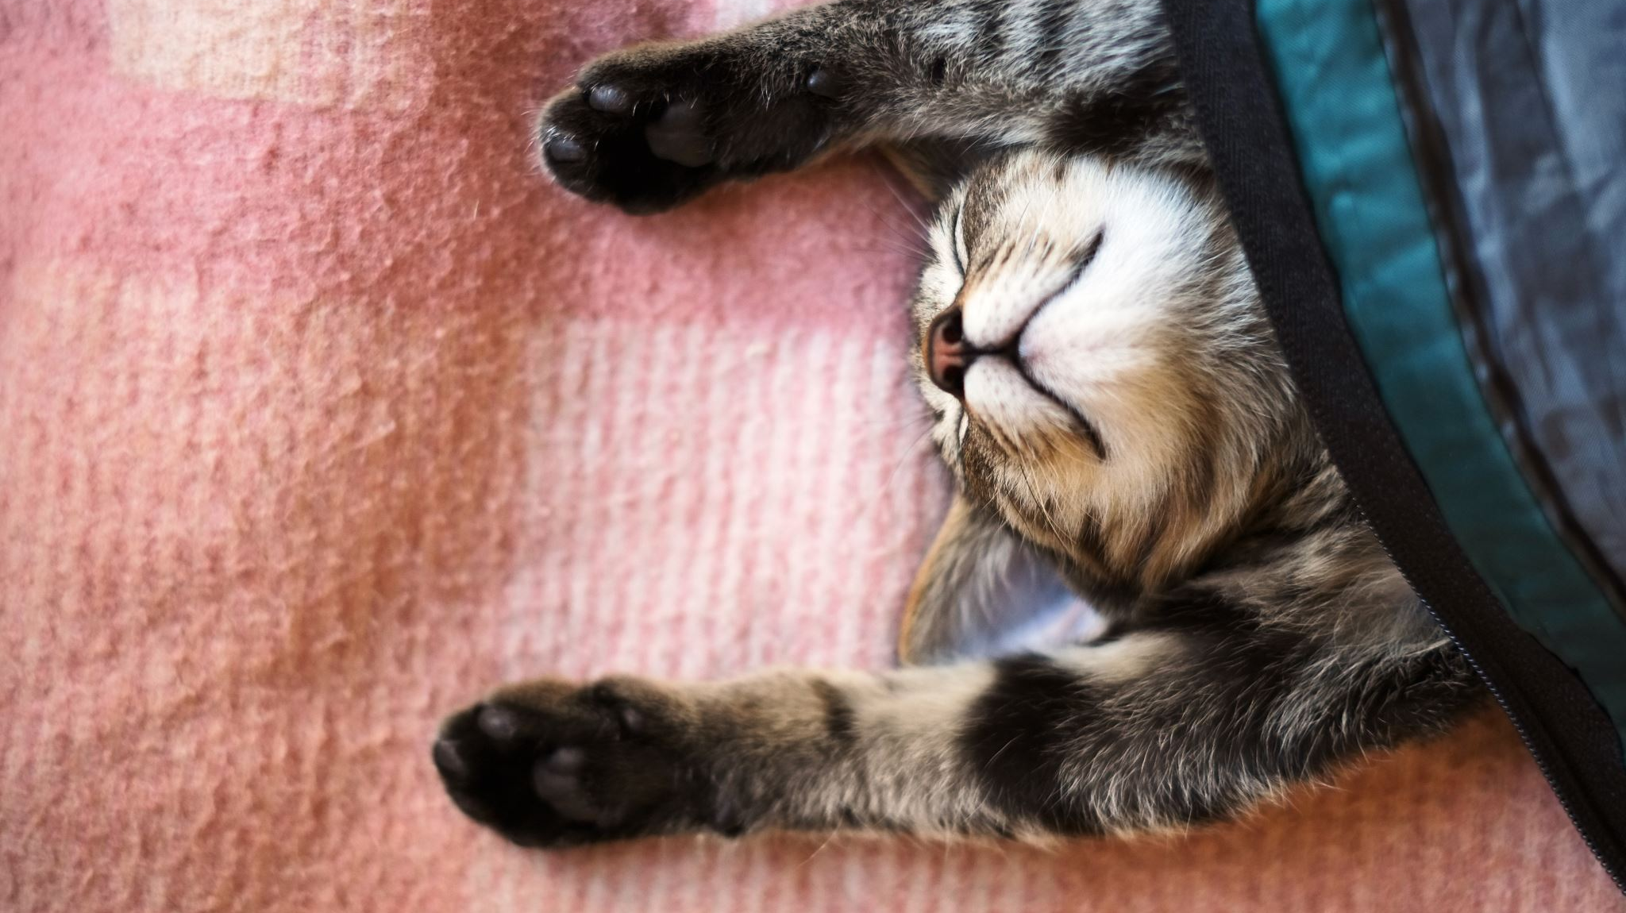
But can’t I just keep my head down and carry on being invisible?

Slide 11
Invisibility is not a safe & stable space from which to develop your vocation
It is also important to emphasise that some ND people may not relate to “disability” because they have not experienced oppression and/or discrimination.
So… let’s flip the coin to the other side

Slide 12
Side 2. Difference
Nearly everyone will experience moments of eccentricity
Communication missed / mismatched
style / work pattern unaccommodated
The experience of being misunderstood
…translating your thoughts and experiences for others
…and developing compassion for others
Makes you a better researcher and communicator
But it is hard work. And some of us have to do a lot more of that work than others.

Slide 13
Talking about ND difference
1. Volitional difference
(historians take note: languor, melancholia, avolitional, acaedia, sloth, cowardice, weak-willed)
Ability to form intentions
Commitment vs. revision of intentions
Acting on desires, beliefs, intentions (so called “executive function” or metacognitive abilities)

Slide 14
Talking about ND difference
2. Cognitive difference
Flow, inertia, focality, bottom-up, top-down, abstract / concrete
Creativity, delusion, hallucination
Use of language, semiotics, rhetoric
Plural subjectivity, gender diversity
Alternative forms of social interaction

Slide 15
Talking about ND difference
3. Sensory difference
Hyper / hypo sensitivities
Embodied movement
See https://sensingspace.bham.ac.uk/

Slide 16
Talking about ND difference
4. Co-occurring conditions
Pain, stress, anxiety, mood regulation

Slide 17
Part 2: Getting to work
Three things I’d say to my past self

Slide 18
1. Perfection is a terrible thing
Speaking about areas of struggle is not a sign of weakness
Asking for help is ok: get an extension, LOA, adjustments
Sometimes it’s easy to start with small things and scaffold up
Start to develop a disability identity (1) at your pace and (2) with safe people
A quick word on supervisors:
Remember, we’re humans too and are navigating our own invisible struggles
Develop a supervision agreement and discuss expectations, especially around styles of communication
It can help to have a buddy / mediator – ND staff network can help!

Slide 19
2. It’s ok to be misunderstood
Sometimes people don’t understand you because your stuff is creative and innovative
Sometimes people don’t understand because your stuff is genuinely confusing – it can take a while (as in decades) to get from intuitive sensibility to reasoned and accessible argument
You may take a longer time to find expression (or the right audience!) for your thinking
It may take extra effort to establish understanding (the double-empathy problem)
Your scholarly arc may be necessarily longer because (a) you’re working holistically, (b) establishing forms of translation

Slide 20
3. Work Better not harder
If things aren’t working it may be because you are:
Exhausted
Overwhelmed
Working with other people’s patterns
Get some rest and then…
Do an audit! (worksheet time)

Slide 21
Part 2: Getting to work
Three tips for getting to work

Slide 22
1. Finding motivation
Getting “the work” done requires, positively speaking (1) inspiration, (2) motivation and (3) work.
Negatively speaking, getting the work done requires an absence of bad stress and a presence of good stress.
When you are stuck in fight/flight/freeze states you won’t be able to do deep critical thinking or coherent synthetic analysis, it is biologically impossible!

Slide 23
Affective neuroscience (or sex, drugs and Research)
Affective neuroscientists doing research on the mesolimbic cortex remind us that context is a vital part of motivation, a change in context can wildly change the way we view an activity or event
Everything is framed by our brains around enjoyment, expectation, and eagerness
Is your research fun? (enjoyment) Do you scaffold up anticipation and planning for your work in a way that leaves you feeling eager to get the work done?
What things prevent any of the above from being a regular experience?
Elements of context: audience, compulsarity, collaborators, disciplinary location / restriction, style expectations (casual / formal)

Slide 24
hacking your context
When you get stuck (or just aren’t even getting started), you can hack your context
Shift your style: from formal (conferences, journal articles) to informal (pub chat, teaching, popular audience) n.b. this shift does not negate the status of your work as research
Change your setting: identify catalysts for thinking
Change your audience OR community / collaborators: from lecturers or supervisors to friends; from familiar people to strangers; peer review to supportive affirming friends; from humans to AI; do people in your community change or is it stable?
Geek out! Change your other contexts to do research for you: teaching, socializing, etc.

Slide 25
ChangE the script
Find a better audience
Reduce your goals: anxiety + perfectionism = interdisciplinarity
Monotropism: great when you’re doing some kinds of PhDs, not so great when you have to write UG essays on other people’s topics. Some essays are just really not going to go your way.
Flow and inertia: finding good patterns that work for you
Work with the long arc
For the people who just have to finish the whole thing

Slide 26
Principles for success
Find your voice: it will be incoherent to some people, and this journey will be more complex because of masking
Find safe community for critique (the above journey makes this all the more important, so you can work out questions of quality without fielding concerns of threat / abuse / discrimination
Accept your past self and move forward
Form a disclosure plan you are comfortable with, develop a disability identity your story, told your way, to the people you want to share it with
Stop trying to emulate other models of success for people who experience the world differently from yourself, identify how you best process learning and communication
Recruit an advocate: never attend an EC panel by yourself, bring a buddy to office hours
Exposure therapy is NOT effective for learning. Track stressors and eliminate or confront them strategically

Slide 27
Useful resources
https://www.timeshighereducation.com/campus/supervising-neurodiverse-postgraduate-researchers

