Slide 1
Theology and Deep Time
Jeremy H. Kidwell, University of Birmingham
25 June 2021

Slide 2
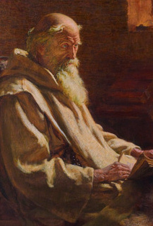
The Venerable Bede
In "An Ecclesiastical History of the English People,” history is not just for the sake of preserving data regarding the past, but to show an instance of the "Providence-guided advance of a people” (Walter Goffart)

Slide 3
Modern Christian Historiography
David Bebbington, Patterns in History: A Christian View (IVP, 1979)
“there is sometimes a need for the providential framework of history to be portrayed without reserve. For the church, it provides the encouragement of knowing that hitherto the Lord has helped his people” (Patterns in History, pp. 187-188)
Jay D. Green, Christian Historiography: Five Rival Versions (Baylor UP, 2015)
Herbert Butterfield, The Whig Interpretation of History (1931), Christianity and History (1949)

Slide 4
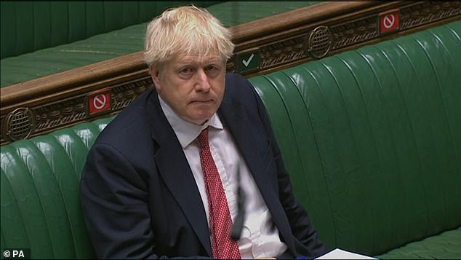
Defending the Myth of Historical Singularity
“The statue of Winston Churchill in Parliament Square is a permanent reminder of his achievement in saving this country – and the whole of Europe – from a fascist and racist tyranny. It is absurd and shameful that this national monument should today be at risk of attack by violent protestors. Yes, he sometimes expressed opinions that were and are unacceptable to us today, but he was a hero, and he fully deserves his memorial. We cannot now try to edit or censor our past. We cannot pretend to have a different history. The statues in our cities and towns were put up by previous generations. They had different perspectives, different understandings of right and wrong. But those statues teach us about our past, with all its faults. To tear them down would be to lie about our history, and impoverish the education of generations to come. As for the planned demonstrations, we all understand the legitimate feelings of outrage at what happened in Minnesota and the legitimate desire to protest against discrimination. Whatever progress this country has made in fighting racism - and it has been huge - we all recognise that there is much more work to do. But it is clear that the protests have been sadly hijacked by extremists intent on violence. The attacks on the police and indiscriminate acts of violence which we have witnessed over the last week are intolerable and they are abhorrent. The only responsible course of action is to stay away from these protests.”
Boris Johnson, June 12, 2020

Slide 5
Why and how is this myth of a single history so persuasive?

Slide 6
As long as it is unconfronted, this myth will distort our attempts to engage with deep / ecological time(s)

Slide 7
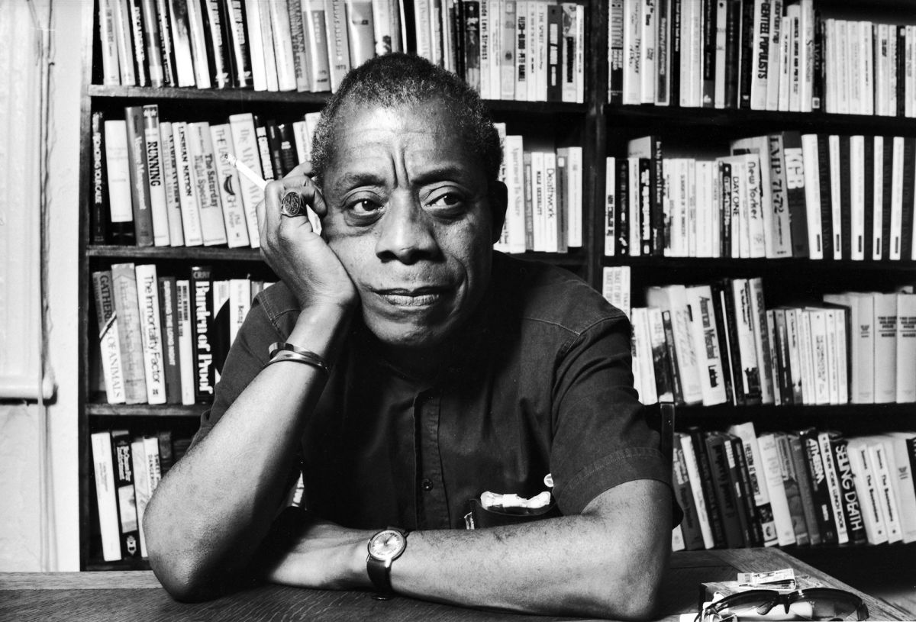
“It's a very serious question in my mind whether or not the people of this country, the bulk of population of this country, have enough sense of what is really happening to their black co-citizens to understand why they're in the streets. I know of this moment they maybe don't know it, and this is proved by the reaction to the civil disorders...
All that can save you now is your confrontation with your own history... which is not your past, but your present. Nobody cares what happened in the past. One can't afford to care what happened in the past. But your history has led you to this moment, and you can only begin to change yourself by looking at what you are doing in the name of your history, in the name of your gods, in the name of your language.”
James Baldwin, July 1968, Esquire Magazine

Slide 8
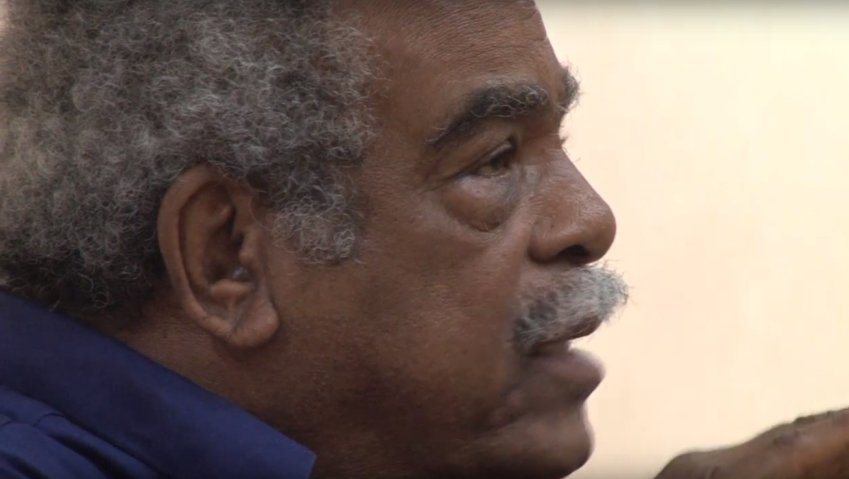
If it is ridiculous to claim that a people “has no history”... because the lived circumstances of this daily reality do not form part of a continuum, which means that its relation with its surroundings (what we would call its nature) is in a discontinuous relation to its accumulation of experiences (what we would call its culture).
In such a context, history as far as it is a discipline and claims to clarify the reality lived by this people, will suffer from a serious epistemological deficiency: it will not know how to make the link. The problem faced by collective consciousness makes a creative approach necessary, in that the rigid demands made by the historical approach can constitute, if they are not restrained, a paralysing handicap. Methodologies passively assimilated, far from reinforcing a global consciousness or permitting the historical process to be established beyond the ruptures experienced, will simply contribute to worsening the problem.
The French Caribbean is the site of a history characterised by ruptures and that began with a brutal dislocation, the slave trade. Our historical consciousness could not be deposited gradually and continuously like sediment, as it were, as happened with those peoples who have frequently produced a totalitarian philosophy of history, for instance, European peoples, but came together in the context of shock, contraction, painful negation and explosive forces. This dislocation of the continuum, and the inability of the collective consciousness to absorb it aIl, characterise what I call a nonhistory.
Édouard Glissant, "The quarrel with history"
https://www.newframe.com/from-the-archive-the-quarrel-with-history/ (written in response to Edward Baugh, "The West Indian Writer and His Quarrel with History"
https://muse.jhu.edu/article/483217/pdf)

Slide 9
Suggestions for Theology and “deep time”
We might begin with an act of of repentance and epistemological clearing - connecting our hegemonic faux-histories with the violence they have underwritten (cf. James Cone, “Whose Earth is it Anyway?”)
We need a rehabilitation on the level of epistemology – and I think this can occur in the seeking of mutuality amidst plural and entangled “histories”

