Slide 1
Religion and Social Values for Sustainability
Christopher Ives¹ and Jeremy Kidwell²
¹School of Geography, University of Nottingham. chris.ives@nottingham.ac.uk
²Department of Theology and Religion, University of Birmingham.

Slide 2
Aim
To highlight how religion intersects with social values for sustainability.
While religion might align closely with certain transcendental values, it is a far more complex phenomenon and cannot be removed from its context.

Slide 3
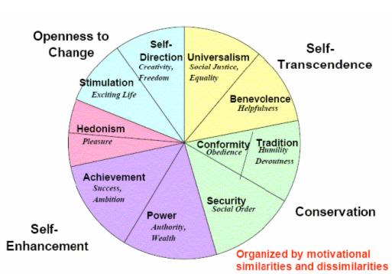
Theoretical traditions
Theory of Universal Human Values (Shalom Schwartz)
Postsecularism.
Peter Berger et al.
“The world today is as furiously religious as it ever was”
Saroglou et al. (2004)

Slide 4
Key arguments
Religion is more than social values (although it relates to them), and must be understood in context. Includes axiology (core values), as well as ontology (including a cosmogony), anthropology (the purpose of the human being) and societal vision (how society should be organised or function). Also encompasses social practices and institutional dynamics.
Religion and ‘sustainability’ may not always align neatly.
Sustainability scholars need to be conscious of religious perspectives and not impose social values theory inappropriately. Local contextualisation is essential.
Guard against instrumentalisation of religion for sustainability.

Slide 5
Implications
Religion can be a powerful vehicle for transformative change.
Religious communities are excellent examples of social learning in practice (e.g. Quaker consensus decision-making).
O’Brien, K. 2018. Is the 1.5°C target possible? Exploring the three spheres of transformation. Current Opinion in Environmental Sustainability 31.

Slide 7
Examples
Concepts that go beyond ‘values’ (e.g. benevolence vs. ‘image of God’; care for the biosphere vs. care for creation)
7 monastic spaces.
Cell (reflection/prayer)
Chapel (worship)
Chapter (decision-making)
Cloister (conversation)
Garden (work, rest, stewardship)
Refectory (hospitality)
Scriptorium (learning)
“nature is something that we cultivate rather than create”
“Nature? I prefer the word creation. Creation has a telos; it already has meaning as a gift from God”
Quaker consensus decision-making
Climate Outreach & Information Network

