Slide 1
Neurodiversity, Learning and Support in Philosophy at the University of Birmingham
Jeremy Kidwell, PhD
School of Philosophy, Theology and Religion

Slide 2
Why am I speaking about this?
I have lived experience of neurodivergence
20 years of working with experimental pedagogies and learning accommodation across various forms of cognitive and cultural difference, facilitating policy/impact workshops across forms of cognitive difference
T&R Head of UG Programmes 2016-2019, PTR EDI Lead 2022-present
Since 2021, I have been running a tutorial with neurodiverse students, learning about student challenges and troubleshooting learning barriers

Slide 3
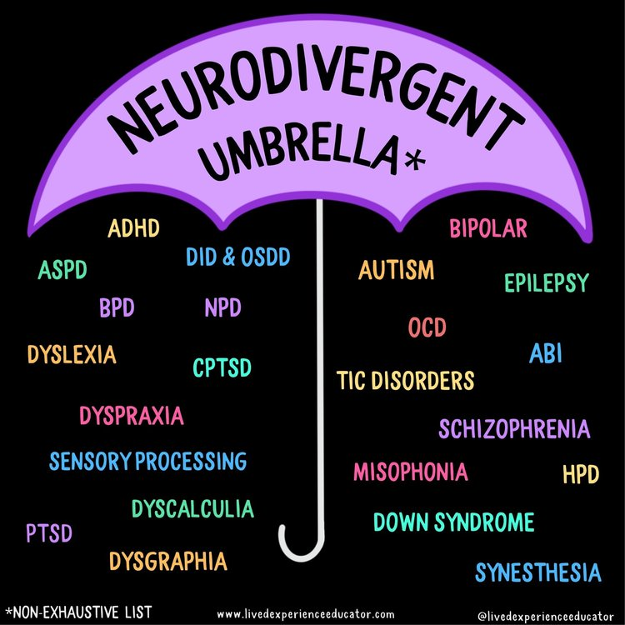
Neurodivergence & Disability
neurodiversity = there are forms of cognitive difference which are salient to the way we work together, teach & learn
These forms of difference are largely unacknowledged & unaccommodated (incidence stats)
Best understood when we see cognition as embodied
We should differentiate between disabilities and cognitive difference (cf. *)
But disabilities can be consequences of unaccommodated difference, or friction-full accommodation (e.g. social anxiety, low mood, meltdowns)… this is called the “social model of disability”
Inasmuch as we control or concede to a given default, we may be an creator of disability
and the embodied experiences of these forms of disability can be quite severe (more in a moment on this)
* It is helpful to establish disability and cognitive difference as separate categories because even if there isn't any meaningful difference between these in practice, we will ultimately confront disabilities as things to be abolished (e.g. a person will not be disabled when we extend and accept forms of work and collaboration which are complementary) whereas we should take cognitive difference as things to be foregrounded and celebrated, driving abiding changes to our working behaviour

Slide 4
Incidence - Summary
The prevalence of autism in the general population in the UK is generally understood to be at a minimum, between 1-3%, for ADHD, dyslexia, dyspraxia predictions of prevalence range 5-17%, add in OCD, low mood, schizophrenia, and co-occurrence and we end up with at least 20-30% of general population
Taking autism as an example: if we assume that the prevalence of autism is around 1.7%, this is "about the same as the percentage of people with red hair, the percentage of people with green eyes, and slightly higher than the percentage of people with borderline personality disorder” (BPD) (quoted from Tara Vance)
This means that at the University of Birmingham, it is quite likely that of the ~7,000 staff, more than 140 persons are autistic, and similarly, among our more than 30,000 students, at least 600 are autistic persons. That makes us a community here of nearly 1000 strong.
NHS provision around autism diagnosis in the UK relies on outdated instruments which are known to under-diagnose a range of different types of demographics and autism presentations. It is worth noting that research into autism prevalence continues to tick upwards, as researchers overcome biases against autistic women and people of colour, and it is not unusual to find studies which suggest that prevalence may be closer to 5% or more.

Slide 5
Incidence and Reporting Mental health condition, such as depression, schizophrenia or anxiety disorder
General overall prevalence 15-30%. Across the sector: 300,595 students (2021/22 academic year) – (UOB = 32,995). All HEIs average 6.06% overall
UOB = 4.7%
8.53% of female students (9.46% all HEIs)
3.78% of Asian students
4.22% of Black students
7.63% of “mixed” students

Slide 6
Incidence and Reporting Specific learning difficulty such as dyslexia, dyspraxia or AD(H)D
General ADHD prevalence among young people = 5–11% (Frances et al 2022), general dyslexia prevalence = 5% - 17.5%, All HEIs average: 5.72% overall.
UOB = 3.5%
4.50% of female students (6.90% all HEI)
1.79% of Asian students
2.41% of Black students
4.96% of “mixed” students

Slide 7
Incidence and Reporting Social/communication impairment such as … autistic spectrum disorder
General prevalence = 2-5%, 0.74% across all UK HEI
UOB = 0.5% overall
0.27% of female students (0.40% All HEIs)
3.24% of “other”
0.20% of Asian students
0.30% of Black students
1.15% of mixed students)
Note HESA rounding +/- ~1%, general prevalence of ASC = 1-5%

Slide 8
What does neurodivergence look like?
Most of the time, it doesn’t look like anything!
Neurodivergence can often be an invisible disability through “masking” and lack of awareness.
Struggles by persons are often more invisible because we can become habituated to finding our own supports and do not find it surprising when we experience impacts in the form of anxiety, depression, reduced executive function, physical illness, etc.
Underreporting is a major issue, assessments are inaccessible, and assuming a disability identity is major (often traumatic) work.
Suffering in silence has consequences (statistics re: autistic persons):
2.5x incidence of anxiety disorders (Nimmo-Smith, 2020)
Significant co-occurrence of complex PTSD
“prevalence of suicide attempts in ASD was estimated to be 7 to 47%, and suicidal ideation was 72%” (Hedley et al, 2018)
life expectancy for autistic persons is lower than average - one study (Smith, 2019) of a USA cohort has this at 39 years old, without significant influence from sex / intellectual disability
measurable disparities in healthcare access, and barriers to access of assessment and support are gendered and racialized
“The journey to developing a disability identity can be complex and lengthy, and many mean that those who do not have a strong autistic identity are discouraged from requesting the adjustments they require.” (Davies et al, 2022)

Slide 9
What does neurodiversity look like for students?
Some features you may have noticed:
Access to speech
Differences in processing information and communicating (e.g. assessment prompts, lecture content, feedback)
Executive function
Sensory processing and integration
Co-occurring conditions (anxiety, low mood, OCD, CPTSD and sensory trauma)

Slide 10
What does neurodivergence feel like for students?
“It's honestly exhausting physically and mentally, trying to get this all figured out”
“I wish someone would just cut out the middle-man, they just keep sending me in circles”
“you know when you just can't be bothered to ask for help because it's so much work?”
“its difficult to understand what's going on / what to do because information isn't explained clearly or I misunderstand what people say”
“processing difficulties makes it slower for me to understand or I can’t hear lecturers… everything takes longer to process, understand, write and read especially when people expect you to get stuff instantly.”
“people don't understand everyone learns differently”
“people don’t realise that outward expression doesn’t reflect the difficulties going on inside”

Slide 11
Part 2: How can we respond?

Slide 12
But… "I think we need to prepare those students for the challenges up ahead so they can build resilience, so this focus on accommodations is unhelpful."
Some parameters for situating disability in learning:
Our systems work with a disability paradigm, this identifies the source of brokenness in the disabled person and seeks to provide accommodations which enable them to participate in our systems of knowledge production as they are, unmodified.
A social model of disability suggests that it is inflexible and unnecessarily homogenous systems which are the source of disability.
My theory: as staff supporting learners, we are often stretched beyond our abilities, pushed beyond exhaustion, and, deep down, afraid that our inabilities might harm someone. So this reflex to hold back, is an indirect way of saying, this situation is overwhelming, I don't have the resources I need to face it, and I'm worried that my inabilities may cause harm to someone who legitimately needs help.
We want to stick to the formula, because colouring outside the lines opens us up to a certain degree of risk - what if we counsel someone and our advice isn't helpful, or what if we introduce an accommodation and it harms others while helping some?
Many of us also look back to our own situations of precarity that we have faced in our own lives before reaching a place of security, and grapple with the trauma and danger we had to navigate without help.
Abstention, gatekeeping and resistance will not address the underlying problems for students requesting support and will most likely intensify them. A more helpful response lies in shifting towards more relational and collaborative forms of teaching and support.

Slide 13
Neurodivergent semiotics
Alongside the co-occurring health challenges for neurodivergent learners, and sensory integration challenges, it’s also the case that some human brains process information quite differently
E.g. synesthesia (2-5% general occurrence), differences around figurative language (e.g. idioms, metaphors, humor, irony, hyperbole) and double-empathy, high/low use of imagination, analogical reasoning, non-verbal experiences, sensory differences around processing aural / visual information
In the 2000s there was a big push around “learning styles” which in many ways created a safe haven for neurodivergent learners, but this has since receded towards more homogenous models.
Is it possible that we may need to consider “thinking” in a more open-ended way and our work of training critical thinkers to be more flexible and less programmatic?

Slide 14
Teaching to (neuro)diversity
Neuro-affirmative teaching can be part of a broader effort to support a diverse group of learners, including persons who do their “thinking in pictures” (Temple Grandin) and sometimes feel like an “Anthropologist on Mars”
“people don't understand everyone learns differently”
“people don’t realise that outward expression doesn’t reflect the difficulties going on inside”
So what does this look like in practice? Some examples…

Slide 15
Grasping neuro-diversity
Monotropism and Flow
Verbal Communication and Non-Speaking
Rejection Sensitive Dysphoria
Sensory Integration & Learning Environment

