Slide 1

Random walk in 1D
A report by
Pankaj K
Under guidance of
Dr Arnab pal

Slide 2

Methodology
In 1D , a walker was modeled whose movement was restrained in x – direction. It could move a unit positive (x+1) or a unit negative (x-1) where x is the current position of walker.
Final position of walker after walk of length = 10 steps was noted in array.
The process was iterated 300000 times and final position of walker was noted into mentioned array.
Plotting and statistics was further derived from the array
Further, the position of walker at each movement was noted and estimation was done to minimize the estimation error

Slide 3

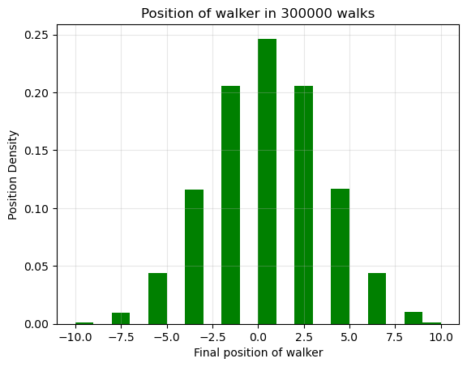
Statistics
Walk length = 10 steps
Mean = 0.0043933
Variance = 10.001680
Skewness=-0.0008601946
Kurtosis=-0.1906642113

Slide 4
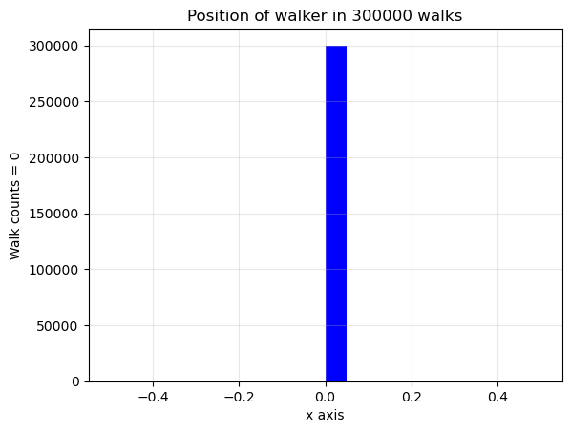

Walker at time $t=0$
Total walks =300000
Minmax=(0, 0)
Mean=0.0
Variance=0.0
Skewness=0.0
Kurtosis=-3.0

Slide 5
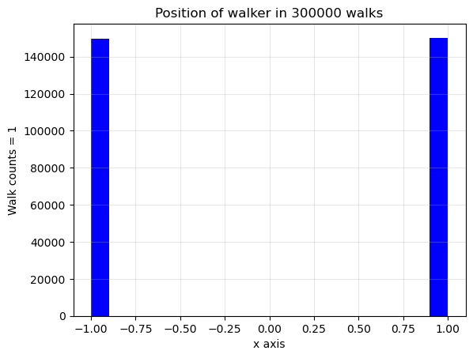

Walker at $t = 1$
Walks =300000
Minmax=(-1, 1),
Mean=0.0014
Variance=1.0000013733379114,
Skewness=-0.00280000274400415
Kurtosis=-1.999992159984634)

Slide 6
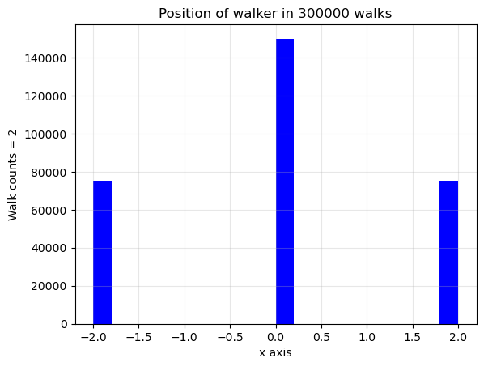
Walker at t=2
Walks =300000,
Minmax=(-2, 2)
Mean=0.0009933333333333333
Variance=2.001485684907838
Skewness =0.0007031712109337253
Kurtosis=-1.001477918170431

Slide 7
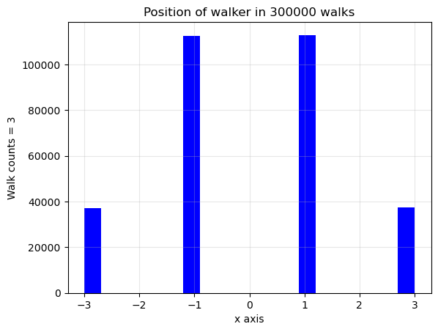
Walker at t = 3

Slide 8
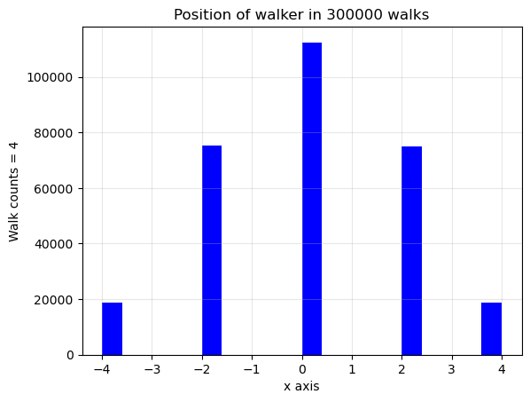
Walker at t=4

Slide 9
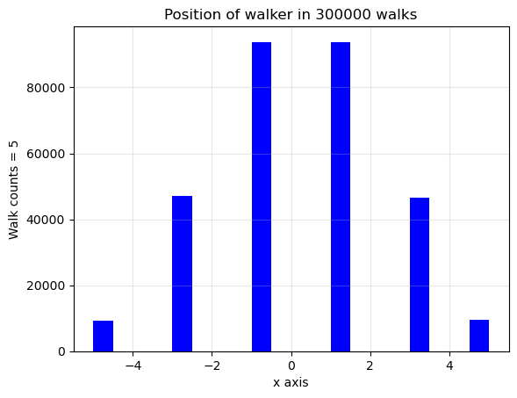
Walker at t=5

Slide 10
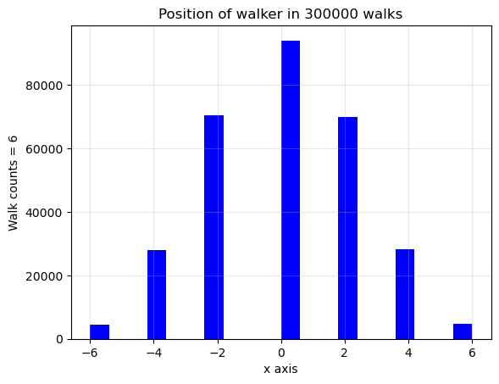
Walker at t=6
Minmax=(-6, 6)
Mean=0.0013066666666666667
Variance=5.987218250016388
Skewness=0.005504249044741521
Kurtosis=-0.33514285741511873

Slide 11
Mean squared displacement wrt position
N * p*q, N = no of steps, p=q= 0.5
1.0,
1.9991733333333332,
2.9967466666666667
4.002386666666666,
5.00488
6.001,
7.002533333333333,
8.002786666666667
8.9988,
10.000533333333333

Slide 12
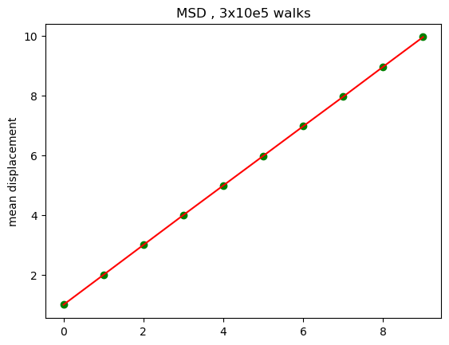
Mean square displacement
Mean of each walk was determined
The probability of -1 movement was assigned as p and that of +1 as 1-p or q.
The square estimation was taken to reduce the uncertainties. Though, we also, for such large data set, were working on mean of mean of reduce error propagation.
Plot of msd vs walks was drawn

Slide 13
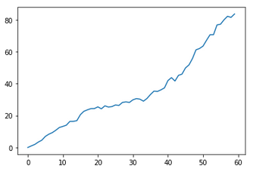
Extra something
The slope msd vs steps did not showed absolute linearity for smaller number of walk. For instance , for 60 is walker, 50 length of steps

Slide 14
Inferences
To be drawn ….

Slide 15
Thank you

