Slide 1
Statistical Properties of Random Walk with Resetting
Supervised by : Dr. Arnab Pal

Slide 2
Random Walk
Random Walk is defined a model to generate path sequence of a random motion.
Wide range of applications in biology, chemistry, mathematics and physics.
Notes:
Random motion is mathematical object, known as stochastic or random processes that describes a path that consists of succession of steps which are randomly chosen.

Slide 3
Areas of application
Random Walk helps us model many natural phenomenon:
Motion of molecules in phases
Search path e.g., foraging animals
Financial Markets
Investment theory
Page Ranking algorithms , etc.
Notes:
Kinesin is a molecular motor which does biased random walks. This molecular motor are designed as carriers to deliver a cargo from a place A to B. Thus, the efficiency of the motor is of interest in biology.
Resetting works as a virtual potential trap for the walker so this helps us better understand and use the finite time taken by walker to reach target.
Also, the walker fluctuates around the resetting point which in our case is same as initial point.

Slide 4
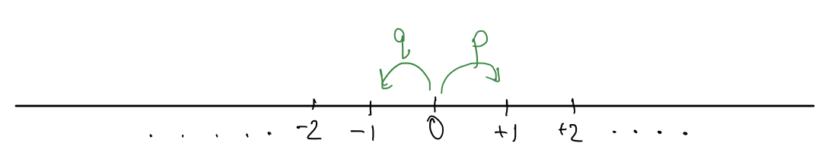
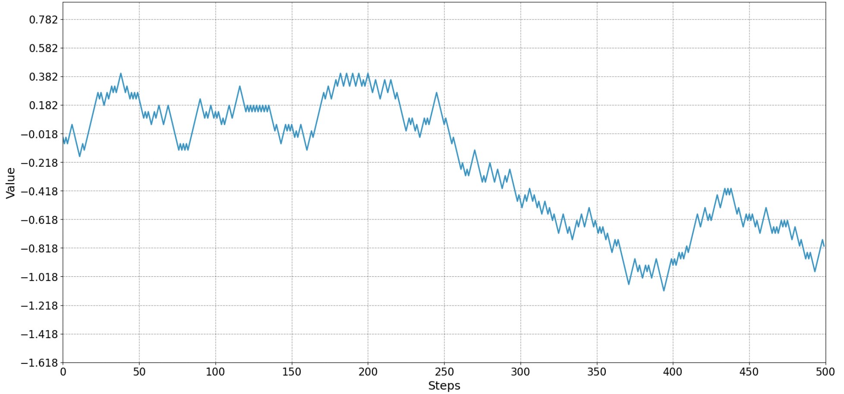
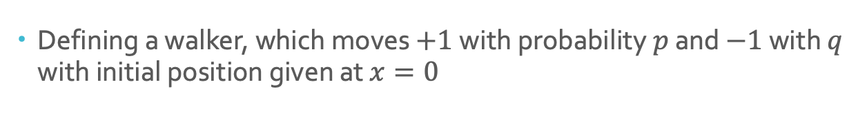
1-D Random Walk
Defining a walker, which moves $+1$with probability$p$ and $−1$ with $q$ with initial position given at $x=0$
Notes:
We further define a walker whose movement are contained in 1 dimensional lattice with discrete timestamps which takes +1 steps with probability p and step of -1 with probability q. Given is the journey of a random walker in one dimension lattice. The walker had equal probability of going either +1 or -1 and p+q = 1.

Slide 5

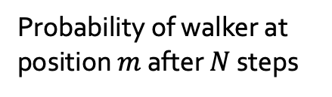
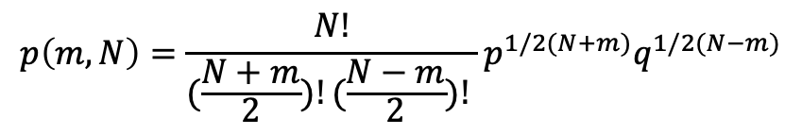
Position distribution of Walker
Plot was simulated for $3∗{10}^{5}$ walkers for each walk of 100 steps. We observed the average to be around $x=0$, initial position.
We observe that the position distribution of walker sums up as what we know as Binomial Distribution.
Mean : 0.0044
$p=q=0.5$
$$p\left(m,N\right)=\frac{N!}{(\frac{N+m}{2})!(\frac{N−m}{2})! }p^{1/2(N+m)}q^{1/2(N−m)}$$
Probability of walker at
position $m$ after $N$ steps
Notes:
For a walker, whose initial position was set to x=0 at t=0, we observed that the most probable position of walker to be found is x=0. This is in agreement with the analytical results.
We are interested in following questions : Since our walker is symmetric i.e it has equal probability to go either direction, there are certain stochastic trajectories which moves away from the target position, m, resulting in overshooting time. This renders walker, taking infinite time to reach target. This the the question we further try to understand and answer in our project.
This can be also understood in the following qualitative way: position distribution of a random walker concurs to a time dependent distribution which never reaches equilibrium. Thus, the walker is never confined and evolves indefinitely spreading the trajectories to explore the extremes of the phase space

Slide 6

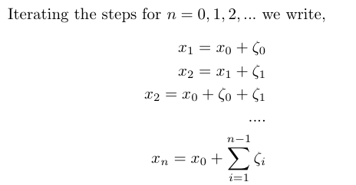

Central Limit Theorem
PDF, $p\left(m,N\right)$for 1D walker is exactly Binomial Distribution and position distribution is Gaussian.
We can define position of walker as
Notes:
We now try to understand the concept behind the distribution being Gaussian. We observe that position of walker can be discretely written as sum of the random variable zeta which is defined as +1 with prob p and -1 with prob q. And our knowlwedge from central limit theorem, we see that it leads us to a normal or gaussain distribution.

Slide 7
Why Resetting?
Simple random walk is not an efficient strategy.
Resetting expedites the walker reaching target.
Resetting renders walker, a virtual potential trap/confinement.
Significant gain in terms of the search performance by the introduction of the resetting
Notes:
We find that the probability density func-tion of the resetting-walker attains to a time independentform in large time. This function is peaked around theorigin which tells us that the most probable position for he walker to be found is near the origin
Crucially, this observation hints towards the possible outcome that the walker may reach the target in a finite time compared to the non-resetting case where the walker tends to escape. This in turns suggests that there is a significant gain in terms of the search performance by the introduction of the resetting.

Slide 8
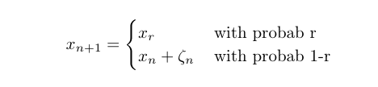
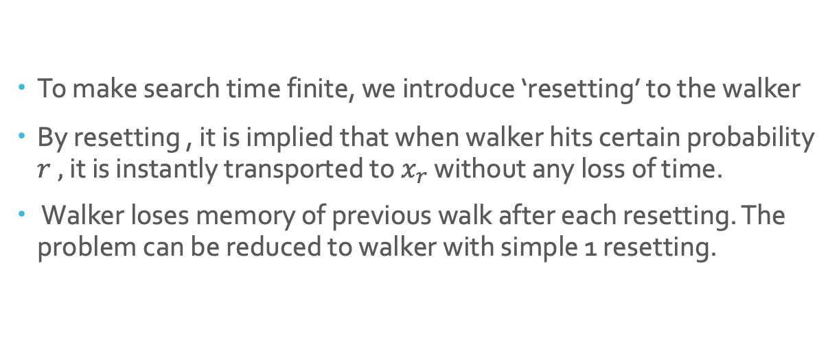
Resetting Walker
To make search time finite, we introduce ‘resetting’ to the walker
By resetting , it is implied that when walker hits certain probability $r ,$ it is instantly transported to $x_{r}$ without any loss of time.
Walker loses memory of previous walk after each resetting. The problem can be reduced to walker with simple 1 resetting.
Notes:
Our choice of x_r is x = 0
the governing time dependent equations forthe PDF, we first observe that the walker erases its mem-ory after each resetting event. In other words, resetting mechanism makes the intervals between any two resetevents independent from each other. This is a crucial observation that helps us reduce the problem to great extent. Provided thatnresetting happens (note that atleast 1 resetting should happen for this approach), we can have the advantage of eliminating all the n−1 resetting in our mind and keep track of only the last resetting event.Thus, our problem reduces to a simple random walker with one resetting event conditioned that this was thelast one before the measurement.

Slide 9
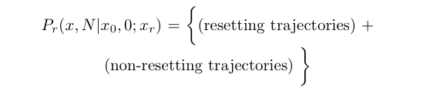
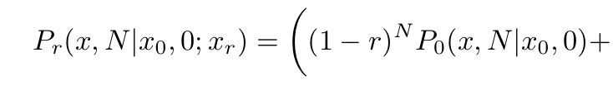
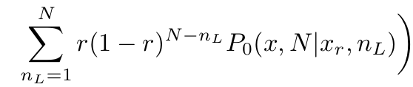

Governing Equations
PDF of the position $p\left(x,N\right)$ can be written as
A walker without resetting is practically a simple random walker.
PDF of position of a resetting walker will be given as
Notes:
Though the probability of a resetting walker, taking aa walk without any resetting in quite less but nevertheless it is finite. There can be such walk. As we can infer,that walk will simply be a general random walk

Slide 10
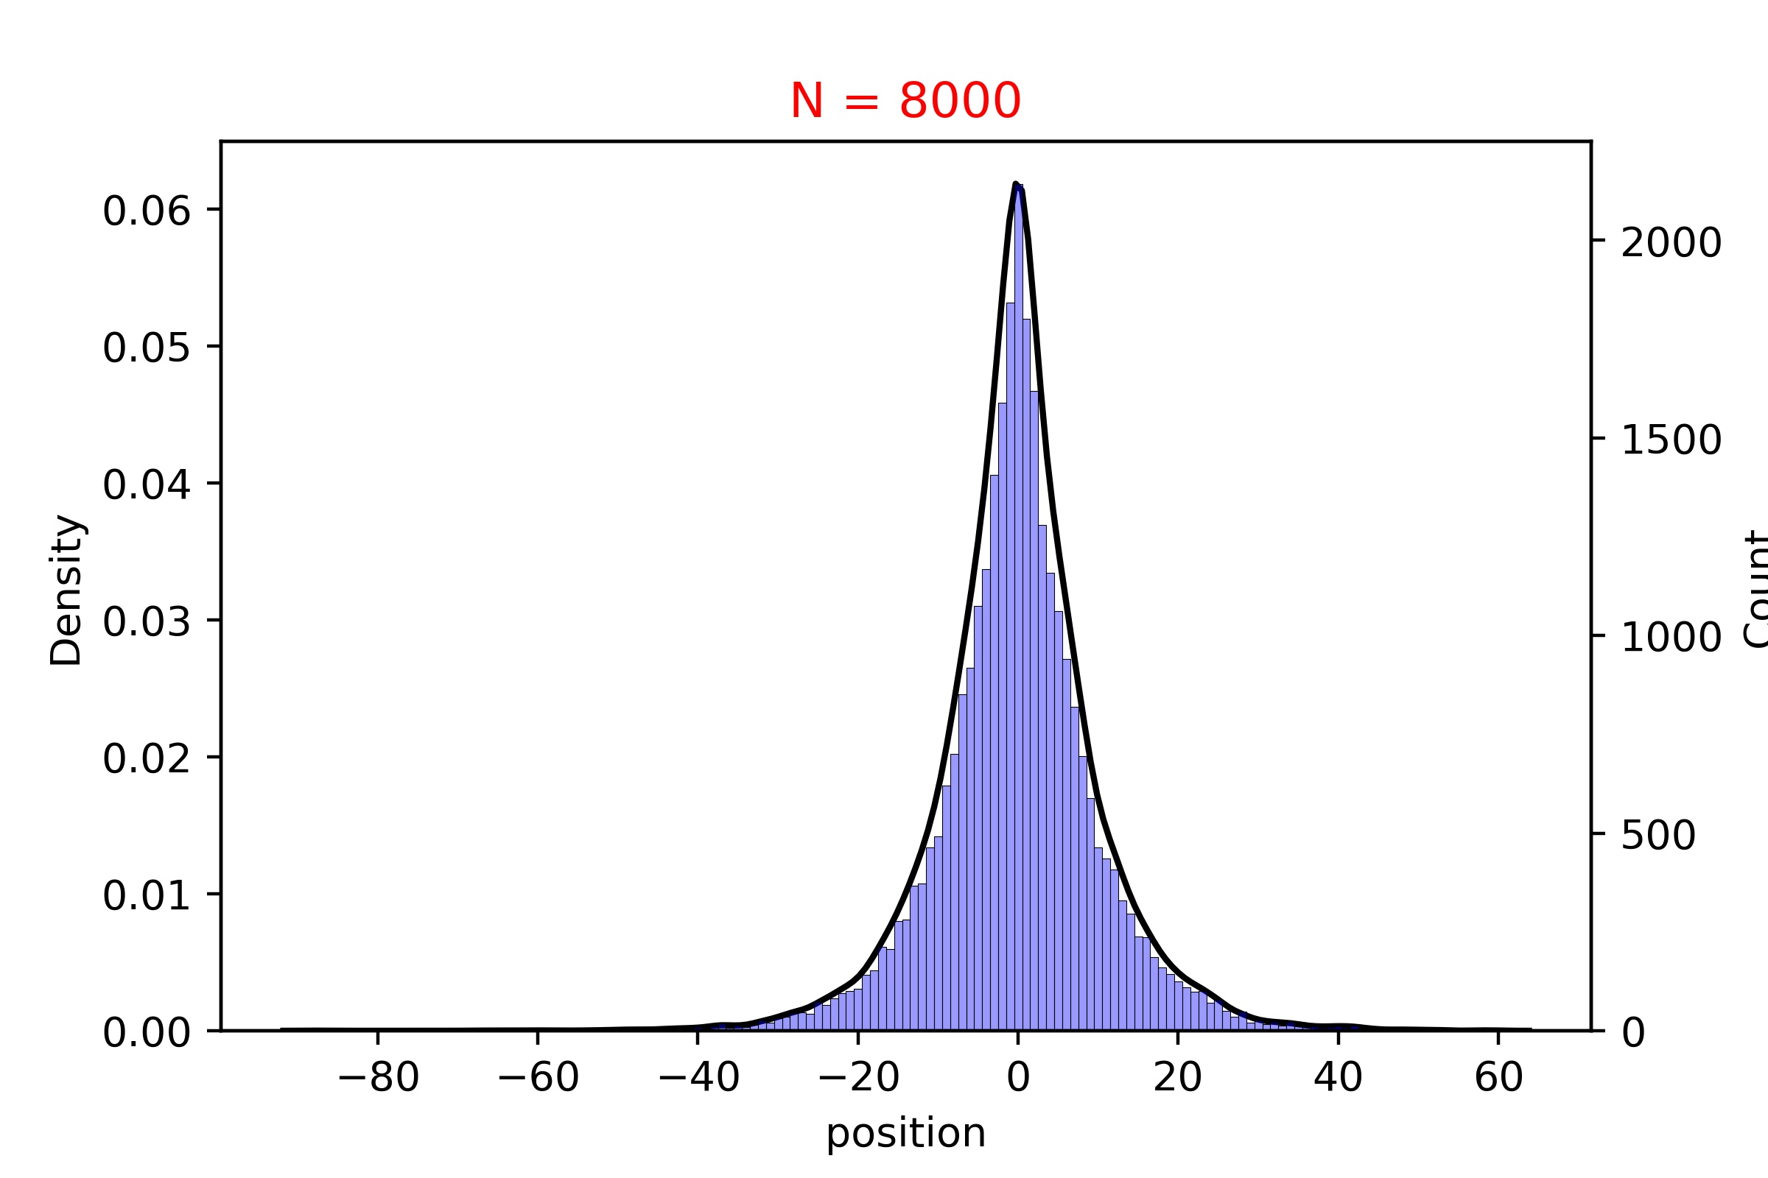

Resetting as a ‘virtual’ confinement
Walker loses the normal distribution and Gaussian behavior starts to blow off.
Walker with resetting for $p_{r}=0.3$.
Defined for symmetric walker with $p=q=0.5$. As expected, we see a spike and at peak we can observe the plot no longer remains differentiable.
minmax=(-73, 44) , mean=0.134, variance=107.428

Slide 11
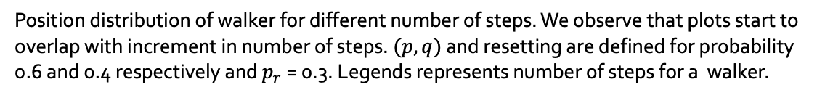
Time Independence position distribution
Walker attains a time invariance position distribution after a certain number of steps.
Position distribution of walker for different number of steps. We observe that plots start to overlap with increment in number of steps. $(p,q)$ and resetting are defined for probability 0.6 and 0.4 respectively and $p_{r}$ = 0.3. Legends represents number of steps for a walker.

Slide 12

Mean Squared Displacement
PDF for a resetting walker grows time invariant after certain number of steps.
MSD confirms that PDF is time independent, and moments too.
It reaches a saturation, and we observe a plateau implying a steady (time independent) state.
Walker defined for $p_{r}=0.3, p=0.6 , q=0.4$
Notes:
after a certain number of steps, the position distribution continues to remain invariant under time. Since the PDF is independent of time, moments of the walker should also be. We con-firm this result by observing the mean squared displacement (MSD) of the walker. Thus, for a large number of steps, we should obtain a plot that reflects to this discussed fact

Slide 13
Current answers and further prospects
Finite mean time with the help of resetting unlikely indefinite spread of walker with non-resetting.
Resetting provides walker a ‘virtual’ confinement which helps significantly expedite search strategy.
Position distribution attains to a time-independent form after large number of steps.
As a future goal, we would like to delve deeper into the first passage time statistics and show explicitly how the knowledge gained here can be utilized to predict many statistical metrics such as the mean, variance of the search time

Slide 14
Thanking you!
Presented by :
PANKAJ KUMAR
170455
PHY556, Fall Semester, 2021

