Slide 1
CS 115
OBJECT ORIENTED PROGRAMMING I
LECTURE 11
GEORGE KOUTSOGIANNAKIS
Copyright: 2015 Illinois Institute of Technology_ George Koutsogiannakis

Slide 2
Last Week’s Topics
Event-Controlled Loops Using while
Type-Safe Input Using Scanner
Constructing Loop Conditions
Reading a Text File
Looping Techniques

Slide 3
New Topics
Event-Controlled Loops Using do/while
Count-Controlled Loops Using for
Nested Loops
Concept of Arrays.
  Declaring and Instantiating Arrays
  Accessing Array Elements

Slide 4
The do/while Loop
Unlike the while loop, the condition for the do/while loop is evaluated at the end of the loop
Thus, do/while loop executes at least once
Some uses for a do/while loop:
  Validate user input
  Ask if the user wants to repeat an operation, such as play a game again.

Slide 5
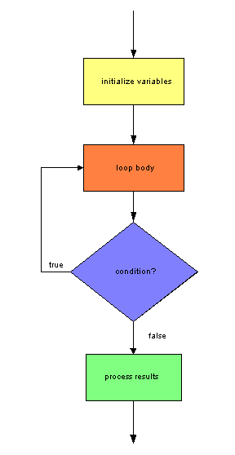
do/while Flow of Control
The do/while loop body is executed,
then the condition is checked. If the
condition is true, the loop body is
repeated. If the condition is false,
the loop body is not repeated.

Slide 6
do/while Syntax
//initialize variables
do
{
// body of loop
} while ( condition );
//process the results

Slide 7
Example:Validate User Input
We can use a do/while loop to check whether the user input is valid.
We prompt the user inside the do/while loop.
If the user input is not valid, we want to reprompt until the user enters a valid value. Thus, we form the condition so that it is true if user enters invalid data.

Slide 8
To Repeat an Operation
Example code using a do/while loop to prompt the user to play a game again:
do
{
// code to play a game
System.out.print( "Play again (yes/no)? ")
String answer = scan.next( );
} while ( answer.equalsIgnoreCase( "yes" ) );

Slide 9
do/while loop Example
public class TestDoWhile
{
public static void main(String[] args)
{
int count=11;
int sum=0;
do
{
count++;
sum=sum+count;
}
while(count<=10);
System.out.println(sum);
}
}

Slide 10
do/while loop Example
The output is 12
We enter the do and advance count to 12 from 11
We add 12 to 0 and sum=12
We reach the while condition and it evaluates to false.
We are out of the while loop

Slide 11
Same code with while Loop
public class TestDoWhile1
{
public static void main(String[] args)
{
int count=11;
int sum=0;
while(count<=10)
{
count++;
sum=sum+count;
}
System.out.println(sum);
}
}

Slide 12
Same code with while Loop
Output is zero.
We reach the while condition and it evaluates to false. Thus we are not allowed to execute inside the while loop.
We exit the while loop.

Slide 13
The for Loop
Ideal when before the loop begins, you know the number of iterations to perform.
Examples:
  Find the sum of 5 numbers
  Find the maximum of 20 numbers
  Print the odd numbers from 1 to 10

Slide 14
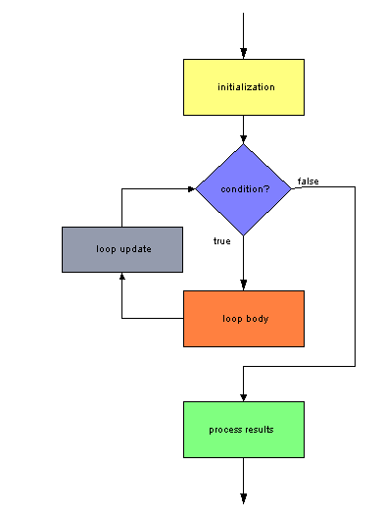
for Loop Flow of Control
The initialization statement is executed (once only).
The loop condition is evaluated.
If the condition is true, the loop body is executed.
The loop update statement is then executed, and the loop condition is reevaluated.

Slide 15
The for Loop Syntax
for ( initialization; loop condition; loop update )
{
// loop body
}
Notes:
semicolons separate terms in the loop header
no semicolon follows the loop header
curly braces are required only if more than one statement is in the loop body

Slide 16
Using a Loop Control Variable
A loop control variable is convenient for counting for loops.
  We set its initial value in the initialization statement
  We check its value in the loop condition
  We increment or decrement its value in the loop update statement

Slide 17
Testing for Loops
An important test for for loops is that the starting and ending values of the loop variable are set correctly.
For example, to iterate 5 times, use this header:
for ( int i = 0; i < 5; i++ )
or this header:
for ( int i = 1; i <= 5; i++ )

Slide 18
Example For Loop
public class ForLoop {
public static void main(String[] args)
{
int count=0;
int sum=0;
for(count=0; count<=5; count++)
{
sum=sum+count;
}
System.out.println(sum);
}
}
Output=15
0+1+2+3+4+5=15 notice that there are 6 iterations in the loop

Slide 19
Processing a String (named word)
In the reverse direction:
  Correct:
for ( int i = word.length( ) - 1; i >= 0; i-- )
  Incorrect:
for ( int i = word.length( ); i >= 0; i-- )
** There is no character at word.length( )
for ( int i = word.length( ) - 1; i > 0; i-- )
** This does not process the character at index 0
Correct way:
We iterate from word.length()=4 minus 1 which is 3 to 0
w o r d
0 1 2 3
The length is 4 but the index of the characters is from 0 to 3
We can not exceed the maximum index number in the loop!!!

Slide 20
Nested for Loop Execution
The inner loop executes all its iterations for each single iteration of the outer loop
Example: how can we produce this output?
1
1 2
1 2 3
1 2 3 4
1 2 3 4 5

Slide 21
Analysis
The highest number we print on each line is the same as the line number.
for line = 1 to 5 increment by 1 each iteration
{
for number = 1 to line by 1
{
print number and a space
}
print a new line
}

Slide 22
Arrays
Arrays allow us to save data into a data structure and retrieve the data later on in the program as needed.
Arrays are useful for many applications, including calculating statistics or representing the state of a game.
  For example the grades that we read off a file in last week’ s lab could had been stored in an array data structure and retrieved from there.

Slide 23
Arrays
An array is a sequence of variables of the same data type.
The data type can be any of Java's primitive types (int, short, byte, long, float, double, boolean, char), an array, or a user defined class (like Student type or People type etc).
Each variable in the array is an element.
We use an index to specify the position of each element in the array.

Slide 24
Declaring and Instantiating Arrays
Arrays are objects, so creating an array requires two steps:
  declaring a reference to the array
  instantiating the array
To declare a reference to the array, use this syntax:
datatype [] arrayName;
To instantiate an array, use this syntax:
arrayName = new datatype[ size ];
where size is an expression that evaluates
to an integer and specifies the number of
elements.
To do it in one line you write:
datatype [] arrayName=new datatype[size]
i.e. int [] my array=new int[10]; create san array that can store 10 int type elements.

Slide 25
Examples
Declaring arrays:
double [] dailyTemps; // elements are doubles
String [] cdTracks; // elements are Strings
boolean [] answers; // elements are booleans
Auto [] cars; // elements are Auto references
int [] cs101, bio201; // two integer arrays
Instantiating these arrays:
dailyTemps = new double[365]; // 365 elements
cdTracks = new String[15]; // 15 elements
int numberOfQuestions = 30;
answers = new boolean[numberOfQuestions];
cars = new Auto[3]; // 3 elements
cs101 = new int[5]; // 5 elements
bio201 = new int[4]; // 4 elements

Slide 26
Default Values for Elements
When an array is instantiated, the elements are assigned default values according to the array data type.
Array data type | Default value
byte, short, int, long | 0
float, double | 0.0
char | space
boolean | false
Any object reference (for example, a String) | null

Slide 27
Assigning Initial Values to Arrays
Arrays can be instantiated by specifying a list of initial values.
Syntax:
datatype [] arrayName = { value0, value1, … };
where valueN is an expression evaluating to
the data type of the array and is the value
to assign to the element at index N.
Examples:
int nine = 9;
int [] oddNumbers = { 1, 3, 5, 7, nine, nine + 2,
13, 15, 17, 19 };
Auto sportsCar = new Auto( "Ferrari", 0, 0.0 );
Auto [] cars = { sportsCar, new Auto( ),
new Auto("BMW", 100, 15.0 ) };

Slide 28
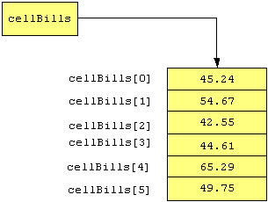
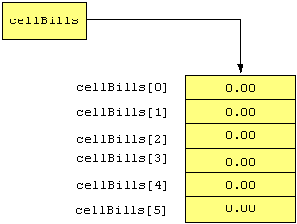
an Array of integer values
When instantiated: After assigning values:

Slide 29
Accessing Array Elements
See Example 8.1 CellBills.java
Element | Syntax
Element 0 | arrayName[0]
Element i | arrayName[i]
Last element | arrayName[arrayName.length - 1]

Slide 30
Example Entering elements into an array
double [] myarray=new double[4];
myarray[0]=3.45;
myarray[1]=4.23;
myarray[2]=1.00;
myarray[3]=0.23;
Notice that the last index of the array is 3 and not 4 since we start the counting of the index from 0.

Slide 31
Inserting elements into an array using loops
double[] myarray=new double[100];
for( int g=0; g<=myarray.length-1; g++)
{
myarray[g]= (g*3/5);
}

Slide 32
Reading the elements of an array
We assign the elements as we read them:
double d=myarray[3];
reads the element at index 3 (4th element) and assigns it to variable d.

Slide 33
Reading the elements of an array using for loop
for (int k=0; k<=myarray.length-1; k++)
{
double d=myarray[k];
System.out.println(d);
}
During each iteration through the loop an element is read and it is outputted.

Slide 34
Reading the elements of an array using for loop
Alternatively :
for (int k=0; k<=myarray.length-1; k++)
{
System.out.println(myarray[k]);
}
Will accomplish the same .

Slide 35
Study Guide
Chapter 6
  Sections 6.8, 6.9 6.10
Chapter 8
  Sections 8.1, 8.2

