Slide 1
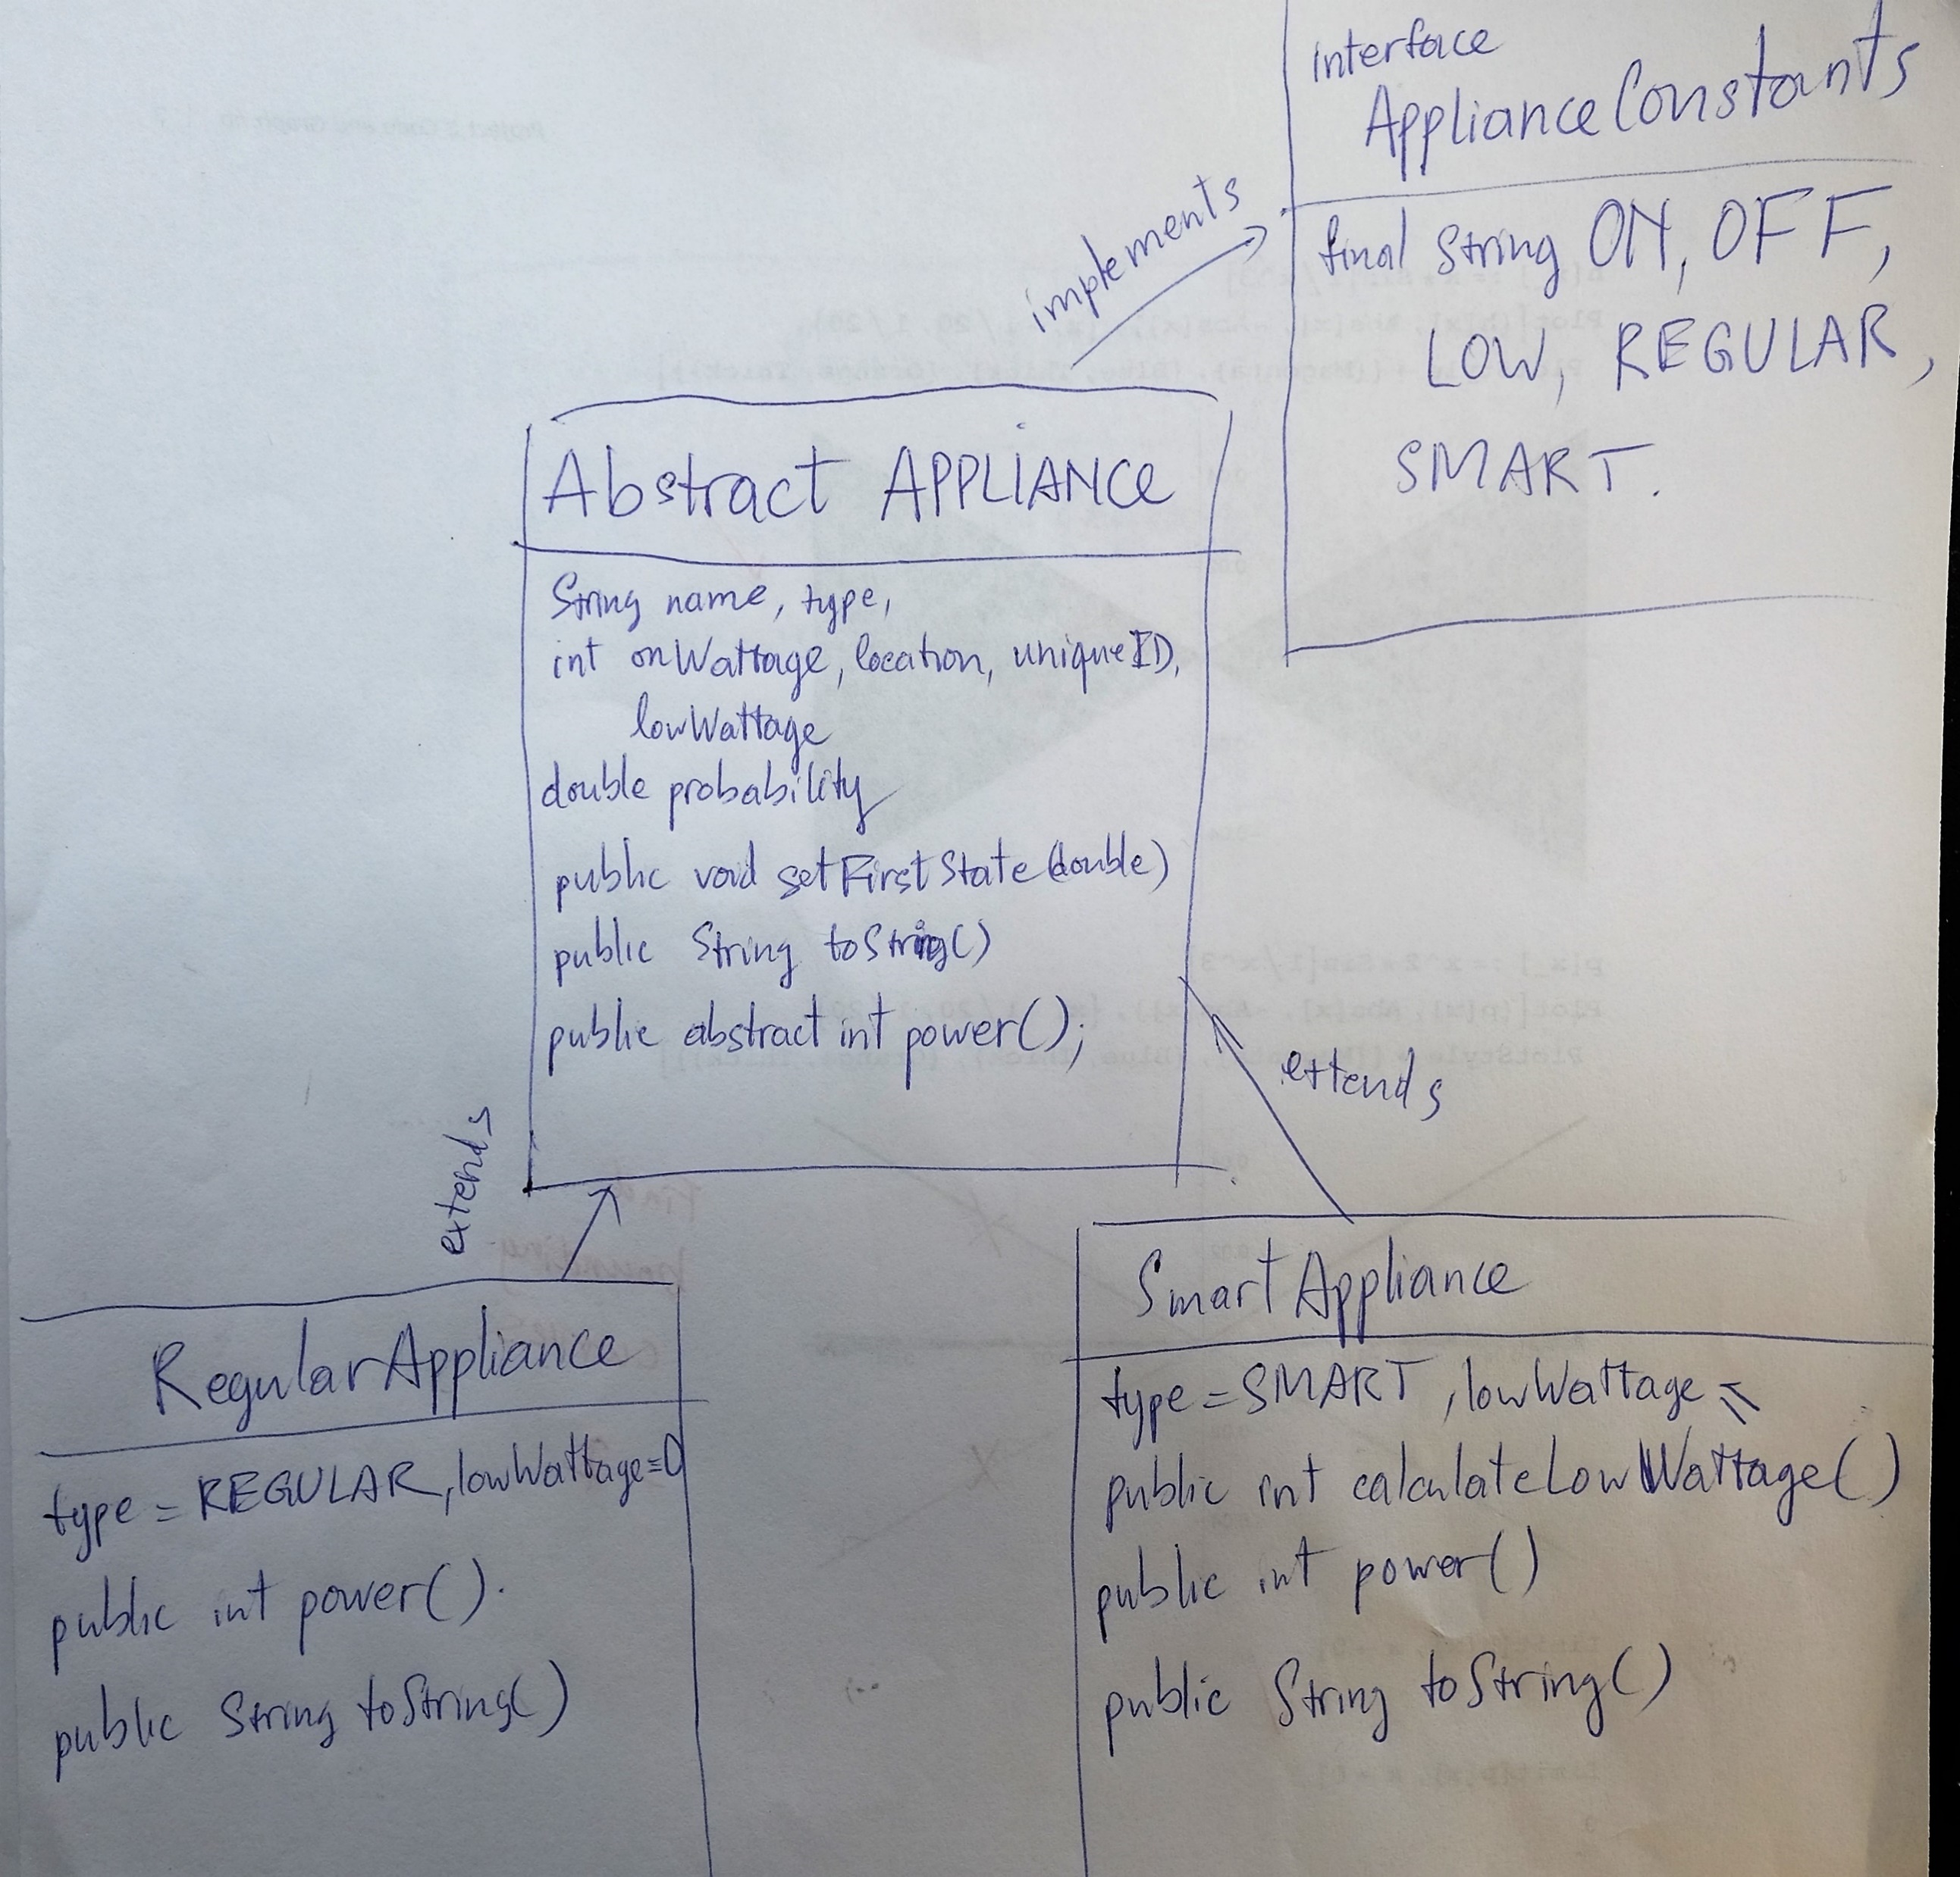
Class tree

Slide 2
Event Simulator (Client)
public static Vector<Appliance> appliances; //store all appliances
public static int maximum; //store user’s input of limit wattage
public static int[] locations; //store all the locations
public static Vector<String> detailedReport; //store report
Public static int totalWattageUsing(){} //calculate total wattage using at the moment
Public static void setFirstState(){} //set initial state of appliances
Public static int calculateAllLow(){} //calculate totalwattage if all ONsmart appliances are turned LOW
public static void sortProbability(){} //sort in increasing order of probability
public static void sortLocations(){ //sort locations in order of increasing average probability
public static void control(int time){ //perform smart fix and save log

Slide 3
Event Simulator (Client) continued
public static void main(String[] args){
-Ask for simulation length and maximum consumption\
-read output.txt
-user menu
-starts EVENT SIMULATOR
-generate summary report and publish detailed report
}

Slide 4
Test case
Test | Output | Tested
Add appliances by file | Should see new appliances added | Yes
Add an appliance | Should see the new appliance added | Yes
Delete an appliance | Should not see the deleted appliance | Yes
Find an appliance according to ID | Should display the info of that appliance | Yes
View all appliances of a location , input “not included” location and right location | Should print error message if location is not found, or else display the location | Yes
View all Regular or Smart appliances | Display all Regular or Smart appliances | Yes
Input a maximum consumption | The program should output proper wattage used in each time interval | Yes

Slide 5
Algorithm summary
The program checks to see if the totalWattageUsing now exceeds the maximum consumption:
If it does:
Check if the total wattage of all the ON Regular and ON Smart appliances (as if they are all turned to LOW) to see if that total still exceeds the maximum consumption
If it does not exceed:
Sort the appliances by increasing order of ONprobability
Turn the ON smart appliance to LOW starting from the lowest to the highest Onprobability until the totalWattageUsing < maximum
If it still exceeds the maximum consumption:
Sort the locations by increasing order of average ONprobability
Brown out locations from the lowest average ONprobability to highest until totalWattageUsing < maximum

