Slide 1
CS 116 Object Oriented Programming II
Acknowledgement: Contains materials provided by George Koutsogiannakis and Matt Bauer

Slide 2
Topics
Abstract Classes and Methods

Slide 3
Database of Figures
You have been asked to lead a team of software engineers to design a database of figures
Part of a graphical software
Purpose
To store position of various figures
Store dimensions of the figure (length, breadth, radius, etc)
Calculate area of the figures
Challenge
Figures have many, many shapes
Circle, rectangle, square etc.
Each figure has a different formula to calculate area and perimeter

Slide 4
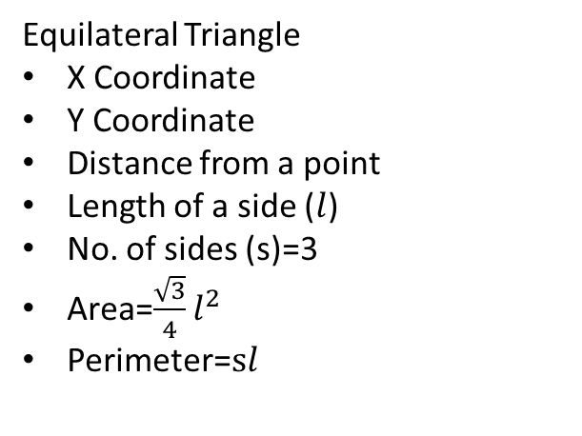
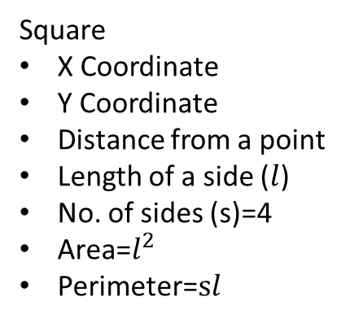
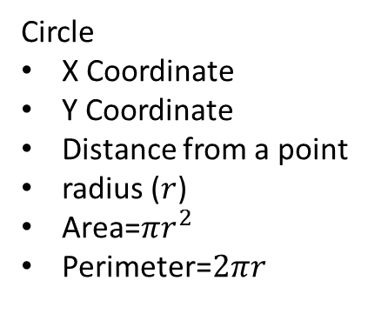
Database of Figures Registry
Square
X Coordinate
Y Coordinate
Distance from a point
Length of a side ($l$)
No. of sides (s)=4
Area=$l^{2}$
Perimeter=$sl$
Equilateral Triangle
X Coordinate
Y Coordinate
Distance from a point
Length of a side ($l$)
No. of sides (s)=3
Area=$\frac{\sqrt{3}}{4}l^{2}$
Perimeter=$sl$
Circle
X Coordinate
Y Coordinate
Distance from a point
radius ($r$)
Area=${πr}^{2}$
Perimeter=$2πr$

Slide 5
Database of Figures Registry
Possible way forward
Define a superclass called Figure that encapsulates the common attributes x coordinate and y coordinate
public class Figure{
private int x;
private int y;
public Figure(int xcor, int ycor){
this.x=xcor;
this.y=ycor;
}
//accessor and mutators
public float distance(int x1, int y1){
//code to calculate the Euclid distance between two points.
}
}

Slide 6
Database of Figures Registry
Now, you can create subclasses Square, EquiTriangle and Circle that inherits the superclass Figure
It is expected that the subclasses will have additional attributes (such as length for class Square and radius for class Circle)
Subclasses will have additional methods (such as area and perimeter implementing the appropriate formula)
How do you force the subclasses to implement area and perimeter?

Slide 7
abstract Classes and Methods
An abstract class is a class that is not completely implemented.
Purpose is to provide an appropriate superclass from which other classes can inherit and thus share a common design.
Usually, the abstract class contains at least one abstract method.
An abstract method provides specification but does not provide an implementation.
The abstract method is used as a pattern for a method the subclasses should implement.
A class with even one abstract method should be declared abstract.

Slide 8
Defining an abstract class
To declare a class as abstract, include the abstract keyword in the class header:
accessModifier abstract class ClassName
{
// class body
}

Slide 9
Defining an abstract Method
To declare a method as abstract, include the abstract keyword in the method header, and end the header with a semicolon:
accessModifier abstract returnType
methodName( argument list );
Note:
The semicolon at the end of the header indicates that the method has no code.
We do not use opening and closing curly braces { }.

Slide 10
A Possible Design of the Figures Database
Figure is an abstract class
It cannot be instantiated
It can be subclassed
Object
Figure
-x :int -y :int
+Constructors, +accessor/Mutator methods +distance()
We can define a Figure hierarchy.
The superclass is Figure, which is abstract. (In the diagram, Figure is an orange box to indicate that it is abstract.)
We will derive three subclasses: Circle, EquiTriangle and Square
Note 1: + indicates public
– indicates private
Square
-length :double -noSides :int
+Constructors +accessor/Mutator methods +area() +perimeter()
EquiTriangle
-length :double -noSides :int
+Constructors +accessor/Mutator methods +area() +perimeter()
Circle
-radius :double
+Constructors +accessor/Mutator methods +area() +perimeter()

Slide 11
A Possible Design of the Figures Database
Open the zip file provided on the website and follow along
Go through the Figure.java and Figclient.java files

Slide 12
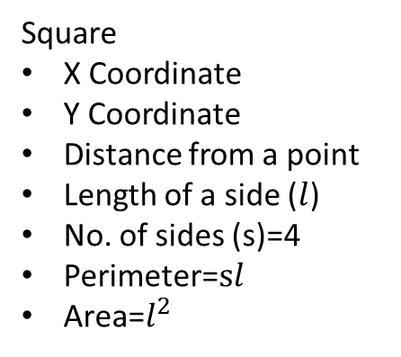
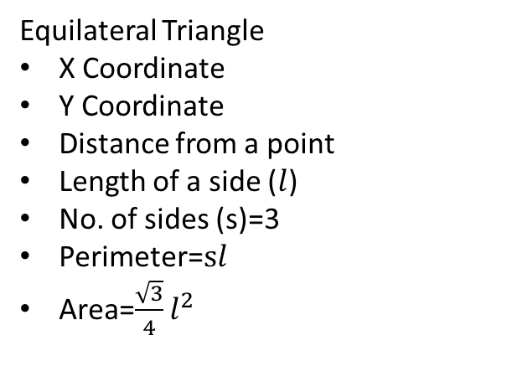
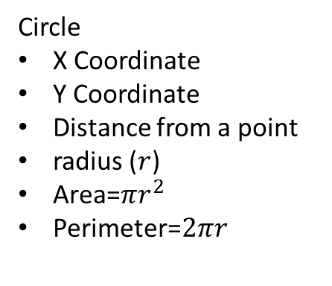
Is there a better design?
Both are regular polygons
Square
X Coordinate
Y Coordinate
Distance from a point
Length of a side ($l$)
No. of sides (s)=4
Perimeter=$sl$
Area=$l^{2}$
Equilateral Triangle
X Coordinate
Y Coordinate
Distance from a point
Length of a side ($l$)
No. of sides (s)=3
Perimeter=$sl$
Area=$\frac{\sqrt{3}}{4}l^{2}$
Circle
X Coordinate
Y Coordinate
Distance from a point
radius ($r$)
Area=${πr}^{2}$
Perimeter=$2πr$

Slide 13
Object
Figure
-x, -y
+Constructors, +accessor/Mutator methods +distance()
Polygon is an abstract class that inherits from another abstract class Figure
Polygon
-lenght -noSides
+Constructors, +accessor/Mutator methods +distance() +perimeter()
Circle
-radius
+Constructors +accessor/Mutator methods +area() +perimeter()
Square
+Constructors +accessor/Mutator methods +area()
EquiTriangle
+Constructors +accessor/Mutator methods +area()

Slide 14
Is there a better design?
Go back to the in-class exercise and implement the Polygon abstract class.

Slide 15
More on abstract Classes
An abstract class cannot be used to instantiate objects (because the class is not complete).
An abstract class can be extended.
subclasses can complete the implementation and objects of those subclasses can be instantiated
An object reference to an abstract class can be declared. (Notice the word reference and not instantiation)
We use this capability in polymorphism, which will be discussed later.

Slide 16
Subclasses of abstract Classes
A subclass of an abstract class can implement all, some, or none of the abstract methods.
If the subclass does not implement all of the abstract methods, it must also be declared as abstract.
Our Circle subclass adds a radius instance variable and implements the draw method.
Our Square subclass adds a length instance variable and implements the draw method.
See Examples 10.15, 10.16, 10.17, & 10.18 in text

Slide 17
Restrictions for Defining abstract Classes
Classes must be declared abstract if the class contains any abstract methods
abstract classes can be extended
An object reference to an abstract class can be declared
abstract classes cannot be used to instantiate objects

Slide 18
Restrictions for Defining abstract Methods
abstract methods can be declared only within an abstract class
An abstract method must consist of a method header followed by a semicolon
abstract methods cannot be called
abstract methods cannot be declared as private or static
A constructor cannot be declared abstract

