Slide 1
Python

Slide 2
Повторення
print("Pick either Ostrich, Lion or Whale")
print("I will attempt to guess your choice")
print("Does the animal live in the water? Y/N")
answer = input().lower()
if answer == "n":
print("Does the animal have wings? Y/N")
answer = input().lower()
if answer == "y":
print("It must be an Ostrich!")
else:
print("It must be a Lion!")
else:
print("It must be a Whale!")
a="Hello"
a=10
print(a)
a=b=10
print(a, b)
a=2
b=3
a,b=b,a
print(a, b)

Slide 3
Повторення
number = 4
print("Guess a number between 1 and 10")
guess = int(input())
while guess != number:
print("Incorrect")
print("Guess a number between 1 and 10")
guess = int(input())
print("Correct")
times_table = 5
answer = 0
print(f"Here is the {times_table} times table")
for x in range(1,11):
answer = x * times_table
print(f"{x} times {times_table} is {answer}")

Slide 4
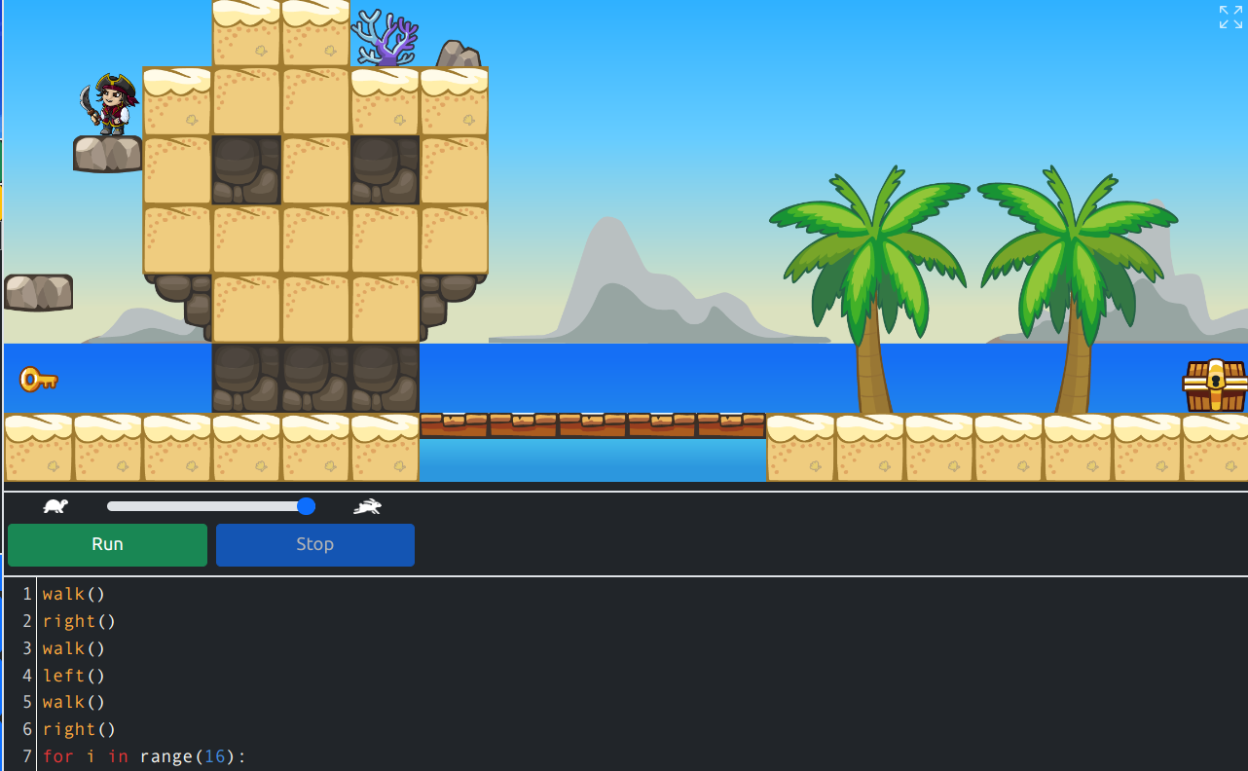
https://py-rates.fr/index.html
Notes:
qmMD4yH

Slide 5
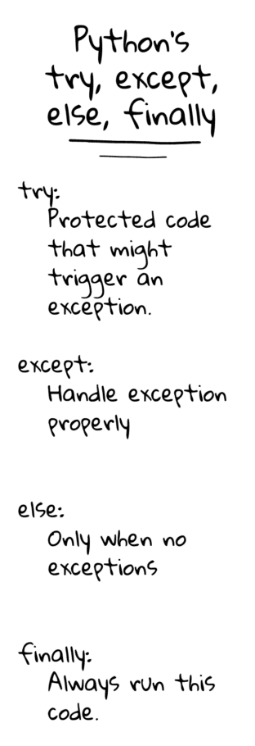
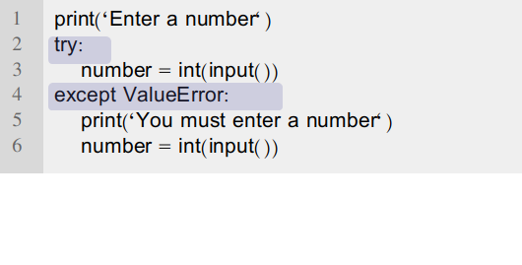
ВИНЯТКИ (exceptions)
https://python.land/deep-dives/python-try-except

Slide 6
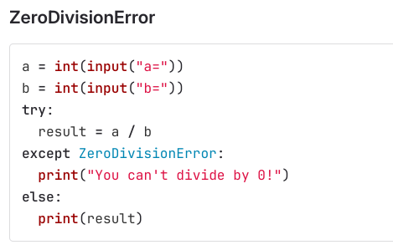
ВИНЯТКИ (exceptions)

Slide 7
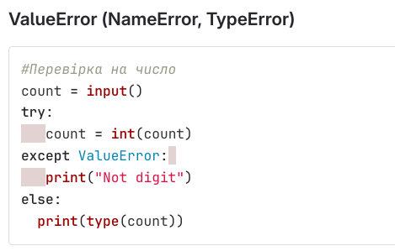
ВИНЯТКИ (exceptions)

Slide 8
ВИНЯТКИ (exceptions)
fruits = ['apple', 'pear', 'banana']
try:
selection = fruits[int(input('Select a fruit number (0-2): '))]
except ValueError:
print('That is not a number')
except IndexError:
print('That fruit number does not exist!')

Slide 9
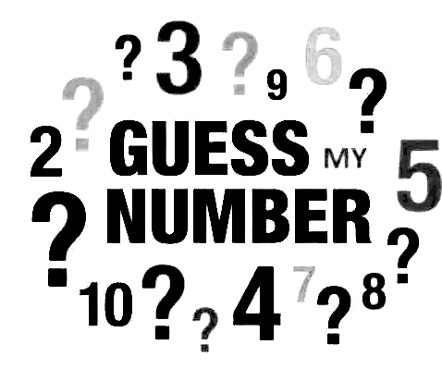
Task 1
Написати програму-гру “Вгадай число”, використовуючи перевірку винятків.
Notes:
import random
number = random.randint(1,10)
try:
print("Guess a number between 1 and 10")
guess = int(input())
except ValueError:
print('That is not a number')
else:
while guess != number:
print("Incorrect")
try:
print("Guess a number between 1 and 10")
guess = int(input())
except ValueError:
print('That is not a number')
print("Correct")

