Slide 1
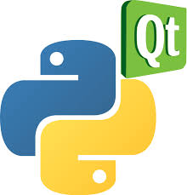
pyQt6

Slide 2

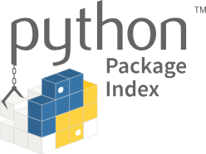
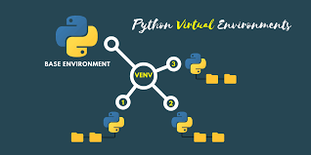
Before start
https://docs.python.org/uk/3/installing/index.html
pip is the package installer for Python. You can use pip to install packages from the Python Package Index and other indexes.
The venv module supports creating lightweight «virtual environments», each with their own independent set of Python packages installed in their site directories.
https://docs.python.org/uk/3/library/venv.html

Slide 3

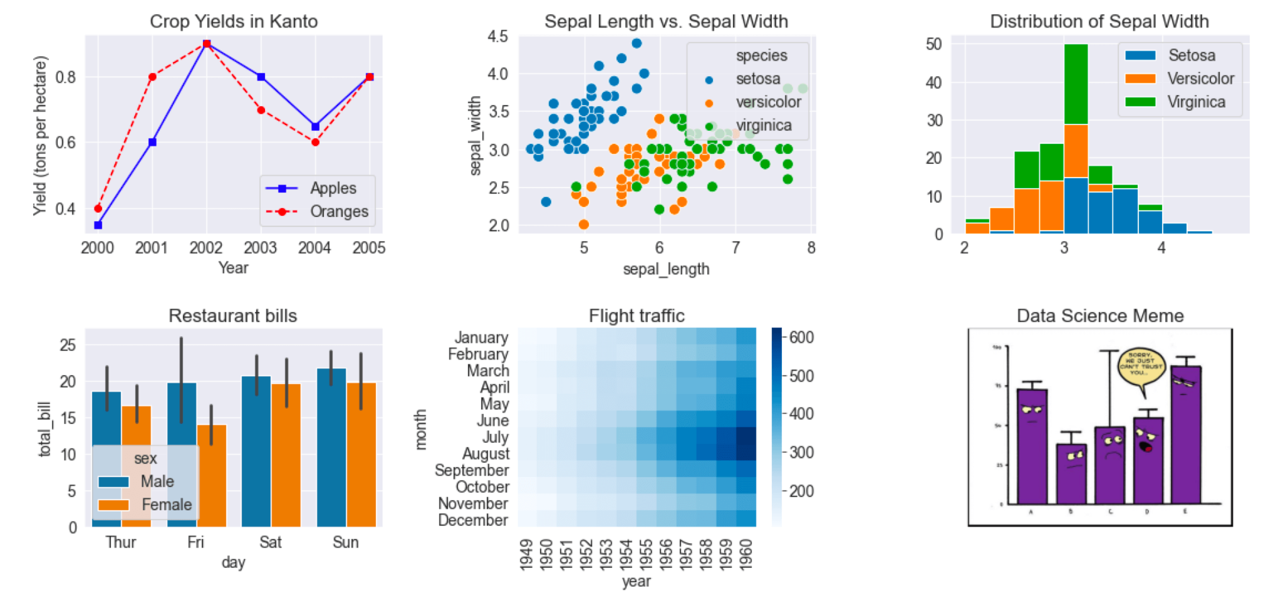
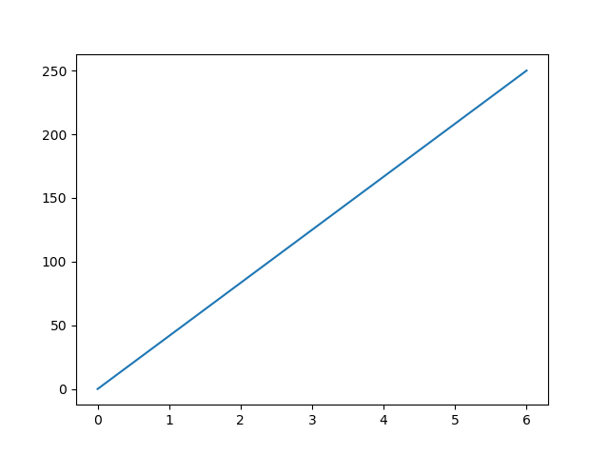
pip install matplotlib
Example
Draw a line in a diagram from position (0,0) to position (6,250):
import matplotlib.pyplot as plt
import numpy as np
xpoints = np.array([0, 6])
ypoints = np.array([0, 250])
plt.plot(xpoints, ypoints)
plt.show()

Slide 4
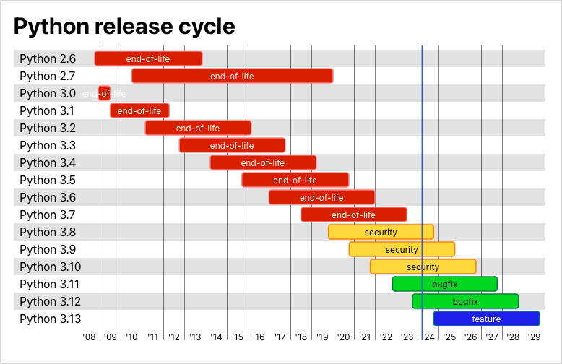
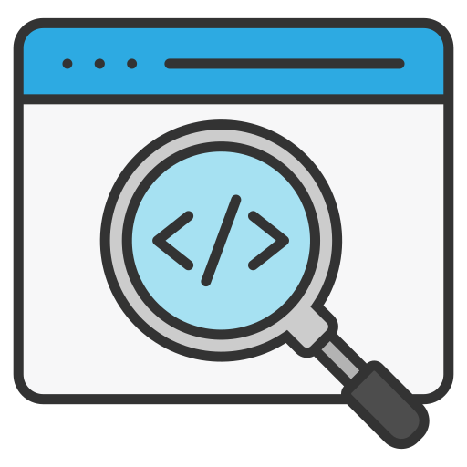

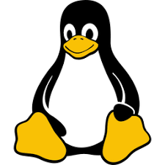
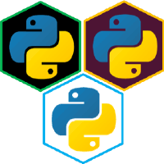
Python3 Versions
https://github.com/pyenv/pyenv
https://youtu.be/sRWigXi8g6I
sudo apt install -y make build-essential libssl-dev zlib1g-dev libbz2-dev libreadline-dev libsqlite3-dev wget curl llvm libncurses5-dev libncursesw5-dev xz-utils tk-dev libffi-dev liblzma-dev python-openssl
curl https://pyenv.run | bash
# Load pyenv automatically by appending
# the following to
# ~/.bash_profile if it exists, otherwise ~/.profile (for login shells)
# and ~/.bashrc (for interactive shells) :
export PYENV_ROOT="$HOME/.pyenv"
[[ -d $PYENV_ROOT/bin ]] && export PATH="$PYENV_ROOT/bin:$PATH"
eval "$(pyenv init -)"
# Restart your shell for the changes to take effect.
# Load pyenv-virtualenv automatically by adding
# the following to ~/.bashrc:
eval "$(pyenv virtualenv-init -)"
pyenv versions
pyenv install --list
pyenv install 3.12
pyenv global 3.12
pyenv local 3.12

Slide 5

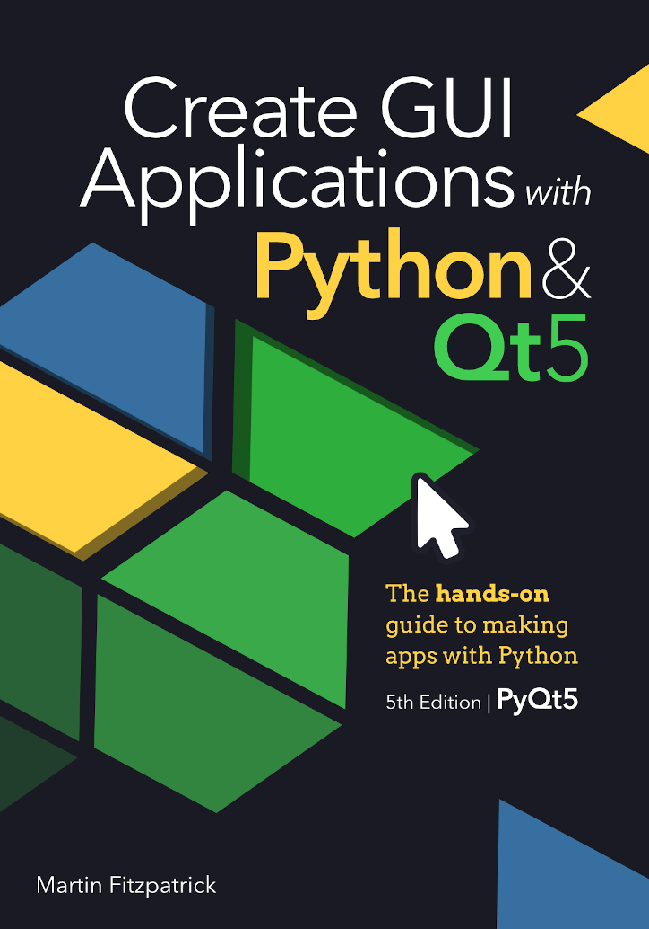
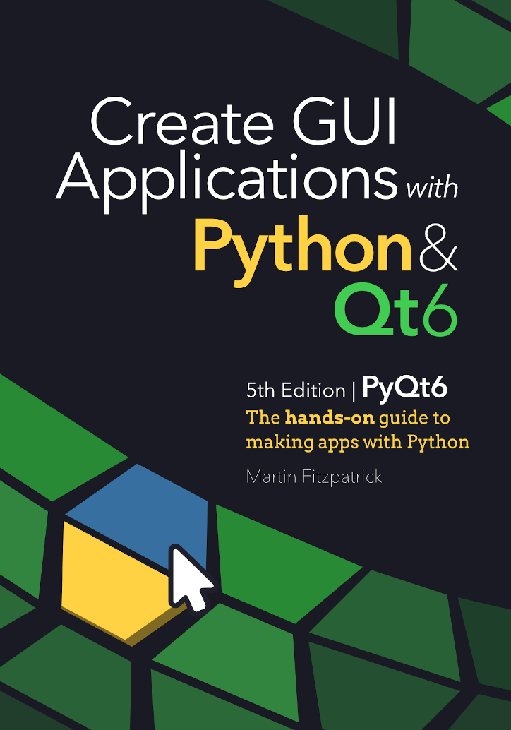
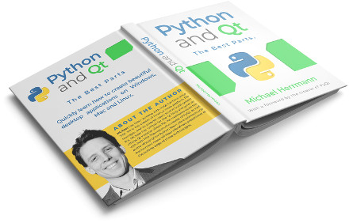

https://www.pythonguis.com/
https://github.com/pyqt/examples
https://realpython.com/qt-designer-python/

