Slide 1

pyQt6

Slide 2
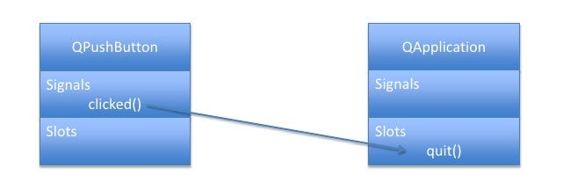
Signals & Slots
Signals are notifications emitted by widgets when something happens.
Slots is the name Qt uses for the receivers of signals.

Slide 3



Slide 4
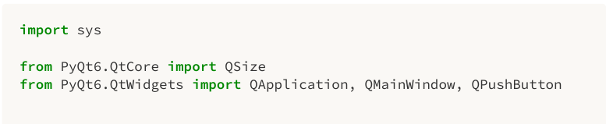
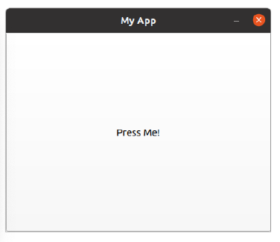
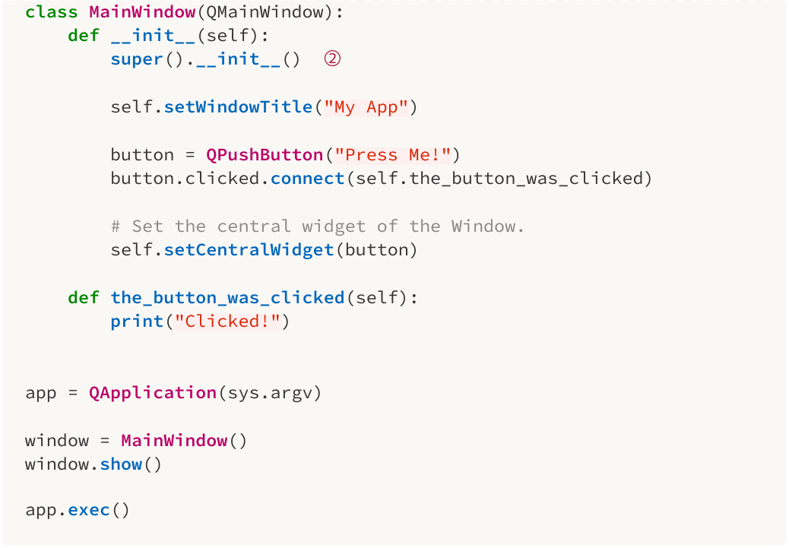
Sample
Clicked!
Clicked!
Clicked!

Slide 5
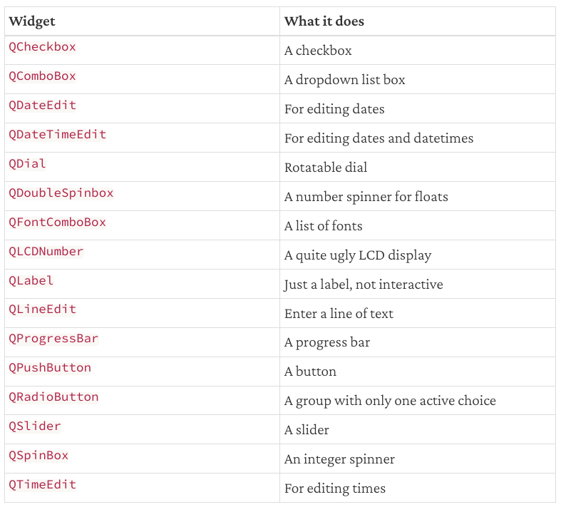
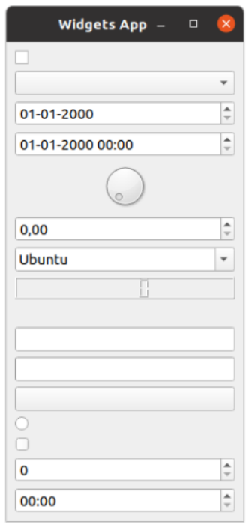
Widgets
https://doc.qt.io/qt-6/qtwidgets-module.html

Slide 6

Layouts

Slide 7

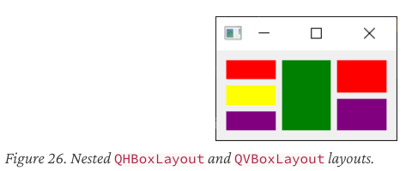

Slide 8
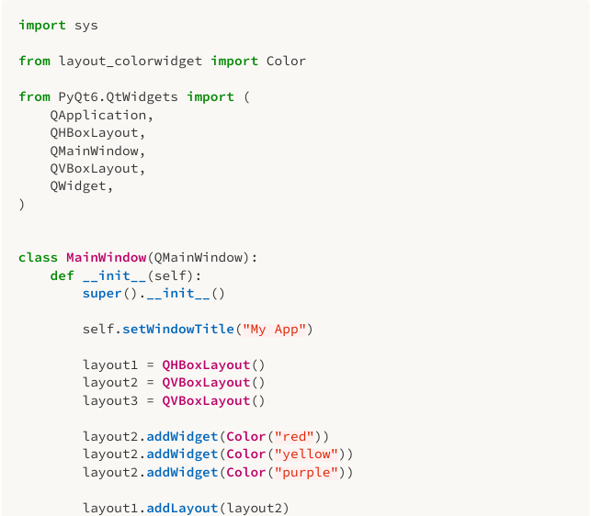
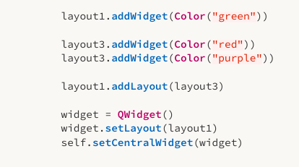
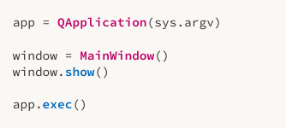

Slide 9
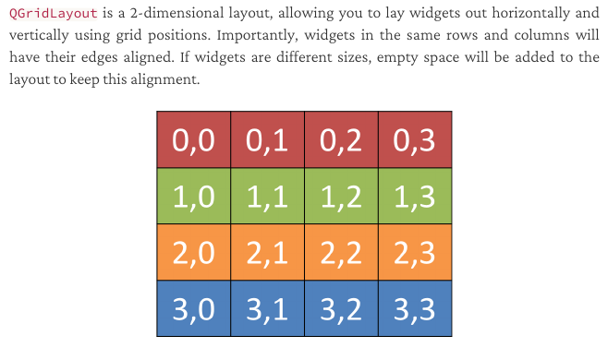

Slide 10

