Slide 1
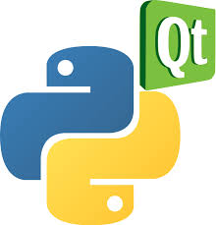
pyQt5

Slide 2
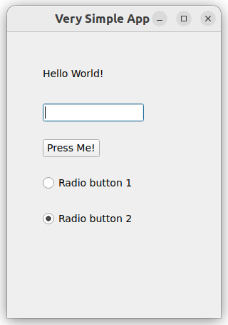
## Very Simple App
from PyQt5.QtWidgets import *
app = QApplication([])
window = QWidget()
window.setGeometry(100,100,300,400) #x, y, width, height
window.setWindowTitle("Very Simple App")
window.show()
label = QLabel(window)
label.setText("Hello World!")
label.move(50,50)
label.show()
lineEdit = QLineEdit(window)
lineEdit.move(50,100)
lineEdit.show()
button = QPushButton(window)
button.setText("Press Me!")
button.move(50,150)
button.show()
radioButton1 = QRadioButton("Radio button 1", window)
radioButton1.move(50,200)
radioButton1.show()
radioButton2 = QRadioButton("Radio button 2", window)
radioButton2.move(50,250)
radioButton2.setChecked(True)
radioButton2.show()
app.exec()

Slide 3
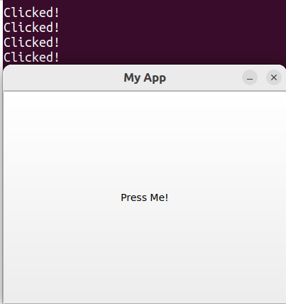
import sys
from PyQt5.QtCore import QSize, Qt
from PyQt5.QtWidgets import (
QApplication,
QMainWindow,
QPushButton,
)
class MainWindow(QMainWindow):
def __init__(self):
super().__init__()
self.setWindowTitle("My App")
self.setFixedSize(QSize(400, 300))
button = QPushButton("Press Me!")
button.setCheckable(True)
button.clicked.connect(self.the_button_was_clicked)
# Set the central widget of the Window.
self.setCentralWidget(button)
#Action slot
def the_button_was_clicked(self):
print("Clicked!")
app = QApplication(sys.argv)
window = MainWindow()
window.show()
app.exec()

Slide 4
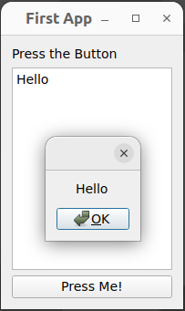
## Simple App with Layouts
from PyQt5.QtWidgets import *
from PyQt5.QtGui import QFont
def main():
app = QApplication([])
window = QWidget()
window.setGeometry(100,100,200,300) #x, y, width, height
window.setWindowTitle("First App")
#---------------------
layout = QVBoxLayout() #vertical layout
label = QLabel("Press the Button")
textbox = QTextEdit()
button = QPushButton("Press Me!")
#button.clicked.connect(on_clicked) #linked with simple on_clicked
button.clicked.connect(lambda: on_clicked(textbox.toPlainText()))
layout.addWidget(label)
#or layout.addWidget(QLabel("Press the Button"))
layout.addWidget(textbox)
layout.addWidget(button)
window.setLayout(layout)
#----------------------
window.show()
app.exec()
# simple output
#def on_clicked():
# print("Hello World!")
# or
# message = QMessageBox()
# message.setText("Hello World!")
# message.exec()
# output textbox content
def on_clicked(msg):
message = QMessageBox()
message.setText(msg)
message.exec()
if __name__ == "__main__":
main()

Slide 5
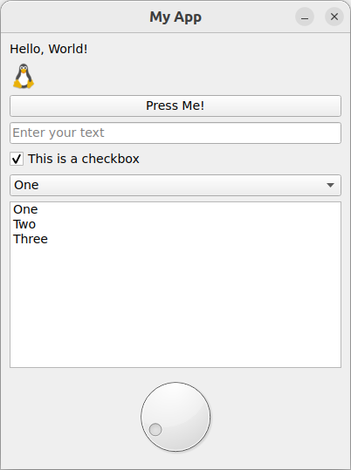
#Basic app with Widgets
import sys
from PyQt5.QtCore import QSize, Qt
from PyQt5.QtGui import QPixmap
from PyQt5.QtWidgets import *
class MainWindow(QMainWindow):
def __init__(self):
super().__init__()
self.setWindowTitle("My App")
self.setFixedSize(QSize(400, 500))
layout = QVBoxLayout()
label = QLabel("Hello, World!")
img = QLabel("tux")
img.setPixmap(QPixmap("tux.png"))
button = QPushButton("Press Me!")
button.clicked.connect(self.the_button_was_clicked)
lineedit = QLineEdit()
lineedit.setMaxLength(10)
lineedit.setPlaceholderText("Enter your text")
checkbox = QCheckBox("This is a checkbox")
checkbox.setCheckState(Qt.CheckState.Checked)
combobox = QComboBox()
combobox.addItems(["One", "Two", "Three"])
listwidget = QListWidget()
listwidget.addItems(["One", "Two", "Three"])
dial = QDial()
dial.setRange(-10, 100)
dial.setSingleStep(1)
layout.addWidget(label)
layout.addWidget(img)
layout.addWidget(button)
layout.addWidget(lineedit)
layout.addWidget(checkbox)
layout.addWidget(combobox)
layout.addWidget(listwidget)
layout.addWidget(dial)
widget = QWidget()
widget.setLayout(layout)
self.setCentralWidget(widget)
def the_button_was_clicked(self):
print("Clicked!")
app = QApplication(sys.argv)
window = MainWindow()
window.show()
app.exec()

