Slide 1

pyQt

Slide 2
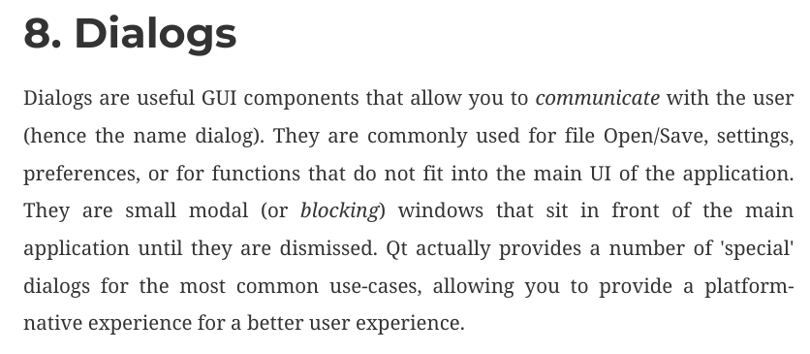
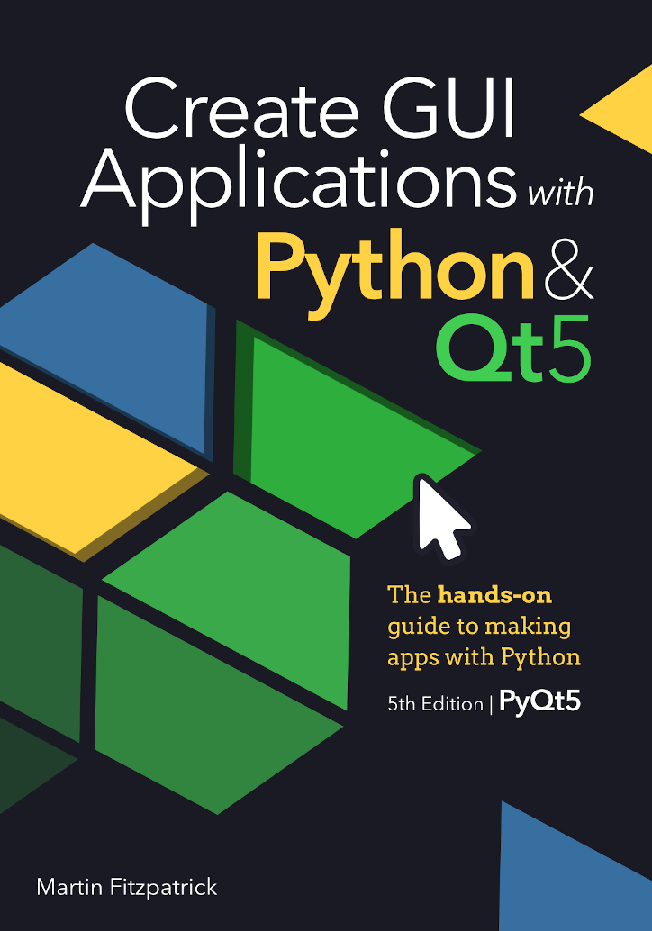
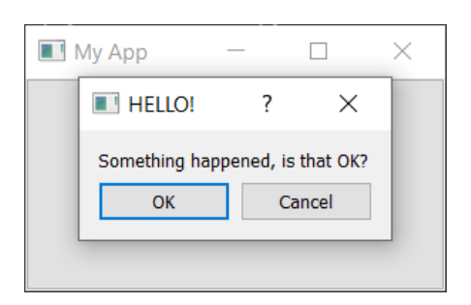

Slide 3
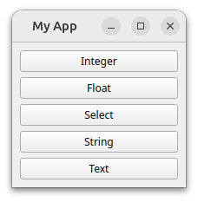
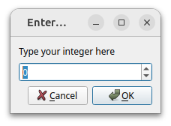
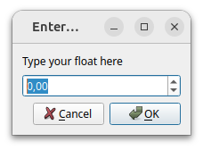
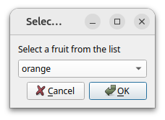
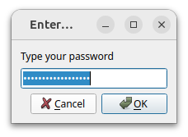
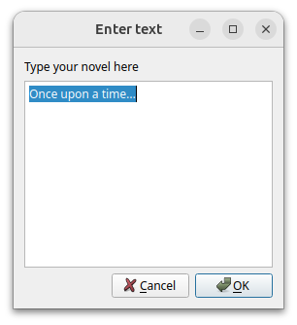
import sys
from PyQt5.QtWidgets import (
QApplication,
QInputDialog,
QLineEdit,
QMainWindow,
QPushButton,
QVBoxLayout,
QWidget, )
class MainWindow(QMainWindow):
def __init__(self):
super().__init__()
self.setWindowTitle("My App")
layout = QVBoxLayout()
button1 = QPushButton("Integer")
button1.clicked.connect(self.get_an_int)
layout.addWidget(button1)
button2 = QPushButton("Float")
button2.clicked.connect(self.get_a_float)
layout.addWidget(button2)
button3 = QPushButton("Select")
button3.clicked.connect(self.get_a_str_from_a_list)
layout.addWidget(button3)
button4 = QPushButton("String")
button4.clicked.connect(self.get_a_str)
layout.addWidget(button4)
button5 = QPushButton("Text")
button5.clicked.connect(self.get_text)
layout.addWidget(button5)
container = QWidget()
container.setLayout(layout)
self.setCentralWidget(container)
def get_an_int(self):
title = "Enter an integer"
label = "Type your integer here"
my_int_value, ok = QInputDialog.getInt(
self, title, label, value=0, min=-5, max=5, step=1 )
print("Result:", ok, my_int_value)
def get_a_float(self):
title = "Enter a float"
label = "Type your float here"
my_float_value, ok = QInputDialog.getDouble(
self, title, label, value=0, min=-5.3, max=5.7, decimals=2, )
print("Result:", ok, my_float_value)
def get_a_str_from_a_list(self):
title = "Select a string"
label = "Select a fruit from the list"
items = ["apple", "pear", "orange", "grape"]
initial_selection = 2
# orange, indexed from 0
my_selected_str, ok = QInputDialog.getItem(
self, title, label, items, current=initial_selection, editable=False, )
print("Result:", ok, my_selected_str)
def get_a_str(self):
title = "Enter a string"
label = "Type your password"
text = "my secret password"
mode = QLineEdit.EchoMode.Password
my_selected_str, ok = QInputDialog.getText(
self, title, label, mode, text )
print("Result:", ok, my_selected_str)
def get_text(self):
title = "Enter text"
label = "Type your novel here"
text = "Once upon a time..."
my_selected_str, ok = QInputDialog.getMultiLineText(
self, title, label, text )
print("Result:", ok, my_selected_str)
app = QApplication(sys.argv)
window = MainWindow()
window.show()
app.exec()

Slide 4
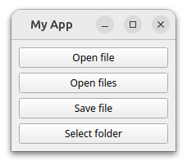
import sys
from PyQt5.QtWidgets import (
QApplication,
QFileDialog,
QMainWindow,
QPushButton,
QVBoxLayout,
QWidget, )
FILE_FILTERS = [
"Portable Network Graphics files (*.png)",
"Text files (*.txt)",
"Comma Separated Values (*.csv)",
"All files (*)", ]
class MainWindow(QMainWindow):
def __init__(self):
super().__init__()
self.setWindowTitle("My App")
layout = QVBoxLayout()
button1 = QPushButton("Open file")
button1.clicked.connect(self.get_filename)
layout.addWidget(button1)
button2 = QPushButton("Open files")
button2.clicked.connect(self.get_filenames)
layout.addWidget(button2)
button3 = QPushButton("Save file")
button3.clicked.connect(self.get_save_filename)
layout.addWidget(button3)
button4 = QPushButton("Select folder")
button4.clicked.connect(self.get_folder)
layout.addWidget(button4)
container = QWidget()
container.setLayout(layout)
self.setCentralWidget(container)
def get_filename(self):
caption = "" # Empty uses default caption.
initial_dir = "" # Empty uses current folder.
initial_filter = FILE_FILTERS[3] # Select one from the list.
filters = ";;".join(FILE_FILTERS)
print("Filters are:", filters)
print("Initial filter:", initial_filter)
filename, selected_filter = QFileDialog.getOpenFileName(
self,
caption=caption,
directory=initial_dir,
filter=filters,
initialFilter=initial_filter, )
print("Result:", filename, selected_filter)
def get_filenames(self):
caption = "" # Empty uses default caption.
initial_dir = "" # Empty uses current folder.
initial_filter = FILE_FILTERS[1] # Select one from the list.
filters = ";;".join(FILE_FILTERS)
print("Filters are:", filters)
print("Initial filter:", initial_filter)
filenames, selected_filter = QFileDialog.getOpenFileNames(
self,
caption=caption,
directory=initial_dir,
filter=filters,
initialFilter=initial_filter, )
print("Result:", filenames, selected_filter)
def get_save_filename(self):
caption = "" # Empty uses default caption.
initial_dir = "" # Empty uses current folder.
initial_filter = FILE_FILTERS[2] # Select one from the list.
filters = ";;".join(FILE_FILTERS)
print("Filters are:", filters)
print("Initial filter:", initial_filter)
filename, selected_filter = QFileDialog.getSaveFileName(
self,
caption=caption,
directory=initial_dir,
filter=filters,
initialFilter=initial_filter, )
print("Result:", filename, selected_filter)
def get_folder(self):
caption = "Select folder"
initial_dir = "" # Empty uses current folder.
folder_path = QFileDialog.getExistingDirectory(
self,
caption="",
directory="")
print("Result:", folder_path)
app = QApplication(sys.argv)
window = MainWindow()
window.show()
app.exec()

