Slide 1
ELECTRICAL CIRCUIT SIMULATOR
Group 11

Slide 2
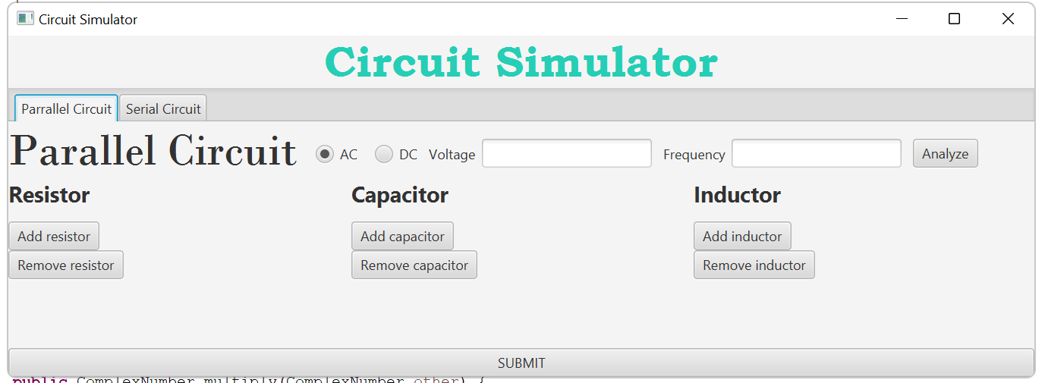
Problem description
This simulator will demonstrate two types of circuits: parallel circuit and serial circuit.
To pick a type of circuit, the user can choose one or two tabs in the navigation bar. Then, the user can start to construct a circuit, add the needed elements and press submit when they are done.
After the user press submit, the application will draw the circuit diagram, output the circuit analysis results in a table, and calculate the equivalent resistance.

Slide 3
Members & Tasks
Full name | Student ID | Task | Percentage
Lê Trung Kiên | 20210926 |  | 40%
Đỗ Đình Kiên | 20214906 |  | 20%
Luyện Minh Khánh | 20210940 |  | 20%
Vũ Đức Hùng | 20215198 |  | 20%

Slide 4
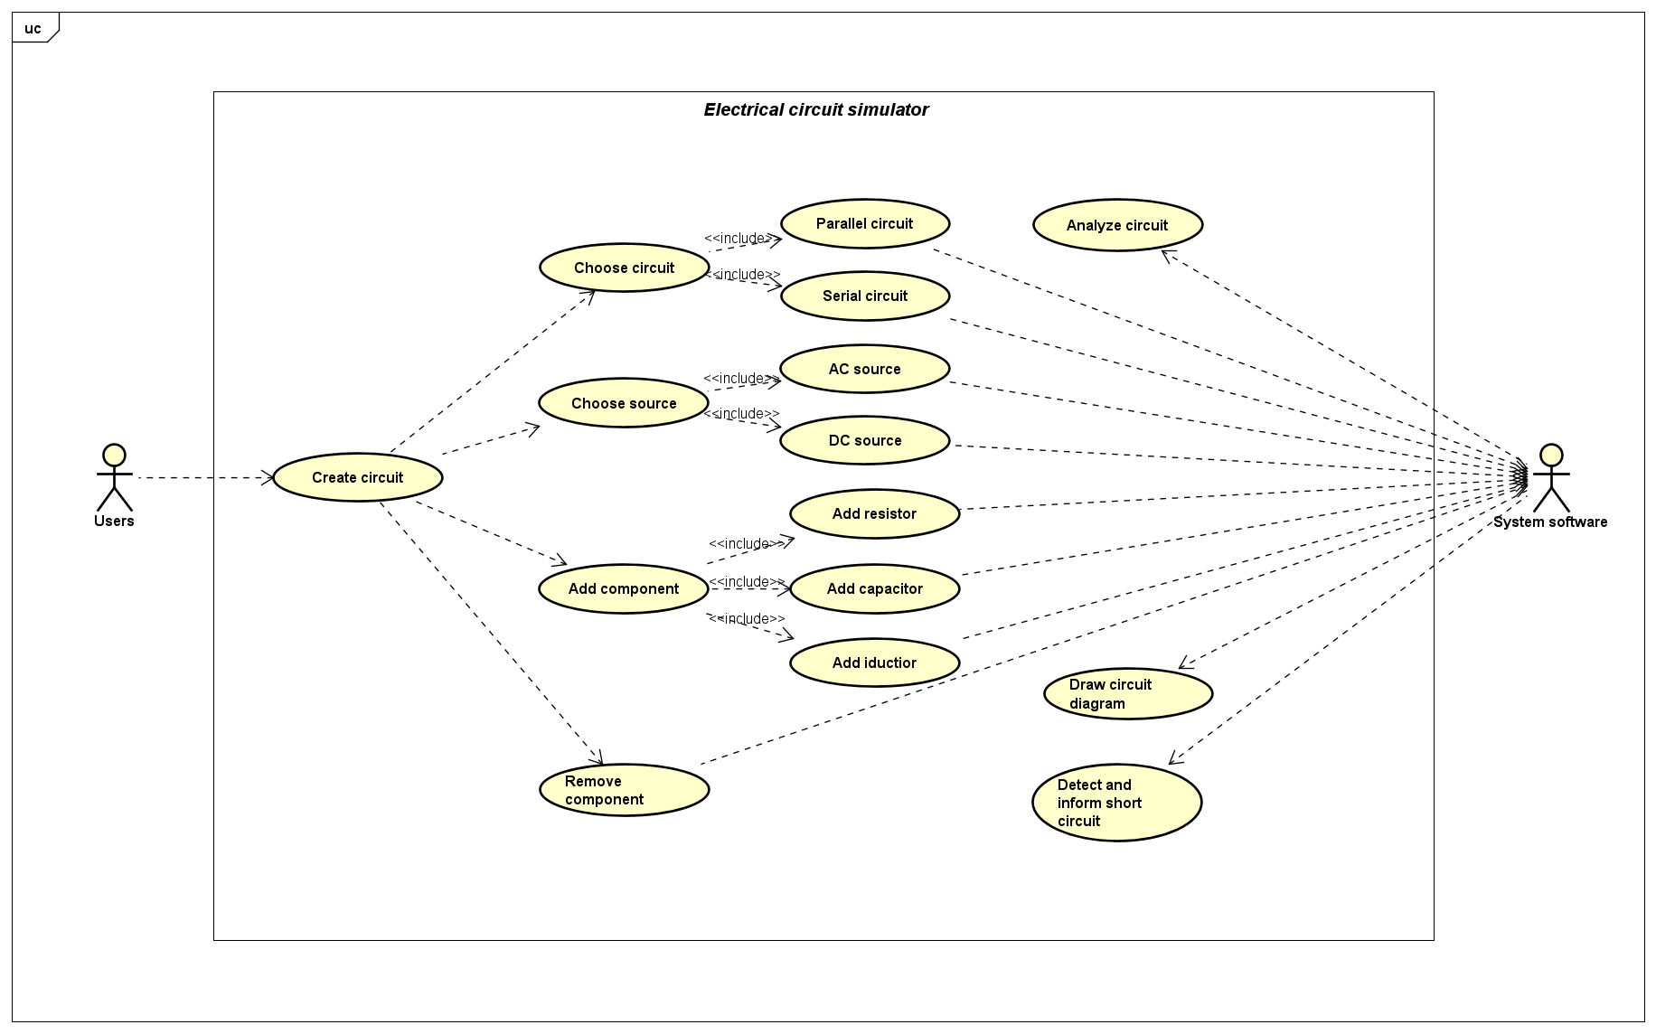
Use case diagram

Slide 5
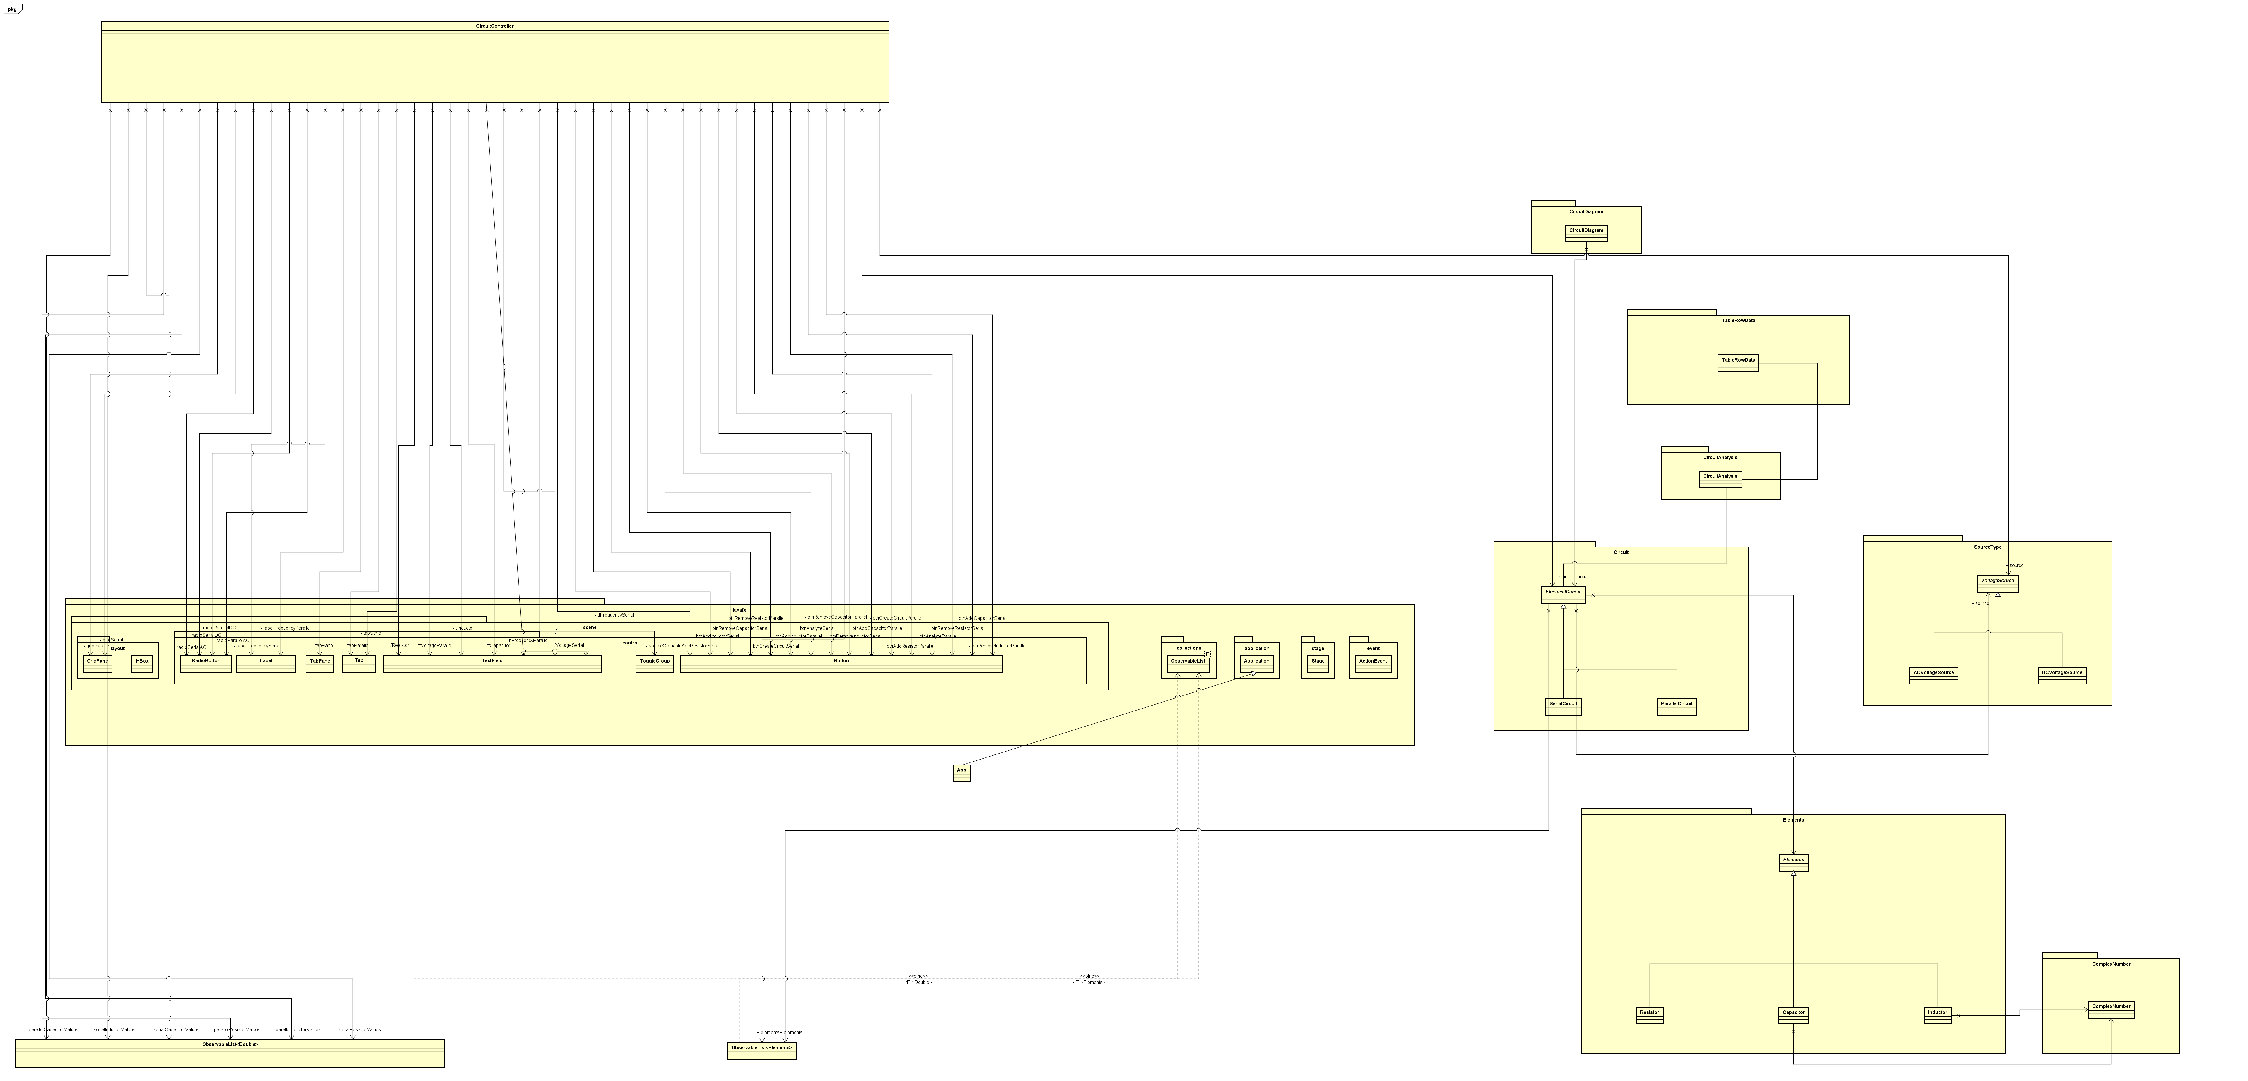
General class diagram

Slide 6
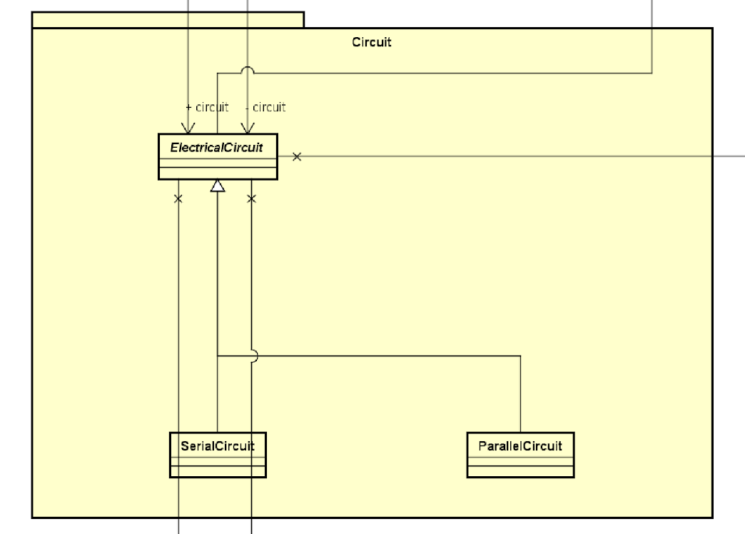
Class diagram
Circuit package:
The two classes ParallelCircuit.java and SerialCircuit.java extend the class ElectricalCircuit.java. They also import the classes Elements.java and VoltageSource.java to compute equivalent resistance and other values for each element and source case.

Slide 7
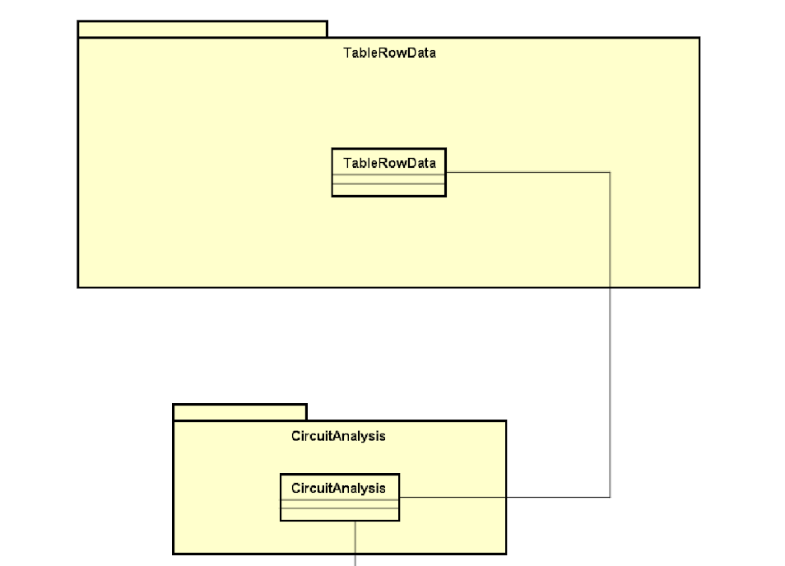
Class diagram
CircuitAnalysis.java and TableRow.java:
The class TableRow.java is imported to create the analysis table. Then the class CircuitAnalysis.java will add the electrical value and then show the table to users.

Slide 8
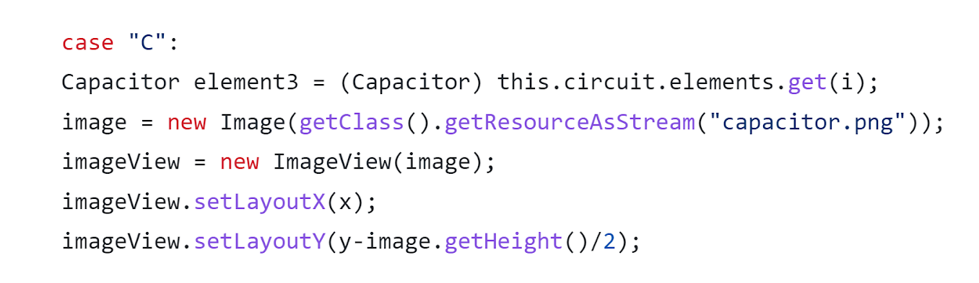
Class diagram
CircuitDiagram.java:
This is the method to draw the corresponding circuit diagram and show it to users.
The below code creates an ImageView object to display the image of a capacitor. The Image object is created with the path to the image capacitor.png as the argument. The ImageView object is then positioned on the Pane object using the setLayoutX() and setLayoutY() methods.

Slide 9
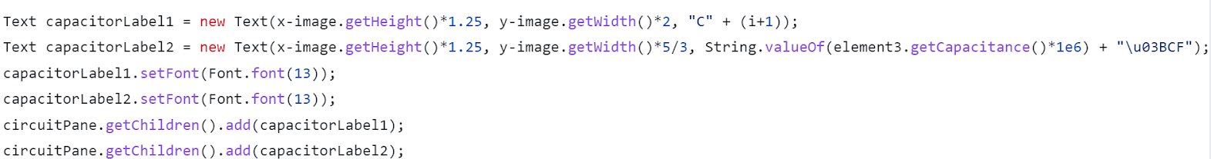
Class diagram
CircuitDiagram.java:
After that we create a Text object to display the name and value of the resistor. The Text object is created with the capacitor's name and value as the arguments. The similar method is applied for the inductor and resistor.

Slide 10
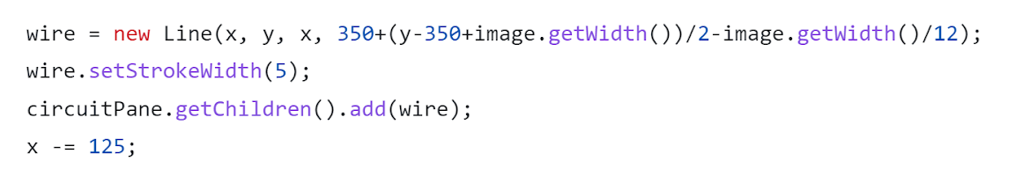
Class diagram
CircuitDiagram.java:
For wire, we create a Line object to represent the connection between the two elements. The Line object is created with the start and end points of the line as the arguments. It is then given a 5-pixel stroke width and added to the Pane object.

Slide 11
Class diagram
Elements packages: The three classes Capacitor.java, Inductor.java, Resistor.java extend the class Elements.java.
The classes Capacitor.java and Inductor.java also import the ComplexNumber.java so that their resistance values can be represented in complex number form.

Slide 12
Class diagram
SourceType:
The two classes ACVoltageSource.java and DCVoltageSource.java extends the class VoltageSource.java

Slide 13
OOP Techniques
Inheritance

Slide 14
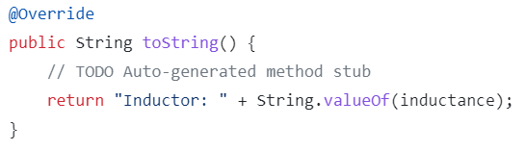
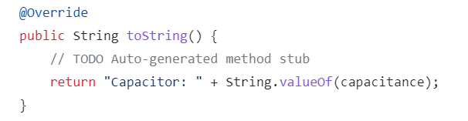
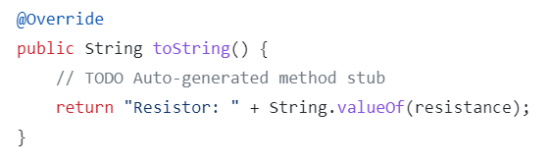
OOP Techniques
Polymorphism
(toString() method)
The three classes Capacitor.java, Inductor.java, Resistor.java are the subclasses of the abstract class Elements.java.
Here is the toString() methods of each class which overriding the method inherited from the parent class.

Slide 15
OOP Techniques
Association
The class CircuitAnalysis is associated with the class Circuit.
The class Capacitor and Inductor is associated with the class ComplexNumber.

Slide 16
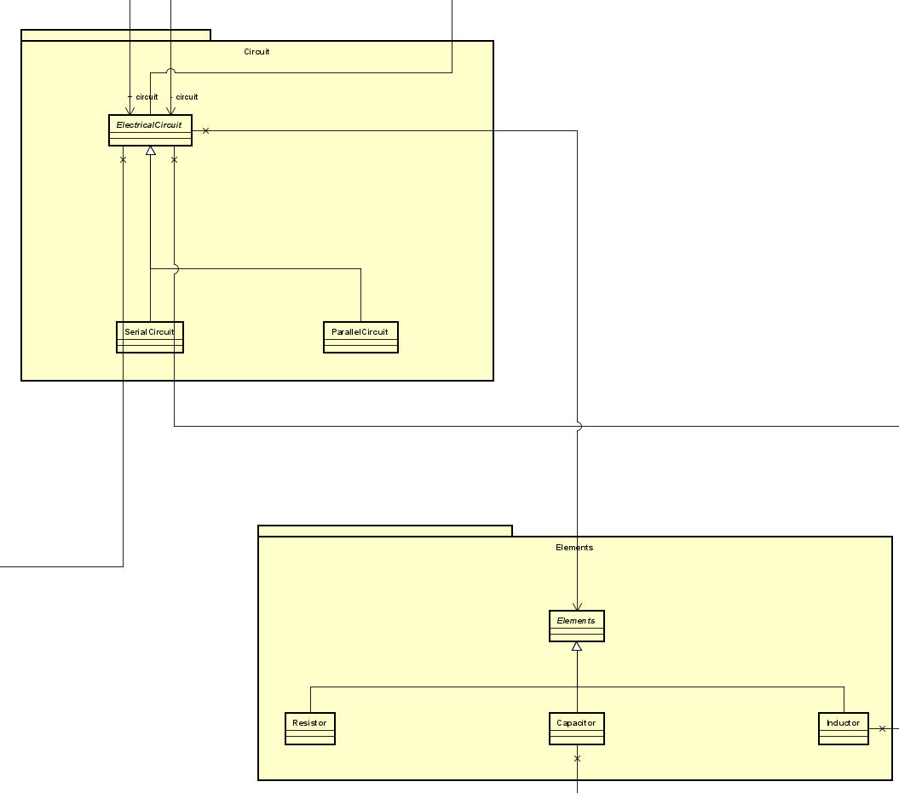
OOP Techniques
Aggregation

Slide 17
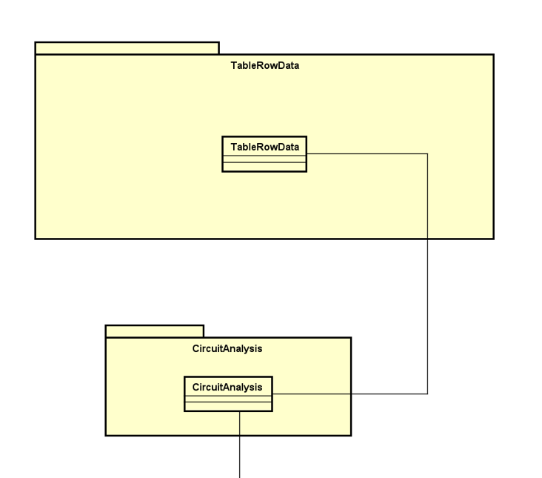
OOP Techniques
Composition

Slide 18
Demo
Video demo

