Slide 2

Agentic Question Answering System for HUST Documents and Lecturers
Name: Le Trung Kien
Student ID: 20214907 Supervisor: Dr. Dinh Viet Sang

Slide 3
Table of Content
Motivation
Objectives
Methodology
Experimental Setup and Results
Conclusions

Slide 4

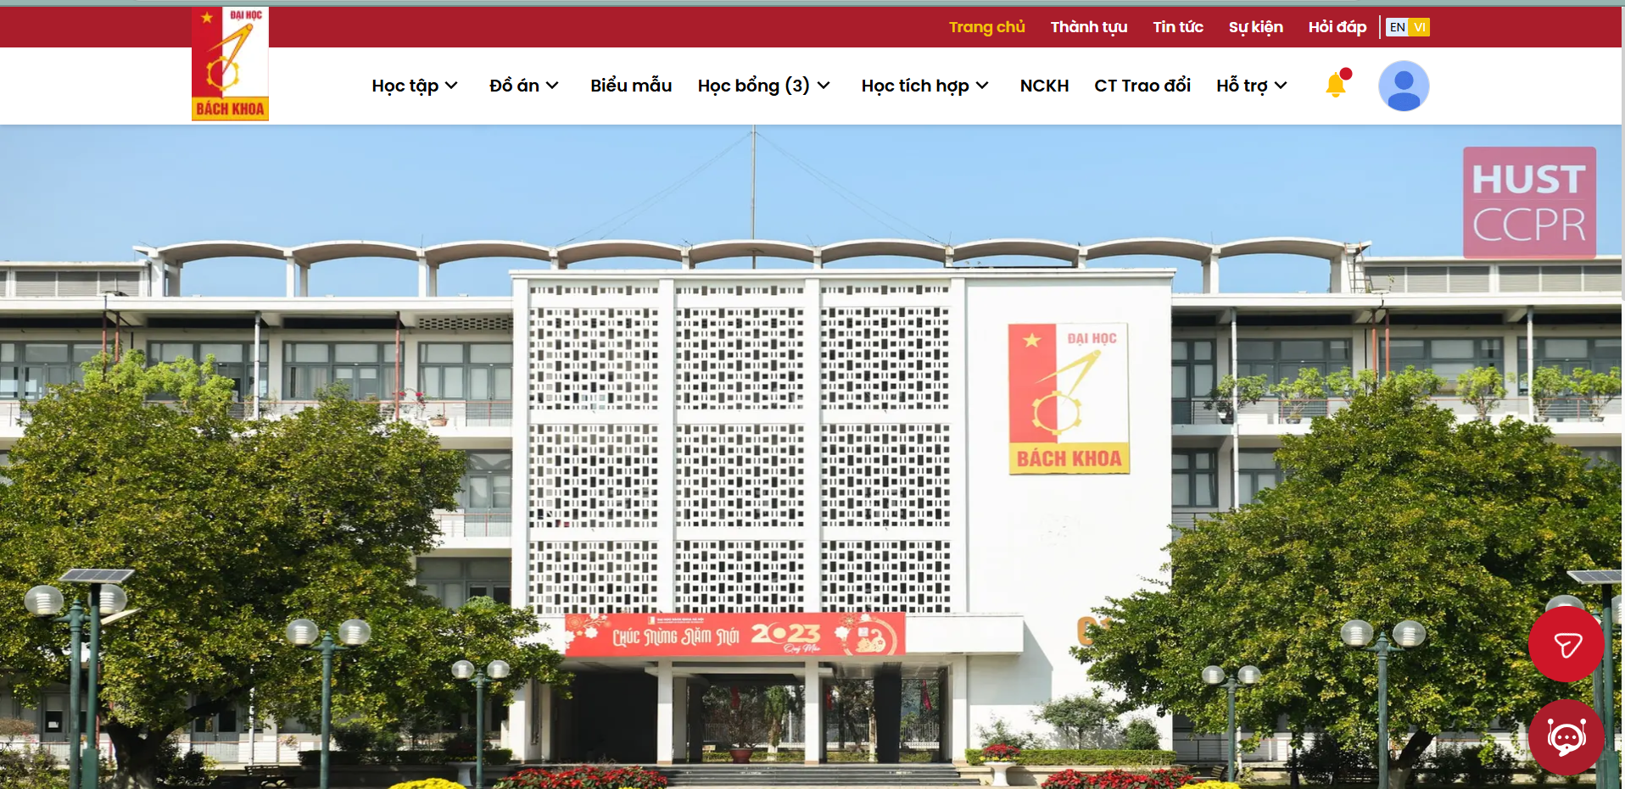
1. Motivation
HUST students + prospectives needs of information is huge.
Admission, scholarships, personnels information,…
Current portals such as CTT, QLDT,… are hard to navigate/unvailable to non-HUSTers
CTT + QLDT Portals

Slide 5
1. Motivation
HUST students + prospectives needs of information is huge.
Admission, scholarships, personnels information,…
Current portals such as CTT, QLDT,… are hard to navigate/unvailable to non-HUSTers

Slide 6
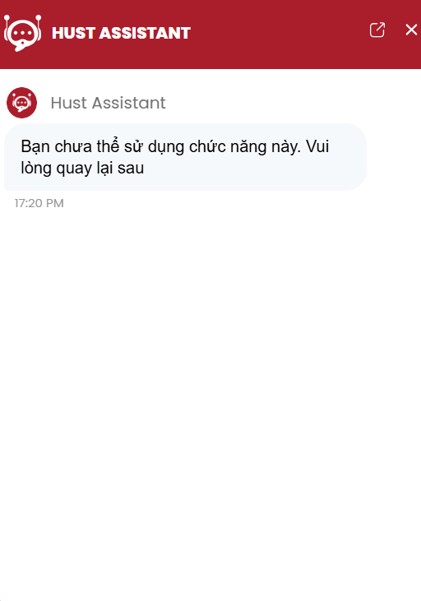
1. Motivation
Solutions like HUST Assistant (on QLDT)
do not covers enough information
not accessible for prospective HUS.T admission
HUST Assistant (taken on 19/06 5:20pm)

Slide 7
2. Objectives
Information ambiguity, hard to access and scattered
A centralized, easy-to-use system to answer questions about HUST documents, personnel
Many types of information, update regularly
→ Agentic system based on LLM for flexibility, adaptability

Slide 8
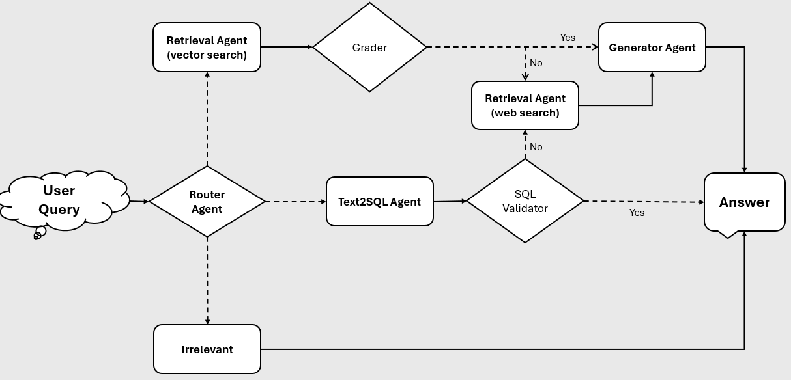
3. Methodology
Overall Architecture

Slide 9
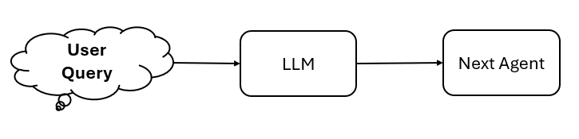
3. Methodology
Router
Decides which agent/flow to use
LLM for flexibility and scalability (adding new agent)
University advices, regulations →RAG Flow
Personnel → Text2SQL Agent
Irrelevant → Answer immediately

Slide 10
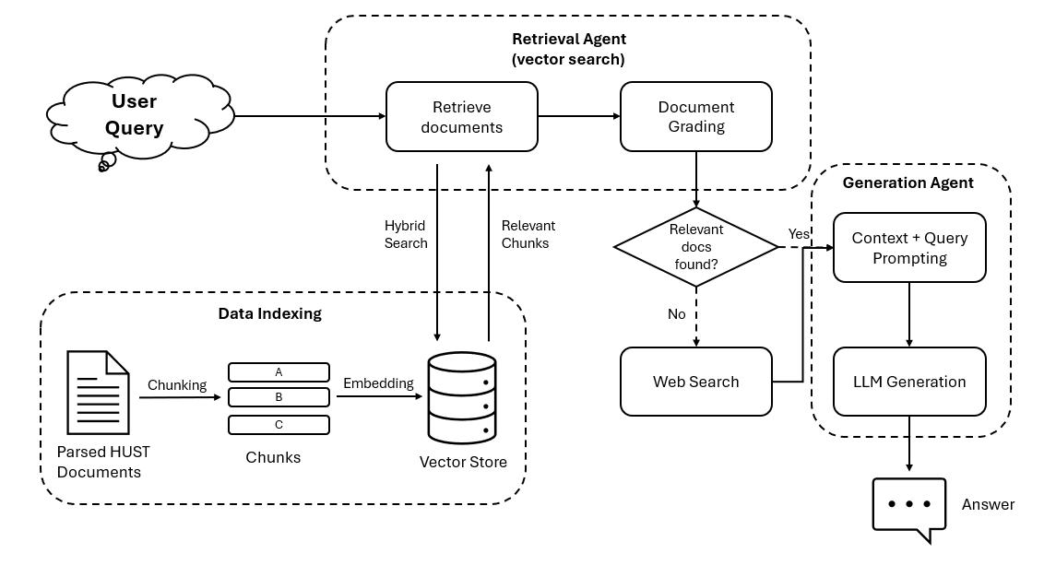
3. Methodology
RAG Pipeline
Handles questions about documents such as education regulations, scholarships regulations,…
Dynamically switch to web search for unvailable data.

Slide 11
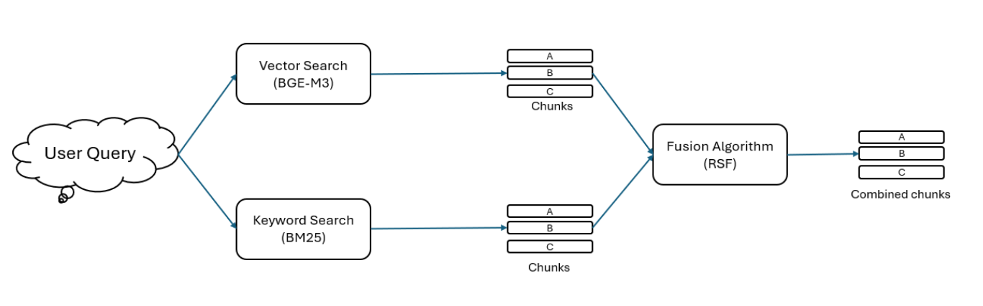
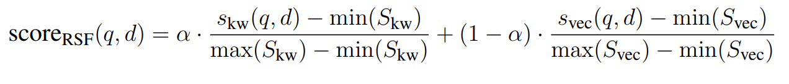
3. Methodology
Retrieval Agent (vector search)
Retrieve relevant chunks using hybrid search.
Grade documents (LLM) to filter irrelevant documents.
No documents → Web Search Agent (discussed later).
Relevant → Generation Agent (discussed later).

Slide 12
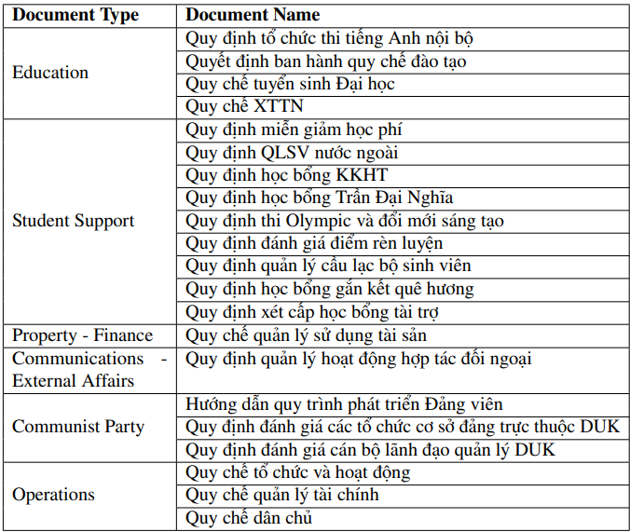
3. Methodology
HUST documents
21 PDFs covering multiple regulations
Only text + tabular data. Can be scanned images.
Used HUST documents

Slide 13
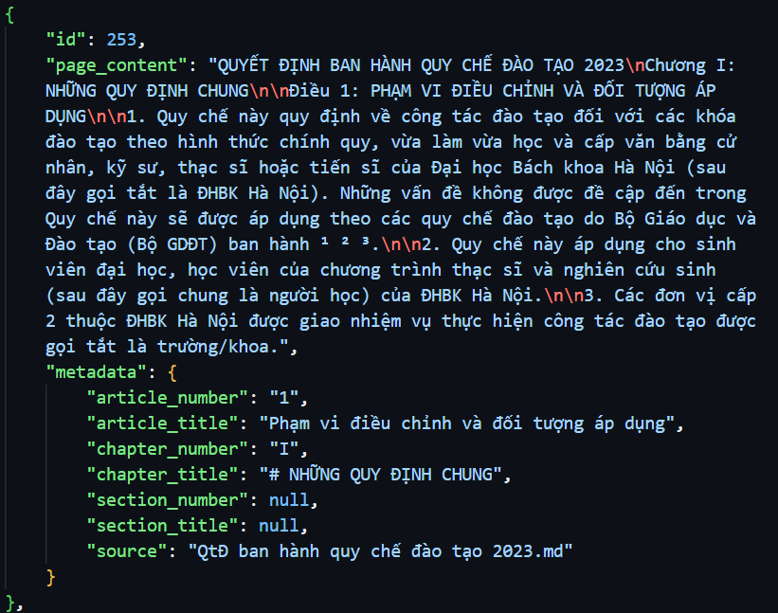
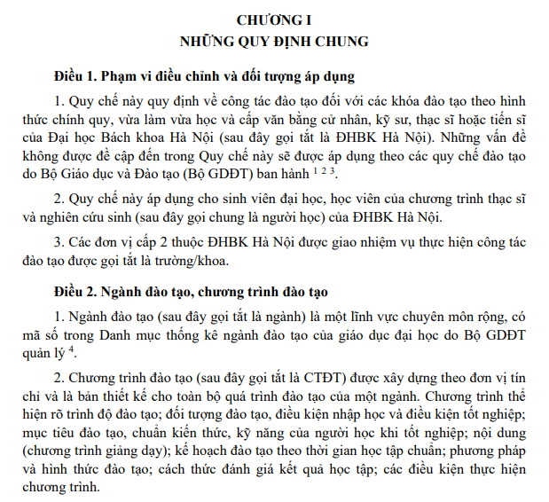
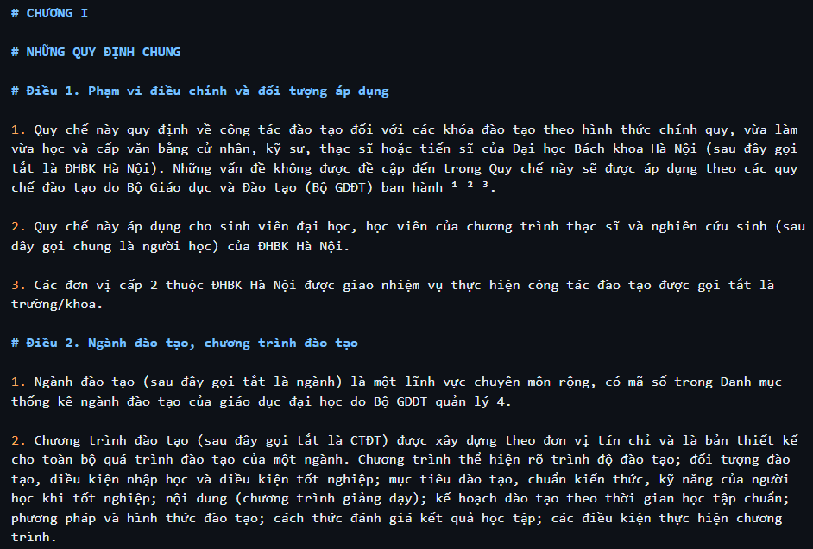
3. Methodology
HUST documents
Parsed into Markdown using LlamaParse
Structured chunking using Regex
Chunking
LlamaParse

Slide 14
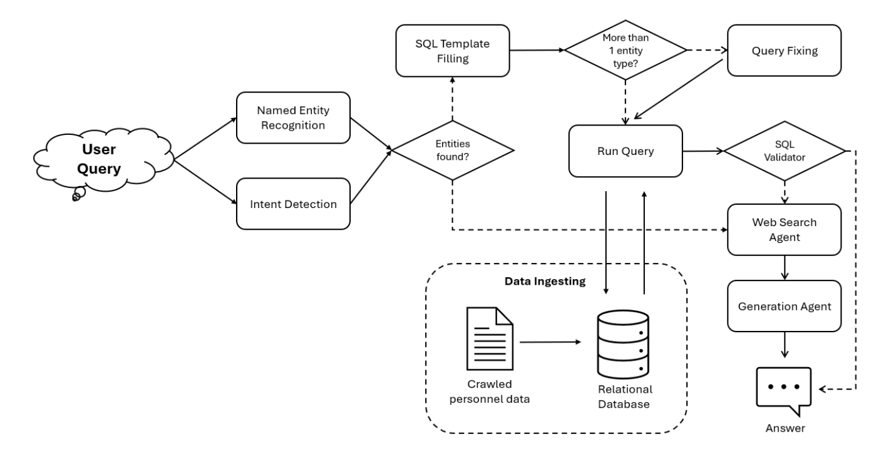
3. Methodology
Text2SQL Agent
Handels queries relating personnel information.
Switch to web search for unvailable data.

Slide 15
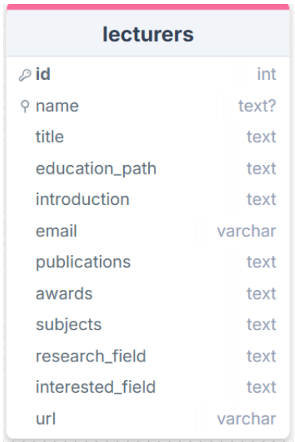
3. Methodology
Text2SQL Agent
Data crawled from SoICT website, all data are text.
Data is normalized → concatenate to add into 1 table.

Slide 16
3. Methodology
Text2SQL Agent
NER: detects entities in questions.
Input: Có những ai tên Linh dạy môn Khoa học dữ liệu?
Output: {name: ’Linh’, subject: ’Khoa học dữ liệu’}.
Intent detection: what information (columns) the user needs.
Both uses LLM.

Slide 17

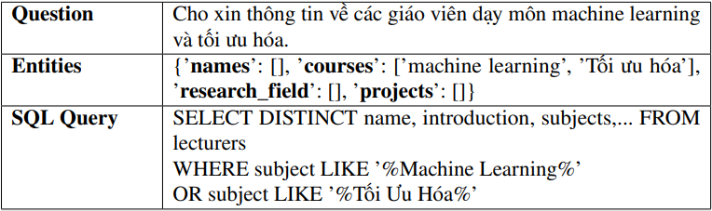
3. Methodology
Text2SQL Agent
Entities and intent (information) is used to fill a template.
Entities are grouped together with OR clause and combined with AND clause.
Use partial string matching since most columns are text.

Slide 18
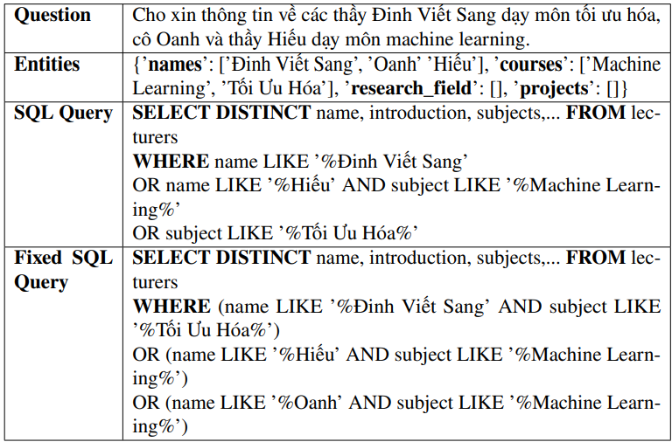
3. Methodology
Text2SQL Agent
Template filling
handles most of the simple questions.
Fails more complex questions.
Query Fixer
Query Fixer fixes queries with more than 1 conditions
Uses an LLM.

Slide 19
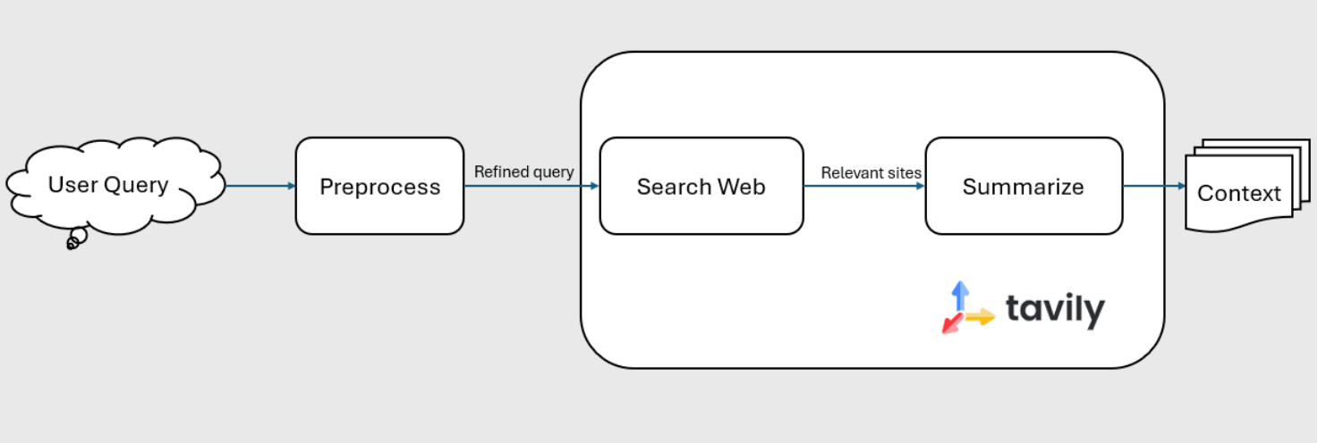
3. Methodology
Retrieval Agent (Web Search)
Retrieve context when
RAG Flow has no relevant document.
Text2SQL Agent returns no output.
Preprocess the queries → Search web → Summarize using an LLM → Context.

Slide 20
3. Methodology
Generation Agent
Generate the answer based on context.
Documents/Web data:
LLM call based on context.
Include metadata.
Personnel data:
Return a template answer to save cost.

Slide 21
4. Experiment Setup and Results
RAGAS
Framework for evaluating LLM-based systems.
Includes a wide range of pre-defined metrics for evaluating LLM-based systems.
ranging from RAG, Text2SQL, to Agentic systems.
Each module (RAG, Text2SQL, Router) is evaluated independently.

Slide 22
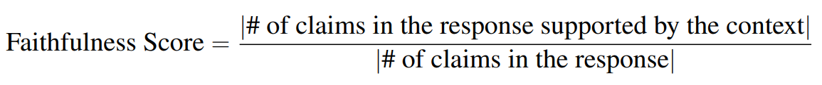
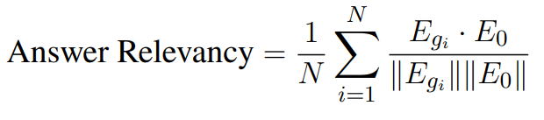
4. Experiment Setup and Results
RAG Metrics
Faithfulness: how factually consistent a response is with the retrieved context.
Response Relevancy: how relevant a response is to the user input (question).

Slide 23
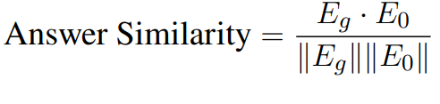
4. Experiment Setup and Results
RAG Metrics
Answer Similarity: measures the semantic resemblance between the generated answer and the ground truth.
Factual Correctness: evaluates the factual accuracy of the generated response with the reference.
Use LLM to break down response + reference → claims.
Determine factual overlap using F1 score.

Slide 24
4. Experiment Setup and Results
Text2SQL Metrics
SQL Query Equivalence:
Evaluate the equivalence of the response query with the reference query.
Requires reference schema.
No need to execute query to evaluate.
Router Metrics
Agent Call Accuracy
Assesses performance in identifying the goals of the users (calling the correct agent).
A classification accuracy metrics.

Slide 25
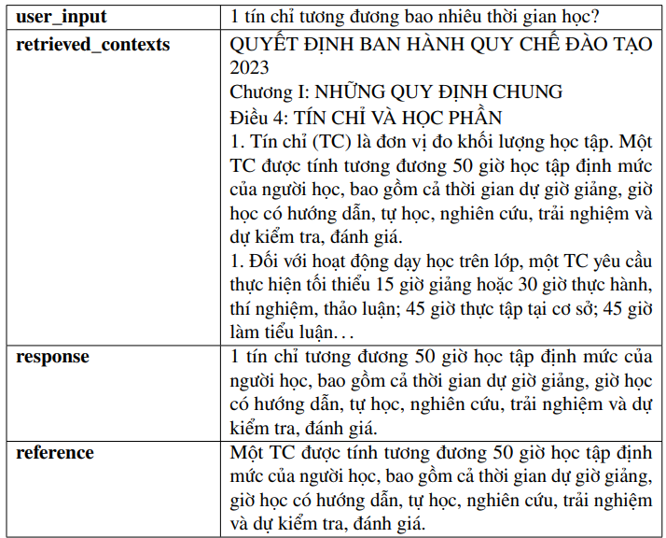
4. Experiment Setup and Results
Evaluation Datasets
RAG Evaluation
Requires: user input, retrieved context, generated response, the ground truth answer.
Created by hand
123 records

Slide 26
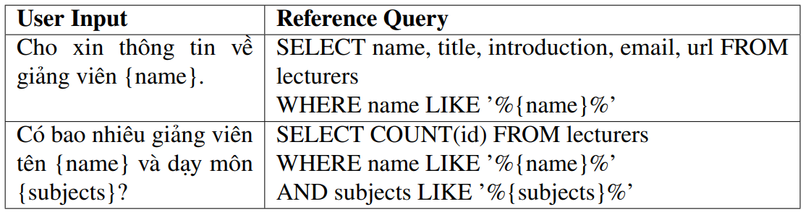
4. Experiment Setup and Results
Evaluation Datasets
Text2SQL Evaluation
Requires: user input; the generated SQL query; the reference query; the schema of the database
Give Gemini 2.5 Pro the schema + some examples → templates
Random sample from the database for the evaluation dataset.
Filter → 140 records.

Slide 27
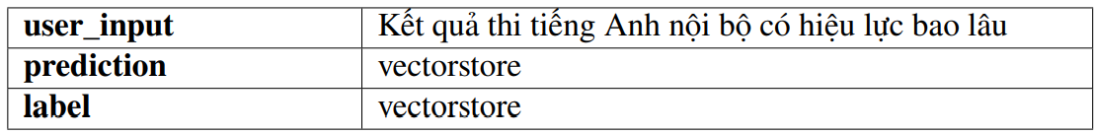
4. Experiment Setup and Results
Evaluation Datasets
Router Evaluation
Requires: user input; predicted agent; label.
Use questions from the other 2 datasets for 2 labels, synthesize random questions for irrelevant label.
200 records

Slide 28
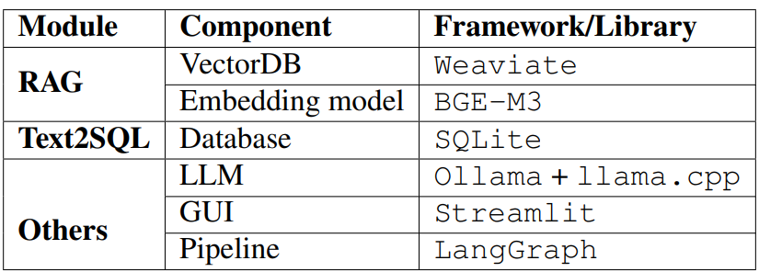
4. Experiment Setup and Results
Evaluation Setup
Test the system with different LLMs (1 LLM for all modules)
Judge LLM: GPT-4o-mini

Slide 29
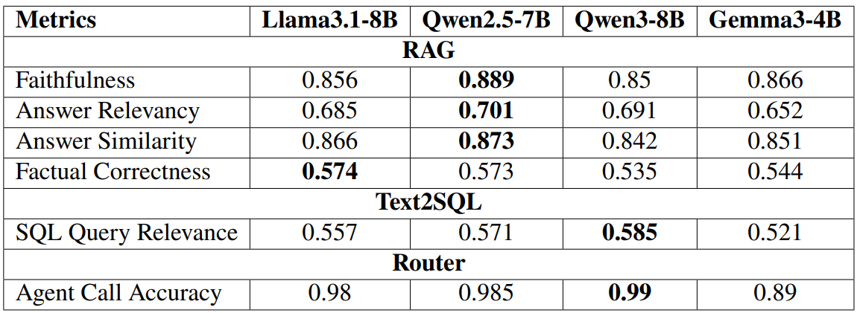
4. Experiment Setup and Results
Evaluation Results
Qwen2.5 achieved the overall highest.
Thinking models struggle with QA.
<7B models struggle heavily.

Slide 30
5. Conclusions
Kết luận
Future works
Planner -> multi-hop
Expand personnel data

Slide 31
THANK YOU !

