Slide 1
Sample
Solutions
Central Europe Regional Contest 2007

Slide 2
B: Billboard

Slide 3
Billboard – Problem
Test all existing subsets
2²⁵⁶ possibilities for the 16x16 board
☹

Slide 4
Billboard – Main Idea
 | x |  | x |  |  |  |  | x
What if we somehow knew the tapped tiles in the first row?

Slide 5
Billboard – Main Idea
 | x |  | x |  |  |  |  | x
We can try what happens with the row
WOW! It is easy to find the second one!

Slide 6
Billboard – Main Idea
 | x |  | x |  |  |  |  | x
 |  |  | x | x
We can try what happens with the row
WOW! It is easy to find the second one!

Slide 7
Billboard – Main Idea
 | x |  | x |  |  |  |  | x
 |  |  | x | x
x | x |  |  | x |  | x
Let’s also do it…
The third row becomes evident
… and so on

Slide 8
Billboard – Solution
Ok, but how to find the first row?
We will try all possibilities!
Approx. 2¹⁶ * 16²

Slide 9
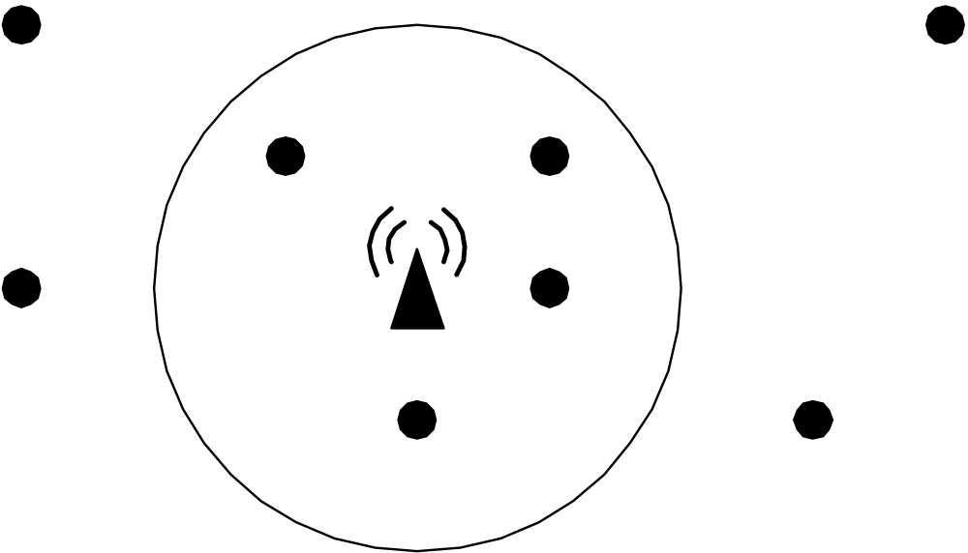
C: Phone Cell

Slide 10
Cell – Problem
Find a circle that covers most points
Center may not be in an existing point
→ Solution will always touch 2 points

Slide 11
Cell – Simple Solution
Take all pairs, find a circle
Then all other points must be tested
→ Time: n³ ☹

Slide 12
Cell –Solution
For each point, use “sweep” technique
Find „interesting angles“ and sort them

Slide 13
Cell –Solution
One sorting for each point
→ Time: n² . log n
Carefully with floating point numbers!

Slide 14
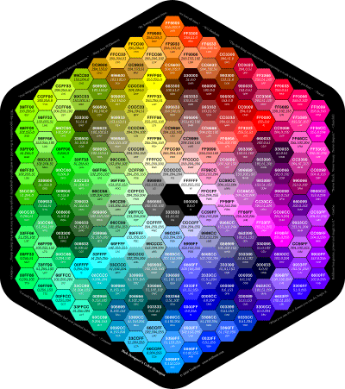
H: Hexagon

Slide 15
Hexagon – Idea
All combinations of 2 green points

Slide 16
Hexagon – Solution
Handle “special” cases

Slide 17
Hexagon –Solution II
Dynamic Programming
For all area subsets (16), find the best solution using each parcel

Slide 18
K: Keys
 |  |  | X |  |  |  | K
 |  |  |  |  |  |  |  |  | K
 | K |  |  | !!!

Slide 19
Keys – Idea
Breadth-First search
Combination of position and keys (!)
4 keys => 16 combinations

Slide 20
Keys – Idea
Position (1,7) + Red Key
  (1,8) + Red/Yellow
  (1,6) + Red
 |  |  |  |  |  | X | K
 |  |  |  |  |  |  |  |  | K
 | K |  |  | !!!

Slide 21
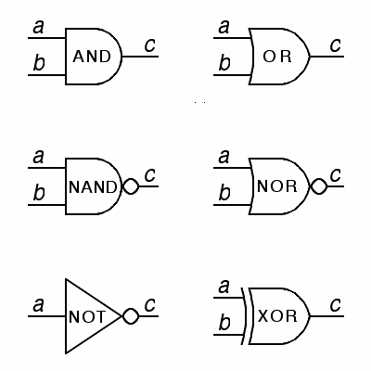
L: Logic

Slide 22
Logic – Problem
Problem? There is no problem
“Only” follow the connections
Compute logical operations

Slide 23
Logic – Potential Pitfalls
Gates with no input
  AND → 1
  OR → 0
  XOR → 0

Slide 24
Logic – Potential Pitfalls
Splitting and joining paths
=> We must remember, what has already been computed
&
&
&
&
&

Slide 25
N: Numbers
10101010100101₋₂ = -10907

Slide 26
Numbers – Solution
TO decimal:
  Use the formula in the problem statement
4257₋₁₀ = -4000 + 200 – 50 + 7 = -3843

Slide 27
Numbers – Solution
FROM decimal:
  Use remainders (modulo)
  Careful with the negative numbers!
4237 mod 10 = 7 -> 423
-423 mod 10 = 7 -> -43
43 mod 10 = 3 -> 4
-4 mod 10 = 6 -> -1
1 mod 10 = 1
-> 16377

Slide 28
P: Polygon

Slide 29
Polygon – Problem
Find the order of polygon vertices

Slide 30
Polygon – Idea
Sort the vertices by their X coordinate
1
2
3
4
5
6
7
8

Slide 31
Polygon – Idea
=> Find their horizontal neighbor
1
2
3
4
5
6
7
8

Slide 32
Polygon – Idea
Sort by Y => vertical neighbor
1
3
5
7
6
4
2
8

Slide 33
Polygon – Solution
Now, each vertex knows its neighbors
Start with the first, and walk around

Slide 34
Polygon – Solution
Count Left / Right turns
Left > Right ? => counter-clockwise
L
L
L
R
R
L
L

Slide 35
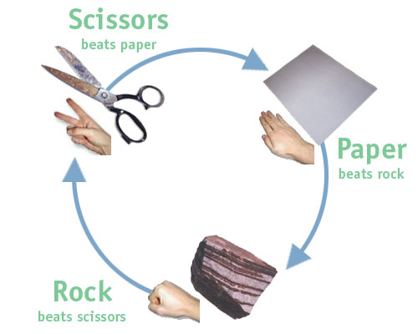
R: Roshambo

Slide 36
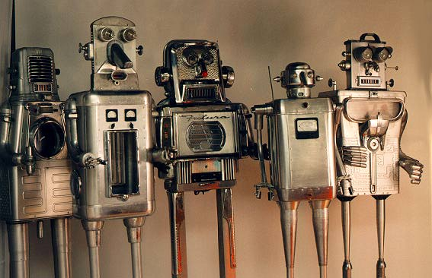
S: Robotic Sort

Slide 37
Sort – Problem
Naive approach – reverse in an array
Little bit better: remember reversed
Quadratic time → 100 000² ☹
3 | 5 | 4 | 7 | 1 | 2 | 8 | 6
1 | 7 | 4 | 5 | 3 | 2 | 8 | 6

Slide 38
Sort – Another Approach
Double-linked list
Problem finding the „forward direction“
3
5
4
7
1
2
8
3
5
4
7
1
2
8

Slide 39
Sort – Solution
Combined solution: use both
Linked list + array of reversed
The array time: O(rev_before)
After SQRT(n) steps: reorder
→ n.SQRT(n) time

Slide 40
Sort – Solution II
Other possibilities - ???
  Heap
  Interval Trees
  … ?

Slide 41
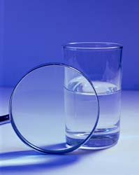
W: Water

Slide 42
Water – Problem
Find the Center of Mass
Amount of water with the lowest center

Slide 43
Water – Idea
Split the glass into horizontal slices
Volume of one slice: π.r².d

Slide 44
Water – Solution
Center of Mass of the glass
Weighted average of all slices

Slide 45
Water – Solution
Add the water “slowly”
Center of water mass

Slide 46
Water – Solution
Combine both centers
(weighted average)

Slide 47
Water – Solution
Water reached the center ? => END!
(Linear time needed only)

Slide 48
Statistics
 | RT | TL | WA | PE | AC
Billboard | 1 | 11 | 8 | 1 | 22
Cell | 5 | 17 | 17 | 1 | 12
Hexagon | 4 | 7 | 13 | 0 | 4
Keys | 1 | 10 | 14 | 3 | 42
Logic | 1 | 1 | 31 | 0 | 4
Numbers | 11 | 5 | 65 | 0 | 46
Polygon | 6 | 11 | 24 | 0 | 37
Roshambo | 6 | 1 | 10 | 16 | 66
Sort | 3 | 24 | 0 | 0 | 1
Water | 1 | 2 | 1 | 0 | 1

