Slide 1
Operation Swift
Hoàng Trọng Kiên

Slide 2
Overview
What is GCD?
Synchronous vs. Asynchronous
Serial and concurrent queues
DispatchQueue
Create serial and concurrent queues
Quality of service (QoS)
Dispatch Groups
Dispatch Semaphore
Concurrency Problems
Race conditions
Deadlock
Priority inversion

Slide 3
What is Operation ?
Operations are an object-oriented way to encapsulate work that you want to perform asynchronously. Operations are designed to be used either in conjunction with an operation queue or by themselves

Slide 4
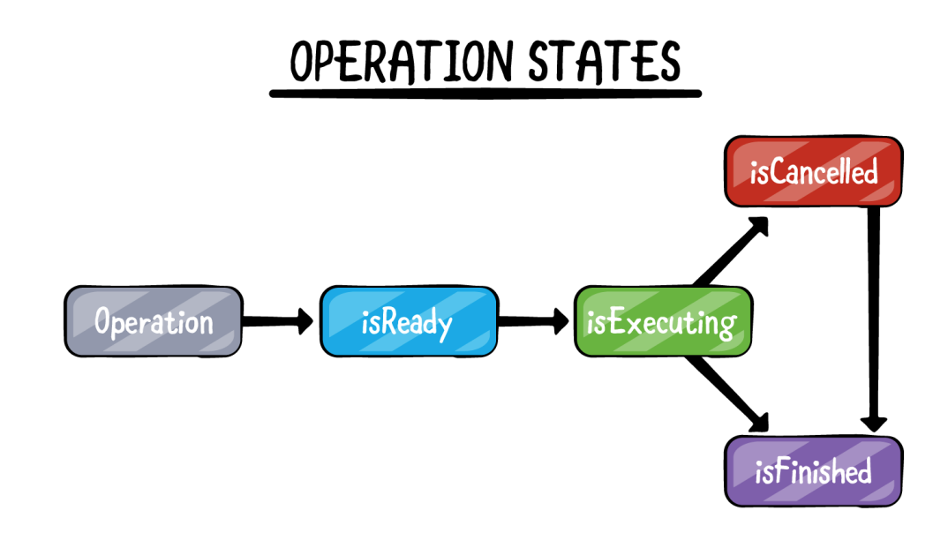
What is Operation ?
When it’s been instantiated, it will transition to the isReady state.
When we invoked the start method, it will transition to the isExecuting state.
When the task finished , it moves to isFinished
When task is in progress and you call cancel , then it will transition to the isCancelled state before moving onto the isFinished state

Slide 5
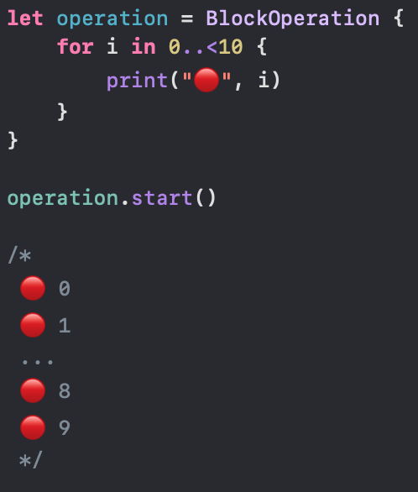
BlockOperation
A class you use as-is to execute one or more block objects concurrently
Operation objects execute in a synchronous manner by default — that is, they perform their task in the thread that calls their start method.

Slide 6
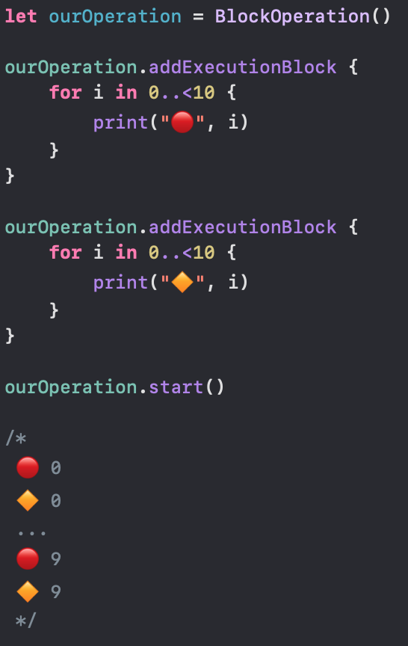
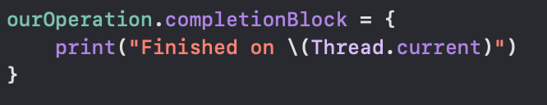
BlockOperation
execute one or more block objects concurrently.

Slide 7
Operation Queue
Operations Queues are Cocoa’s high-level abstraction on GCD.
Using Operation Queues you will see the real power of operations , instead of the starting the operation yourself , you give it to the operation queue it then handle the scheduling and execution.
Operation Queues are an object-oriented way to encapsulate work that you want to perform asynchronously.
You add operations (tasks/work) on operation queue and we discussed how we can create operations by using two methods.

Slide 8
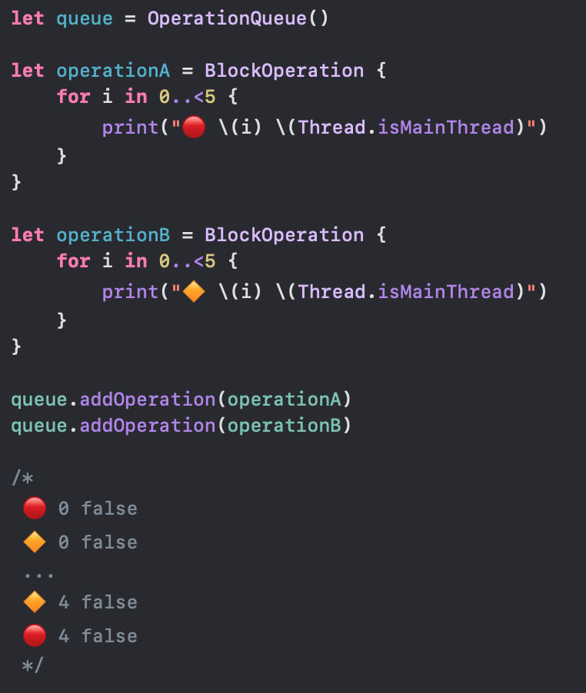
Operation Queue – Add Operation
Operation queue started both operation on some background thread and executed them. No need to call start() method on custom thread. When we add operation to the operation queue it run as soon as it’s ready

Slide 9
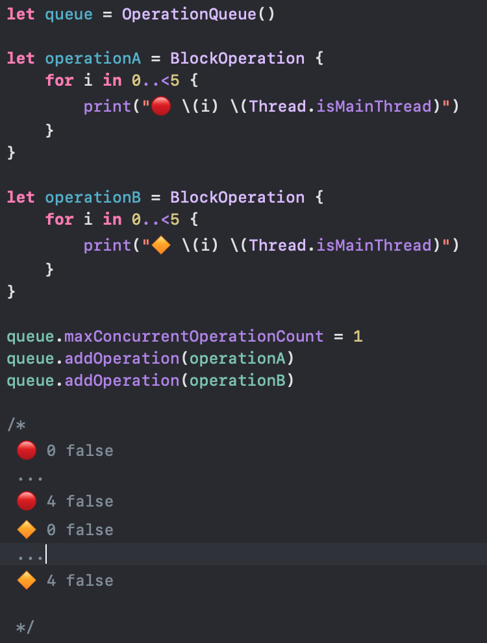
Operation Queue – Add Operation
maxConcurrentOperationCount →The maximum number of queued operations that can execute at the same time. The default value is -1 which means let the system decide

Slide 10
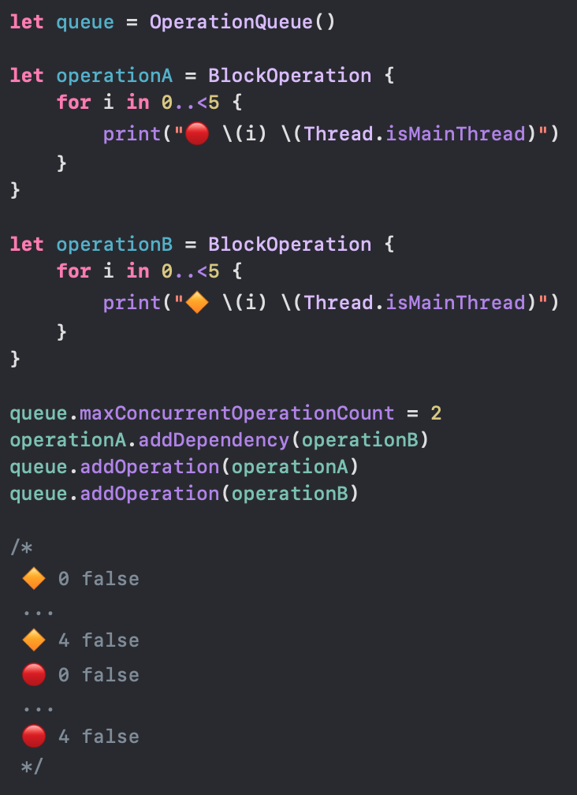
Operation Queue – Add Dependency
We created two block operations and we are saying that don’t start task A until task B is finished by calling operationA.addDependency(operationB)

Slide 11
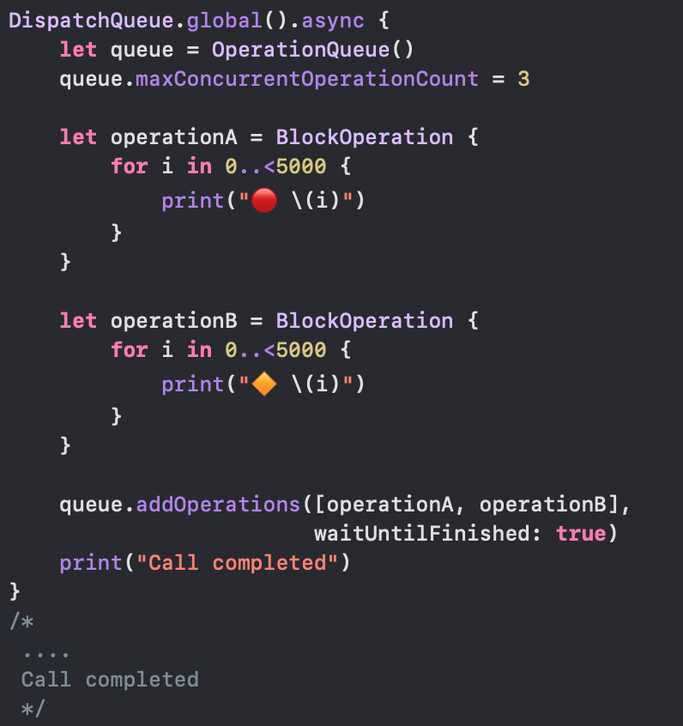
Dispatch Group Implementation Using Operations Queue
We have two tasks and we wanted to run concurrently and when all the tasks finished we need to call some method to indicate that all tasks has finished

Slide 12
Benefits of Operation Queues over GCD
The Operation API provides support for dependencies. You can create complex dependencies between tasks very easily though in GCD you can achieve it but you have to do a lot of work.
The NSOperation and NSOperationQueue classes have a number of properties that can be observed, using KVO (Key Value Observing). This is another important benefit if you want to monitor the state of an operation or operation queue.
Operations can be paused, resumed, and cancelled. Once you dispatch a task using Grand Central Dispatch, you no longer have control or insight into the execution of that task. The NSOperation API is more flexible in that respect, giving the developer control over the operation’s life cycle
The NSOperationQueue also adds a number of benefits to the mix. For example, you can specify the maximum number of queued operations that can run simultaneously. This makes it easy to control how many operations run at the same time or to create a serial operation queue.

Slide 13
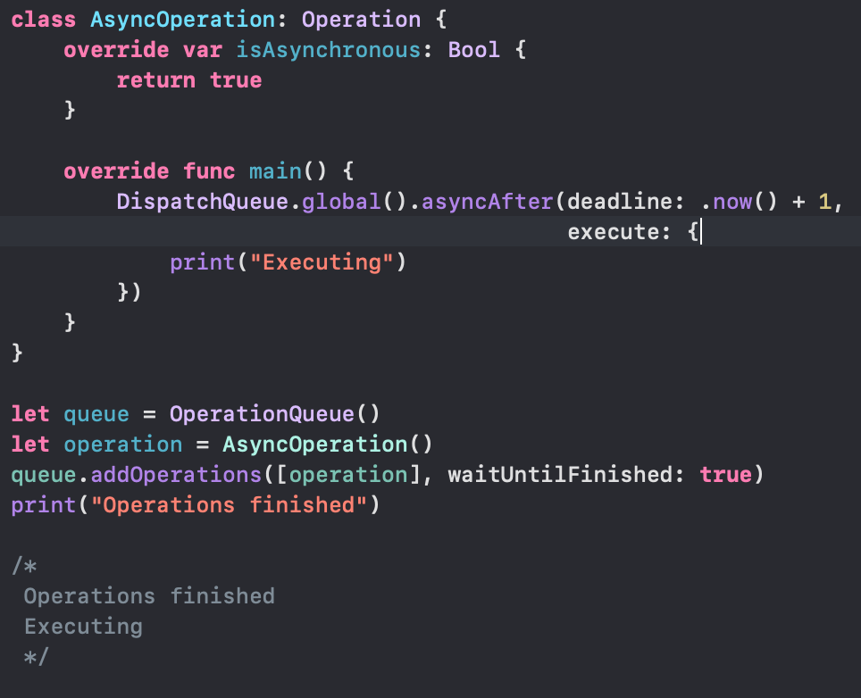
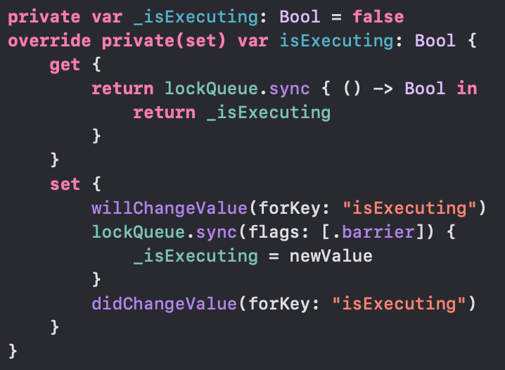
Creating an Asynchronous Operation
Managing the state of an Asynchronous Operation
To manage the state correctly, we need to override the isFinished and isExecuting properties with multi-threading and KVO support. This looks as follows for the isExecuting property:

Slide 14
THANK YOU

