Slide 1
CATCH THE NUMBER
Network Programming Mini Project
Group:HUST MAN
Nguyen Anh Tien
Do Trung Kien

Slide 2
Contents
Introduction
Implementation
Network Protocol
Demo
Evaluate
Assigned tasks

Slide 3
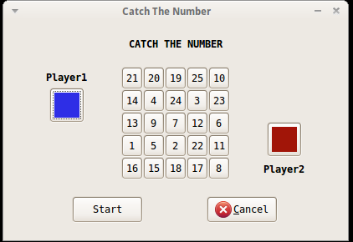
Introduction
2 players – 1 number pad
Choose the number as fast as you can
The faster (more catched numbers ), the winner

Slide 4


Network Protocol
Use select() for non-blocking I/O processing
Use select() to deal with multi-client

Slide 5
Packet Structure
Character buffer
First 4 bytes : defined message id
Next 4 bytes : the length of text part of message
Rest : text part of message
Before send and after received a message, we encode and decode the buffer

Slide 6
Implementation
Client/Server: C
Compiler: gcc
OS: Ubuntu

Slide 7
Demostration
(demo)

Slide 8
Evaluate (1)
Succeeded point:
Design the network protocol suitable with the game and expandable
Handle the communication between 2 player
Time when player click a number is sent to another player
Compare it with local click time of player to determine who is the faster
Create a thread to continously check for status of a cell and update the number pad

Slide 9
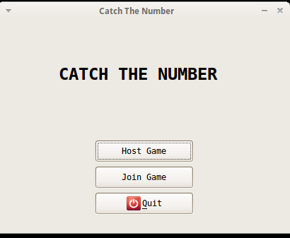
Evaluate (2)
Failed point:
Have not completed the connection between GUI (gtk in C) and main Program yet

Slide 10
Description of TeamWork
Source Management: github
Assigned tasks:
Nguyen Anh Tien
Write main server, main client
Do Trung Kien
Write GUI by gtk (C), write client
Both
Design network model and protocol
Connect client/server code with GUI
Debug
Program Test

Slide 11
Thank You for Your Listening!

