Slide 1
CATCH THE NUMBER
Network Programming Mini Project
Group:HUST MAN
Nguyen Anh Tien
Do Trung Kien

Slide 2
Contents
Introduction
Implementation
Network Protocol
Demo
Evaluate

Slide 3
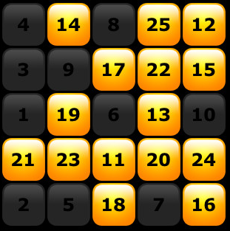
Game: Catch the number
2 players – 1 number pad
Choose the number as fast as you can
The faster (more catched numbers ), the winner

Slide 4


Network Protocol

Slide 5
Implementation
Client/Server: C
Compiler: gcc
OS: Ubuntu

Slide 6
Demostration
(demo)

Slide 7
Evaluate
Success point:
Design the network protocol suitable with the game
Handle the conflict communication
Failure point:
Have not completed the connection between GUI and main Program yet

Slide 8
Thank You for Your Listening!

