Slide 1

F - CINEMA
FPT Software
MOCKUP PROJECT 01
Group 01 : F – CINEMA

Slide 2
F - CINEMA
GROUP 01
Nguyễn Đăng Kiên(KienND9)
Văn Quốc Phát(PhatVQ)
Đặng Ngọc Tuấn Anh(AnhDNT)
LECTURER: Nguyễn Quốc Tùng (TungNQ4)

Slide 3
Presentation content
1 . Application Overview
2 . Introduce the function screen
3. Demo , Q&A .

Slide 4


1. Application Overview
Main feature: Let user can book a movie ticket online.
Number of screen : 11
Database: using SQLite .

Slide 5
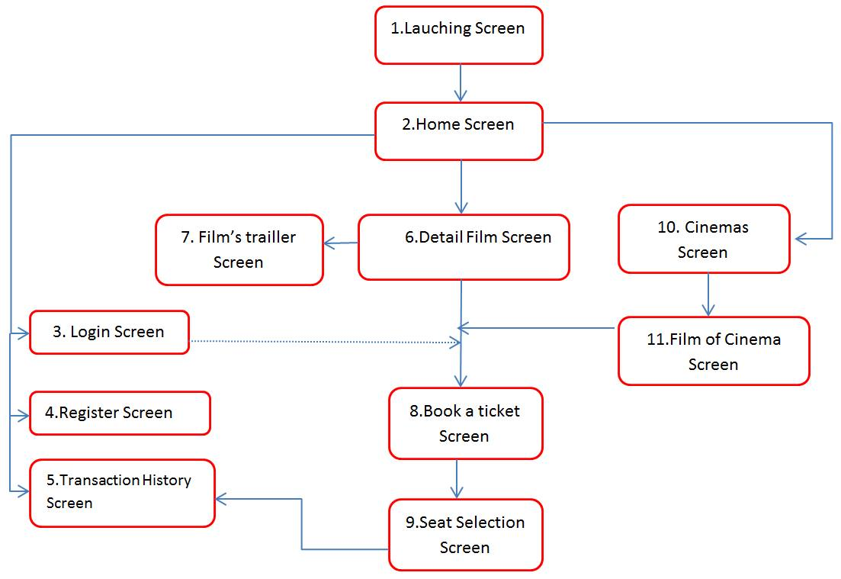
1. Application Overview (Screen flow)

Slide 6
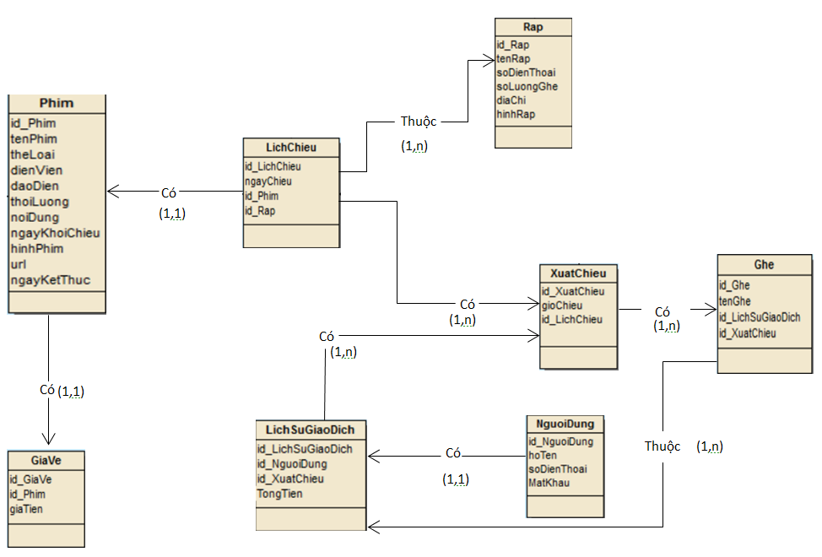
1. Application Overview (Project Architect)

Slide 7
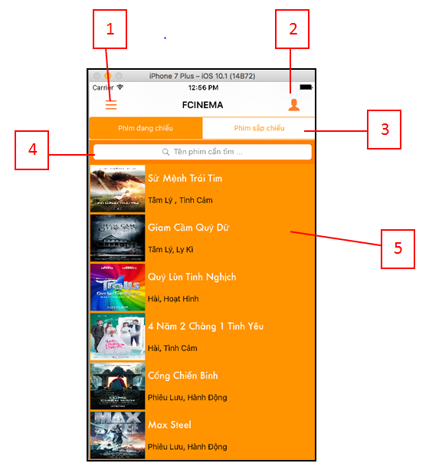
2 . Introduce the function screen (Home Screen)
(1): Touch the button to push a “cinemas screen”.
(2): Touch the button to login or register.
(3): Touch the segment control to filter film by upcomming or playing.
(4): Touch the search bar to search film by name.
(5): Scroll table up or down to view the film information.

Slide 8
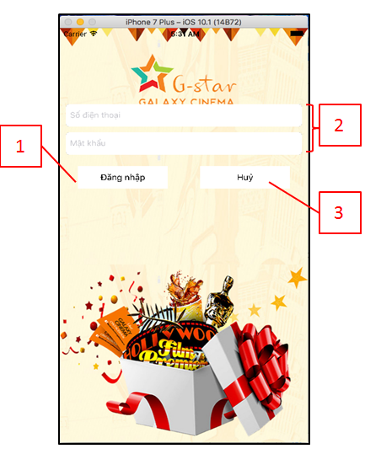
2 . Introduce the function screen (Login Screen)
(1): Touch the button to log in.
(2): Enter the phone number, password.
(3): Touch the button to return “home screen”.

Slide 9
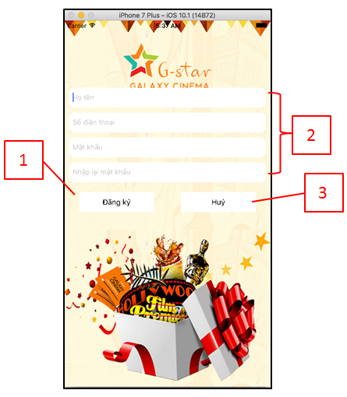
2 . Introduce the function screen (Register Screen)
(1): Touch the button to register.
(2): Enter the name, phone number, password.
(3): Touch the button to return“home screen”.

Slide 10
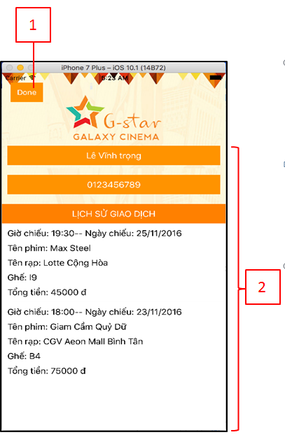
2 . Introduce the function screen (Transaction History Screen)
(1): Touch the button to return “home screen”.
(2): Show user’s information and transaction history.

Slide 11
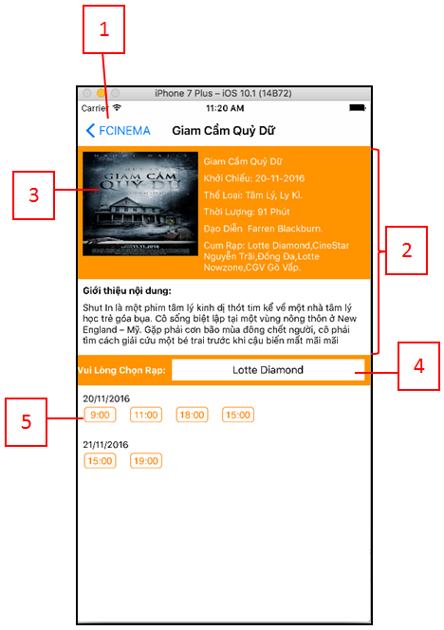
2 . Introduce the function screen (Film’s Detail Screen)
(1): Touch the back button to return “home screen”.
(2): Show detail information of the movie which you selected in “home screen”.
(3): Touch the image to view film’s trailer.
(4): Touch the button to select cinema which you want to view showtimes.
(5): Touch the showtimes button to push a “book a ticket screen”.

Slide 12
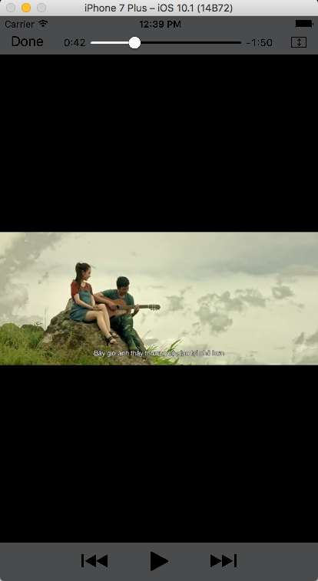
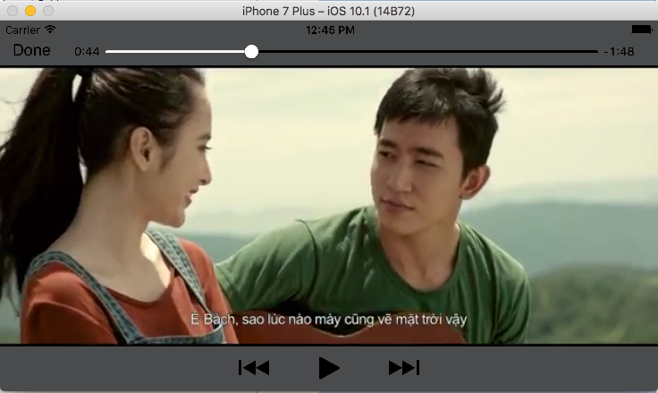
2 . Introduce the function screen (Film’s Trailer Screen)

Slide 13
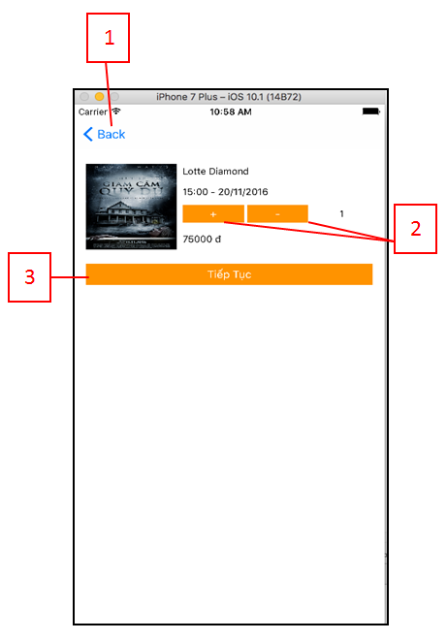
2 . Introduce the function screen (Book a Sticket Screen)
(1): Touch the back button to return “film’s detail screen”.
(2): Touch add or minus button to change number of tickets.
(3): Touch the button to continue booking process.

Slide 14
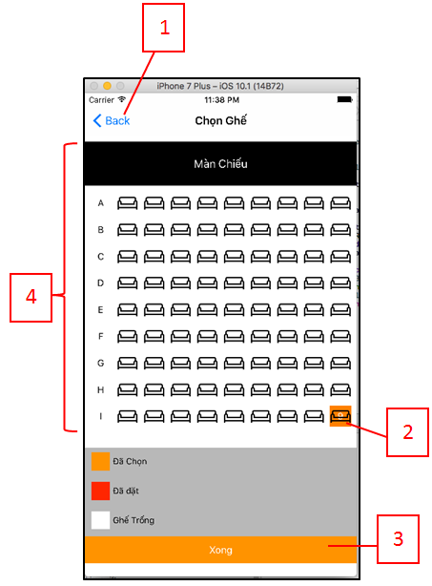
2 . Introduce the function screen (Seat Selection Screen)
(1): Touch the back button to return “book a ticket screen”.
(2): Touch the seat’s cell to select seating positions in the theater.
(3): Touch the finish button to complete.
(4): Show a seating plan and state of seats in the cinema.

Slide 15
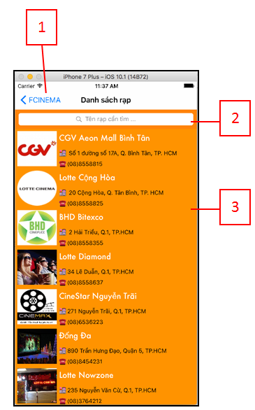
2 . Introduce the function screen (Cinemas Screen)
(1): Touch the back button to return “home screen”.
(2): Touch the search bar to search cinemas by name.
(3): Show a list of cinemas. Touch on a row of list to push a “films of cinema screen”.

Slide 16
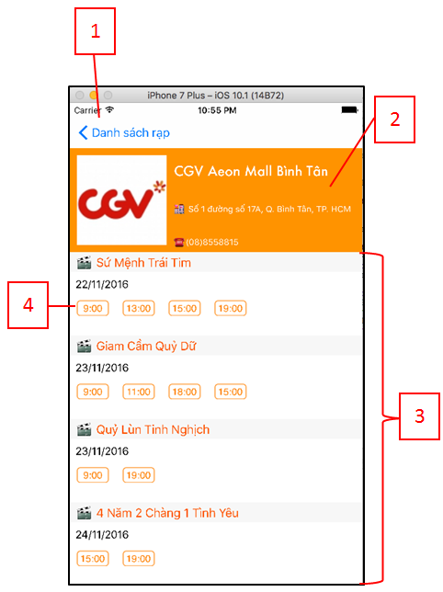
2 . Introduce the function screen (Film Of Cinema Screen)
(1): Touch the back button to return “cinems screen”.
(2): Show information of the cinema which you selected in “cinemas screen”.
(3): Show a list of movies and showtimes of the cinema.
(4): Touch the time button to push a “book a ticket screen”.

Slide 17
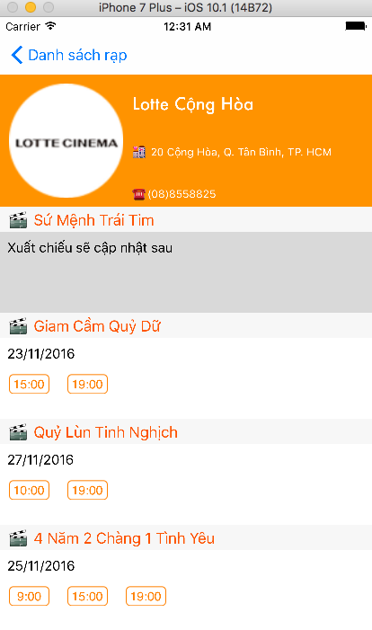
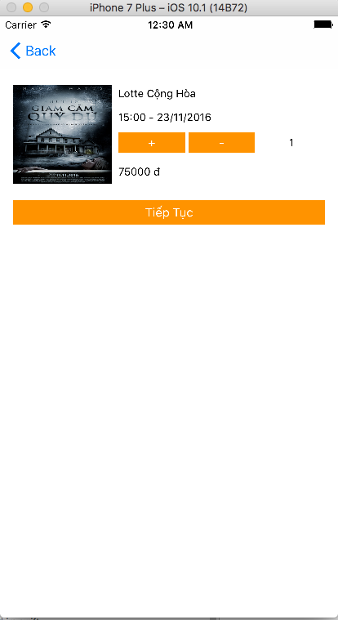
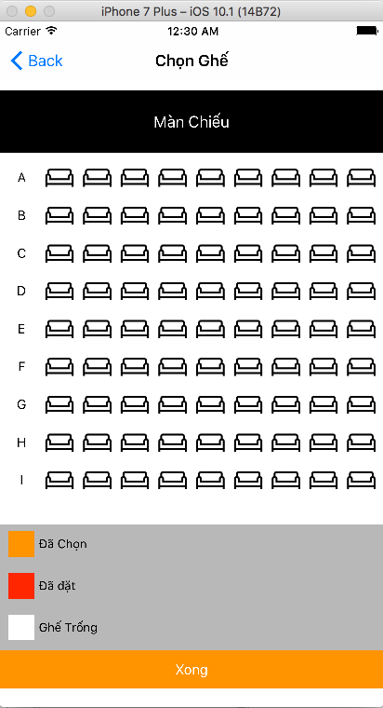
2 . Introduce the function screen (Film Of Cinema Screen)

Slide 18
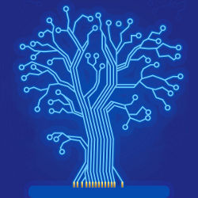
3. Demo, Q&A
THANKS
YOUR
FOR
LISTENING

