Slide 1

F - CINEMA
FPT Software
MOCKUP PROJECT 01
Group 01 : KAP Chat Application

Slide 2
KAP Chat Application
GROUP 01
Nguyễn Đăng Kiên(KienND9)
Văn Quốc Phát(PhatVQ)
Đặng Ngọc Tuấn Anh(AnhDNT)
LECTURER: Nguyễn Quốc Tùng (TungNQ4)

Slide 3
Presentation content
Application Overview.
Introduce function screen.
Future feature.
Demo.
Q & A.

Slide 4
1. Application Overview
Main Feature:
Real-time communication.
User can send text, image, audio message.
You can find your friends based on their email.
Group chat.
Update your mood.
User can post and see the posts of their friends.
User can manage the list of their friends, personal information.

Slide 5
1. Application Overview
System and Requirement:
Build on IOS 10.0
Real – time database (Firebase).
- Upload and store data into firebase storage.
- Account Firebase: mockproject2.group1@gmail.com
- Password: mockproject2

Slide 6
2 . Introduce the function screen
List Screen:
KienND9: Login, Register, Request Friend, Add Friend, User Info, Find Friend
PhatVQ: New Feed Screen, Create Slide Presentation, Design DataBase
AnhDNT: Contact, Conservation, Chat Screen, Data Base Manager.

Slide 7
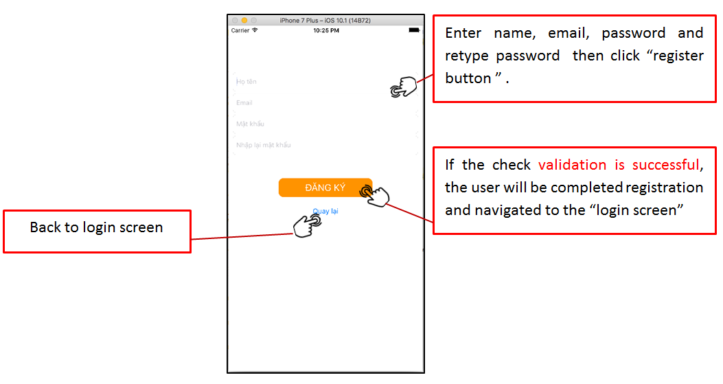
2 . Introduce the function screen (Register Screen)

Slide 8
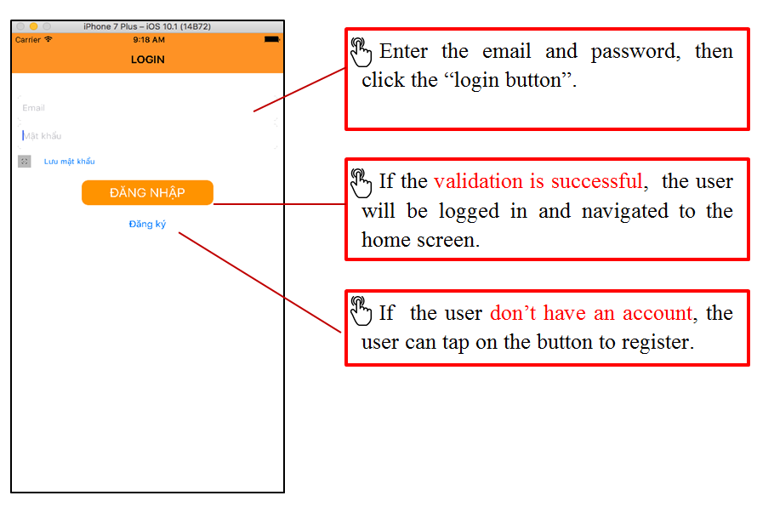
2 . Introduce the function screen (Login Screen)

Slide 9
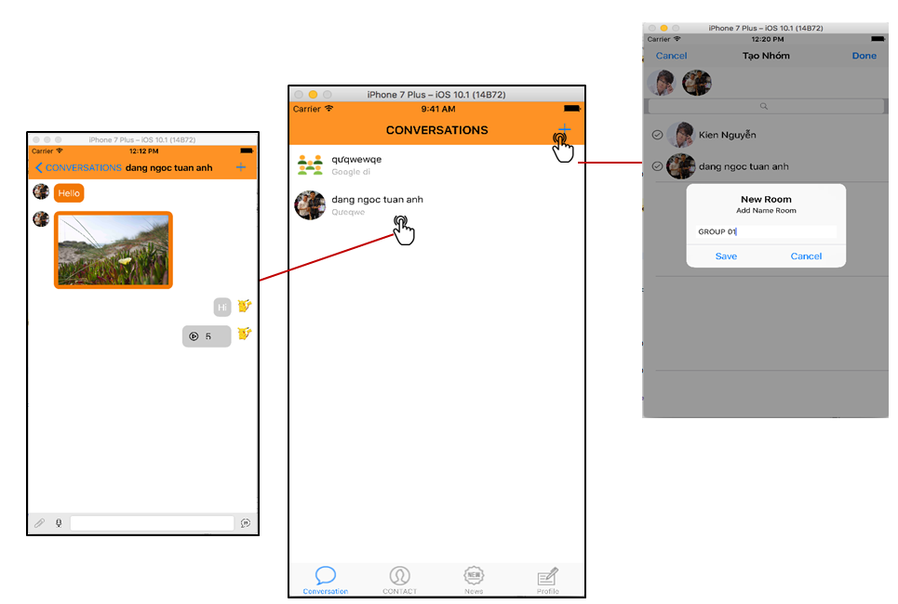
2 . Introduce the function screen (Conversation Screen)

Slide 10
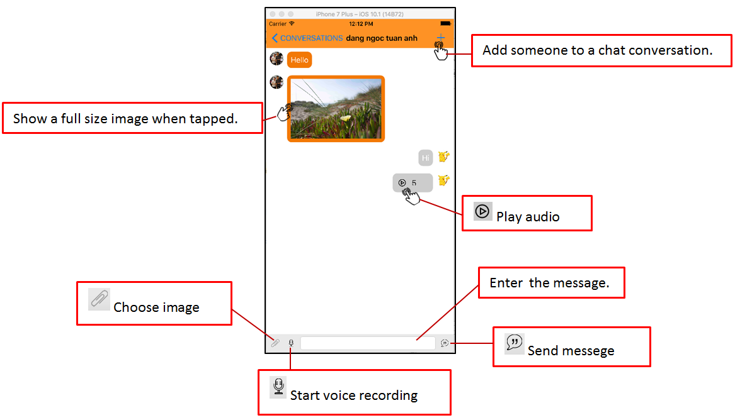
2 . Introduce the function screen (Chat Screen)

Slide 11
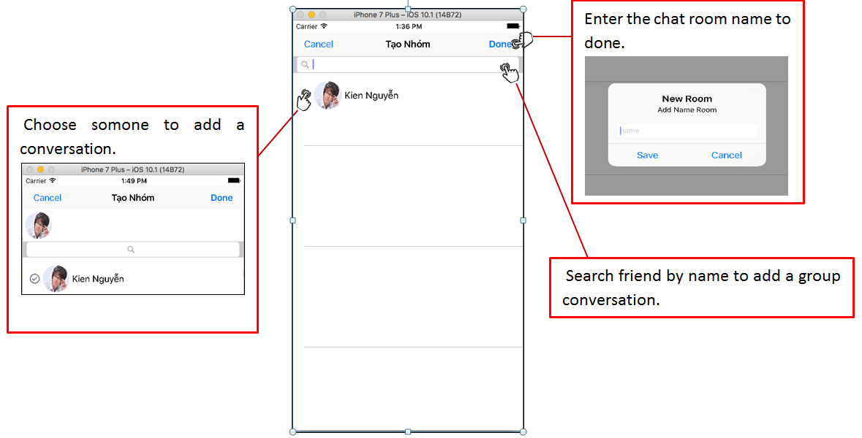
2 . Introduce the function screen (Create Group Screen)

Slide 12
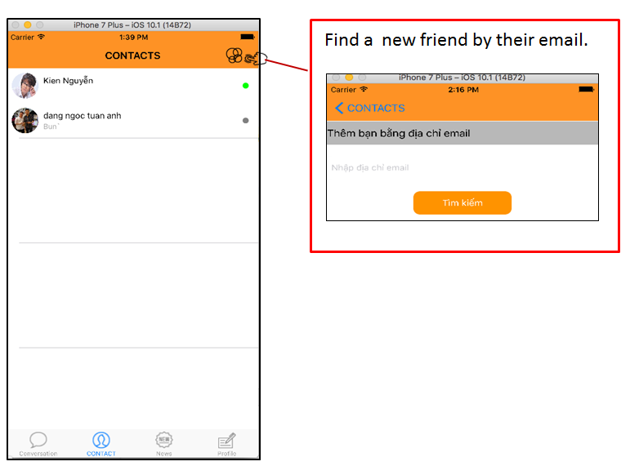
2 . Introduce the function screen (Contact Screen)
- Show a list contact :

Slide 13
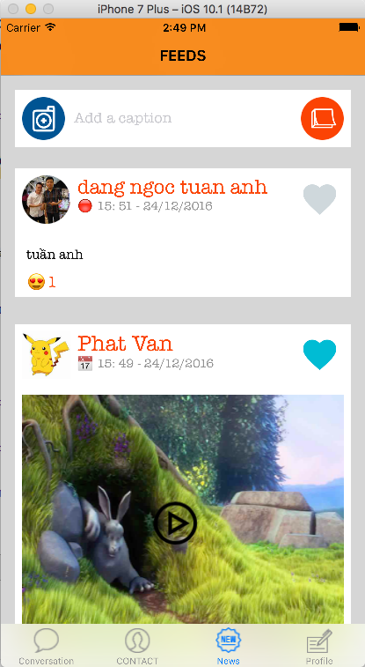
2 . Introduce the function screen (News Feed Screen)
Show a list of post from yourself and your friend.
You can :
Upload Image.
Video and text.
Add or minus like

Slide 14
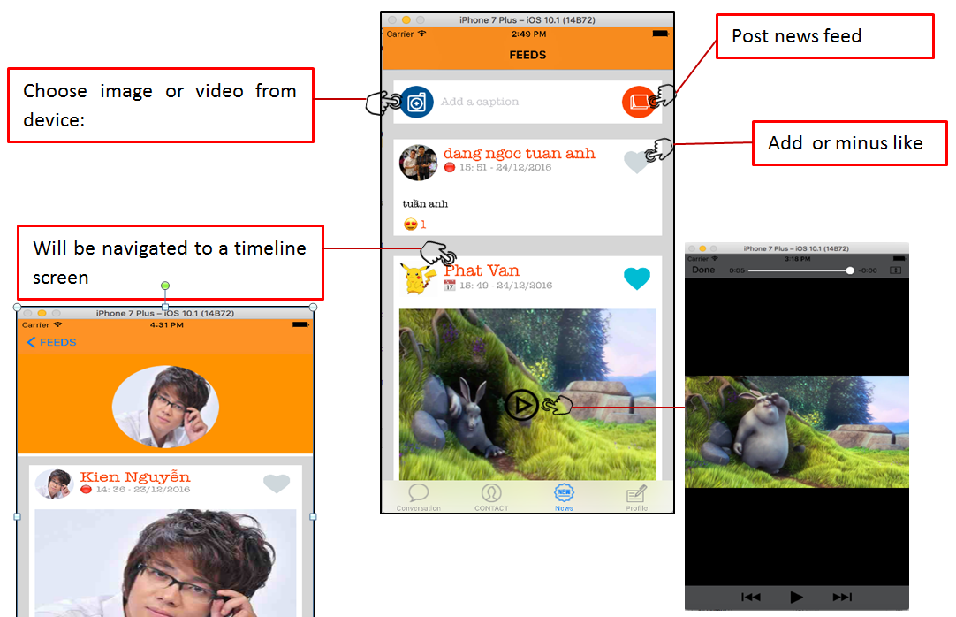
2 . Introduce the function screen (News Feed Screen)

Slide 15
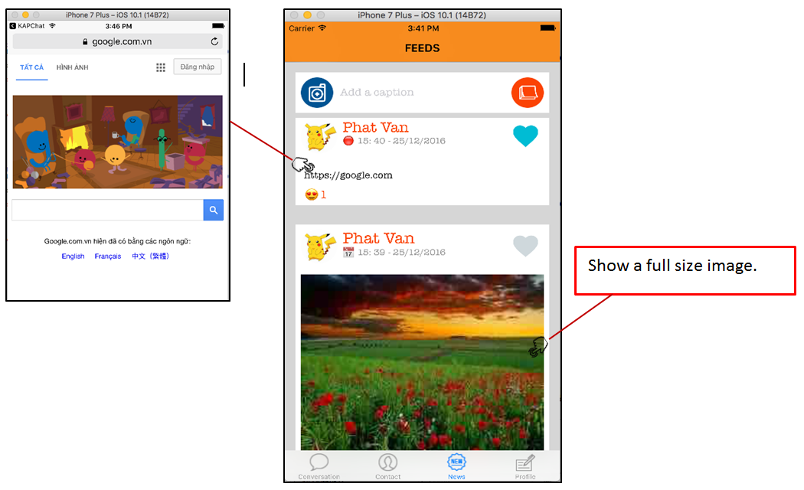
2 . Introduce the function screen (News Feed Screen)

Slide 16
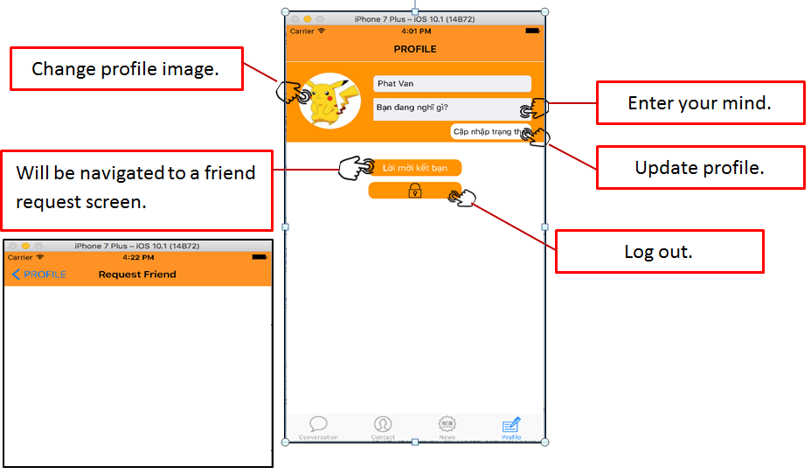
2 . Introduce the function screen (Profile Screen)

Slide 17
3 . Future feature
Support video chat.
Allows users to send emotions.
Allows users to share their current location through google map.
- Allows users to comment below the post.
- Store data offline into core data.

Slide 18

3. Demo, Q&A
THANKS
YOUR
FOR
LISTENING

