Slide 1
Data Mining: Concepts and Techniques (3rd ed.) — Chapter 1 —
Jiawei Han, Micheline Kamber, and Jian Pei
University of Illinois at Urbana-Champaign &
Simon Fraser University
©2012 Han, Kamber & Pei. All rights reserved.
<number>
<number>
Notes:
<number>
<number>

Slide 2

April 27, 2026
April 27, 2026
<number>
Data Mining: Concepts and Techniques
<number>
Data Mining: Concepts and Techniques
Notes:
<number>
<number>

Slide 3
Data and Information Systems (DAIS:) Course Structures at CS/UIUC
Coverage: Database, data mining, text information systems, Web and bioinformatics
Data mining
Intro. to data warehousing and mining (CS412: Han—Fall)
Data mining: Principles and algorithms (CS512: Han—Spring)
Seminar: Advanced Topics in Data mining (CS591Han—Fall and Spring. 1 credit unit)
Independent Study: only if you seriously plan to do your Ph.D./M.S. on data mining and try to demonstrate your ability
Database Systems:
Introd. to database systems (CS411: Kevin Chang + Saurabh Sinha: Spring and Fall)
Advanced database systems (CS511: Kevin Chang Fall’11)
Text information systems
Text information system (CS410 ChengXiang Zhai: Spring)
Bioinformatics
Introduction to BioInformatics (Saurabh Sinha)
CS591 Seminar on Bioinformatics (Sinha: 1 credit unit)
Yahoo!-DAIS seminar (CS591DAIS—Fall and Spring. 1 credit unit)
<number>
<number>
Notes:
<number>
<number>

Slide 4
CS412 Coverage (Chapters 1-10, 3rd Ed.)
The textbook book will be covered in two courses at CS, UIUC
CS412: Introduction to Data Mining (Fall) [Chapters 1-10]
CS512: Data Mining: Principles and Algorithms (Spring) [Chaps. 11-13]
CS412 Coverage (BK2: 2nd Ed.)
Introduction
Data Preprocessing
Data Warehouse and OLAP Technology: An Introduction
Advanced Data Cube Technology and Data Generalization
Mining Frequent Patterns, Association and Correlations
Classification and Prediction
Cluster Analysis
CS412 Coverage (BK3: 3rd ed.)
Introduction
Getting to Know Your Data
Data Preprocessing
Data Warehouse and OLAP Technology: An Introduction
Advanced Data Cube Technology
Mining Frequent Patterns & Association: Basic Concepts
Mining Frequent Patterns & Association: Advanced Methods
Classification: Basic Concepts
Classification: Advanced Methods
Cluster Analysis: Basic Concepts
Cluster Analysis: Advanced Methods (CS512)
Outlier Analysis (CS512)
<number>
<number>
Notes:
<number>
<number>

Slide 5
CS512 Coverage (Chapters 11, 12, 13 + More Advanced Topics)
Cluster Analysis: Advanced Methods (Chapter 11)
Outlier Analysis (Chapter 12)
Mining data streams, time-series, and sequence data
Mining graph data
Mining social and information networks
Mining object, spatial, multimedia, text and Web data
Mining complex data objects
Spatial and spatiotemporal data mining
Multimedia data mining
Text and Web mining
Additional (often current) themes if time permits
<number>
<number>
Notes:
<number>
<number>

Slide 6
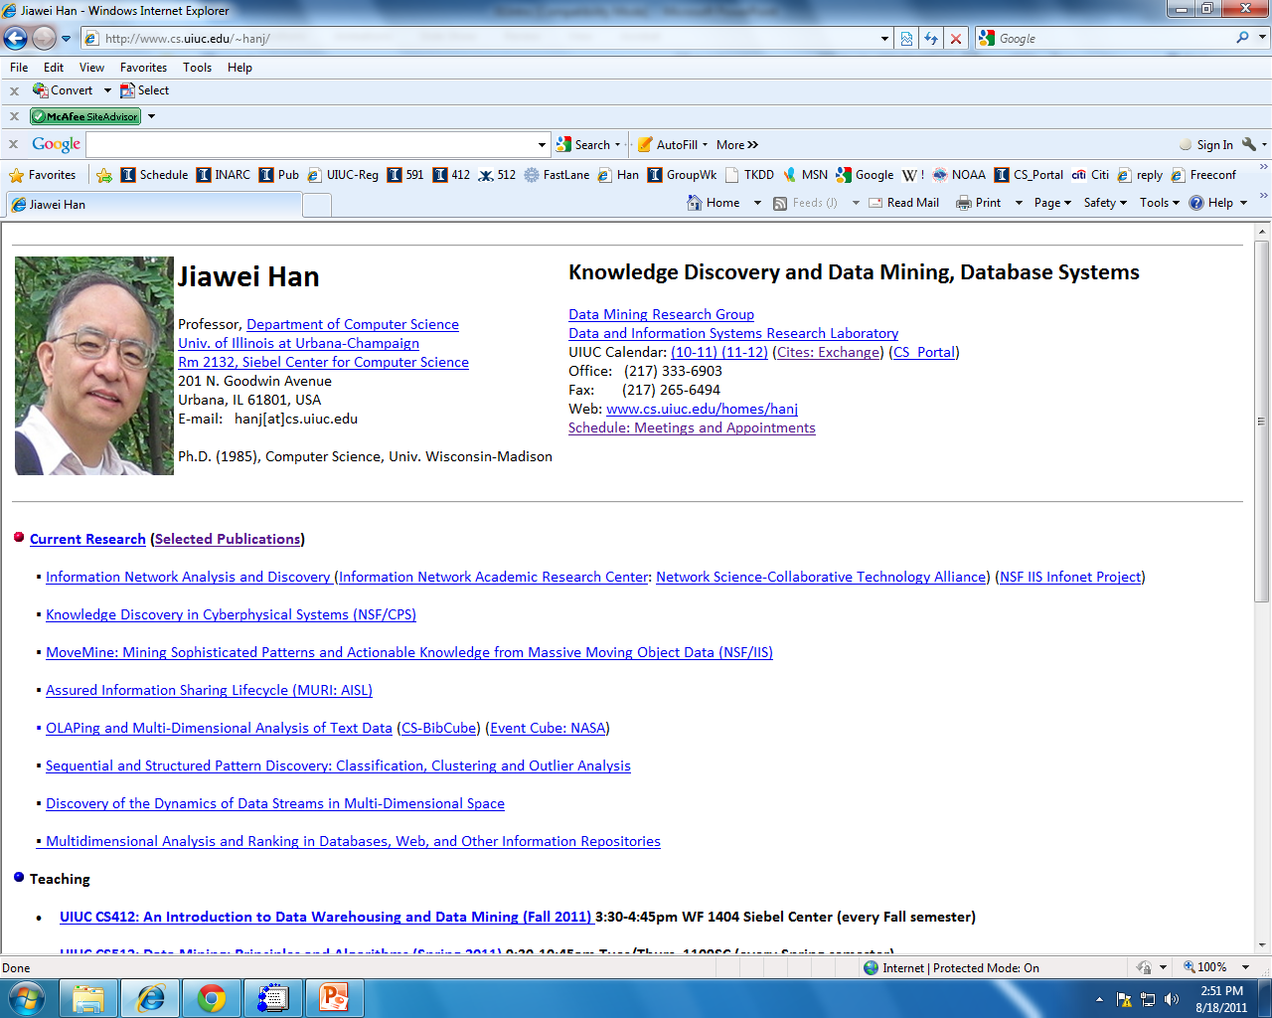
<number>
<number>
Notes:
<number>
<number>

Slide 7
CS 412. Course Page & Class Schedule
Class Homepage: https://wiki.engr.illinois.edu/display/cs412
Wiki course outline
Course Information
Course Schedule (Fall_2011)
Lecture media (Fall_2011)
Assignments (Fall 2011)
Resources and Reading Lists
Staff
Project [Only for students taking 4 credits for the course]
Comments and Suggestions—Textbook, Slides, Class Presentation, and Teaching
Class-Related Questions and Answers
<number>
<number>
Notes:
<number>
<number>

Slide 8
CS 412: Course Project [4th credit]
A comprehensive survey on a focused topic
Individual surveys, not group work
Examples of topics (need to be focused and specific)
Data cleaning for effective social network analysis
Clustering data streams in big data
Transfer learning for recommender systems
Mining compressed frequent patterns
Counter examples of topics (too general or too specific)
Scalable classification methods [Too general]
The FPGrowth algorithm for mining frequent patterns [Too specific]
Note: No copy of textbook sections! No plagiarism!
<number>
<number>
Notes:
<number>
<number>

Slide 9
Chapter 1. Introduction
Why Data Mining?
What Is Data Mining?
A Multi-Dimensional View of Data Mining
What Kinds of Data Can Be Mined?
What Kinds of Patterns Can Be Mined?
What Kinds of Technologies Are Used?
What Kinds of Applications Are Targeted?
Major Issues in Data Mining
A Brief History of Data Mining and Data Mining Society
Summary
<number>
Notes:
<number>

Slide 10
Why Data Mining?
The Explosive Growth of Data: from terabytes to petabytes
Data collection and data availability
Automated data collection tools, database systems, Web, computerized society
Major sources of abundant data
Business: Web, e-commerce, transactions, stocks, …
Science: Remote sensing, bioinformatics, scientific simulation, …
Society and everyone: news, digital cameras, YouTube
We are drowning in data, but starving for knowledge!
“Necessity is the mother of invention”—Data mining—Automated analysis of massive data sets
<number>
Notes:
<number>

Slide 11
Evolution of Sciences: New Data Science Era
Before 1600: Empirical science
1600-1950s: Theoretical science
Each discipline has grown a theoretical component. Theoretical models often motivate experiments and generalize our understanding.
1950s-1990s: Computational science
Over the last 50 years, most disciplines have grown a third, computational branch (e.g. empirical, theoretical, and computational ecology, or physics, or linguistics.)
Computational Science traditionally meant simulation. It grew out of our inability to find closed-form solutions for complex mathematical models.
1990-now: Data science
The flood of data from new scientific instruments and simulations
The ability to economically store and manage petabytes of data online
The Internet and computing Grid that makes all these archives universally accessible
Scientific info. management, acquisition, organization, query, and visualization tasks scale almost linearly with data volumes
Data mining is a major new challenge!
Jim Gray and Alex Szalay, The World Wide Telescope: An Archetype for Online Science, Comm. ACM, 45(11): 50-54, Nov. 2002
<number>
Notes:
<number>

Slide 12
Chapter 1. Introduction
Why Data Mining?
What Is Data Mining?
A Multi-Dimensional View of Data Mining
What Kinds of Data Can Be Mined?
What Kinds of Patterns Can Be Mined?
What Kinds of Technologies Are Used?
What Kinds of Applications Are Targeted?
Major Issues in Data Mining
A Brief History of Data Mining and Data Mining Society
Summary
<number>
Notes:
<number>

Slide 13
What Is Data Mining?
Data mining (knowledge discovery from data)
Extraction of interesting (non-trivial, implicit, previously unknown and potentially useful) patterns or knowledge from huge amount of data
Data mining: a misnomer?
Alternative names
Knowledge discovery (mining) in databases (KDD), knowledge extraction, data/pattern analysis, data archeology, data dredging, information harvesting, business intelligence, etc.
Watch out: Is everything “data mining”?
Simple search and query processing
(Deductive) expert systems
<number>
Notes:
<number>

Slide 14
Knowledge Discovery (KDD) Process
Knowledge
This is a view from typical database systems and data warehousing communities
Data mining plays an essential role in the knowledge discovery process
Pattern Evaluation
Data Mining
Task-relevant Data
Data Warehouse
Selection
Data Cleaning
Data Integration
Databases
<number>
Notes:
<number>

Slide 15
Example: A Web Mining Framework
Web mining usually involves
Data cleaning
Data integration from multiple sources
Warehousing the data
Data cube construction
Data selection for data mining
Data mining
Presentation of the mining results
Patterns and knowledge to be used or stored into knowledge-base
<number>
Notes:
<number>

Slide 16
Data Mining in Business Intelligence
Increasing potential
to support
business decisions
End User
Decision Making
Data Presentation
Business
Analyst
Visualization Techniques
Data Mining
Data
Analyst
Information Discovery
Data Exploration
Statistical Summary, Querying, and Reporting
Data Preprocessing/Integration, Data Warehouses
Data Sources
DBA
Paper, Files, Web documents, Scientific experiments, Database Systems
<number>
Notes:
<number>

Slide 17
KDD Process: A Typical View from ML and Statistics
Pattern
Information
Knowledge
Input Data
Data Pre-Processing
Data Mining
Post-Processing
Data integration
Normalization
Feature selection
Dimension reduction
Pattern discovery
Association & correlation
Classification
Clustering
Outlier analysis
… … … …
Pattern evaluation
Pattern selection
Pattern interpretation
Pattern visualization
This is a view from typical machine learning and statistics communities
<number>
Notes:
<number>

Slide 18
Which View Do You Prefer?
Which view do you prefer?
KDD vs. ML/Stat. vs. Business Intelligence
Depending on the data, applications, and your focus
Data Mining vs. Data Exploration
Business intelligence view
Warehouse, data cube, reporting but not much mining
Business objects vs. data mining tools
Supply chain example: mining vs. OLAP vs. presentation tools
Data presentation vs. data exploration
<number>
Notes:
<number>

Slide 19
Chapter 1. Introduction
Why Data Mining?
What Is Data Mining?
A Multi-Dimensional View of Data Mining
What Kinds of Data Can Be Mined?
What Kinds of Patterns Can Be Mined?
What Kinds of Technologies Are Used?
What Kinds of Applications Are Targeted?
Major Issues in Data Mining
A Brief History of Data Mining and Data Mining Society
Summary
<number>
Notes:
<number>

Slide 20
Multi-Dimensional View of Data Mining
Data to be mined
Database data (extended-relational, object-oriented, heterogeneous, legacy), data warehouse, transactional data, stream, spatiotemporal, time-series, sequence, text and web, multi-media, graphs & social and information networks
Knowledge to be mined (or: Data mining functions)
Characterization, discrimination, association, classification, clustering, trend/deviation, outlier analysis, etc.
Descriptive vs. predictive data mining
Multiple/integrated functions and mining at multiple levels
Techniques utilized
Data-intensive, data warehouse (OLAP), machine learning, statistics, pattern recognition, visualization, high-performance, etc.
Applications adapted
Retail, telecommunication, banking, fraud analysis, bio-data mining, stock market analysis, text mining, Web mining, etc.
<number>
Notes:
<number>

Slide 21
Chapter 1. Introduction
Why Data Mining?
What Is Data Mining?
A Multi-Dimensional View of Data Mining
What Kinds of Data Can Be Mined?
What Kinds of Patterns Can Be Mined?
What Kinds of Technologies Are Used?
What Kinds of Applications Are Targeted?
Major Issues in Data Mining
A Brief History of Data Mining and Data Mining Society
Summary
<number>
Notes:
<number>

Slide 22
Data Mining: On What Kinds of Data?
Database-oriented data sets and applications
Relational database, data warehouse, transactional database
Advanced data sets and advanced applications
Data streams and sensor data
Time-series data, temporal data, sequence data (incl. bio-sequences)
Structure data, graphs, social networks and multi-linked data
Object-relational databases
Heterogeneous databases and legacy databases
Spatial data and spatiotemporal data
Multimedia database
Text databases
The World-Wide Web
<number>
Notes:
<number>

Slide 23
Chapter 1. Introduction
Why Data Mining?
What Is Data Mining?
A Multi-Dimensional View of Data Mining
What Kinds of Data Can Be Mined?
What Kinds of Patterns Can Be Mined?
What Kinds of Technologies Are Used?
What Kinds of Applications Are Targeted?
Major Issues in Data Mining
A Brief History of Data Mining and Data Mining Society
Summary
<number>
Notes:
<number>

Slide 24
Data Mining Function: (1) Generalization
Information integration and data warehouse construction
Data cleaning, transformation, integration, and multidimensional data model
Data cube technology
Scalable methods for computing (i.e., materializing) multidimensional aggregates
OLAP (online analytical processing)
Multidimensional concept description: Characterization and discrimination
Generalize, summarize, and contrast data characteristics, e.g., dry vs. wet region
<number>
Notes:
<number>

Slide 25
Data Mining Function: (2) Association and Correlation Analysis
Frequent patterns (or frequent itemsets)
What items are frequently purchased together in your Walmart?
Association, correlation vs. causality
A typical association rule
Diaper → Beer [0.5%, 75%] (support, confidence)
Are strongly associated items also strongly correlated?
How to mine such patterns and rules efficiently in large datasets?
How to use such patterns for classification, clustering, and other applications?
<number>
Notes:
<number>

Slide 26
Data Mining Function: (3) Classification
Classification and label prediction
Construct models (functions) based on some training examples
Describe and distinguish classes or concepts for future prediction
E.g., classify countries based on (climate), or classify cars based on (gas mileage)
Predict some unknown class labels
Typical methods
Decision trees, naïve Bayesian classification, support vector machines, neural networks, rule-based classification, pattern-based classification, logistic regression, …
Typical applications:
Credit card fraud detection, direct marketing, classifying stars, diseases, web-pages, …
<number>
Notes:
<number>

Slide 27
Data Mining Function: (4) Cluster Analysis
Unsupervised learning (i.e., Class label is unknown)
Group data to form new categories (i.e., clusters), e.g., cluster houses to find distribution patterns
Principle: Maximizing intra-class similarity & minimizing interclass similarity
Many methods and applications
<number>
Notes:
<number>

Slide 28
Data Mining Function: (5) Outlier Analysis
Outlier analysis
Outlier: A data object that does not comply with the general behavior of the data
Noise or exception? ― One person’s garbage could be another person’s treasure
Methods: by product of clustering or regression analysis, …
Useful in fraud detection, rare events analysis
<number>
Notes:
<number>

Slide 29
Time and Ordering: Sequential Pattern, Trend and Evolution Analysis
Sequence, trend and evolution analysis
Trend, time-series, and deviation analysis: e.g., regression and value prediction
Sequential pattern mining
e.g., first buy digital camera, then buy large SD memory cards
Periodicity analysis
Motifs and biological sequence analysis
Approximate and consecutive motifs
Similarity-based analysis
Mining data streams
Ordered, time-varying, potentially infinite, data streams
<number>
Notes:
<number>

Slide 30
Structure and Network Analysis
Graph mining
Finding frequent subgraphs (e.g., chemical compounds), trees (XML), substructures (web fragments)
Information network analysis
Social networks: actors (objects, nodes) and relationships (edges)
e.g., author networks in CS, terrorist networks
Multiple heterogeneous networks
A person could be multiple information networks: friends, family, classmates, …
Links carry a lot of semantic information: Link mining
Web mining
Web is a big information network: from PageRank to Google
Analysis of Web information networks
Web community discovery, opinion mining, usage mining, …
<number>
Notes:
<number>

Slide 31
Evaluation of Knowledge
Are all mined knowledge interesting?
One can mine tremendous amount of “patterns” and knowledge
Some may fit only certain dimension space (time, location, …)
Some may not be representative, may be transient, …
Evaluation of mined knowledge → directly mine only interesting knowledge?
Descriptive vs. predictive
Coverage
Typicality vs. novelty
Accuracy
Timeliness
…
<number>
Notes:
<number>

Slide 32
Chapter 1. Introduction
Why Data Mining?
What Is Data Mining?
A Multi-Dimensional View of Data Mining
What Kinds of Data Can Be Mined?
What Kinds of Patterns Can Be Mined?
What Kinds of Technologies Are Used?
What Kinds of Applications Are Targeted?
Major Issues in Data Mining
A Brief History of Data Mining and Data Mining Society
Summary
<number>
Notes:
<number>

Slide 33
Data Mining: Confluence of Multiple Disciplines
Machine
Learning
Pattern
Recognition
Statistics
Applications
Data Mining
Visualization
Algorithm
Database
Technology
High-Performance
Computing
<number>
Notes:
<number>

Slide 34
Why Confluence of Multiple Disciplines?
Tremendous amount of data
Algorithms must be highly scalable to handle such as tera-bytes of data
High-dimensionality of data
Micro-array may have tens of thousands of dimensions
High complexity of data
Data streams and sensor data
Time-series data, temporal data, sequence data
Structure data, graphs, social networks and multi-linked data
Heterogeneous databases and legacy databases
Spatial, spatiotemporal, multimedia, text and Web data
Software programs, scientific simulations
New and sophisticated applications
<number>
Notes:
<number>
Add a definition/description of “traditional data analysis”.

Slide 35
Chapter 1. Introduction
Why Data Mining?
What Is Data Mining?
A Multi-Dimensional View of Data Mining
What Kinds of Data Can Be Mined?
What Kinds of Patterns Can Be Mined?
What Kinds of Technologies Are Used?
What Kinds of Applications Are Targeted?
Major Issues in Data Mining
A Brief History of Data Mining and Data Mining Society
Summary
<number>
Notes:
<number>

Slide 36
Applications of Data Mining
Web page analysis: from web page classification, clustering to PageRank & HITS algorithms
Collaborative analysis & recommender systems
Basket data analysis to targeted marketing
Biological and medical data analysis: classification, cluster analysis (microarray data analysis), biological sequence analysis, biological network analysis
Data mining and software engineering (e.g., IEEE Computer, Aug. 2009 issue)
From major dedicated data mining systems/tools (e.g., SAS, MS SQL-Server Analysis Manager, Oracle Data Mining Tools) to invisible data mining
<number>
Notes:
<number>

Slide 37
Chapter 1. Introduction
Why Data Mining?
What Is Data Mining?
A Multi-Dimensional View of Data Mining
What Kinds of Data Can Be Mined?
What Kinds of Patterns Can Be Mined?
What Kinds of Technologies Are Used?
What Kinds of Applications Are Targeted?
Major Issues in Data Mining
A Brief History of Data Mining and Data Mining Society
Summary
<number>
Notes:
<number>

Slide 38
Major Issues in Data Mining (1)
Mining Methodology
Mining various and new kinds of knowledge
Mining knowledge in multi-dimensional space
Data mining: An interdisciplinary effort
Boosting the power of discovery in a networked environment
Handling noise, uncertainty, and incompleteness of data
Pattern evaluation and pattern- or constraint-guided mining
User Interaction
Interactive mining
Incorporation of background knowledge
Presentation and visualization of data mining results
<number>
Notes:
<number>

Slide 39
Major Issues in Data Mining (2)
Efficiency and Scalability
Efficiency and scalability of data mining algorithms
Parallel, distributed, stream, and incremental mining methods
Diversity of data types
Handling complex types of data
Mining dynamic, networked, and global data repositories
Data mining and society
Social impacts of data mining
Privacy-preserving data mining
Invisible data mining
<number>
Notes:
<number>

Slide 40
Chapter 1. Introduction
Why Data Mining?
What Is Data Mining?
A Multi-Dimensional View of Data Mining
What Kinds of Data Can Be Mined?
What Kinds of Patterns Can Be Mined?
What Kinds of Technologies Are Used?
What Kinds of Applications Are Targeted?
Major Issues in Data Mining
A Brief History of Data Mining and Data Mining Society
Summary
<number>
Notes:
<number>

Slide 41
A Brief History of Data Mining Society
1989 IJCAI Workshop on Knowledge Discovery in Databases
Knowledge Discovery in Databases (G. Piatetsky-Shapiro and W. Frawley, 1991)
1991-1994 Workshops on Knowledge Discovery in Databases
Advances in Knowledge Discovery and Data Mining (U. Fayyad, G. Piatetsky-Shapiro, P. Smyth, and R. Uthurusamy, 1996)
1995-1998 International Conferences on Knowledge Discovery in Databases and Data Mining (KDD’95-98)
Journal of Data Mining and Knowledge Discovery (1997)
ACM SIGKDD conferences since 1998 and SIGKDD Explorations
More conferences on data mining
PAKDD (1997), PKDD (1997), SIAM-Data Mining (2001), (IEEE) ICDM (2001), WSDM (2008), etc.
ACM Transactions on KDD (2007)
<number>
Notes:
<number>

Slide 42
Conferences and Journals on Data Mining
KDD Conferences
ACM SIGKDD Int. Conf. on Knowledge Discovery in Databases and Data Mining (KDD)
SIAM Data Mining Conf. (SDM)
(IEEE) Int. Conf. on Data Mining (ICDM)
European Conf. on Machine Learning and Principles and practices of Knowledge Discovery and Data Mining (ECML-PKDD)
Pacific-Asia Conf. on Knowledge Discovery and Data Mining (PAKDD)
Int. Conf. on Web Search and Data Mining (WSDM)
Other related conferences
DB conferences: ACM SIGMOD, VLDB, ICDE, EDBT, ICDT, …
Web and IR conferences: WWW, SIGIR, WSDM
ML conferences: ICML, NIPS
PR conferences: CVPR,
Journals
Data Mining and Knowledge Discovery (DAMI or DMKD)
IEEE Trans. On Knowledge and Data Eng. (TKDE)
KDD Explorations
ACM Trans. on KDD
<number>
Notes:
<number>

Slide 43
Where to Find References? DBLP, CiteSeer, Google
Data mining and KDD (SIGKDD: CDROM)
Conferences: ACM-SIGKDD, IEEE-ICDM, SIAM-DM, PKDD, PAKDD, etc.
Journal: Data Mining and Knowledge Discovery, KDD Explorations, ACM TKDD
Database systems (SIGMOD: ACM SIGMOD Anthology—CD ROM)
Conferences: ACM-SIGMOD, ACM-PODS, VLDB, IEEE-ICDE, EDBT, ICDT, DASFAA
Journals: IEEE-TKDE, ACM-TODS/TOIS, JIIS, J. ACM, VLDB J., Info. Sys., etc.
AI & Machine Learning
Conferences: Machine learning (ML), AAAI, IJCAI, COLT (Learning Theory), CVPR, NIPS, etc.
Journals: Machine Learning, Artificial Intelligence, Knowledge and Information Systems, IEEE-PAMI, etc.
Web and IR
Conferences: SIGIR, WWW, CIKM, etc.
Journals: WWW: Internet and Web Information Systems,
Statistics
Conferences: Joint Stat. Meeting, etc.
Journals: Annals of statistics, etc.
Visualization
Conference proceedings: CHI, ACM-SIGGraph, etc.
Journals: IEEE Trans. visualization and computer graphics, etc.
<number>
Notes:
<number>

Slide 44
Recommended Reference Books
E. Alpaydin. Introduction to Machine Learning, 2nd ed., MIT Press, 2011
S. Chakrabarti. Mining the Web: Statistical Analysis of Hypertex and Semi-Structured Data. Morgan Kaufmann, 2002
R. O. Duda, P. E. Hart, and D. G. Stork, Pattern Classification, 2ed., Wiley-Interscience, 2000
T. Dasu and T. Johnson. Exploratory Data Mining and Data Cleaning. John Wiley & Sons, 2003
U. M. Fayyad, G. Piatetsky-Shapiro, P. Smyth, and R. Uthurusamy. Advances in Knowledge Discovery and Data Mining. AAAI/MIT Press, 1996
U. Fayyad, G. Grinstein, and A. Wierse, Information Visualization in Data Mining and Knowledge Discovery, Morgan Kaufmann, 2001
J. Han, M. Kamber, and J. Pei, Data Mining: Concepts and Techniques. Morgan Kaufmann, 3rd ed. , 2011
T. Hastie, R. Tibshirani, and J. Friedman, The Elements of Statistical Learning: Data Mining, Inference, and Prediction, 2nd ed., Springer, 2009
B. Liu, Web Data Mining, Springer 2006
T. M. Mitchell, Machine Learning, McGraw Hill, 1997
Y. Sun and J. Han, Mining Heterogeneous Information Networks, Morgan & Claypool, 2012
P.-N. Tan, M. Steinbach and V. Kumar, Introduction to Data Mining, Wiley, 2005
S. M. Weiss and N. Indurkhya, Predictive Data Mining, Morgan Kaufmann, 1998
I. H. Witten and E. Frank, Data Mining: Practical Machine Learning Tools and Techniques with Java Implementations, Morgan Kaufmann, 2nd ed. 2005
<number>
Notes:
<number>

Slide 45
Chapter 1. Introduction
Why Data Mining?
What Is Data Mining?
A Multi-Dimensional View of Data Mining
What Kinds of Data Can Be Mined?
What Kinds of Patterns Can Be Mined?
What Kinds of Technologies Are Used?
What Kinds of Applications Are Targeted?
Major Issues in Data Mining
A Brief History of Data Mining and Data Mining Society
Summary
<number>
Notes:
<number>

Slide 46
Summary
Data mining: Discovering interesting patterns and knowledge from massive amount of data
A natural evolution of science and information technology, in great demand, with wide applications
A KDD process includes data cleaning, data integration, data selection, transformation, data mining, pattern evaluation, and knowledge presentation
Mining can be performed in a variety of data
Data mining functionalities: characterization, discrimination, association, classification, clustering, trend and outlier analysis, etc.
Data mining technologies and applications
Major issues in data mining
<number>
Notes:
<number>

Slide 47
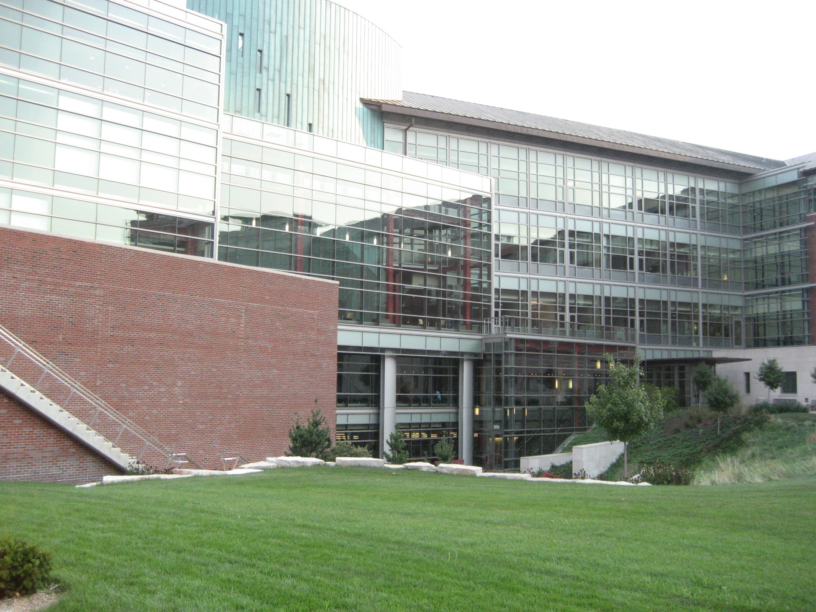
April 27, 2026
Data Mining: Concepts and Techniques
<number>
Notes:
<number>

