Slide 1
Computer Architecture
Ch1 – Introduction
Nguyễn Quốc Đính, FIT – IUH
HCMC, Aug 2015

Slide 2
Information
Me - Nguyễn Quốc Đính
Contact me via nqdinh@hui.edu.vn
Site: https://github.com/kientrucmaytinh/kientrucmaytinh-dhth10
  Download lecture slides
  News
Office hours: H2.1, 1pm – 4pm Monday.

Slide 3
Reading
Textbook (must have):
  Andrew S. Tanenbaum, Structured Computer Organization (5th Edition), Prentice Hall, 2006
More
  John L. Hennessy, and David A. Patterson, Computer Architecture : A Quantitative Approach (5th Edition), The Morgan Kaufmann Series in Computer Architecture and Design, 2011

Slide 4
Tentative topics
Introduction (Chapter 1)
Overview of computer systems organization (Chapter 2)
The digital logic level (Chapter 3)
The instruction set architecture level (Chapter 5)
Assembly language: linking and loading macros (Chapter 7)
Advanced computer architectures (Chapter 8)

Slide 5
Course Goals

Slide 6
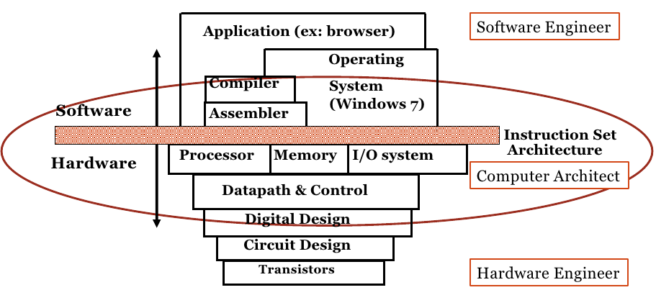
Computer Structure
Coordination many levels of abstraction
Copied from UC Berkeley CS61C

Slide 7
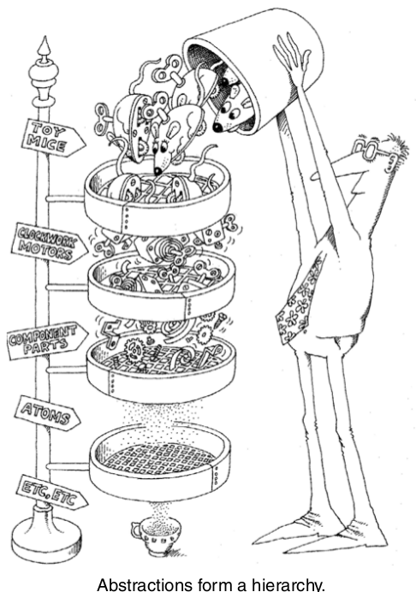
Levels of Abstraction
Application
High Level Languages
Assembly language
Architecture
Gate-level logic
Electronics
Semiconductor
Real world of physics
Grady Booch et al, Object oriented analysis and design with applications, Addison Wesley, 2007

Slide 8
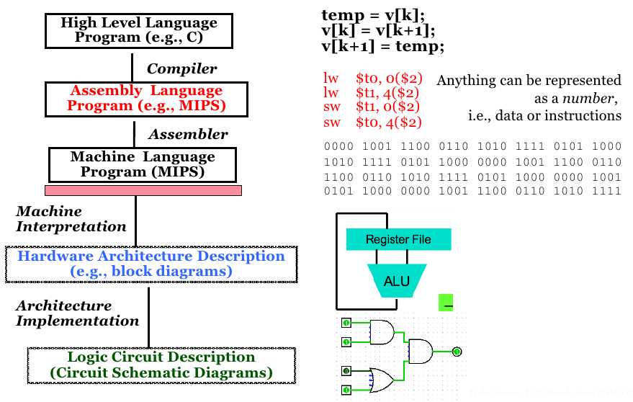
Level of Representation
Copied from UC Berkeley CS61C

Slide 9
Course Goals
Learn to think about the machine from the
  ISA level
  Assembly language level
  Logic level
Understand relationships and interactions between levels
Be able to understand key computer organization concepts.

Slide 10
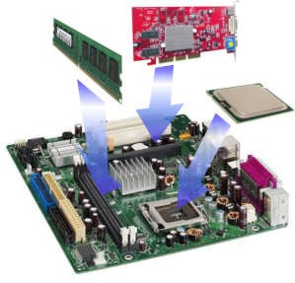
Course Goals (cont'd)
How to assemble a PC? Boring
Picture from intelligenceunited.com

Slide 11
Machine and Assembly Language
Op Code
Data reg. #5
Data reg. #4
MC68000 Assembly Language | Machine Language
MOVE.W D4, D5 | 0011 101 000 000 100
ADDI.W #9, D2 | 00000001 01 000 010 0000 0000 0000 1001
Op Code

Slide 12
Who Uses ASM Language?
Machine designers
  Implement and tradeoffs of instruction functionality
Compiler writers
  Generate machine language from a HLL
The writer of time or space critical code
  Performance goals may force program specific optimizations of the assembly language (e.g. DSP, encryption)
Embedded processor programmers
  I/O devices

Slide 13
Architecture's Goal
Design
  ISA: programming utility, optimum implementation performance
  Machine: best implementation of instructions
Performance
  Time to completion
  Energy-efficiency

Slide 14
Architecture's View
Functional building blocks and their interconnections
  ISA (interface)
  CPU and memory
  Buses
Tools
  Benchmark programs
  Simulators, emulators
  Register transfer notation

Slide 15
Logic
Computer aided design tools
  Logic design and simulation packages
  Printed circuit layout tools
  IC (integrated circuit) design and layout tools
Logic analyzers and oscilloscopes
Hardware development system

Slide 16
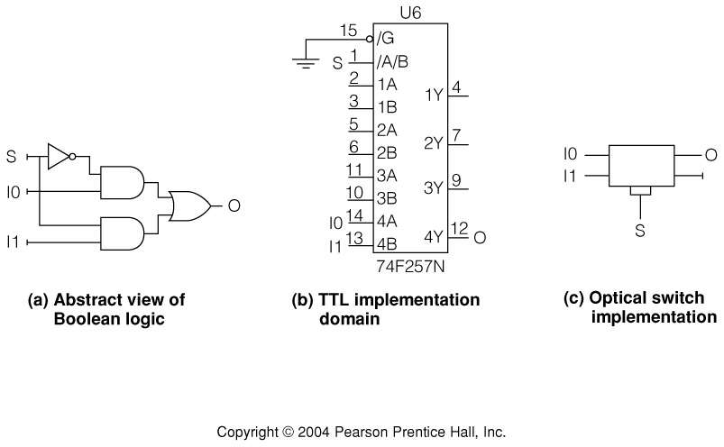
Implementation Domain
Well defined building blocks are used repeatedly

Slide 17
Levels of Abstraction (again)
Application
High Level Languages
Assembly language
Architecture
Gate-level logic
Electronics
Semiconductor
Real world of physics
Grady Booch et al, Object oriented analysis and design with applications, Addison Wesley, 2007

Slide 18
A brief overview of
computer history

Slide 19
Computer Generations
Expensive, large, unreliable
Zeroth: Mechanical Computers (1642 – 1945)
First: Vacuum Tubes (1945 – 1955)
Second: Transistors (1955 – 1965)
Third: Integrated Circuits (1965 – 1980)
Fourth: Very Large Scale Integration (1980 – ?)
Cheaper, smaller, reliable

Slide 20
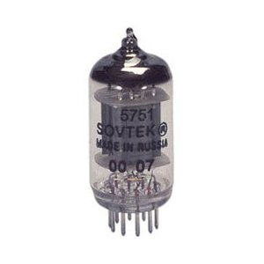
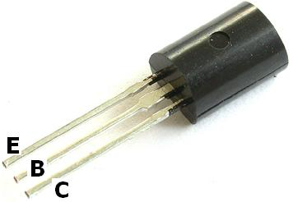
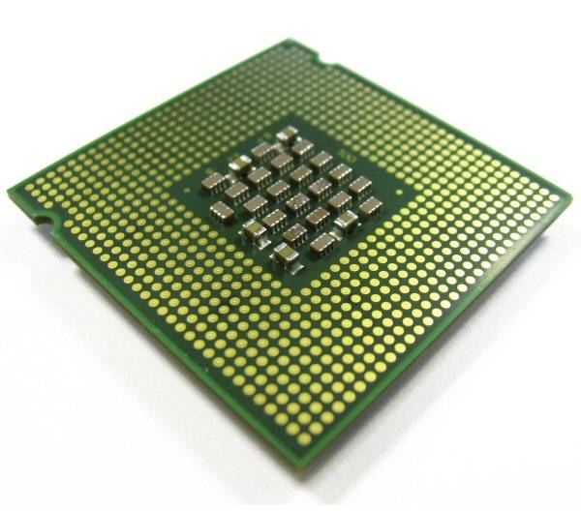
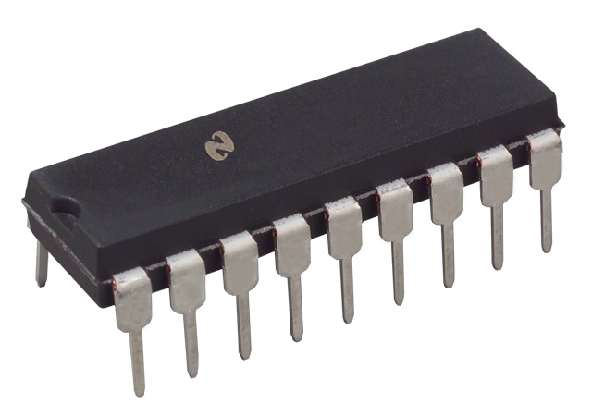
Computer Generations

Slide 21
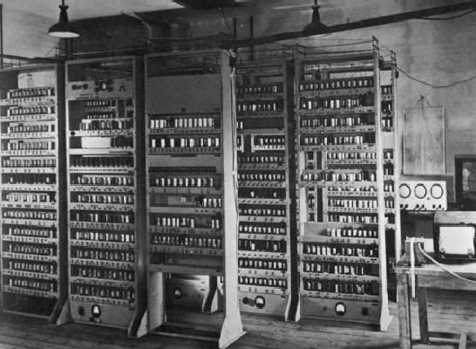
Vacuum Tube (45-55)
ENIAC (WWII)
  Eckhert and Mauchly (UPenn)
  18,000 vacuum tubes, 1500 electronic relays
  hardwired programs
Stored program concept
  Von Neumann
No OS, no programming language
EDSAC, University of Cambridge, UK, 1949

Slide 22
Transistor (55-65)
1/10 size of vacuum tube
Lower operating temperature → longer life
Programming with ASM, Fortran, Cobol

Slide 23
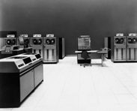
IC (65-80)
Kilby of Texas Instruments
  Idea to build entire circuits on semiconducting material
10 – 10,000 components per chip
Computers became smaller
Programming with Algol, Pascal, C.
  Unix born

Slide 24
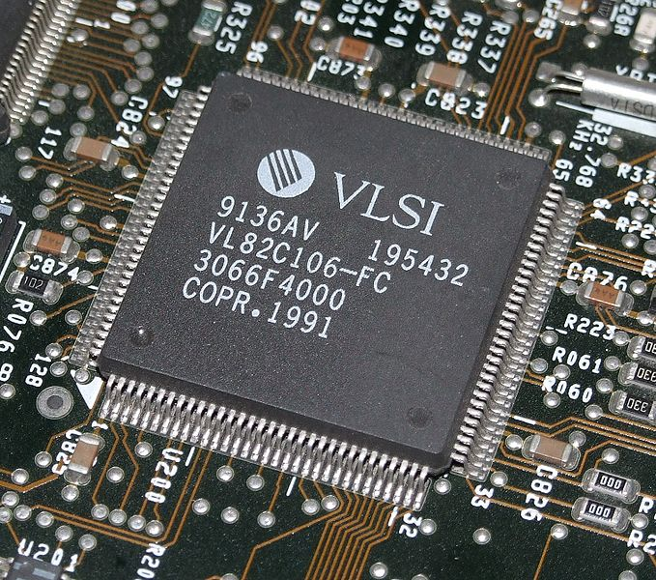
VLSI and Ultra VLSI
Million to trillion transistors in one chip
SoC

Slide 25
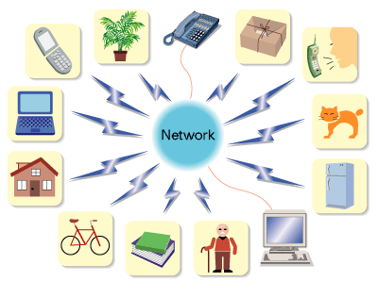
Next generation?
Invisible computers
  Ubiquitous computing
  Perversive computing
Computer everywhere
Picture from quantumcinema.blogspot.com

Slide 26
Classes of Computing
Desktop
  Req: Low cost, high performance
Server
  Req: Stable and safety
Super computer
  Req: High performance
Embedded Processor
  Req: variety (performance, cost, consuming energy, resistance to failure …)

Slide 27
Next ...
General purpose computer
Read Chapter II <<computer system organization>>

Slide 28
Copyright note
Some slides are adapted from Dr. Michele Co, University of Virginia.
Contents taken from Andrew S. Tanenbaum. Structured Computer Organization, 5th.

