Slide 1
Computer Architecture
Ch2 – Computer System Organization
Nguyễn Quốc Đính, FIT – IUH
HCMC, Aug 2015

Slide 2
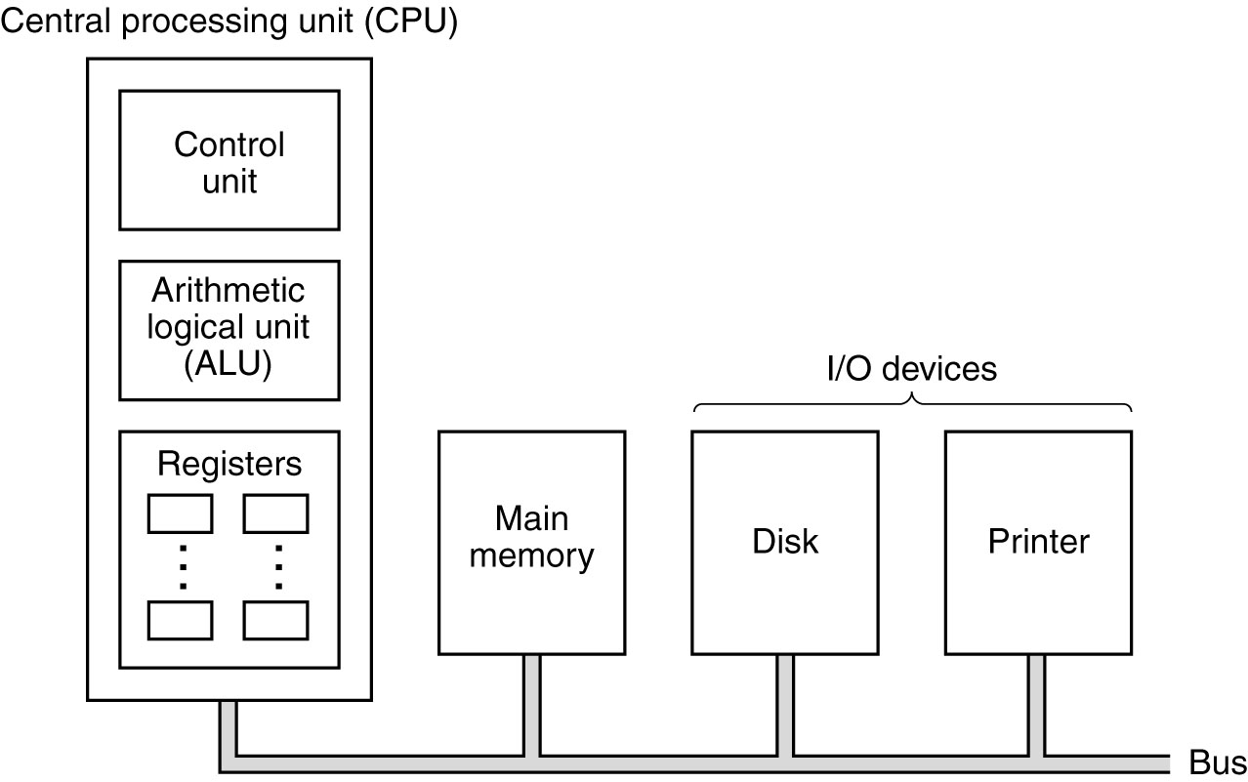
Computer System Organization
- Processor
- Memory (bit, byte, address, ECC, cache, RAM, ROM, RAID, CD ...)
- I/O (terminal, printer, modems, ASCII)
- Buses
The organization of a simple computer with
one CPU and two I/O devices

Slide 3
Central Processing Unit (CPU)
CPU function is to execute programs stored in the main memory
- fetching instructions
- examining instructions
- executing them one after another
The organization of a simple computer with
one CPU and two I/O devices

Slide 4
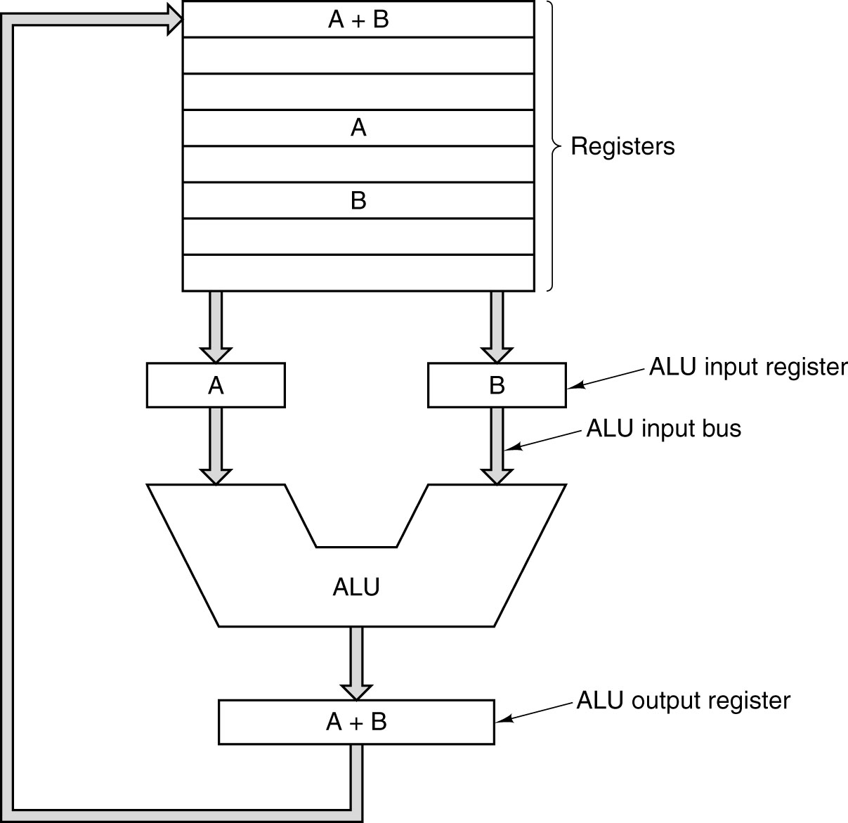
CPU Organization
Data path consists of:
  Registers (No 1 – 32)
  Arithmetic Logic Unit
  Buses
Data path cycle is the hart of most CPU
The data path of a typical Von Neumann machine.

Slide 5
Instruction Execution Steps
Fetch next instruction from memory into instruction register
Change program counter to point to next instruction
Determine type of instruction just fetched
If instructions uses word in memory, determine where it is
Fetch the word, if needed, into CPU register
Execute the instruction
Go to step 1 to begin executing following instruction
Fetch – decode – execute cycle

Slide 6
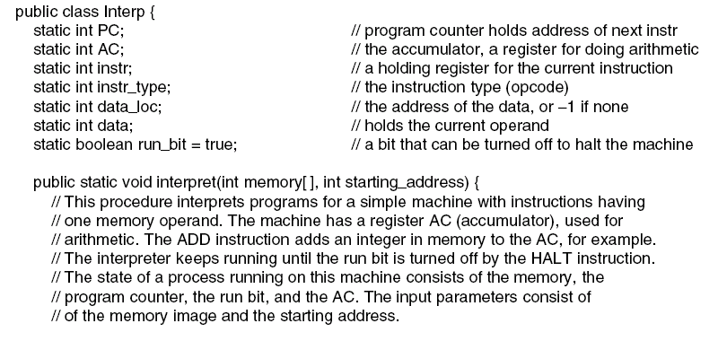
Interpreter (1)
…
An interpreter for a simple computer (written in Java).

Slide 7
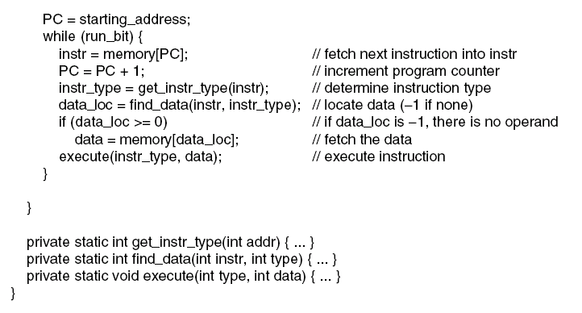
Interpreter (2)
…
An interpreter for a simple computer (written in Java).

Slide 8
CISC
(Complex Instruction Set Computer)
Origin:
  Initial instruction set and computer architecture
  Hardware designed to facilitate software languages and programming
Instruction
  Complex, defined based on software and/or application requests
CPI (cycles per instruction)
  Increase with instruction complexity

Slide 9
CISC
(Complex Instruction Set Computer) – cont'd
Classic CISC processor
  Motorola 68000
  Intel 8088, 8086, 80286
Early CISC got out of hand
  How to get more accomplished faster? One way is to reduce CPI
  < 10% of instruction execute 90% of the time … results in wasted hardware and large size

Slide 10
The architecture fix to early CISC
To reduce the CPI, the instructions had to get easier and faster
  CPI = 1 goal
  Instructions should be easily decoded (fewer, simpler instruction)
Memory accesses are slow and a major processor speed impediment
  Add more register for fewer memory access
  Force to use register by limiting memory access to load and store
Result in a “Reduced Instruction Set Computer” (RISC)

Slide 11
RISC
Reduced Instruction Set Computer
Origin:
  1980 Berkeley: David Patterson and Carlo Sequin
  1981 Stanford: John Hennessy
Addressing
  Load/Store
Instruction:
  Fixed length (typically word length), minimal format

Slide 12
Design Principle for Modern Computers
(RISC design principle)
All instructions directly executed by hardware
  Eliminate a level of interpretation provides high speed for most instructions
Maximize rate at which instructions are issued
  Increase number of instructions per second (MIPS)
  Parallelism can play a major role in improving performance

Slide 13
Design Principle for Modern Computers
(RISC design principle) – cont'd
Instructions should be easy to decode
  Making instruction regular, fixed length.
  Fewer different formats for instruction, the better
Only loads, stores should reference memory
  Most instruction come from/return to CPU registers
  Only LOAD, STORE instructions should reference memory
Provide plenty of registers
  At least 32 registers

Slide 14
If RISC was so great, why did CISC still exist?
Backward compatibility
CISC instructions set with RISC micro-operation execution cores

Slide 15
Speed up CPU computing capacity?
Increasing clock speed.
  Up-bound?
Parallelism
  Instruction-level parallelism (ILP)
  Processor-level parallelism (PLP)

Slide 16
Speed up CPU computing capacity?
Increasing clock speed. Up-bound?
Parallelism
  Instruction-level parallelism (ILP)
  Processor-level parallelism (PLP)

Slide 17
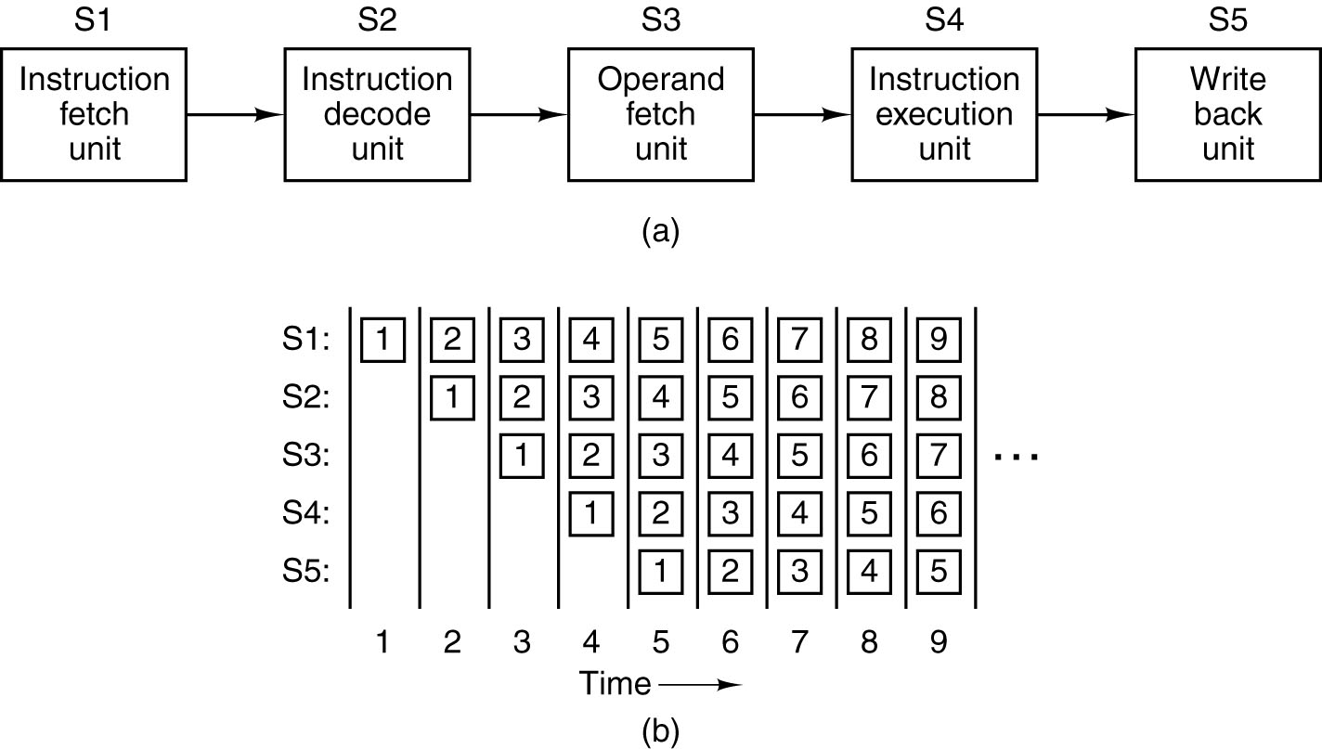
Instruction-Level Parallelism
A five-stage pipeline
The state of each stage as a function of time. Nine clock cycles are illustrated

Slide 18
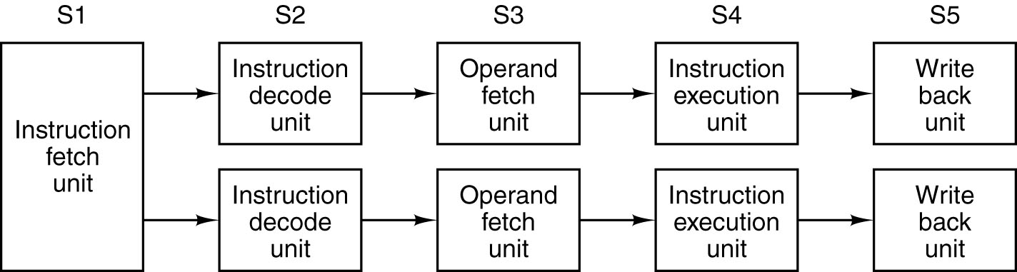
Dual Pipeline
If one pipeline is good, then surely two pipelines are better
Pentium processor has two five-stage pipelines
Dual five-stage pipelines with a common instruction fetch unit

Slide 19
Dual Pipeline
Pentium two-issue superscalar
  U-pipeline (main): execute all Pentium instructions
  V-pipeline (sub): execute simple Pentium instr. when there are no conflicts
Dual five-stage pipelines with a common instruction fetch unit

Slide 20
Multi-Pipeline?
More than 2 pipeline is so complicated
Different approach:
  Instruction issue rate is much higher than the execution rate, then the workload spread across a collection of functional units
  CPU with 100ns clock ↔ CPU with 400ns clock that issues 4 instructions per cycle.

Slide 21
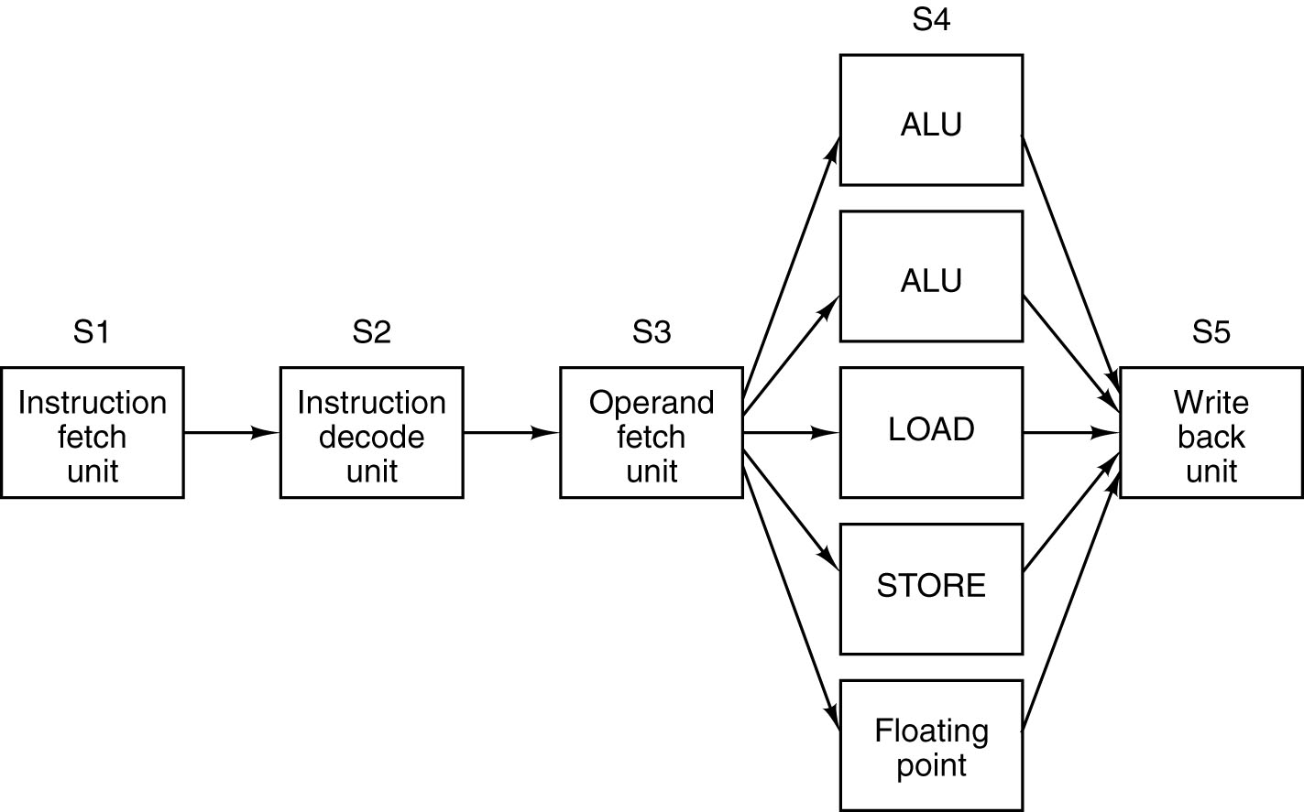
Superscalar Processor
Stage 4 have functional units take longer than one clock cycle to execute (e.g access memory, floating-point arithmetic)
A superscalar processor with five functional units
Pentium II concept

Slide 22
Speed up CPU computing capacity?
Increasing clock speed. Up-bound?
Parallelism
  Instruction-level parallelism (ILP)
  Processor-level parallelism (PLP)

Slide 23
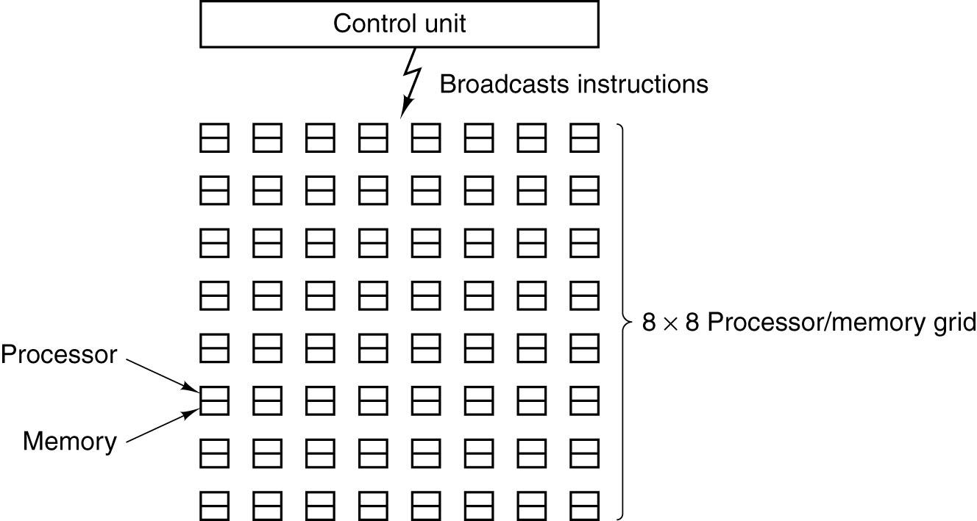
Processor-level Parallelism (1)
An array of processor of the ILLIAC IV type
(first array processor at UIUC 1972)

Slide 24
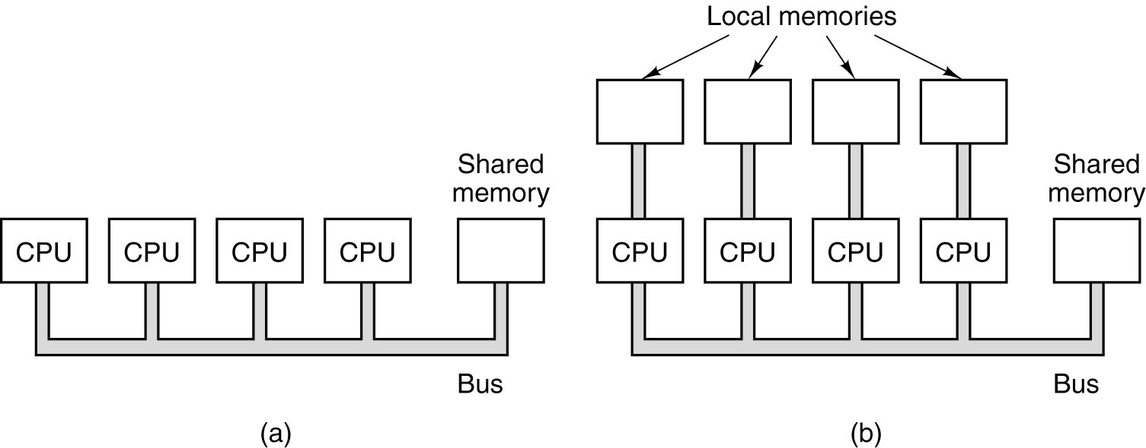
Processor-level Parallelism (2)
A single-bus multiprocessor.
A multicomputer with local memories.

Slide 25
Primary Memory
Memory Addresses
Given 2^10 bits, how is the memory organized:
1024 1-bit cells
128 8-bit bytes
64 16-bit words
32 32-bit words
Each could have a different means of addressing: bit-level, byte-level, word(?)-level ...

Slide 26
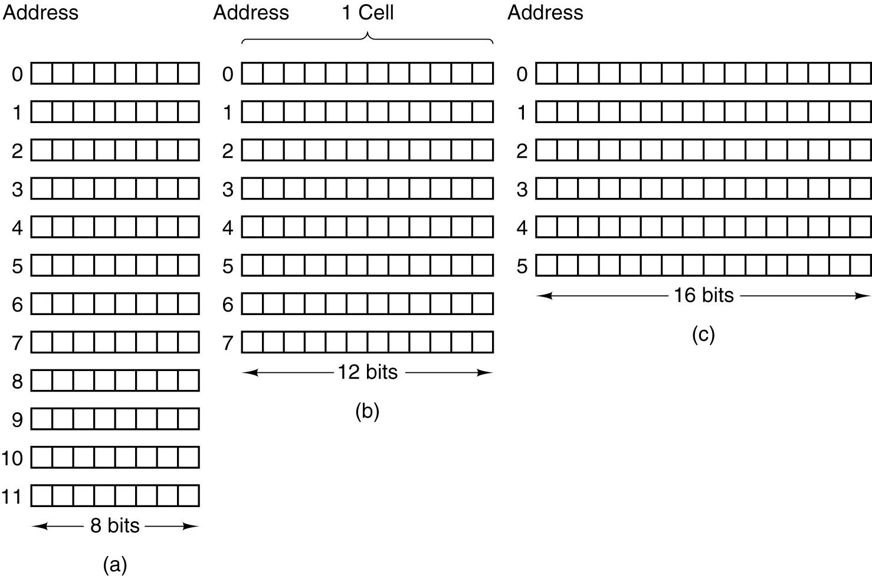
Primary Memory
Memory Addresses
Three ways of organizing a 96-bit memory

Slide 27
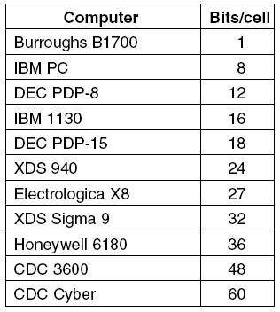
Primary Memory
Memory Addresses
A memory with 2^12 cells of 8 bits each and a memory with 2^12 cells of 64 bits each need 12-bit addresses
Number of bits per cell for some historically
interesting commercial computers

Slide 28
Primary Memory
Memory Addresses
Note:
  Most PC based processors use byte-addressing
  Others use word-addressing, particularly DSP and microcontroller
A byte-addressable 32-bit (memory addresses) computer can address 2^32 = 4GB
Intel 8086 (16-bit) supported 20-bit addressing, allowing it to access 1 MiB.

Slide 29
Primary Memory
Memory Addresses
When a modern computer reads from or writes to a memory address, it will do this in word sized chunks
Byte aligned storage is typically required
  16-bit words start at multiple of 2
  32-bit words start at multiple of 4
  If not?

Slide 30
Alignment
struct mydata {
int a; //4
char b; //1
int c; //4
char d; //1
char e; //1
float t; //4
};
?
cout<<"Size = " << sizeof(mydata) <<endl;
struct mydata2 {
double x; //4
char n[1]; //
};
?
cout<<"Size = " << sizeof(mydata2) <<endl;

Slide 31
Padding
padding = (align - (offset mod align)) mod align
new offset = offset + padding
Typical padding
A char (one byte) will be 1-byte aligned.
A short (two bytes) will be 2-byte aligned.
An int (four bytes) will be 4-byte aligned.
A long (four bytes) will be 4-byte aligned.
A float (four bytes) will be 4-byte aligned.
A double (eight bytes) will be 8-byte aligned on Windows and 4-byte aligned on Linux (8-byte with -malign-double compile time option).
Any pointer (four bytes) will be 4-byte aligned. (e.g.: char*, int*)
See http://en.wikipedia.org/wiki/Data_structure_alignment

Slide 32
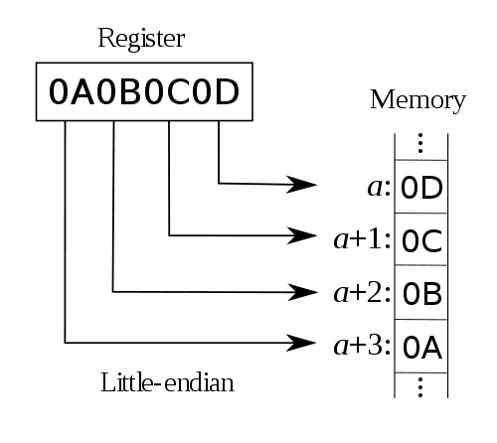
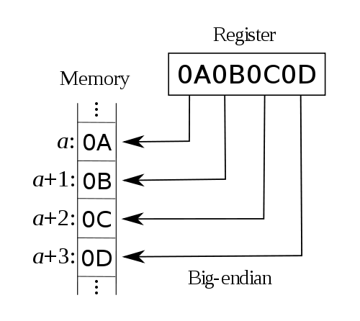
Byte Ordering
Big endian vs Little endian
From http://en.wikipedia.org/wiki/Endianness

Slide 33
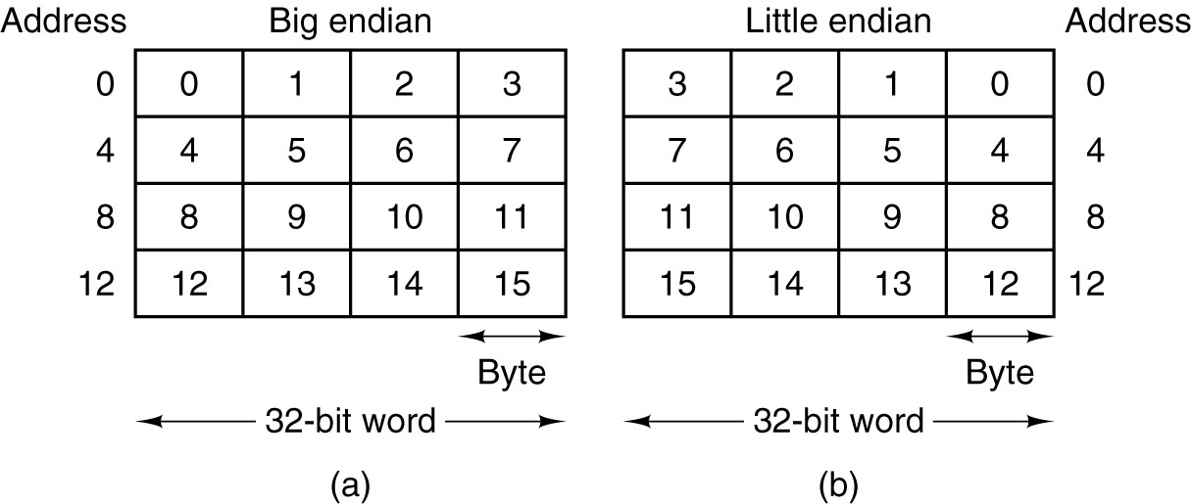
Byte Ordering
Big endian vs Little endian
(a) Big endian memory (b) Little endian memory

Slide 34
Byte Ordering
Big endian vs Little endian
Question: illustrate following struct memory organization under big-endian and little-endian machine
struct {
char c //(“A”)
int i //(21)
}

Slide 35
Byte Ordering
Big endian vs Little endian
Question: illustrate following struct memory organization under big-endian and little-endian machine
(char*) JIM SMITH
(int) 21
(int) 260

Slide 36
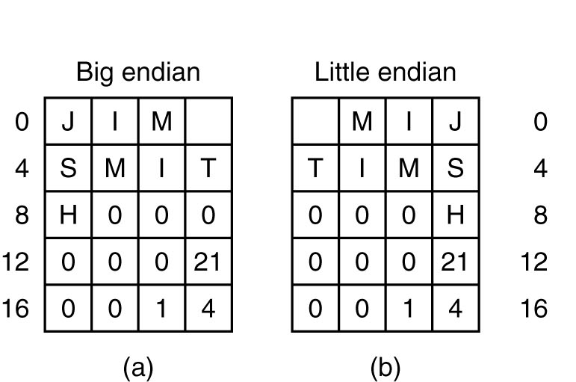
Byte Ordering
Big endian vs Little endian
Name:(Char*) JIM SMITH
Age:(int) 21
Department:(int) 260
(a) Big endian memory
(b) Little endian memory

Slide 37
Problem
Write a C/C++ program to determine the current running computer is big-endian or little-endian

Slide 38
Why is this really importance?
Big endian | Little endian
SPARC (Sun Micro) Motorola 68000 PowerPC | Intel IBM(typically)
“Well-known processor architectures that use the little-endian format include:
x86 (including x86-64), 6502 (including 65802, 65C816), Z80 (including Z180, eZ80 etc.), MCS-48, 8051, DEC Alpha, Altera Nios, Atmel AVR, SuperH, VAX, and, largely, PDP-11.”
“Well-known processors that use the big-endian format include:
Motorola 6800 and 68k, Xilinx Microblaze, IBM POWER, and System/360 and its successors such as System/370, ESA/390, and z/Architecture.”
Bi-endian: ARM versions 3 and above, PowerPC, Alpha, SPARC V9, MIPS, PA-RISC and IA-64
From http://en.wikipedia.org/wiki/Endianness

Slide 39
Error Correcting Codes (1)
The bits in a data transfer can become corrupted.
  More likely with modem or wireless transmission
  Bus can have bit errors!
If you expect there to be a high probability that bits in a byte/word will be corrupted, encode!

Slide 40
Error Correcting Codes (2)
Parity Bit
  For EVEN parity, the sum of all the bits must be even (0110 = 0+1+1+0=2)
  For ODD parity, the sum of all the bits must be odd (1011 = 1+0+1+1=3)
  One more bit is added to the binary data to make the “bit field” EVEN or ODD
Notes
  It works really well with 7-bit ASCII to create an 8-bit word !
  Also 9-bit memory ICs, used for 8-bits and parity

Slide 41
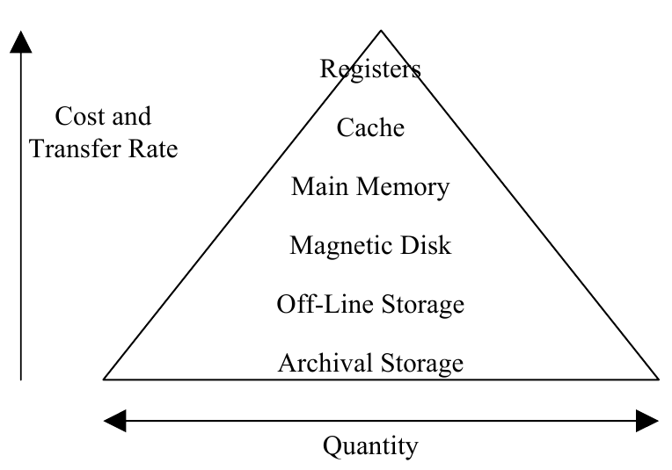
Memory Hierarchy Pyramid
Single clock cycle access
Multiple clock cycles access
10's – 100's clocks cycle access
100's clock cycles
access or more
Removable disks. 1000's clock
cycles access or more
“Overnight achieves”

Slide 42
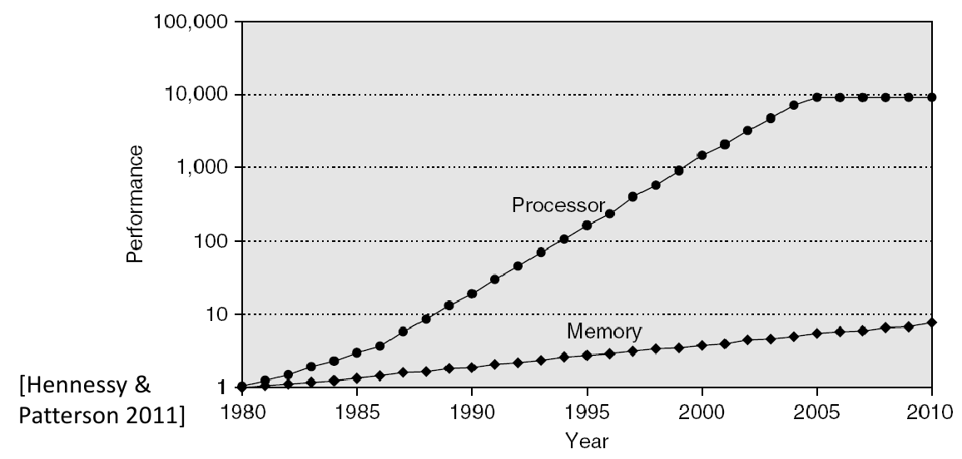
Processor-DRAM Latency Gap

Slide 43
Cache Memory
Fact:
  CPU goes in vertical
  Memory goes in horizon
Build memory inside CPU chip?
  Cost
Combination?
  Small amount of fast memory
  Large amount of slow memory

Slide 44
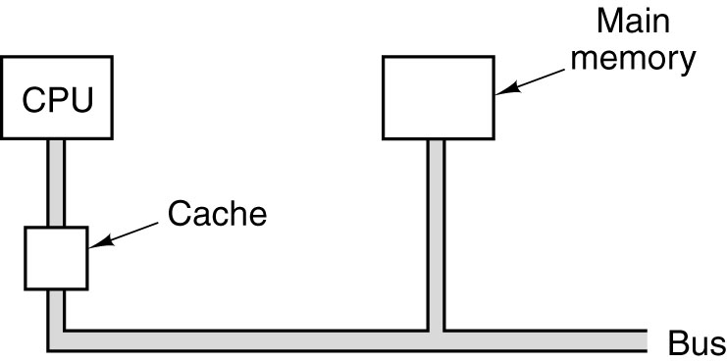
Cache Memory
Observation: 90% time to execute 10% instructions overall
Idea: the most heavily used memory words are kept in the cache. When the CPU need a word, it first looks in the cache

Slide 45
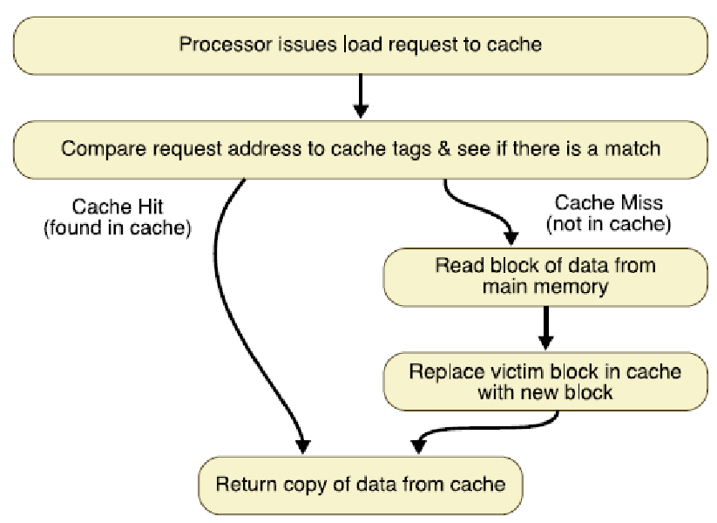
Basic Cache Algorithm for Load

Slide 46
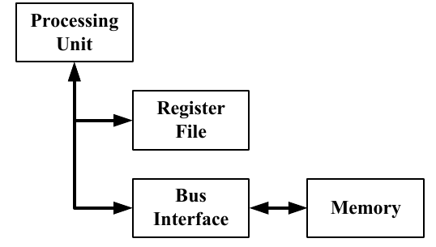
Average Memory Access Time
Registers and Main Memory (1)

Slide 47

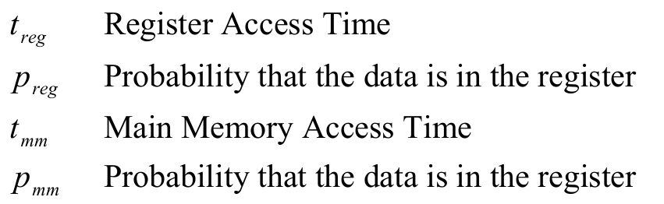

Average Memory Access Time
Registers and Main Memory (2)
Average memory access time
Where:
Defined:

Slide 48

Average Memory Access Time
Registers and Main Memory (3)
Defined:

Slide 49
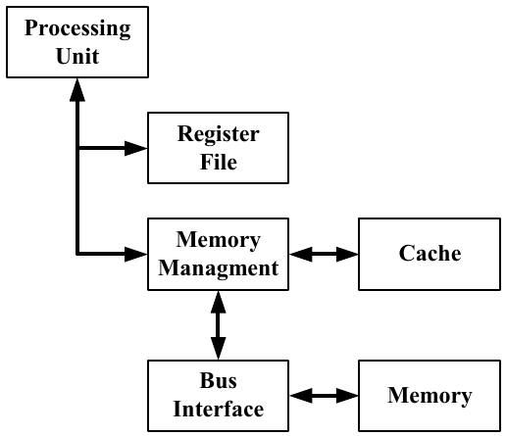
Average Memory Access Time
Registers, Cache, and Main Memory (1)

Slide 50
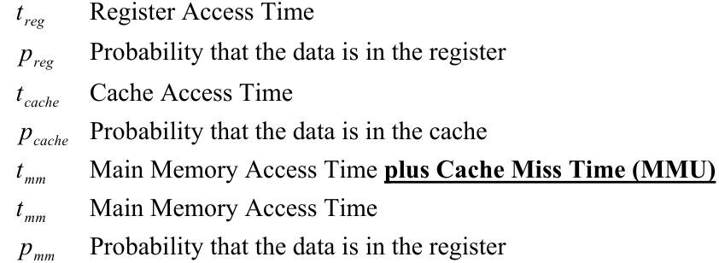
Average Memory Access Time
Registers, Cache, and Main Memory (2)
Average memory access time
Where:

Slide 51
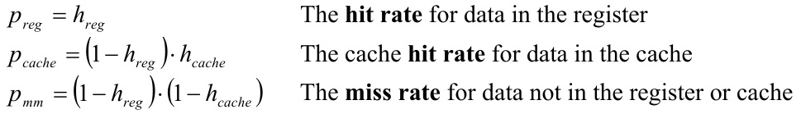



Average Memory Access Time
Registers, Cache, and Main Memory (3)
Defined:

Slide 52
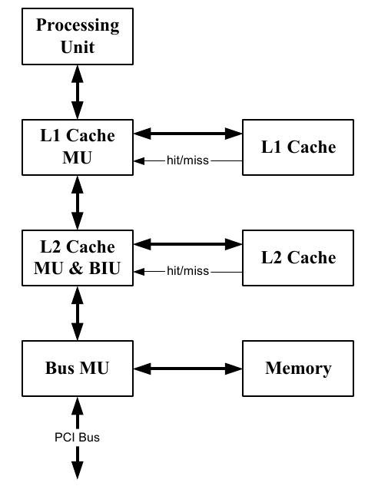
Average Memory Access Time
L1, L2 Cache, and Main Memory (1)

Slide 53
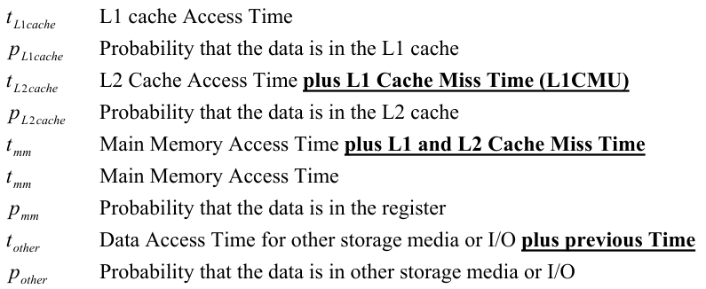
Average Memory Access Time
L1, L2 Cache, and Main Memory (2)

Slide 54
Cache Memory
Modern machines typically have split L1 caches.
  Level 1 Instruction Cache: Optimized for threads of execution, support for branching, integrated with intelligent instruction fetch and preprocessing units. Focus on filling from higher level caches and main memory. It does not typically need to write-back instruction to main memory.
  Level 1 Data Cache: Optimized for data handling. Facilitate data fetching for computations and data write back of results.
Therefore, the cache controllers are concerned about different “cache policies and procedures”.

Slide 55
Mapping Functions
Cache of 64kByte
Cache block of 4 bytes
  i.e. cache is 16k (214) lines of 4 bytes
16MBytes main memory
  24 bit address
  (22^4=16M)

Slide 56
Direct Mapping
Each block of main memory maps to only one cache line
  i.e. if a block is in cache, it must be in one specific place
Address is in two parts
Least Significant w bits identify unique word
Most Significant s bits specify one memory block
The MSBs are split into a cache line field r and a tag of s-r (most significant)

Slide 57
Direct Mapping: Address Structure
24 bit address
2 bit word identifier (4 byte block)
22 bit block identifier
  8 bit tag (=22-14)
  14 bit slot or line
No two blocks in the same line have the same Tag field
Check contents of cache by finding line and checking Tag
Tag s-r
Line or Slot r
Word w
8
14
2

Slide 58
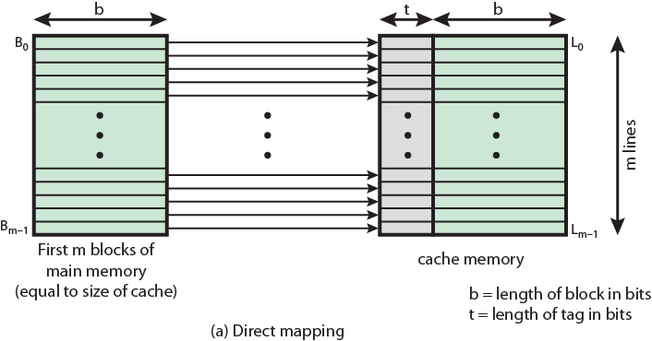
Direct Mapping: From Cache to Memory

Slide 59
Direct Mapping: Cache Line Table
Cache line | Main Memory blocks held
0 | 0, m, 2m, 3m…2s-m
1 | 1,m+1, 2m+1…2s-m+1
…
m-1 | m-1, 2m-1,3m-1…2s-1

Slide 60
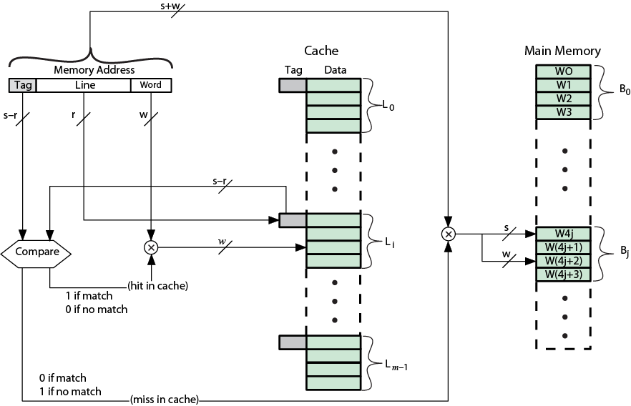
Direct Mapping: Cache Organization

Slide 61
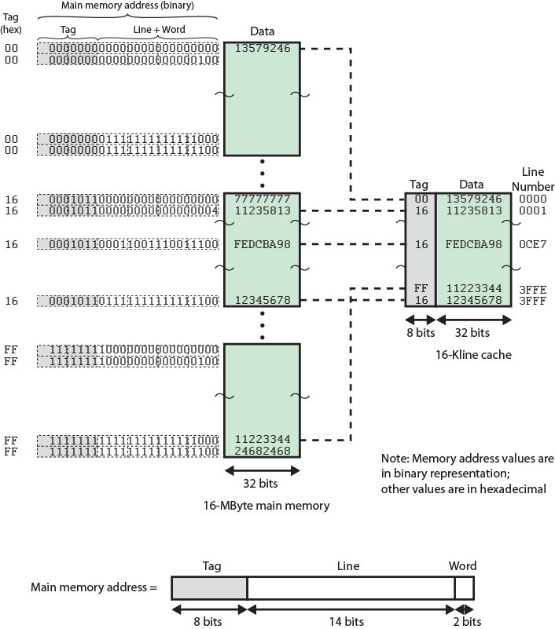

Slide 62
Direct Mapping: Summary
Address length = (s + w) bits
Number of addressable units = 2^(s+w) words or bytes
Block size = line size = 2^w words or bytes
Number of blocks in main memory = 2^(s+ w)/2^w = 2^s
Number of lines in cache = m = 2^r
Size of tag = (s – r) bits

Slide 63
Direct Mapping: Pros & Cons
Simple
Inexpensive
Fixed location for given block
  If a program accesses 2 blocks that map to the same line repeatedly, cache misses are very high

Slide 64
Victim Cache
Lower miss penalty
Remember what was discarded
  Already fetched
  Use again with little penalty
Fully associative
4 to 16 cache lines
Between direct mapped L1 cache and next memory level

Slide 65
Associative Mapping (AM)
A main memory block can load into any line of cache
Memory address is interpreted as tag and word
Tag uniquely identifies block of memory
Every line’s tag is examined for a match
Cache searching gets expensive

Slide 66
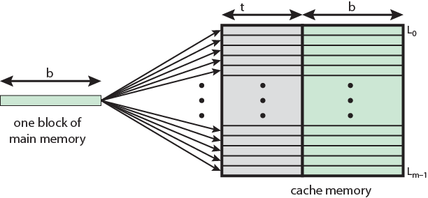
AM: Cache to Memory

Slide 67
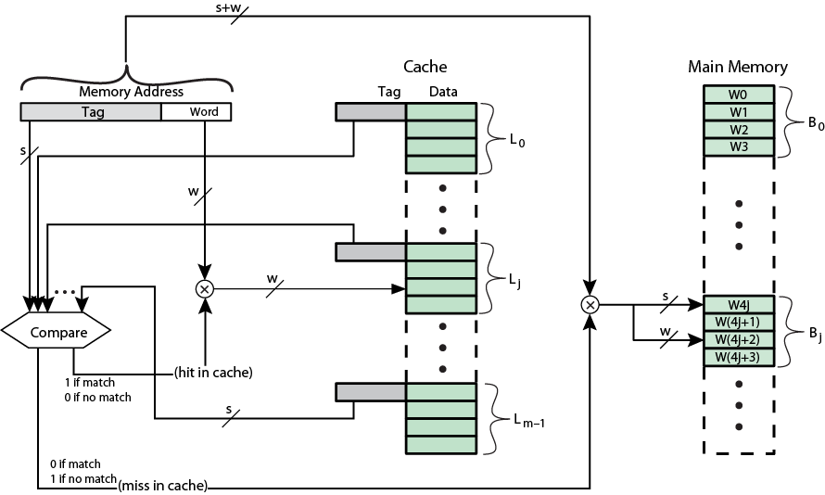
Fully Associative Cache Organization

Slide 68
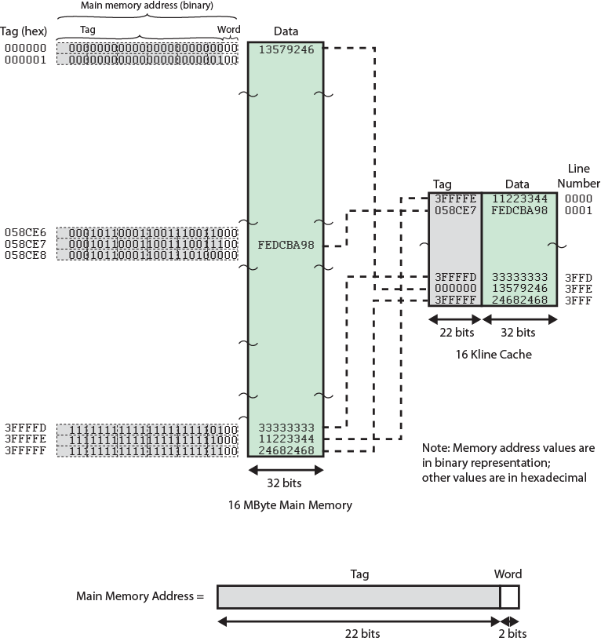

Slide 69
AM: Address Structure
22 bit tag stored with each 32 bit block of data
Compare tag field with tag entry in cache to check for hit
Least significant 2 bits of address identify which 16 bit word is required from 32 bit data block
e.g.
  Address Tag Data Cache line
  FFFFFC FFFFFC 24682468 3FFF
Word
2 bit
Tag 22 bit

Slide 70
AM: Summary
Address length = (s + w) bits
Number of addressable units = 2^(s+w) words or bytes
Block size = line size = 2^w words or bytes
Number of blocks in main memory = 2^(s+ w)/2^w = 2^s
Number of lines in cache = undetermined
Size of tag = s bits

Slide 71
Memory Hierarchy Pyramid (again)
Single clock cycle access
Multiple clock cycles access
10's – 100's clocks cycle access
100's clock cycles
access or more
Removable disks. 1000's clock
cycles access or more
“Overnight archieves”

Slide 72
IC Memory Types
ROM
  Read-only Memory
  Permanent storage (boot code, embedded code)
SRAM
  Static Random Access Memory: cache and high speed access
DRAM
  Dynamic Random Access Memory: Main Memory
EPROM
  Electrically programmable read-only memory
  Replace ROM when reprogramming required

Slide 73
IC Memory Types
EEPROM
  Electrically erasable, programmable read-only memory.
  Alternative to EPROM, limited but regular reprogramming,
  Device configuration info during power down
FLASH
  An advancement on EEPROM technology allowing blocks of memory location to be written and cleared at one time instead. Found in thumb drives/memory stick or as solid-state hard disks.
Note: EEPROM and FLASH have lifetime write cycle limitations!

Slide 74
Secondary Memory
Magnetic, CD …

Slide 75
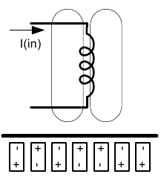
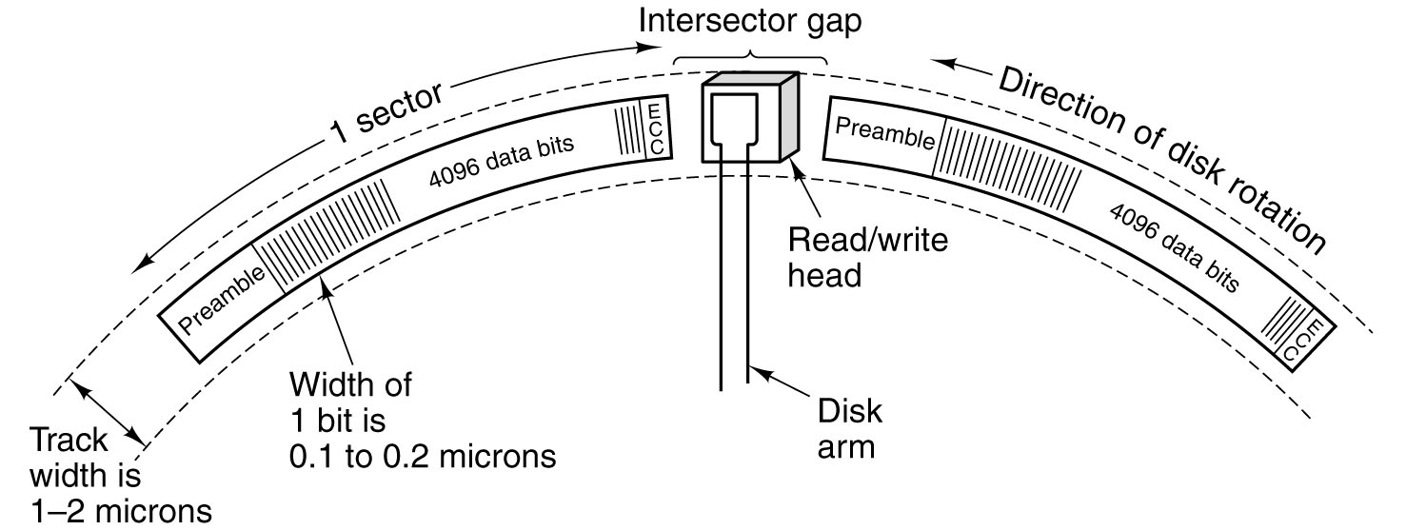
Magnetic Disks
Electronic Coil Writing/Reading Magnetic Medium
Synchronization information
A portion of a disk track. Two sectors are illustrated.

Slide 76
Magnetic Disks
Track
  A radial spaced circle on a platter for storing data.
  Typically 5,000 to 10,000 tracks per centimeter on a platter or 1-2 micron track widths.
Sector
  A fixed bit-length section of a track.
  There are multiple sectors in a track.
  A typical sector contains: a preamble, 512 Bytes or 4096 bits, and error correction code bits.
  Between sectors on a track are inter-sector gaps.

Slide 77
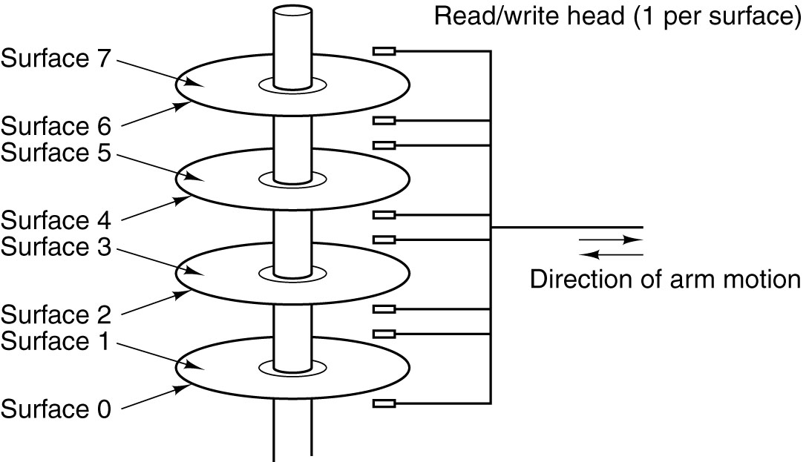
Magnetic Disks
A disk with four platter

Slide 78
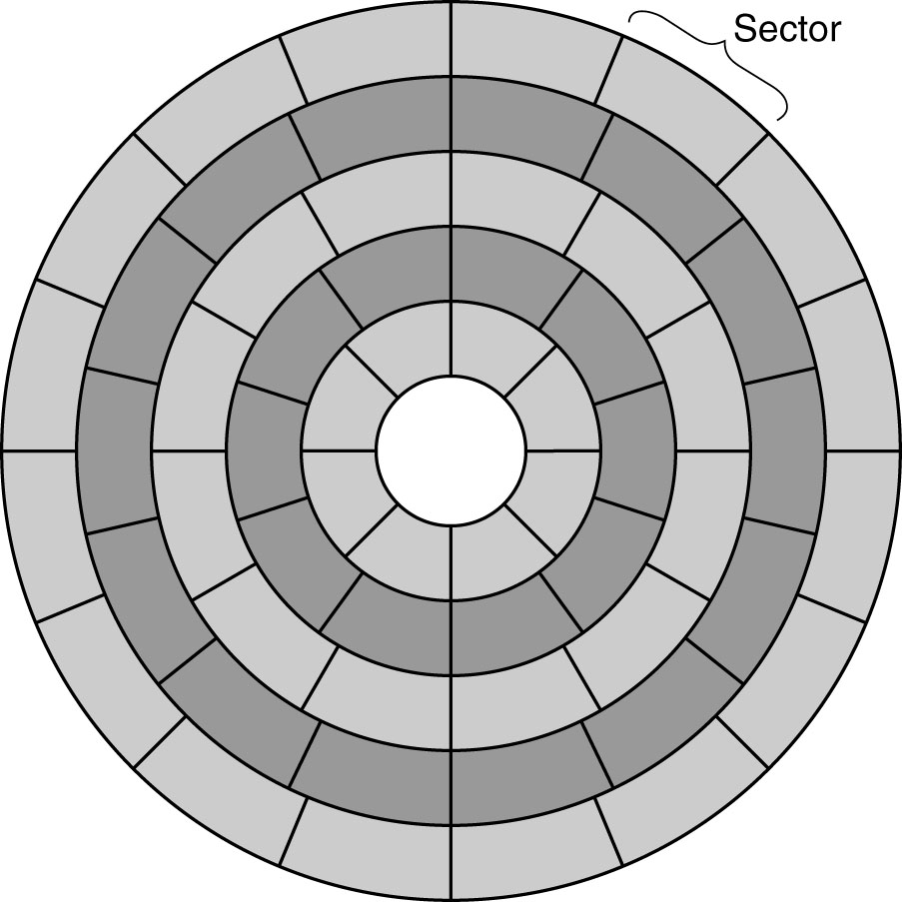
Magnetic Disks
A disk with five zones. Each zone has many tracks

Slide 79
Speed up the Transfers
Disk Controllers:
Typically includes buffer memory space for rapid burst transfers.
May (must) allow simultaneous access to the multiple tracks in a cylinder.
Performs the ECC generation, testing, and corrections
Can provide a mapping table of good and bad sectors.

Slide 80
ATA vs SATA vs SCSI
IDE → EIDE → ATA → SATA: IDE disks
SCSI disk
  Differ from IDE disk in the interface
  Higher data rate
  More than one devices in the bus can operate (compare to 1 active device of IDE/EIDE)
Current trend: SATA

Slide 81
RAID (1)
Redundant Array of Inexpensive Disks
Example from Intel Modular, a strong web server
CPU: 2 x Intel® Nehalem-EP Xeon Quad Core Gainestown E5520 ( 2.26GHz 8-Threads 2x6.4GT/s 8MB(L3))
RAM: Kingston DDR3 PC-8400 12GB/1066/Ecc/Reg Intel Certifield
HDD: 14 x Seagate 2.5" 300G/SAS/10Krpm Version 2.0 (RAID 5)

Slide 82
Note: Hard disk provides low bandwidth and is quite easily to fail!
Ideas: Use a box full of hard disks to allow:
Higher data transfer and storage rates (operate disks in parallel)
Higher degrees of redundancy (save on multiple disks simultaneously), and
Higher degree of error detection and correction (Additional ECC)

Slide 83
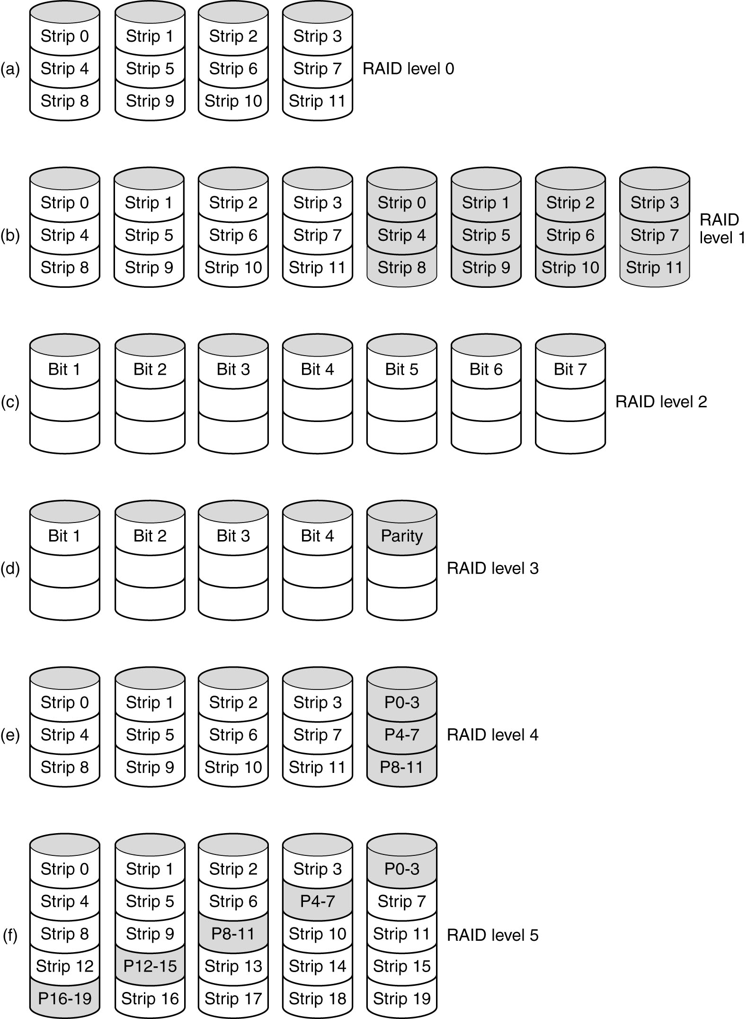
RAID (2)
Redundant Array of Inexpensive Disks
RAID levels 0 through 2.
Backup and parity disks are shown shaded.

Slide 84
RAID (3)
Redundant Array of Inexpensive Disks
Level | Description | Feature
RAID 0 | Block-level striping | Speed Increase
RAID 1 | Mirroring | Redundancy
RAID 2 | Bit-level striping with error-correcting code Drives were synchronized | Faster with conditional 1 drive failure recovery

Slide 85
RAID (4)
Redundant Array of Inexpensive Disks
RAID levels 3 through 5.
Backup and parity disks are shown shaded.

Slide 86
RAID (5)
Redundant Array of Inexpensive Disks
Level | Description | Feature
RAID 3 | Byte-level striping with parity (Simple version of level 2) | Faster with 1 drive failure recovery (with parity bit?)
RAID 4 | Block-level striping with parity (XOR calculation) | Faster with 1 drive failure recovery
RAID 5 | Block-level striping with distributed parity Eliminated the bottleneck of parity disk in level 4 | Faster with conditional 1 drive failure recovery

Slide 87
Question
How ECC with parity bit in RAID level 3 has “recovery” feature?
Why RAID level 4 and RAID level 5 utilize XOR function but not AND or OR?
Why RAID level 5 is considered to be more fairly distributing in utilizing among disks than level 4?
Total storing capacity of n disk in RAID level 0, 1, 2, 3, 4, and 5?

Slide 88
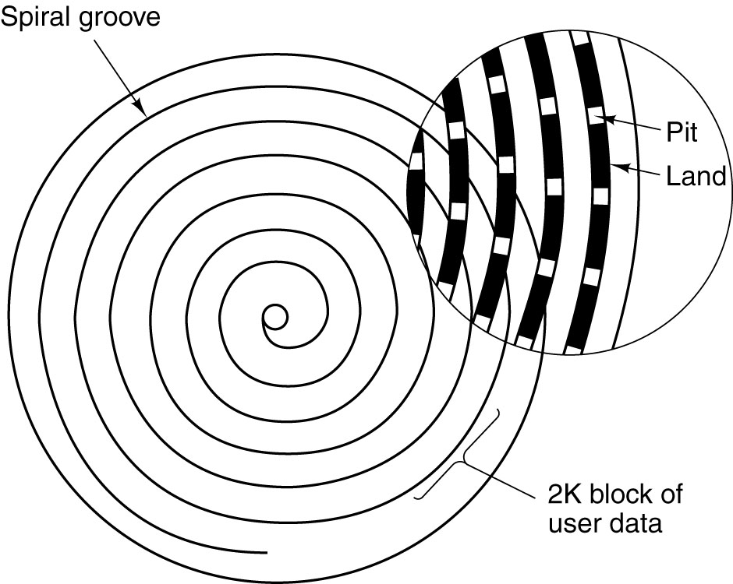
CD-ROM
Recording structure
of CD-ROM
Bit=1 Transitions from pit to land OR transitions from land to pit
Bit=0 No transition of the data.

Slide 89
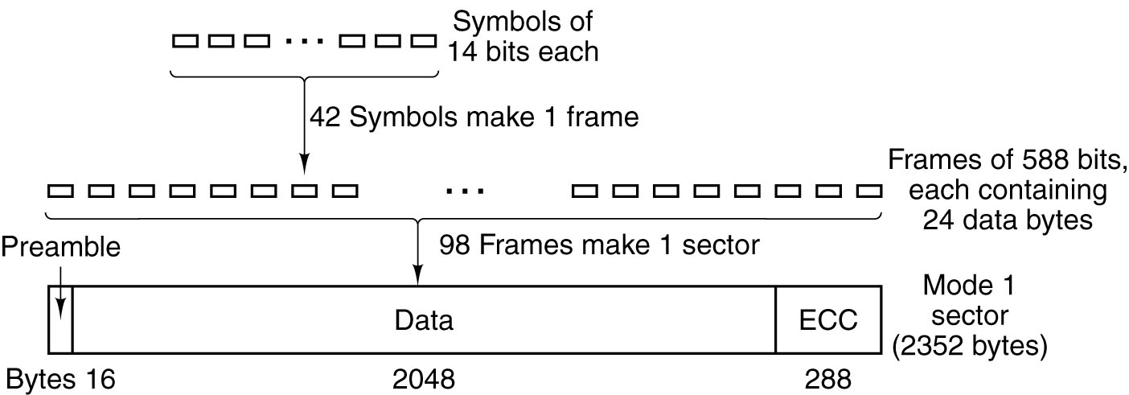
CD-ROM
Logical data layout on a CD-ROM

Slide 90
CD Storage Requirement
Audio Format Storage Requirement:
74 min. Audio: 44,100 samples/channel/second x 2 bytes/sample x 2 channels x 74 minutes x 60 seconds/minute = 783,216,000 bytes
80 min. Audio: 44,100 samples/channel/second x 2 bytes/sample x 2 channels x 80 minutes x 60 seconds/minute = 846,720,000 bytes

Slide 91
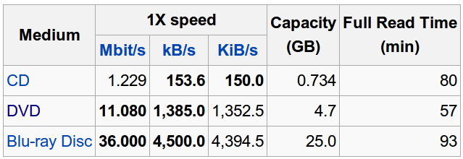
Operating Rate
http://en.wikipedia.org/wiki/CD_and_DVD_writing_speed

Slide 92
DVD
Name
  Digital Video Disk (originally)
  Digital Versatile Disk (now)
A higher density version of the CD.
  Smaller pits
  Tighter spiral
  Different laser with a reduced spot size (more expensive)
  Advanced versions with multiple layers (dual layer, top and bottom)

Slide 93
Operating Rate
Total Data: 4.7 GB (single-sided, single layer)
  133 min of 720x480 high-resolution video, 8-language sound track, and 32 subtitles. (Fit 92% of all Hollywood movies)
Potential DVD Capacities:
  Single-sided, single layer 4.7 GB
  Single-sided, dual layer 8.5 GB
  Double-sided, single layer 9.4 GB
  Double-sided, dual layer 17.0 GB

Slide 94
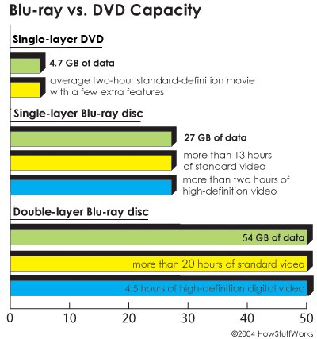
Blue-Ray
http://www.howstuffworks.com/blu-ray.htm

Slide 95
Input/Output
Bus, Terminal, Mice, Printer, Tel Com

Slide 96
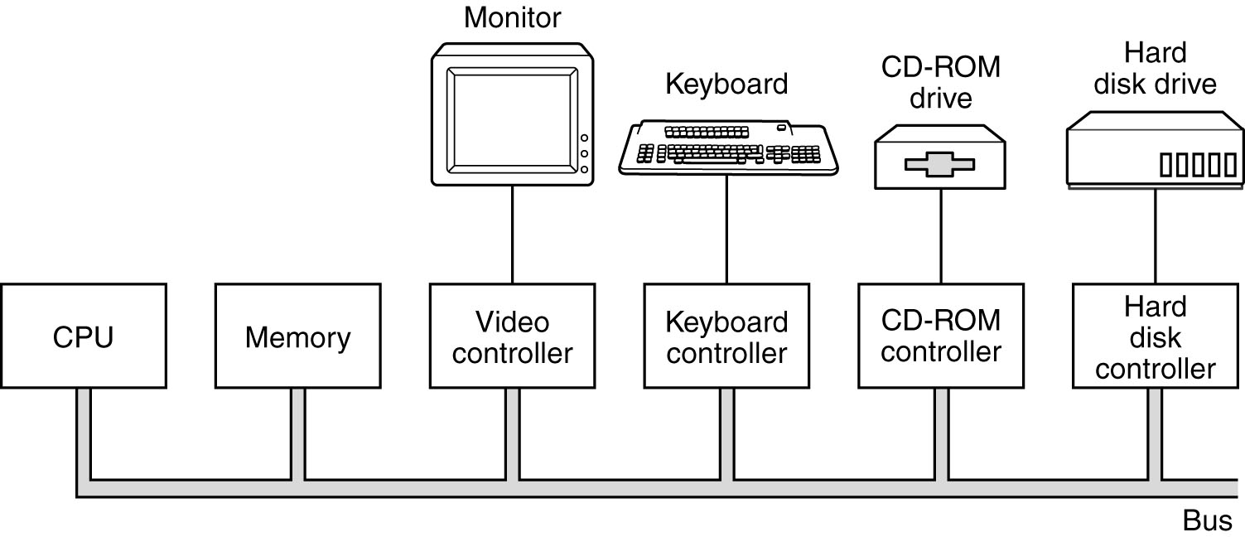
Single Bus System
Old Omnibus, Unibus, Single-bus System

Slide 97
Aspects of Bus
One operation at a time
  Buses include address/data/control
  Bus multiplex on one cycle with data on the next
DMA
  A controller that reads/write data to/from memory without CPU intervention is said to be performing Direct Memory Access (DMA)
Bus arbiter
  What if CPU, I/O controller want to use the bus at the same time?

Slide 98
Problems from Single Bus System
The simple bus works well when all components ware roughly in balance
Unbalance performance nowadays between components
People tend to keep printer, scanner, modem when upgrading their PC
→ Solution: multiple buses

Slide 99
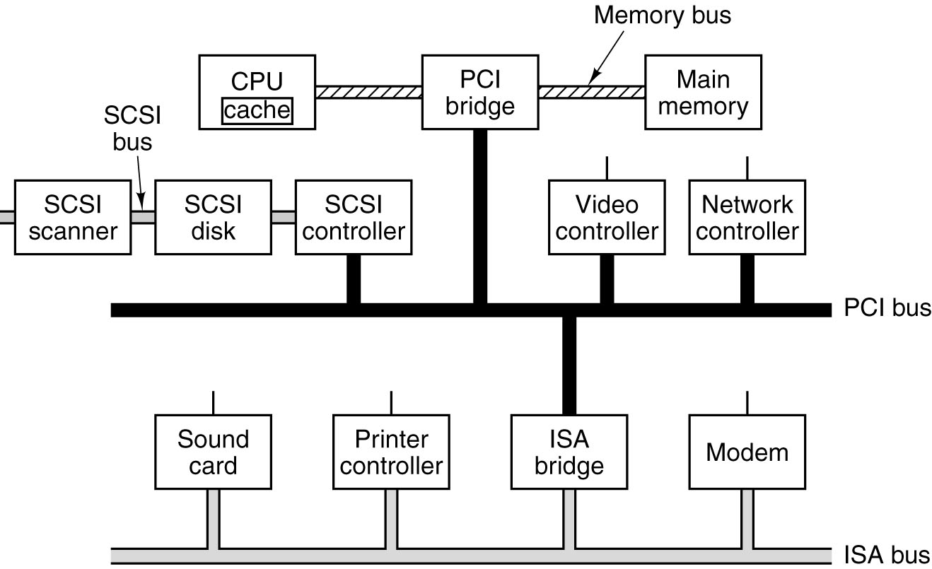
Multiple Bus System
A typical modern PC with a PCI bus and an ISA bus

Slide 100
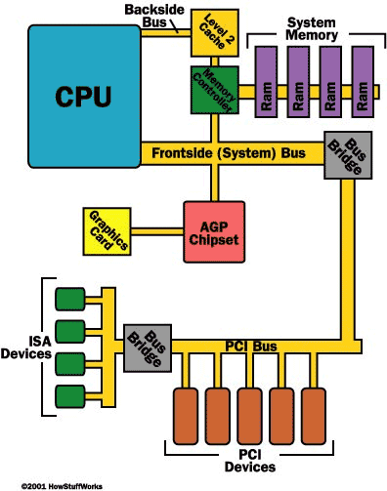
Other version
Picture from http://computer.howstuffworks.com/pci1.htm

Slide 101
Bit-map terminals
Writing pixels to the screen (4:3 aspect ratios)
VGA 640 x 480 (480i)
SVGA 800 x 600
XVGA 1024 x 768
1280 x 960
HD 1440 x 1080
1600 x 1200
Writing pixels to a high definition screen (16:9 aspect ratios)
640 x 360
800 x 450
1024 x 576
HD 1280 x 720 (720p)
1600 x 900
HD 1920 x 1080 (1080i, 1080p)

Slide 102
Byte per Pixel
1
  2^8 levels or 256 colors (the levels for RGB)
color palette
  interpretation of 256 into whatever is fixed for the value ”indexed” color
  reduce video RAM by 2/3
3
  one byte for each color - 2^8 levels or 256 each 24-bit RGB representation

Slide 103
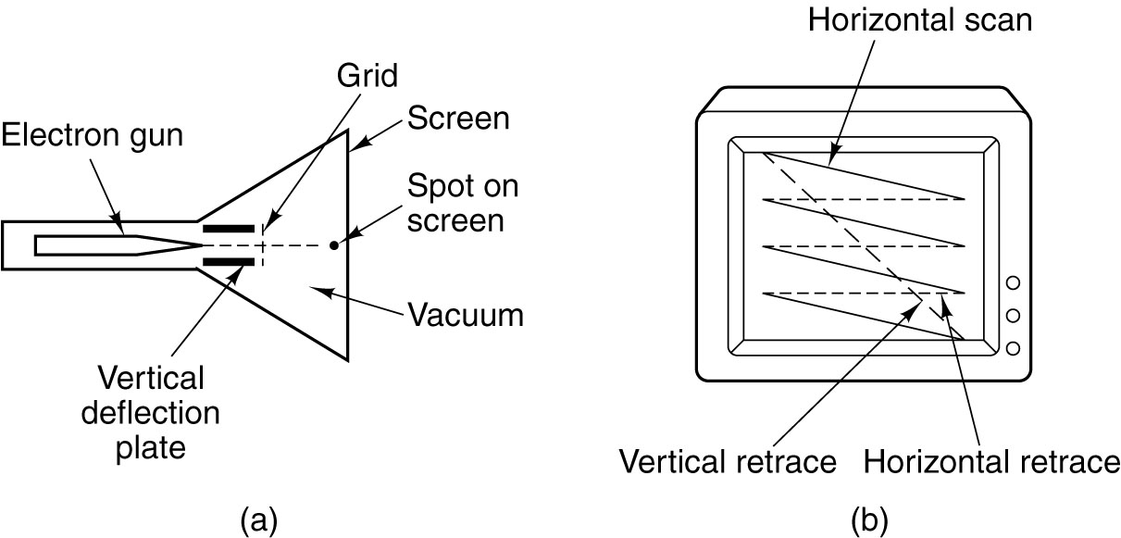
CRT Monitor
(CRT = Cathode Ray Tube)
(a) Cross section of a CRT
(b) CRT scanning pattern

Slide 104
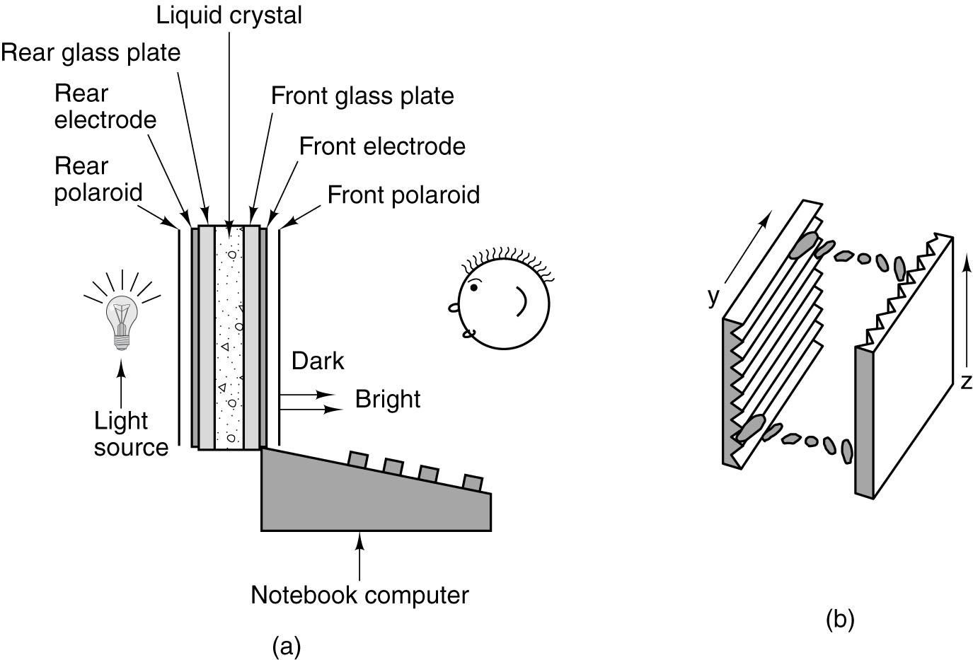
Flat Panel Displays
(a) The construction of an LCD screen.
(b) The grooves on the rear and front plates are perpendicular to one another.

Slide 105
Printer
Matrix printer
Inkjet printer
Laser printer

Slide 106
Telecommunication
Modem
DSL
Ethernet

Slide 107
MODEM – Modulator/Demodulator
Convert digital data 0’s and 1’s to audio tones.
Allow data transmission on an analog phone line (audio) which allows tones from 50Hz to 3500 Hz
Full-duplex vs Half-duplex
  Full-duplex employs different frequencies

Slide 108
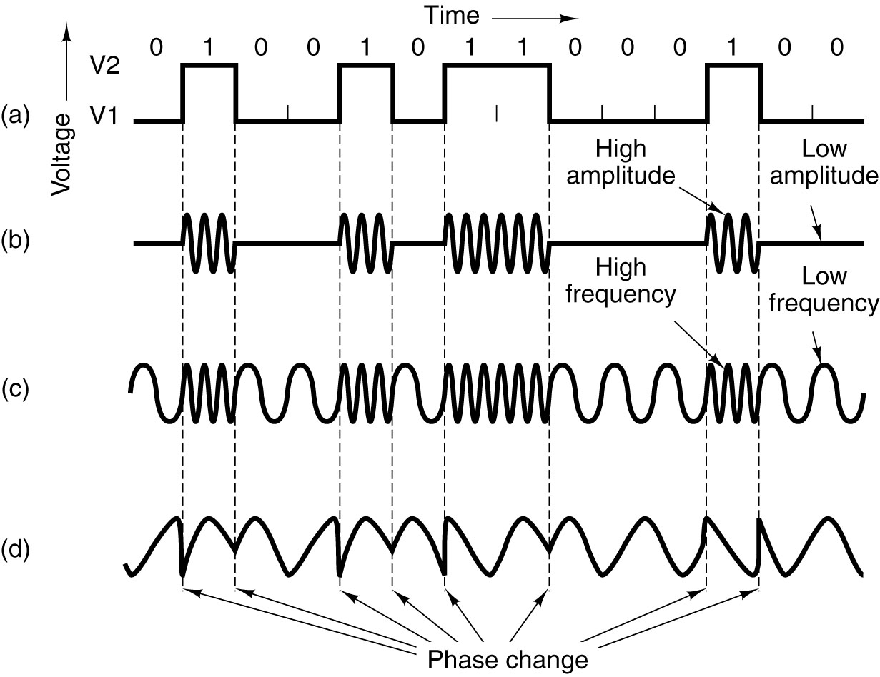
MODEM
Transmission of the binary number 01001010000100 over a
telephone line bit by bit. (a) Two-level signal. (b) Amplitude
modulation. (c) Frequency modulation. (d) Phase modulation.

Slide 109
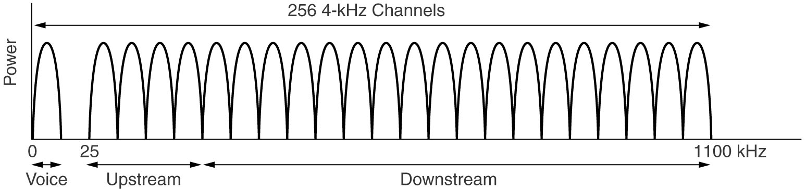
Digital Subscriber Lines
Low speed in dial-up connection due to filler in telco office (limit to 3000Hz)
xDSL
  Remove the filter
  ADSL (Asymmetric DSL)
Asymmetric

Slide 110
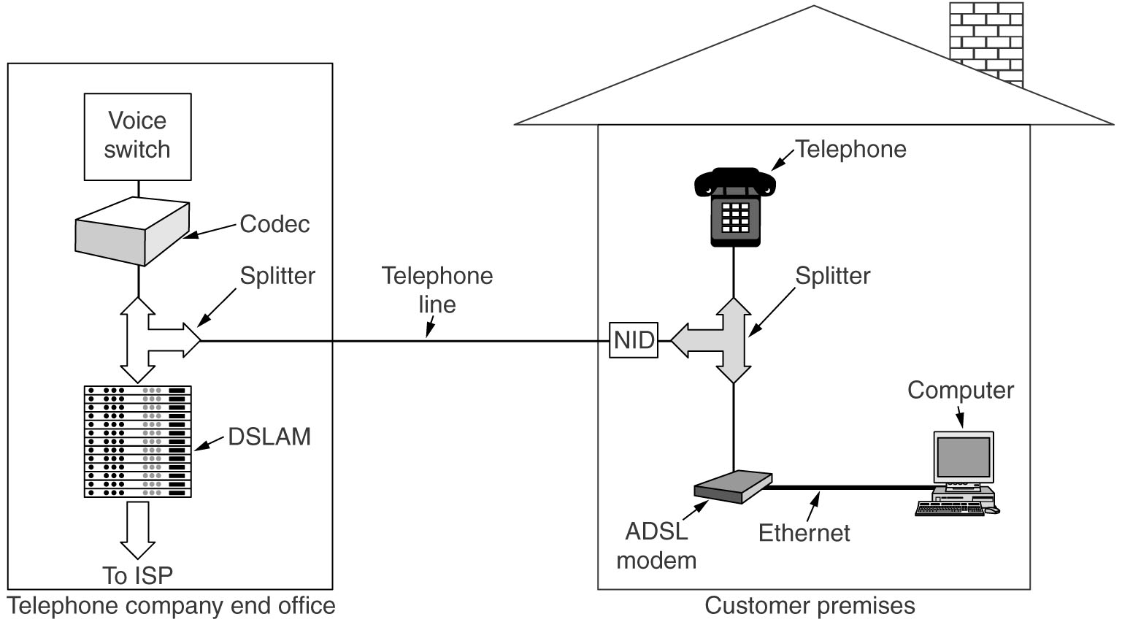
Digital Subscriber Lines
A typical ADSL equipment configuration.

Slide 111
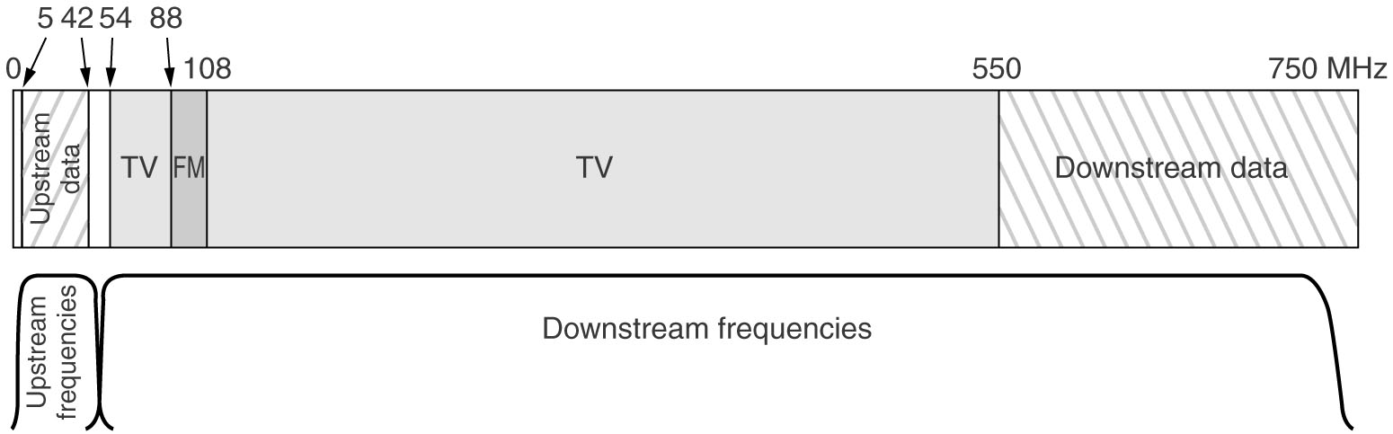
Internet over Cable
Frequency allocation in a typical cable TV system
used for Internet access
Properties:
- Hundreds of user share the same cable to the headend
- Asymmetric connection also

Slide 112

Digital Cameras

Slide 113
Digital Cameras
Four CCD make up on pixel
  4 is more convenience than 3
  Eye is more sensitive to green light than to red or blue light
  Camera maker claim 6 mpixel, means 1.5 mpixel in real

Slide 114
Bonus
Hard Disk Access Time Calculation

Slide 115
Access Time (1)
Seek time:
  First the head must be position on the right track (radial distance).
  Typical numbers: 5-15 msec.
  “Avg. seek time”: not best case, not worst case, average!
  Min. time – one track to the next
  Max. time – outer track to inner track or vice versa

Slide 116

Access Time (2)
Rotational Latency:
  The head must arrive at the correct sector on a track (rotational distance)

Slide 117
Access Time (3)
Access time = Seek time + Rotational time
Example:
  A drive with 8.9 msec avg. seek time at 7200 RPM (Western Digital WD800JBRTL drive)
  Access Time = 8.9 msec + 4.17 msec = 13.07 msec.

Slide 118
Transfer Time
Example: If there are 16 or 64 sectors on a track and the rotation rate is 7200 RPM, what is the maximum possible data transfer rate to read one sector on the disk.
7200 RPM → 8.33 msec/rev
For 16 sectors → 8.33/16 = 0.52 msec/sector
4096 bits/sector → 4096/0.00052 = 7,876,923 bits/sec ~ 0.98 MB/sec.
7200 RPM → 8.33 msec/rev
For 64 sectors → 8.33/64 = 0.13 msec/sector
4096 bits/sector → 4096/0.00013 = 31,507,692 bits/sec ~ 3.94 MB/sec.
Note: this is the maximum burst rate
doesn't include access time to get data

Slide 119
Transfer Time
How does cylinder help?
Example: If there are 16 or 64 sectors on a track and the rotation rate is 7200 RPM, what is the maximum possible data transfer rate to read one sector on the disk.
0.98 MB/sec & 3.94 MB/sec.
Note:
  To support (or even get close to) ATA rates of 100-150 MB/sec and quoted WD rate, multiple tracks in a cylinder must be read simultaneously!
  Multiply the rates defined by the number of surfaces simultaneously read, and higher rates can be achieved!

Slide 120
Example: Time to read one sector given as 10,800 RPM, 8.0 msec avg. seek time and 64 sectors per track.
Avg. Access Time = 8.0 msec + (5.56/2 msec) = 10.78 msec
Transfer time = 5.56 msec/rev / 64 sectors/rev = 0.0869 msec
Total Time = 10.78 msec + 0.0869 msec = 10.8669 msec
If this is the average data transfer rate we have,
4096 bits/10.8669 msec = 376,924 bits/sec or 46.01 kB/sec ... not very fast for “random sectors”
Fortunately, we usually read multiple sectors at a time (64).
Avg. Access Time = 8.0 msec + (2.78 msec) = 10.78 msec
Transfer time = 5.56 msec/rev / all sectors/rev = 5.56 msec
Total Time = 10.78 msec + 5.56 msec = 16.34 msec
64 x 4096 bits/16.34 msec = 16,043,084 bits/sec or 2.005 MB/sec ... much better

Slide 121
Copyright note
Slides are adopted form lecture notes of Tanenbaum, Structured Computer Organization, Fifth Edition, (c) 2006 Pearson Education, Inc.

