Slide 1
Computer Architecture
Ch3 – The Digital Logic Level
Nguyễn Quốc Đính, FIT – IUH
HCMC, Aug 2015

Slide 2
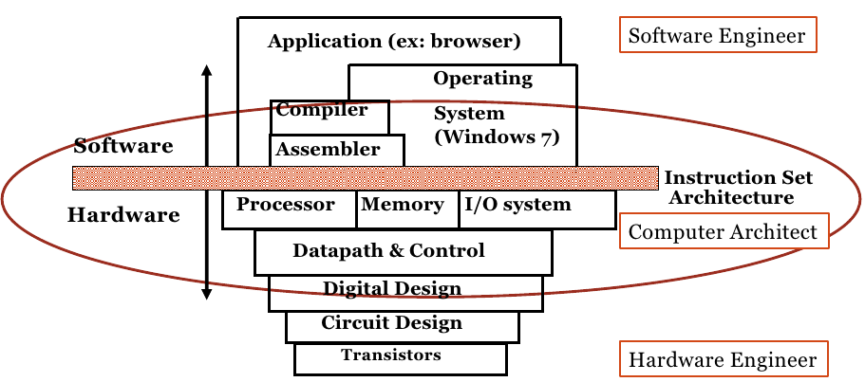
Computer Structure
Coordination many levels of abstraction
Copied from UC Berkeley CS61C

Slide 3
Outline
Gates And Boolean Algebra
Basic Digital Logic Circuits
Memory
CPU Chips And Buses
Example CPU Chips
Example Buses

Slide 4
Outline
Gates And Boolean Algebra
Basic Digital Logic Circuits
Memory
CPU Chips And Buses
Example CPU Chips
Example Buses

Slide 5
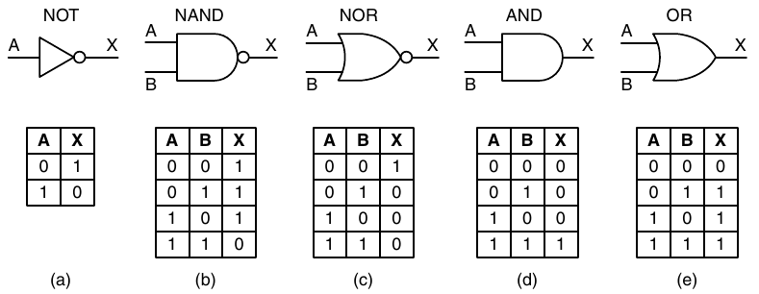
Gate and Boolean Algebra (1)

Slide 6
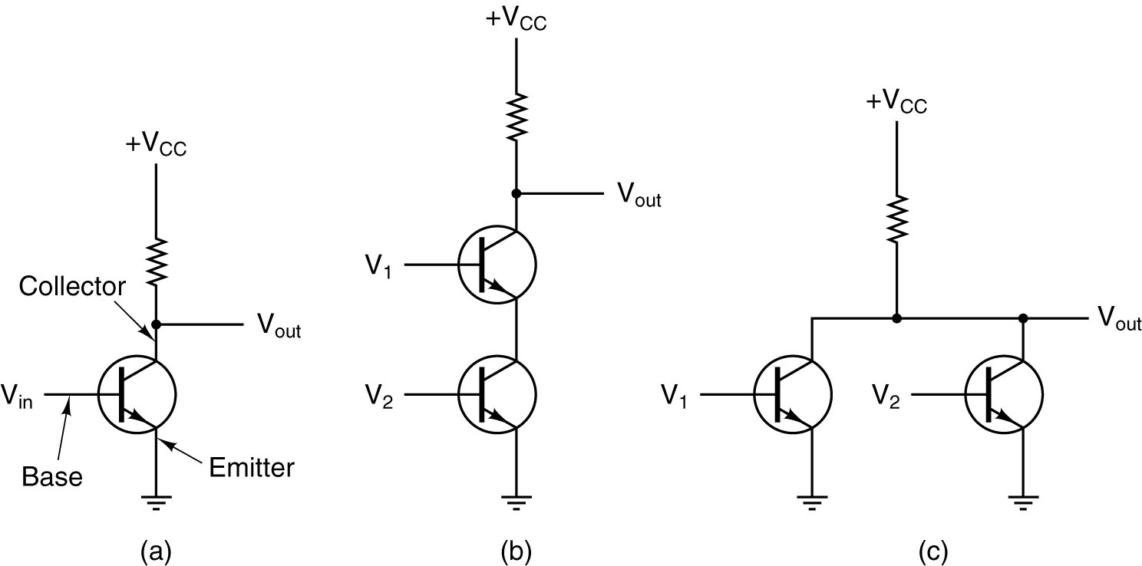
Gate and Boolean Algebra (2)
(a) A transistor inverter.
(b) A NAND gate.
(c) A NOR gate.

Slide 7
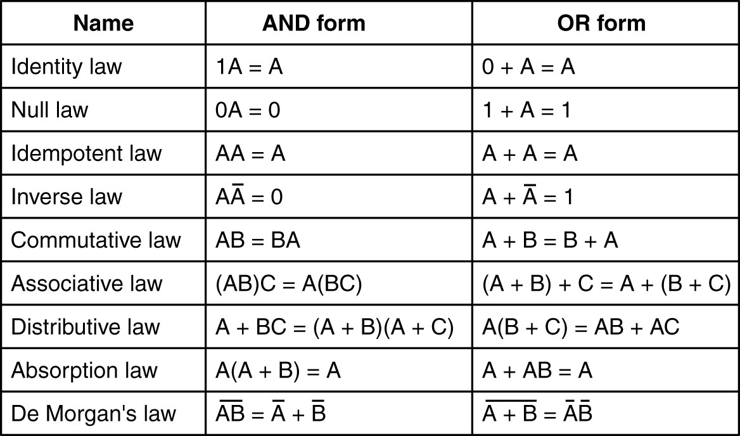
Boolean Algebra

Slide 8
Function Implementation
A direct form implementation:
  Generate the required signals and their inverse
  AND the terms that need to be
  OR the sum of products

Slide 9
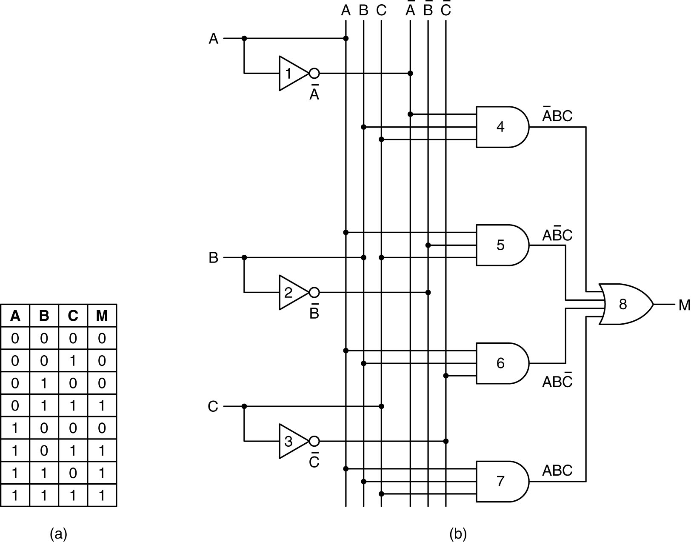
(a) Truth table for majority function of three variables.
(b) A circuit for (a).

Slide 10
It is straightforward to convert circuits generated by the preceding algorithm to pure NAND or pure NOR form
→ need a way to implement NOT, AND, OR using a single type

Slide 11
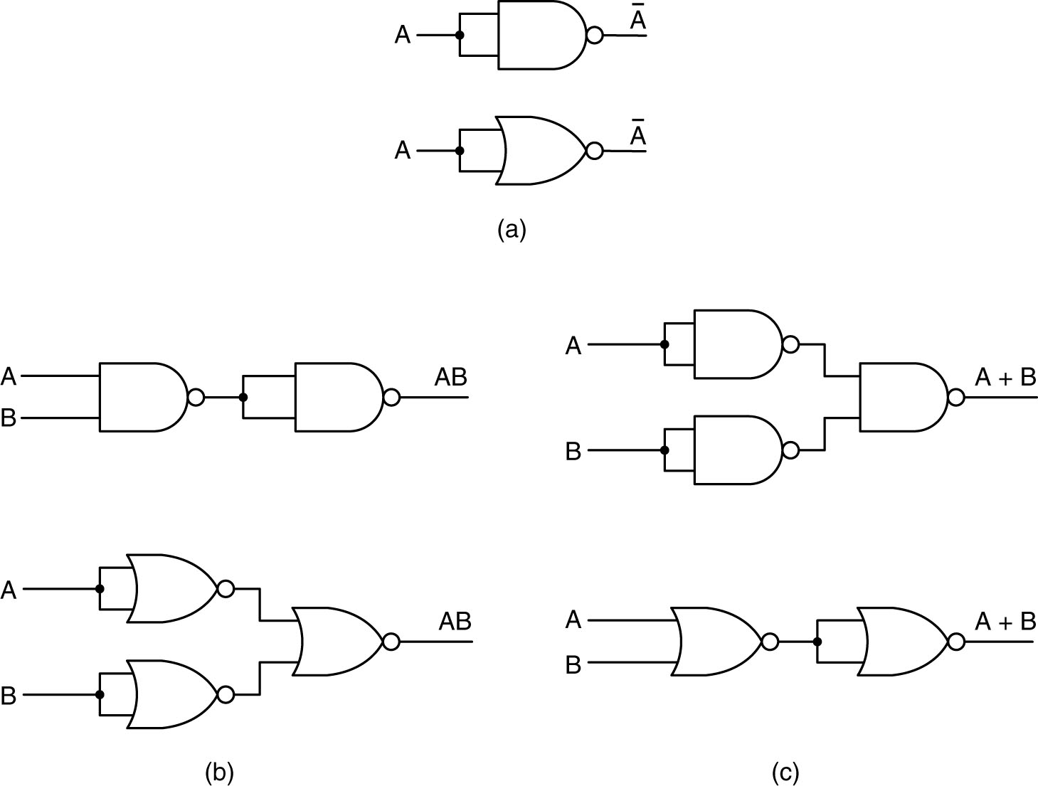
Equivalent Gate
Construction of (a) NOT, (b) AND, and (c) OR gates
using only NAND gates or only NOR gates.

Slide 12
Reduce number of gates to
- reduce component cost
- PCB space
- power consumption

Slide 13
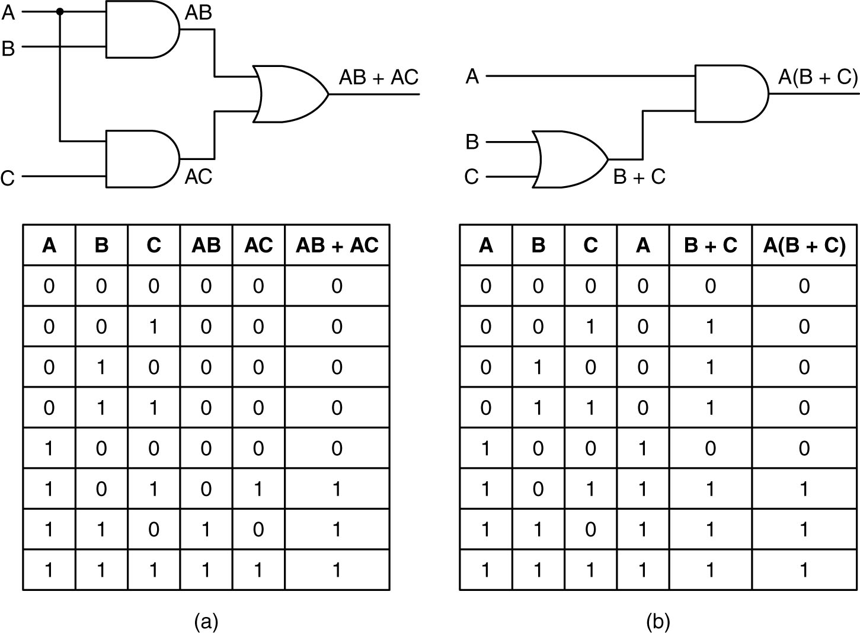
Circuit Equivalence
Two equivalent functions (a) AB + AC, (b) A(B + C).

Slide 14
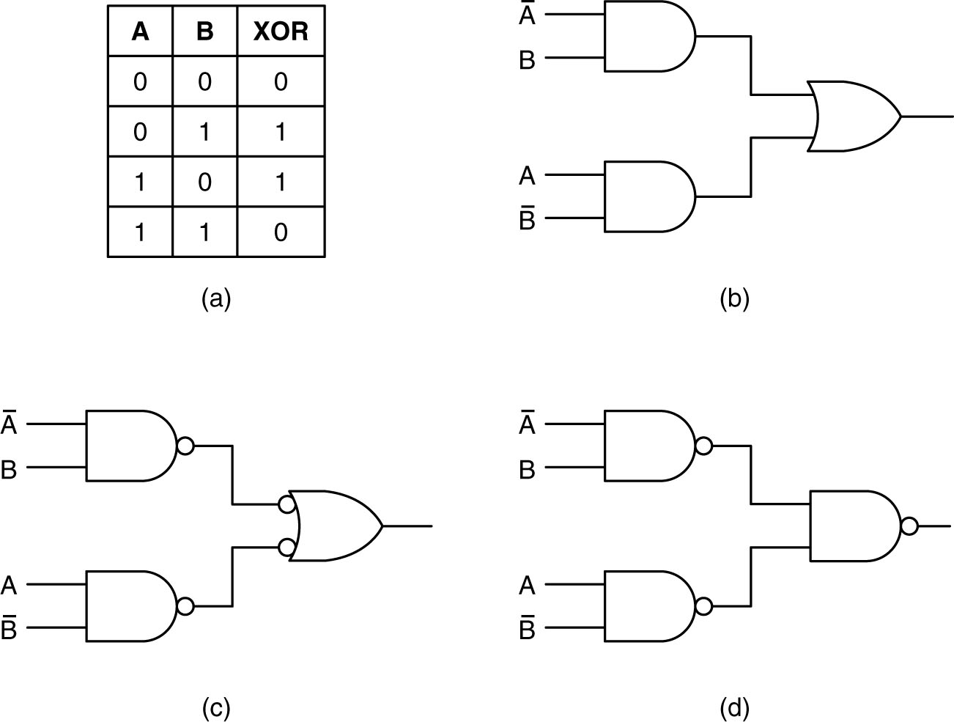
Circuit Equivalence
The Exclusive Or (XOR) Function and Equivalent Gates
(a) The truth table for the XOR function.
(b-d) Three circuits for computing it.

Slide 15
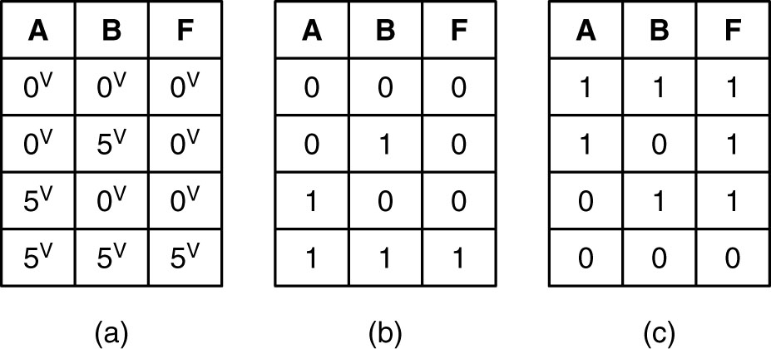
Logic Design Level
(a) Electrical characteristics of a device.
(b) Positive logic.
(c) Negative logic.

Slide 16
Problem (*):
Write a program to read in two arbitrary Boolean expressions and see if they represent the same function.
The input language should include single letters, as Boolean variables, the operands AND, OR, and NOT, and parentheses. Each expression should fit on one input line.
The program should compute the truth tables for both functions and compare them.

Slide 17
Outline
Gates And Boolean Algebra
Basic Digital Logic Circuits
Memory
CPU Chips And Buses
Example CPU Chips
Example Buses

Slide 18
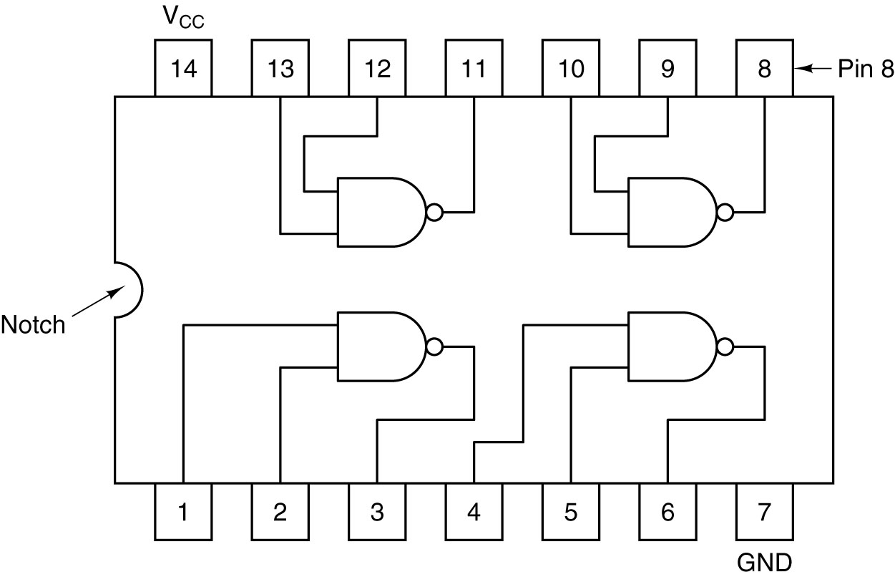
Integrated Circuit
An SSI chip containing four gates.

Slide 19
Integrated Circuit
Device Classifications
  SSI: Small-Scale Integrated Circuit
  MSI: Medium-Scale Integrated Circuit
  LSI: Large-Scale Integrated Circuit
  VLSI: Very Large-Scale Integrated Circuit
  ULSI: Ultra-Large-Scale Integrated Circuit
  GSI: Giga-Scale Integrated Circuit
  TSI: Tera-Scale Integrated Circuit

Slide 20
Integrated Circuit
Device Packages (http://www.semiconfareast.com/packages.htm )
  CDIP: Ceramic Dual In-Line Package
  PDIP: Plastic Dual In-Line Package
  PQFP: Plastic Quad Flat Pack (QFP)
  PGA: Pin Grid Array
  BGA: Ball Grid Array
  PLCC: Plastic Lead Chip Carrier
  SOJ: Small Outline J-Lead
  SOIC: Small Outline Plastic Package
  PSOP: Plastic Small Outline Package (surface mount)
  TSOP: Thin-Small Outline package (surface mount)
  SSOP: Shrink Small Outline Package (surface mount)
  TSSOP: Thin Shrink Small Outline Package (surface mount)
  Etc.

Slide 21
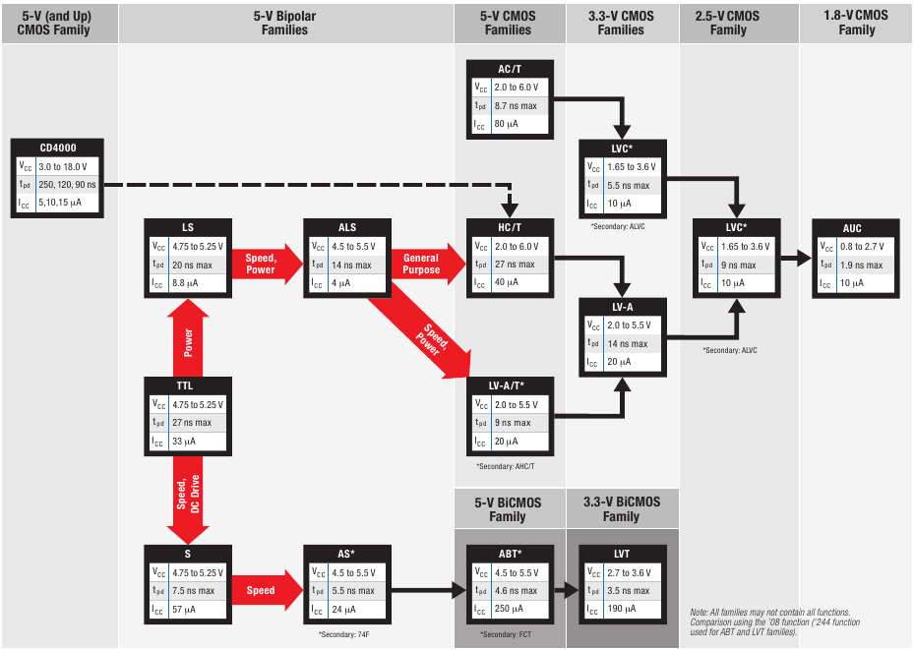
From: http://www.ti.com/litv/pdf/sdyu001z, page 5

Slide 22
Important Circuits for Computer Design
Combinational Circuits
  Decoders
  Multiplexers
  Comparators
  Programmable Logic Arrays
Arithmetic Circuits
  Adders
  Shifters
  Arithmetic Logic Units (ALU)
  Multipliers
Latches, Flip-Flops and the Clock Glitch Generator
  Set-Reset Latch
  “Gated” SR Latch
  “Gated” D Latch
  The clock glitch (pulse) generator (only to be used by experts)
  D Flip Flop
  Synchronous Register Writing

Slide 23
Important Circuits for Computer Design
Combinational Circuits
  Decoders
  Multiplexers
  Comparators
  Programmable Logic Arrays
Arithmetic Circuits
  Adders
  Shifters
  Arithmetic Logic Units (ALU)
  Multipliers
Latches, Flip-Flops and the Clock Glitch Generator
  Set-Reset Latch
  “Gated” SR Latch
  “Gated” D Latch
  The clock glitch (pulse) generator (only to be used by experts)
  D Flip Flop
  Synchronous Register Writing

Slide 24
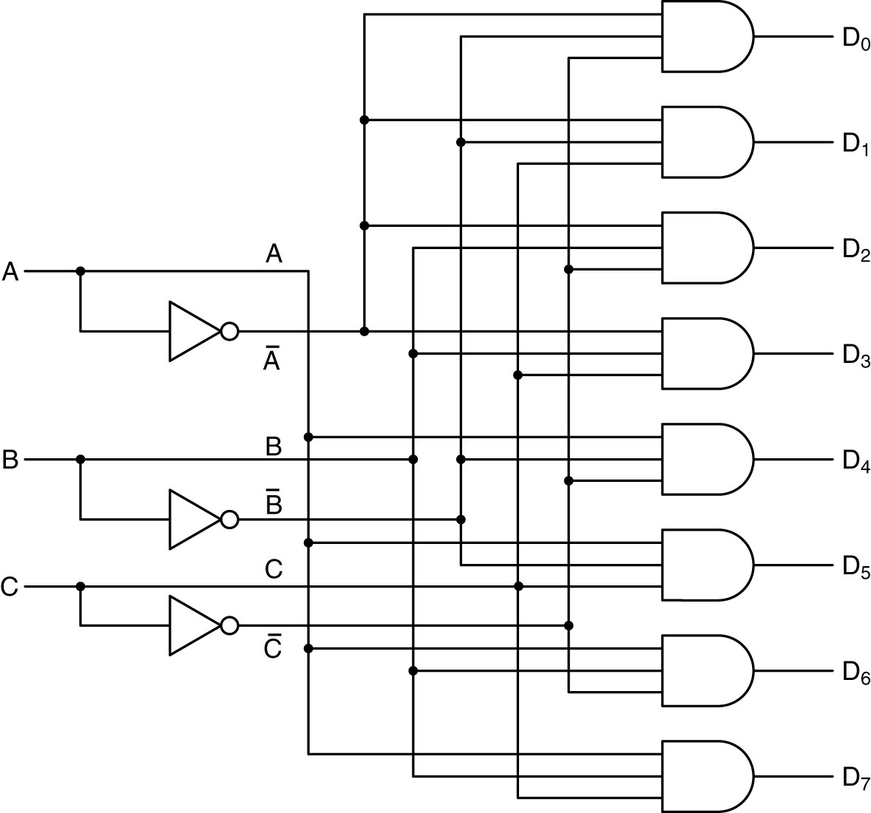
Decoders (1)
A 3-to-8 decoder circuit.

Slide 25
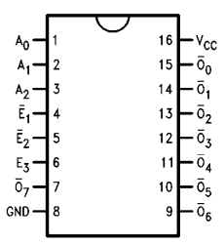
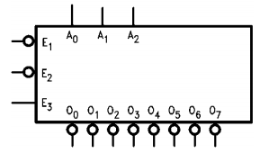
Decoders (2)
A 3-to-8 decoder circuit: 74F138
Used for generating specific “chip-select” signals from address busses or other encoded identification.

Slide 26
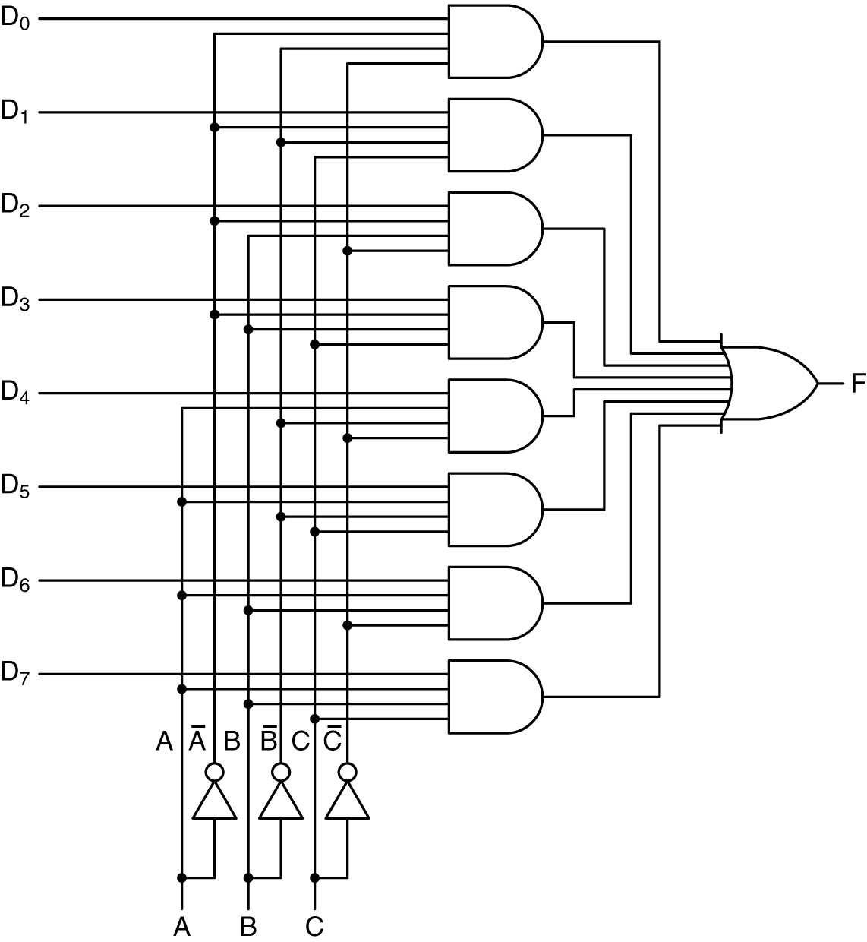
Multiplexer (1)
8 to 1 multiplexer (8 inputs, 3 coded select lines)

Slide 27
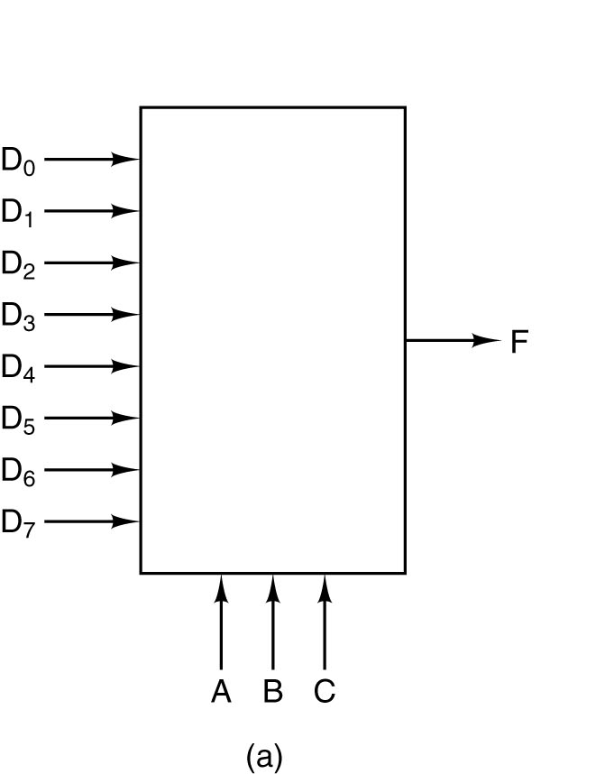
Multiplexer (2)
74X151/74X152: an MSI multiplexer.
Used for selecting one of a number of “inputs”, such as serial or parallel signal inputs, monitoring interrupt lines, etc.

Slide 28
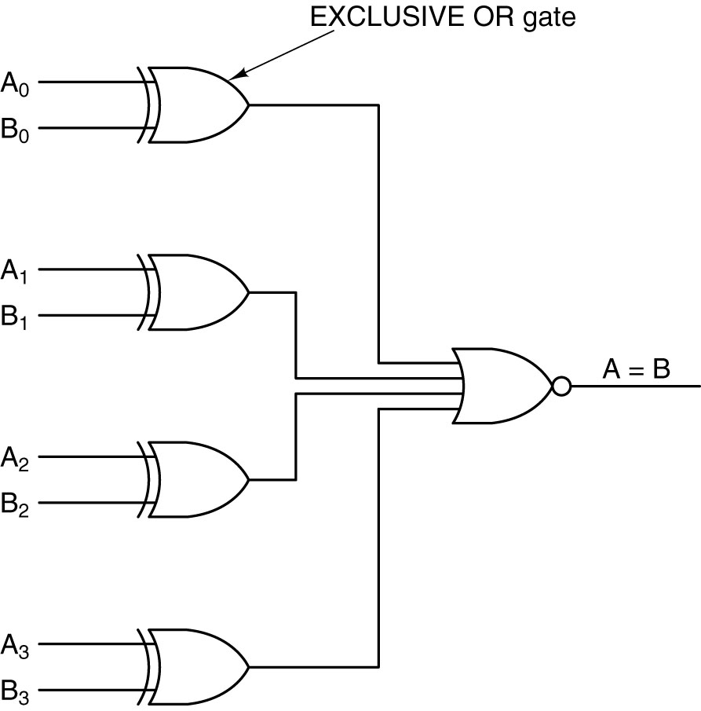
Comparators
See the TI comparator truth table and logic diagram
74X85 – full magnitude comparator, including equal
A simple 4-bit comparator

Slide 29
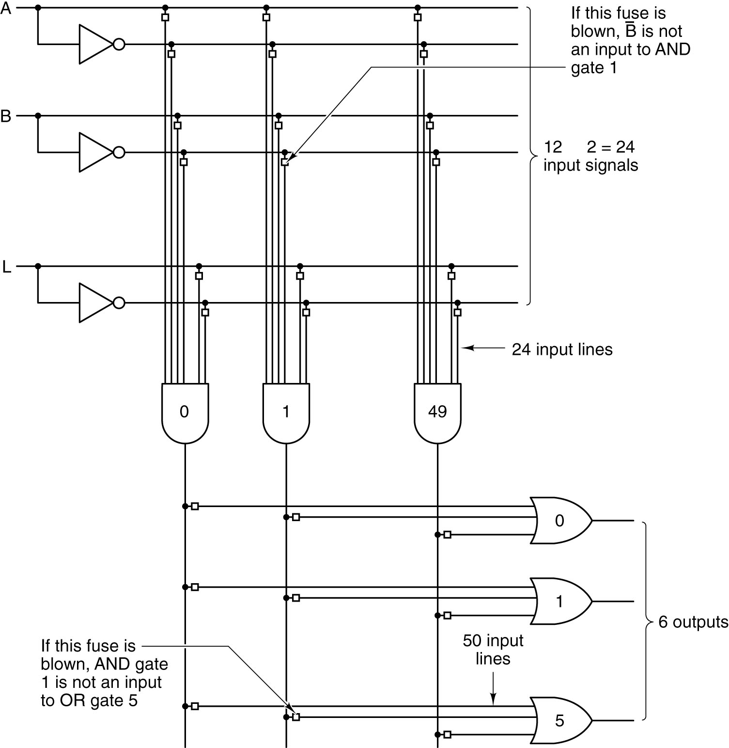
Programmable Logic Arrays
A 12-input, 6-output
programmable logic array. The little squares represent fuses that can be burned out.

Slide 30
RELOOK
(a) Truth table for majority function of three variables.
(b) A circuit for (a).

Slide 31
Programmable Logic Arrays
- INV-AND-OR planes shown for performing basic combinatorial logic functions
- Sufficient (suggested) encoding style for VHDL or Verilog.
TIBPAL22V10 Logic Diagram was (is?) one of the most commonly used programmable devices (see datasheet).

Slide 32
Problem (*):
Write a program to read in a collection of Boolean expressions and compute the 24 × 50 and 50 × 6 matrices needed to implement them with the PLA of Fig. 3-15. The input language should include single letters, as Boolean variables, the operands AND, OR, and NOT, and parentheses. Print the matrices on the line printer.

Slide 33
Important Circuits for Computer Design
Combinational Circuits
  Decoders
  Multiplexers
  Comparators
  Programmable Logic Arrays
Arithmetic Circuits
  Adders
  Shifters
  Arithmetic Logic Units (ALU)
  Multipliers
Latches, Flip-Flops and the Clock Glitch Generator
  Set-Reset Latch
  “Gated” SR Latch
  “Gated” D Latch
  The clock glitch (pulse) generator (only to be used by experts)
  D Flip Flop
  Synchronous Register Writing

Slide 34
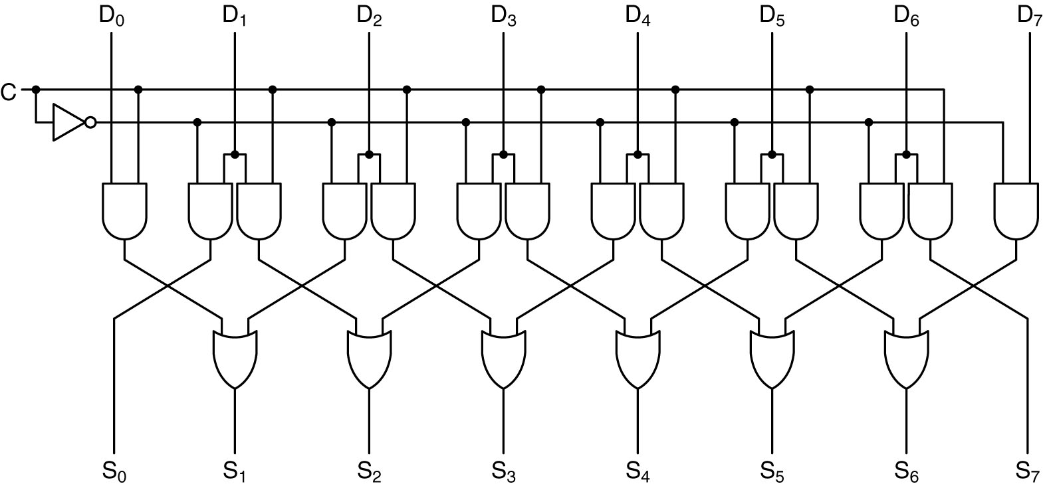
Shifter (1)
C=0 for left shift
C=1 for right shift
A 1-bit left/right shifter

Slide 35
Shifter (2)
Shifter applications:
  Normalizing and denormalizing floating point number fractional components.
  Support multipliers using shift and added
  Multiply by 2^shift (x5 → x4 + x1) (Shifting and adding is sometimes faster than a full multiplier)

Slide 36
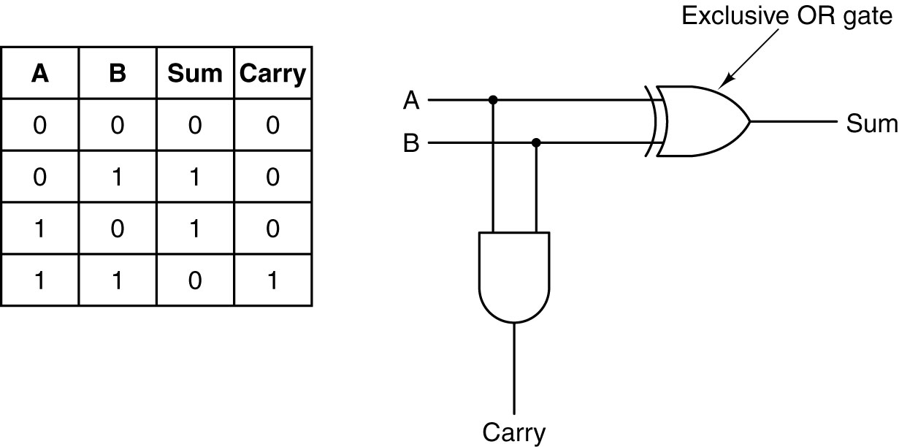
Adder: HA
(a) A truth table for 1-bit addition.
(b) A circuit for a half adder (HA).

Slide 37
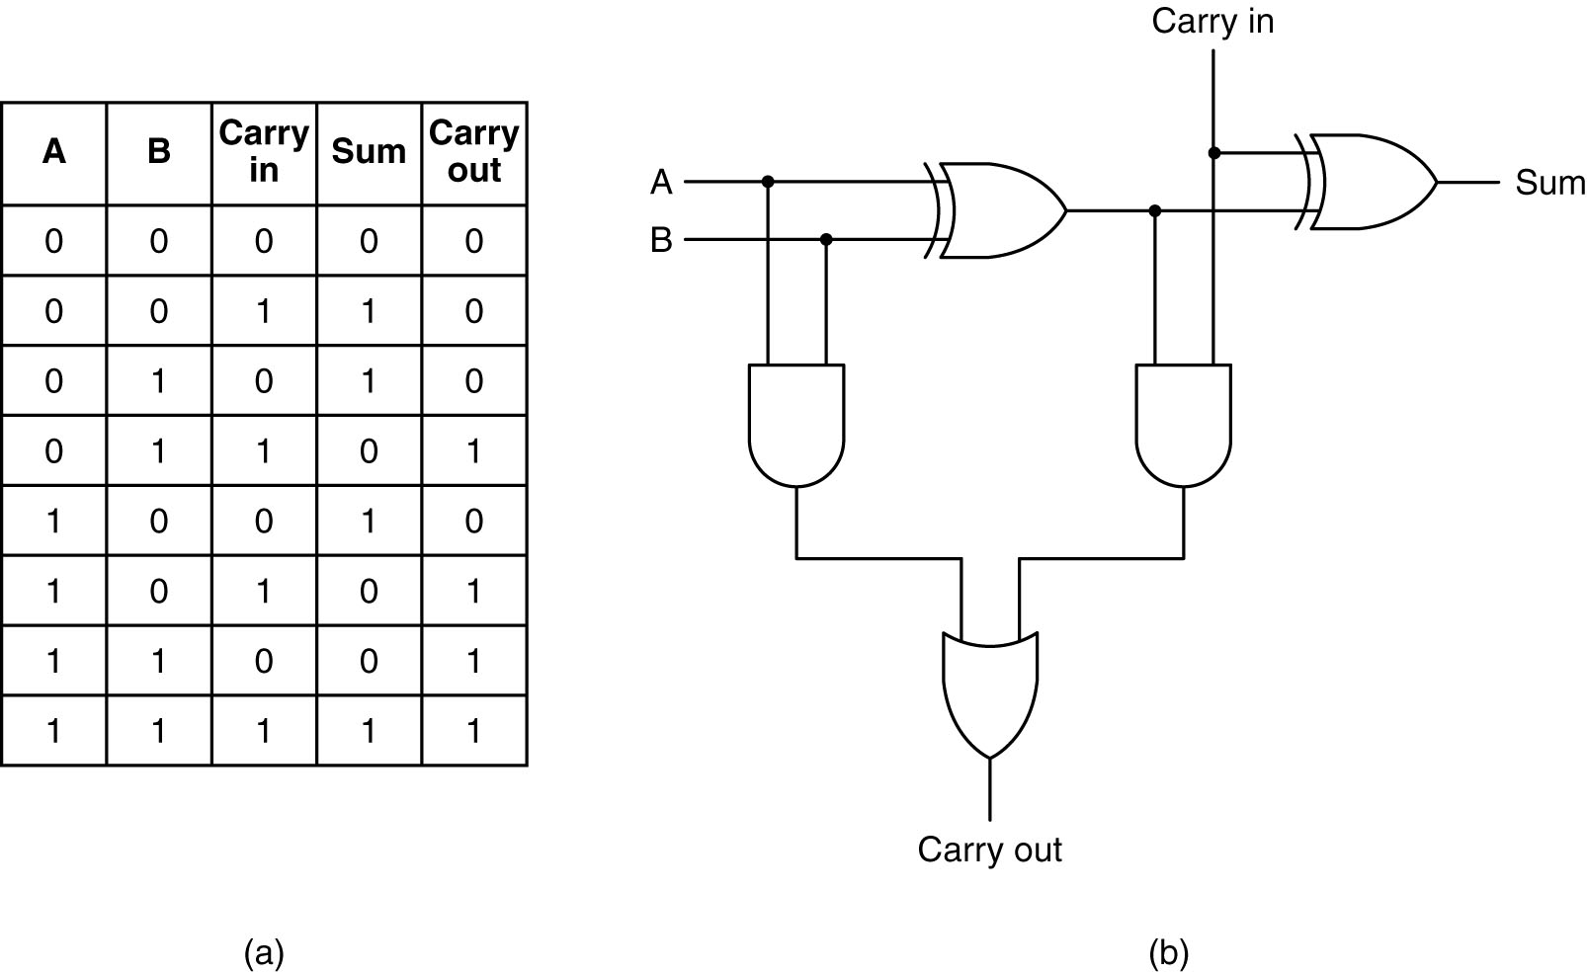
Adder: FA
(a) Truth table for a full adder (FA).
(b) Circuit for a full adder.

Slide 38
Question:
Using HAs and FAs, construct a 2 input - 8 bits adder

Slide 39
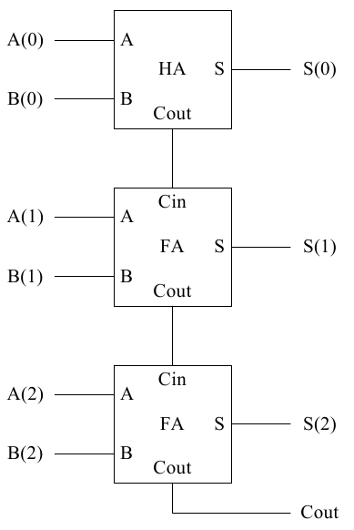
Adder (3)
Ripple Adder Using HA and FA cells (an example of hierarchy)

Slide 40
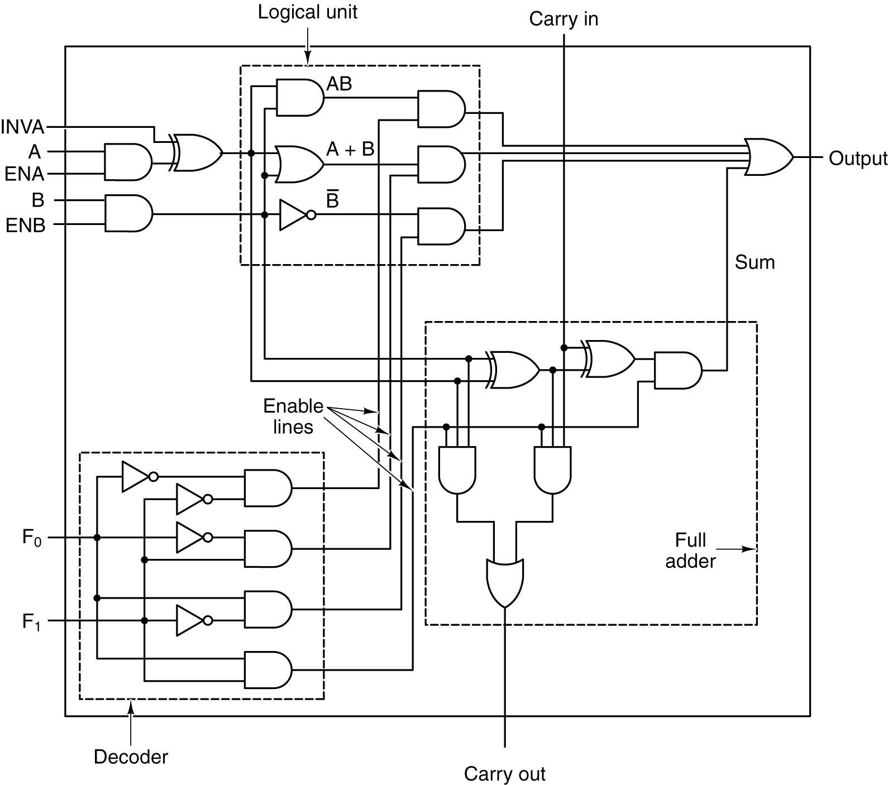
Arithmetic Logic Unit
A 1-bit ALU
AND, OR, INV, Binary Added with Cin and Cout

Slide 41
Question:
- Why this is called a 1-bit ALU?
- What're the functions of F0, F1?

Slide 42
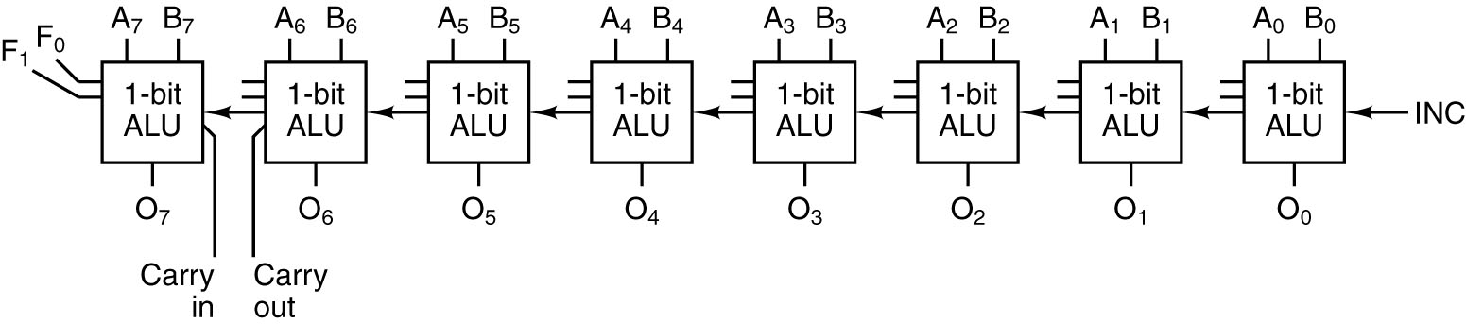
Arithmetic Logic Unit
Eight 1-bit ALU slices connected to make an 8-bit ALU.
The enables and invert signals are not shown for simplicity.

Slide 43
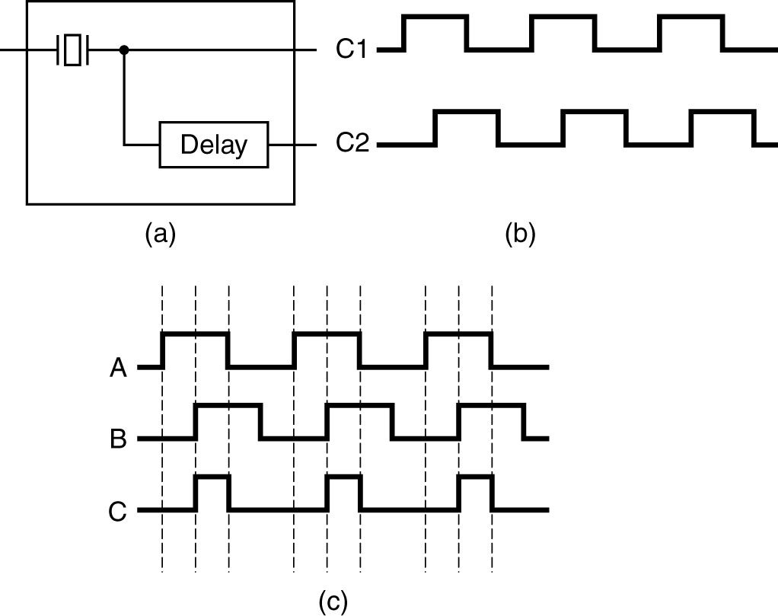
Clock
Pulse frequencies are commonly between 1 and 500MHz
(a) A clock.
(b) The timing diagram for the clock.
(c) Generation of an asymmetric clock.

Slide 44
Important Circuits for Computer Design
Combinational Circuits
  Decoders
  Multiplexers
  Comparators
  Programmable Logic Arrays
Arithmetic Circuits
  Adders
  Shifters
  Arithmetic Logic Units (ALU)
  Multipliers
Latches, Flip-Flops and the Clock Glitch Generator
  Set-Reset Latch
  “Gated” SR Latch
  “Gated” D Latch
  The clock glitch (pulse) generator (only to be used by experts)
  D Flip Flop
  Synchronous Register Writing

Slide 45
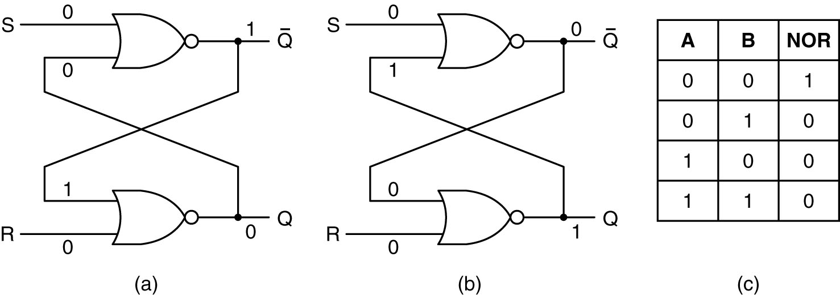
Latch (1)
(a) NOR latch in state 0.
(b) NOR latch in state 1.
(c) Truth table for NOR.

Slide 46
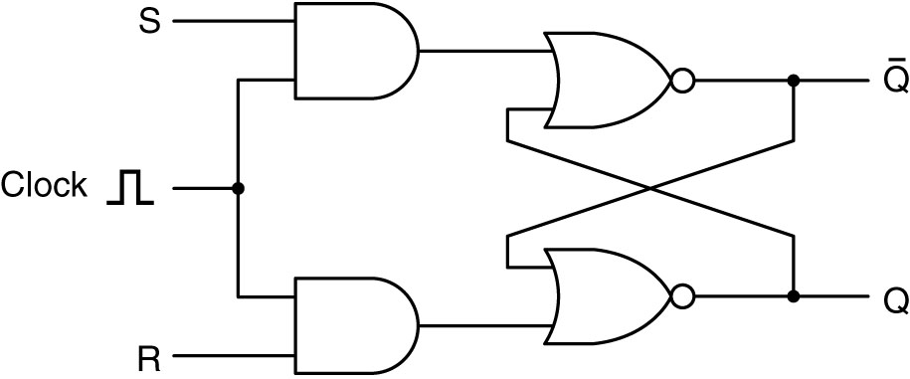
Latch (2)
A clocked SR latch.

Slide 47
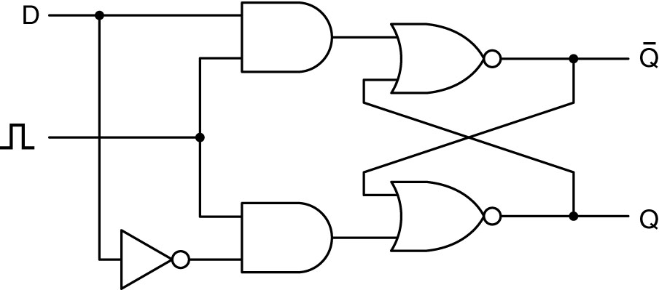
Latch (3)
A clocked D latch

Slide 48
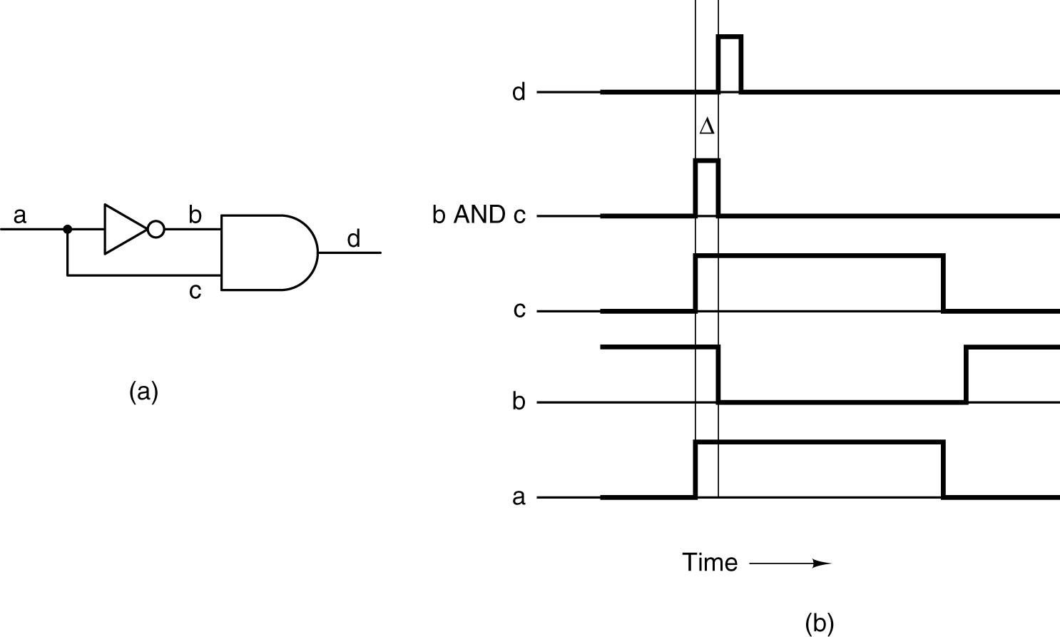
Flip-flop (1)
(a) A pulse generator.
(b) Timing at four points in the circuit.

Slide 49
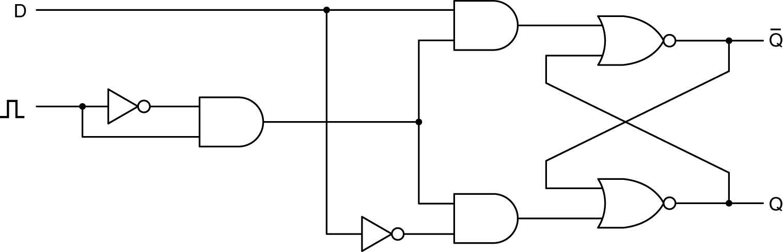
Flip-flop (2)
A D flip-flop

Slide 50
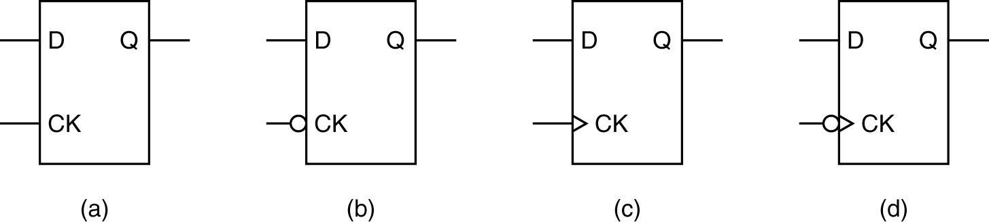
Flip-flop (3)
D latches and flip-flops.

Slide 51
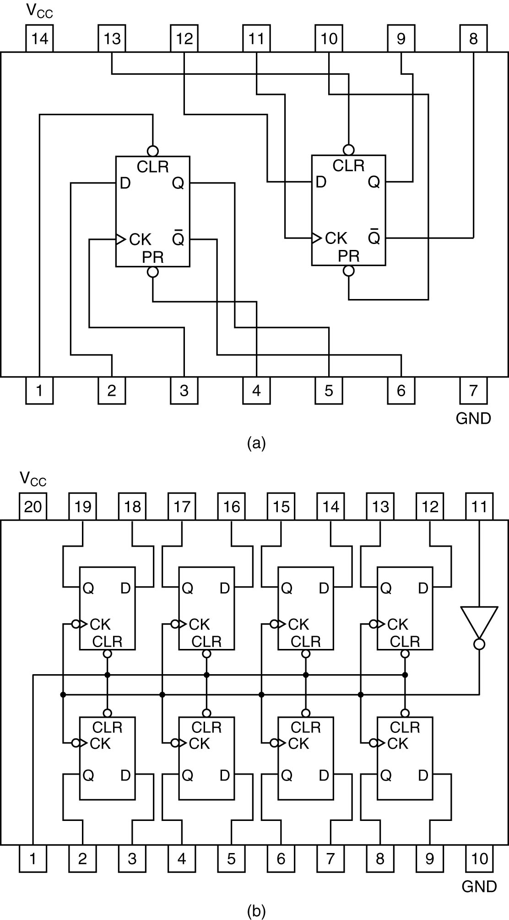
Flip-flop (4)
a) Octal flip-flop.
b) Dual D flip-flop

Slide 52
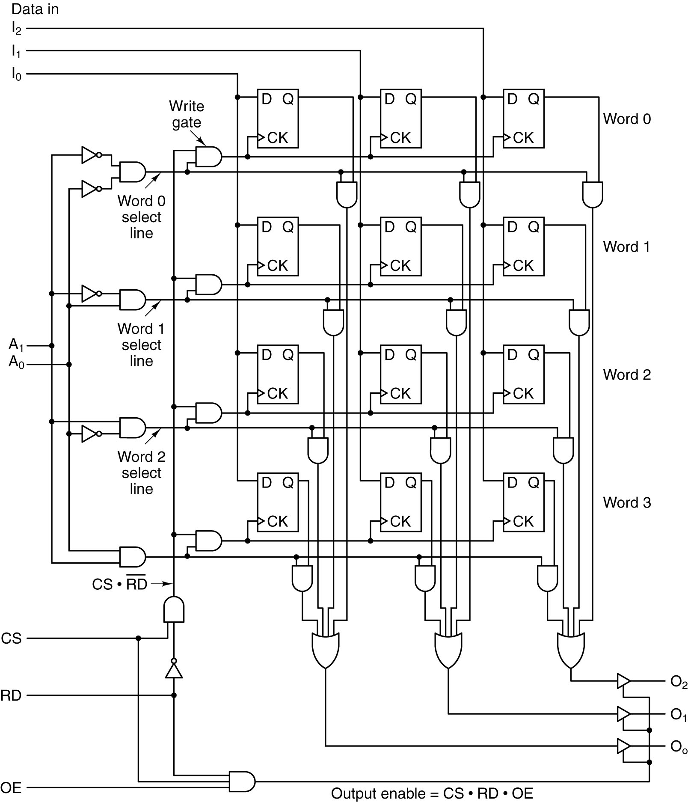
Memory Organization
(1)
Logic diagram for a 4 x 3 memory.
Each row is one of the four 3-bit words.

Slide 53
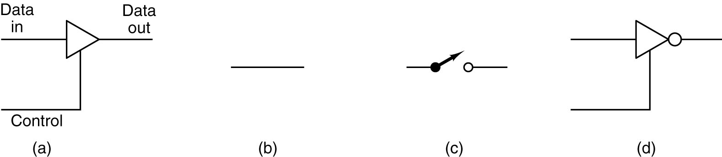
Memory Organization (2)
(a) A noninverting buffer.
(b) Effect of (a) when control is high.
(c) Effect of (a) when control is low.
(d) An inverting buffer.

Slide 54
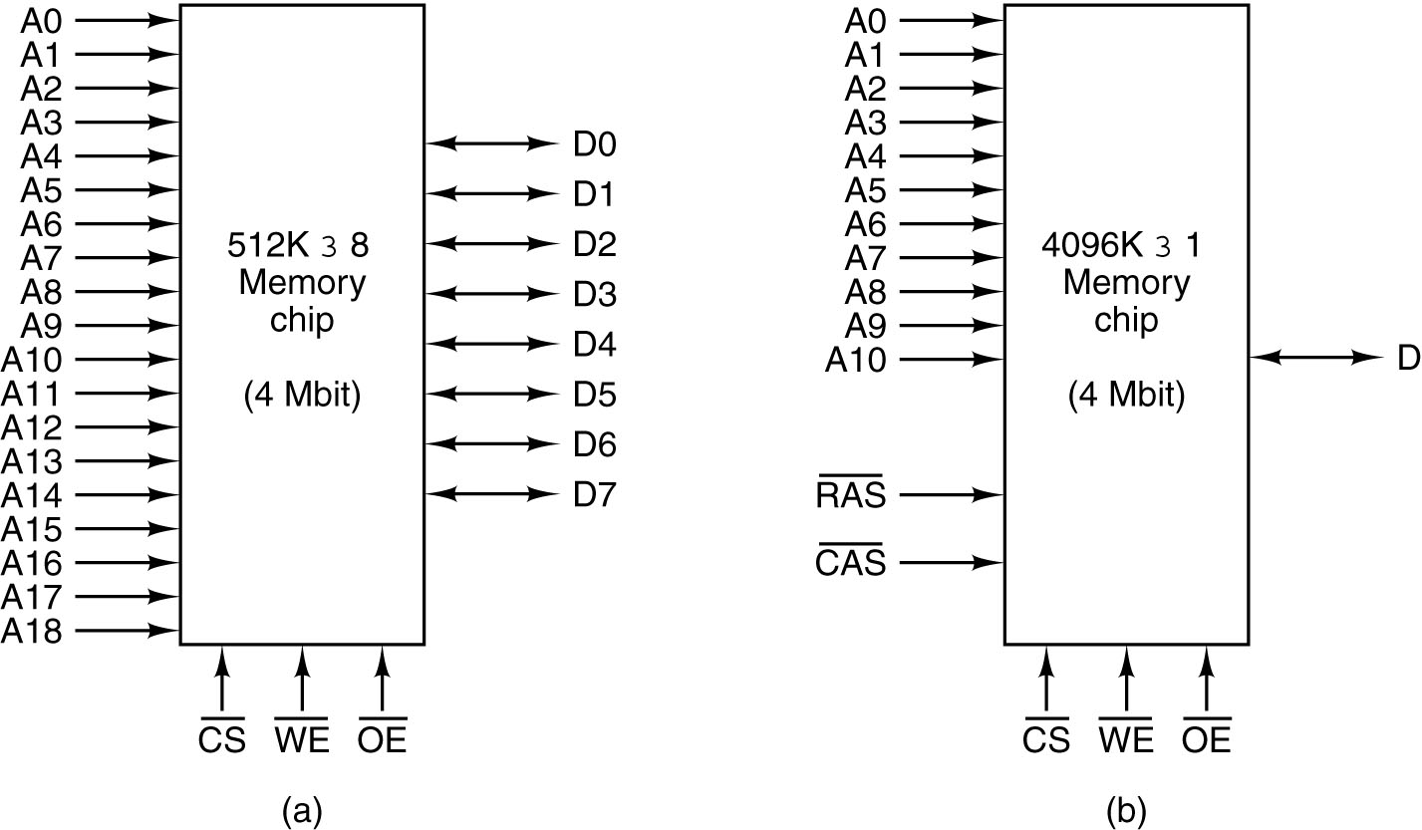
Memory Chip (1)
RAS: row address strobe
CAS: column address strobe
1 bit data → memory chips in parallel
Two ways of organizing a 4-Mbit memory chip

Slide 55
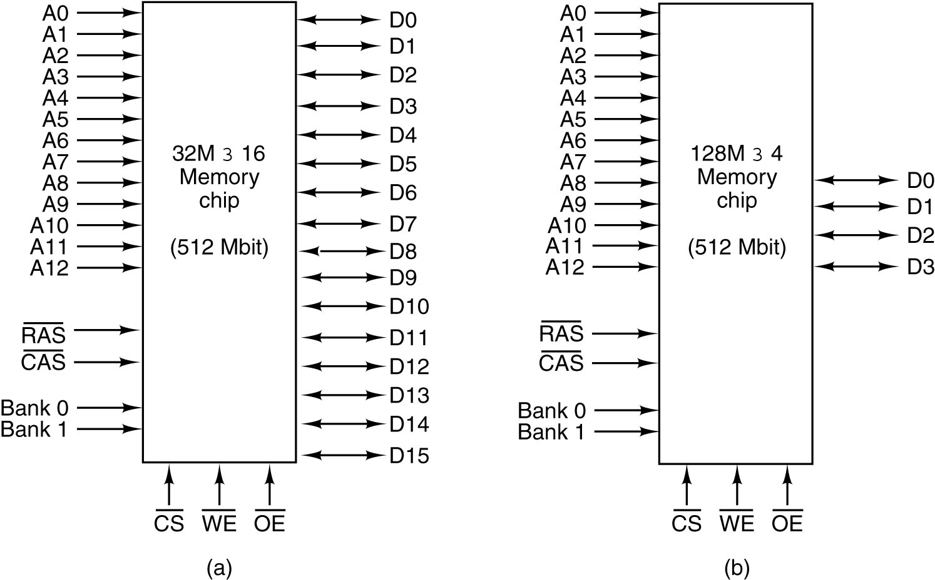
Memory Chip (2)
13 lines for RAS signal
10 lines for CAS signal
2 lines for bank select
13 lines for RAS signal
12 lines for CAS signal
2 lines for bank select
Two ways of organizing a 512 Mbit memory chip.

Slide 56
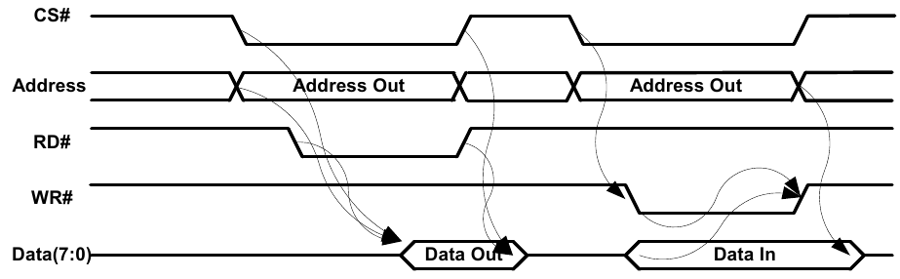
Asynchronous SRAM Memory Timing
Simple Asynchronous Memory Operation (Memory Perspective)
Note: X# indicates Not(X), the inverse of X

Slide 57
Asynchronous SRAM Memory Timing
(1) Chip select required to “turn the memory on”
(1) Address is required to select word or bit (before write, preferably before a read)
(2) Read (RD#) and Write (WR#) gates specifically defined or a single (RD/WR#)
(2 or 3) Data bus is bi-directional ... both input and output (using internal tri-state output enables)

Slide 58
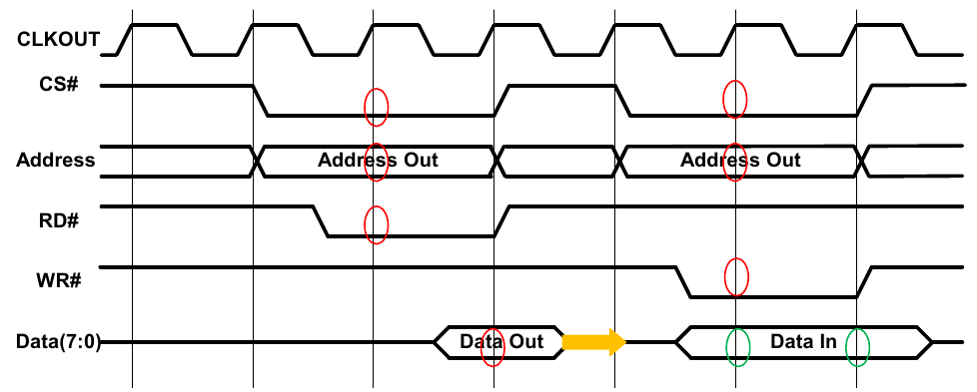
Synchronous SRAM Memory Timing
Same operations may be asynchronous, but internal control signals are registered for application on clock edges.

Slide 59
Synchronous SRAM Memory Timing
Control changes after clock edges (change caused by clocking, positive or negative edge)
Operations typically occur one clock cycle after “control is clocked”
When outputting, the output may tri-state asynchronously (when RE# is removed) to avoid multiple devices simultaneously driving the bus.
Wait states for read/write may be need due to speed of CPU vs. memory?

Slide 60
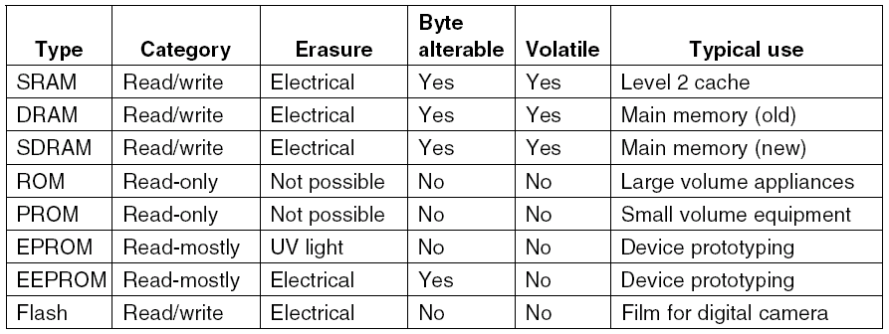
Nonvolatile Memory Chips
A comparison of various memory types.

Slide 61
Outline
Gates And Boolean Algebra
Basic Digital Logic Circuits
Memory
CPU Chips And Buses
Example CPU Chips
Example Buses

Slide 62
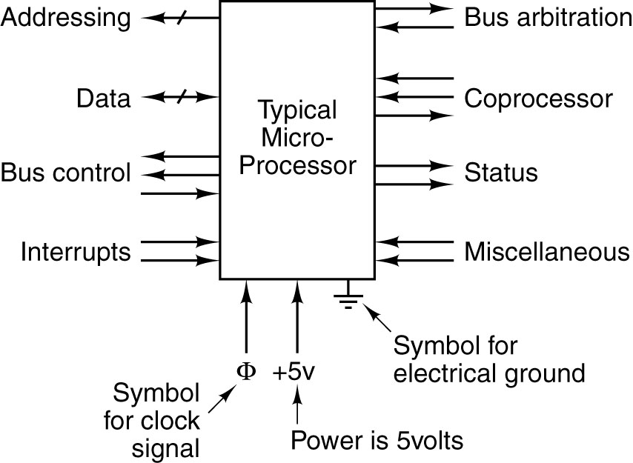
CPU Chip
Memory and I/O Addressing → address, data, bus control
Bus master/slave control → bus arbitration
Interrupts and Status
Special signals → coprocessor interfaces or miscellaneous (JTAG, IIC, debug, etc.)

Slide 63
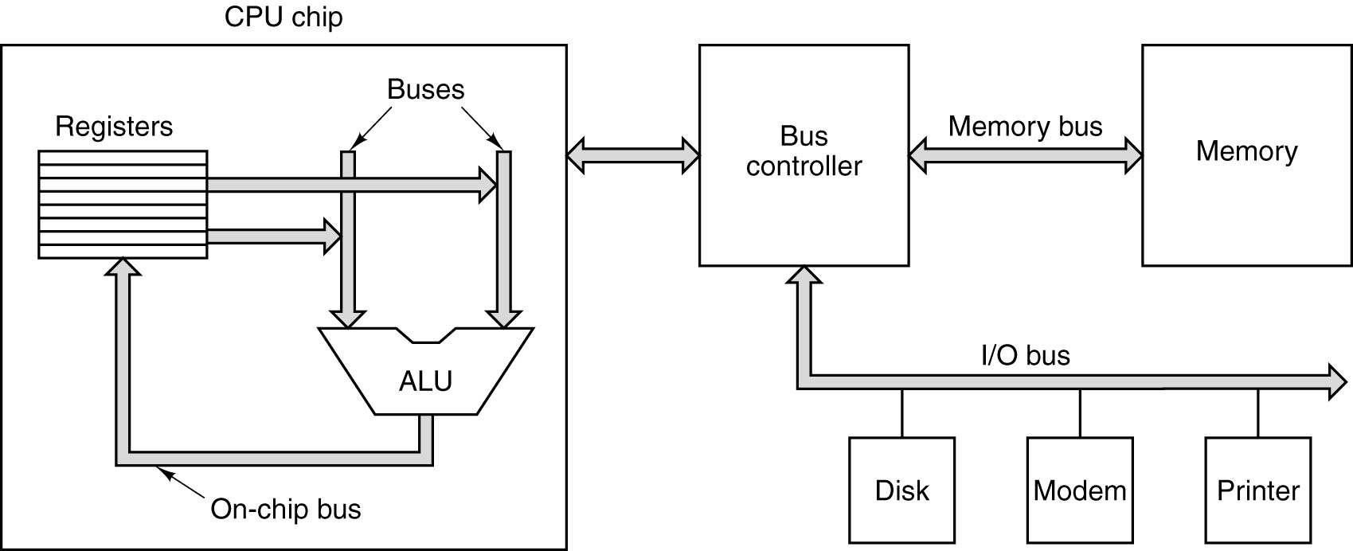
Computer Buses (1)
Computers use numerous buses at multiple levels.
- On-chip buses for registers, execution unit operands, instructions, etc.
- Off-chip buses for memory, peripherals, interrupts, status, etc.

Slide 64
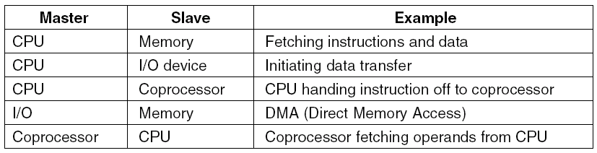
Computer Buses (2)
Examples of bus masters and slaves
Master: can initiate bus transfer
Slave: wait for request
Under no circumstances can memory ever be a master

Slide 65
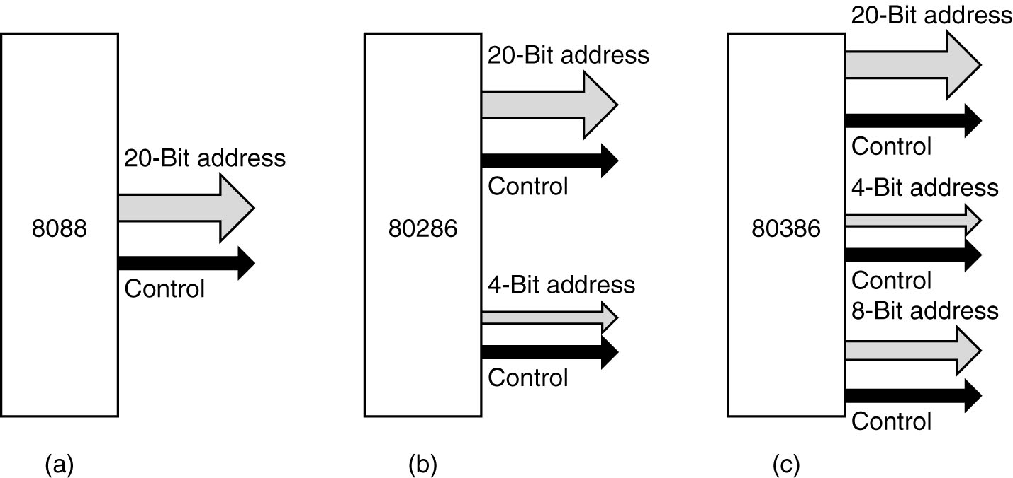
Buses Width in Time
1MB
16MB
4GB
(a) 8088 generation 20A, (b) 80286 generation 24A, (c) 8036 generation 32A

Slide 66
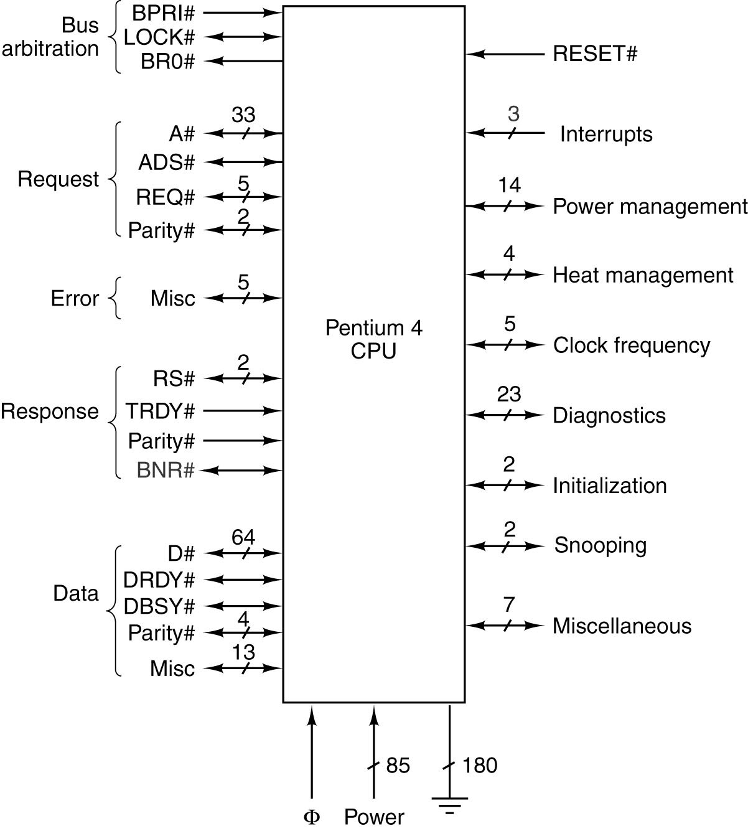
CPU Buses Pentium 4
Note: Pentium 4’s started the use of PCI and DRAM bridge ICs.

Slide 67
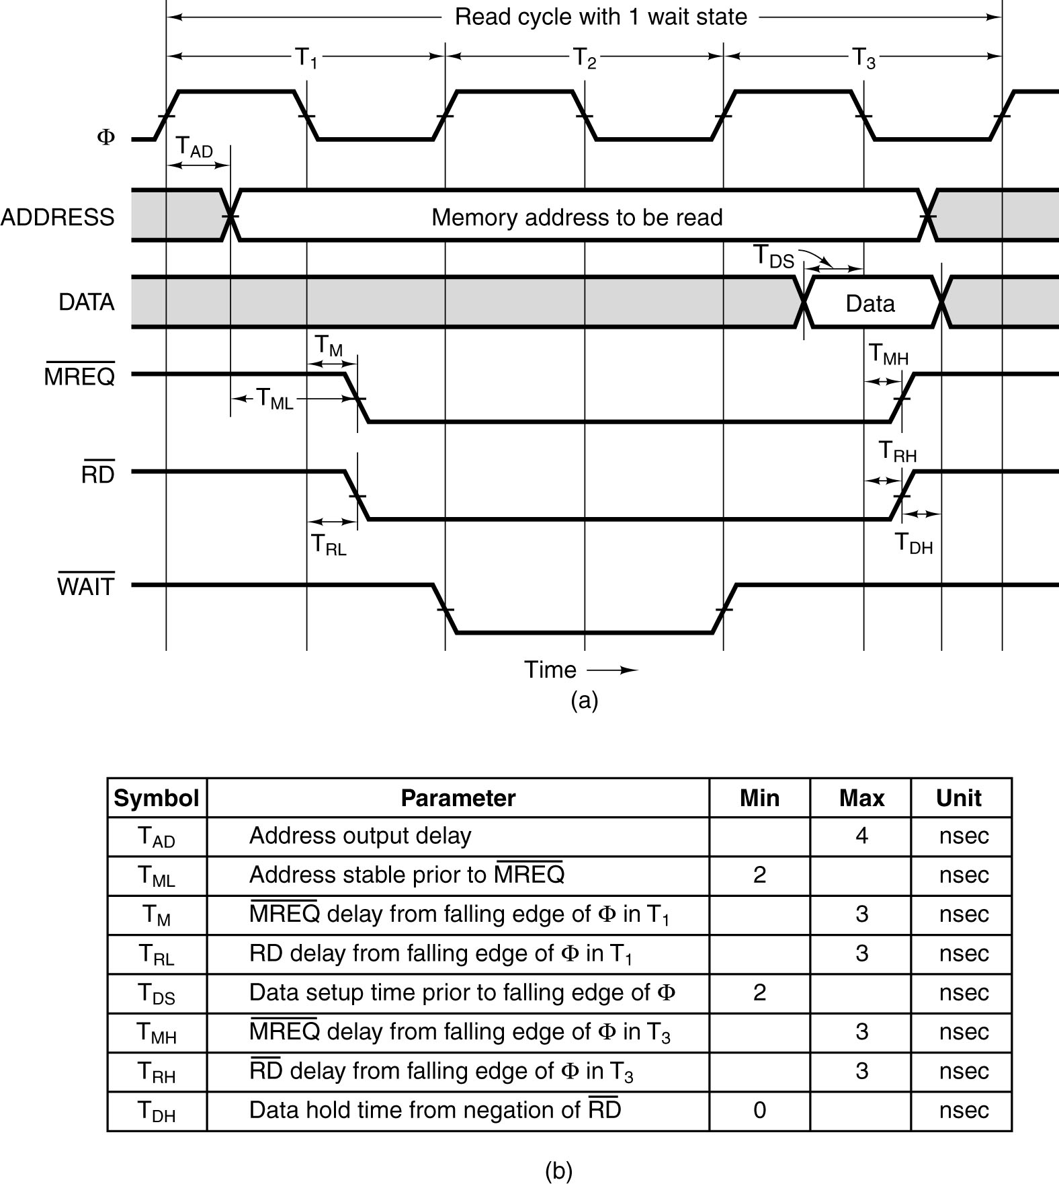
Synchronous CPU Bus Timing with an Asynchronous Memory
(from memory)

Slide 68
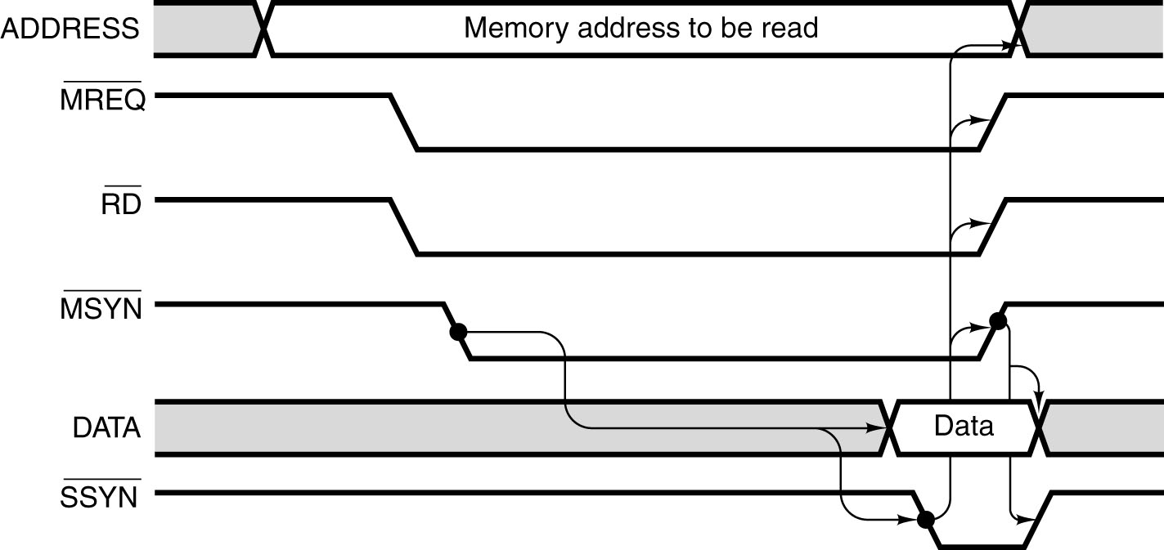
Asynchronous CPU Bus Timing
From
CPU
From
Memory
Asynchronous Bus Read Cycle with hardware handshaking.
Memory Timing Considerations:
- Address
- Read
- Write
- Handshaking

Slide 69
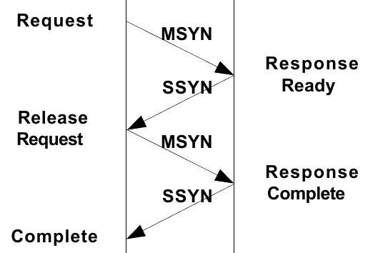
Handshaking and Messaging Protocol
From
CPU
From
memory

Slide 70
Bus Arbitration
What happens if two or more devices all want to become bus master at the same time?
→ bus arbitration
  Centralized
  Decentralized

Slide 71
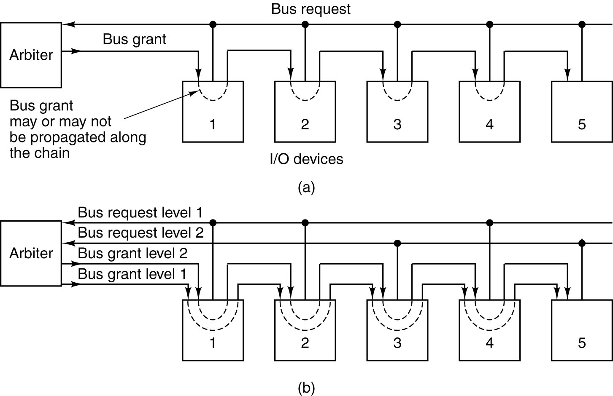
Bus Arbitration – centralized
(with
priority)
(a) A centralized one-level bus arbiter using daisy chaining.
(b) The same arbiter, but with two levels.

Slide 72
Daisy chain
Bus Request:
  Always high, pulled down to ground when I/O devices wants to make a request
Bus Grant:
  Starts at arbiter. Each successive device on the “Daisy Chain” can “block” the signal from passing to the next device or pass the signal to the next device.
  When “blocking”, that I/O device has requested the bus and will use the “Bus Grant” for itself.
  When “passing”, the I/O device doesn’t care which device controls the bus.
Arbiters are often “built-in” to the CPU

Slide 73
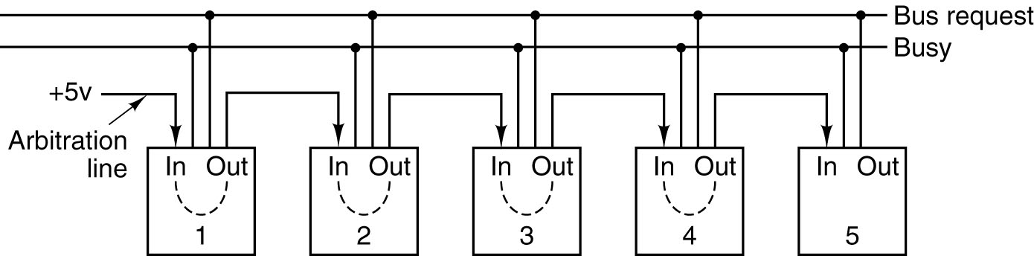
Bus Arbitration – decentralized
If there is no “arbiter” a “Daisy Chain” can still be used, but an indication that the Bus is Busy is required.
This technique could work for a multiprocessor system where any of the processors can act as the bus master or as a bus slave device.

Slide 74
EXAMPLE CPU CHIPS

Slide 75
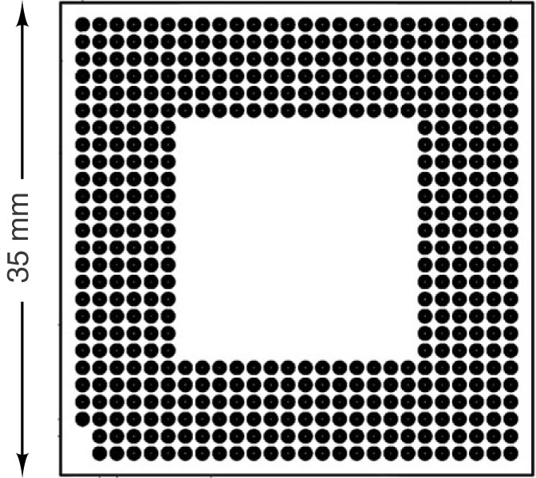
The
Pentium 4

Slide 76
Pipelining Request on the Pentium 4's memory bus
CPU much faster than DRAM
It's essential to get the maximum possible throughput from the memory
→ Pentium 4 memory bus is highly pipelined.

Slide 77
Pipelining Request on the Pentium 4's memory bus
Bus transaction operations: (similar to PCI coming up)
The bus arbitration phase (not shown – happens prior to transfer)
The request phase – address and command
Address/command error reporting phase
Snooping phase when multiprocessors are involved
The response phase – waiting for the device to respond
The data transfer phase

Slide 78


Slide 79


The 8051
Physical pinout of the 8051
Logical pinout of the 8051.

Slide 80
EXAMPLE BUSES
ISA, PCI, PCI Express, USB

Slide 81

The ISA Bus
The PC/AT bus has two components, the original PC
part and the new part.
Max rate = 8.33 MB/sec

Slide 82
Moving away from ISA …
New application was coming: Windows, GUI
  1024x768 screen, true color, 30 screens/sec is needed → data rate of 67.5 MB/sec
  Need a bus bandwidth of 135 MB/sec or more?
  → ISA bus is out of hand
→ PCI (peripheral component interconnect bus) coming
  Original PCI bus transferred 32 bits per cycle, ran @33MHz → total bandwidth of 132MB/s
  PCI 2.1 run @66MHz, handle 64 bit transfer → 528 MB/s

Slide 83

The PCI
Bus (1)
Architecture of an early Pentium system. The thicker buses have more bandwidth than the thinner ones but the figure is not to scale.

Slide 84
The PCI Bus (2)
By the late 1990s, ISA bus was dead
More graphic demand
  Monitor resolution had increase in cases to 1600x1200
  Highly interactive game with full-screen full motion video
  → Intel released AGP bus (Accelerated Graphic Port bus). AGP 3.0 running at 2.1GB/s

Slide 85

The PCI
Bus (2)
Bridge chip is now central
The bus structure of a modern Pentium 4.

Slide 86

PCI Bus Arbitration
The PCI bus uses a centralized bus arbiter.
Algorithm used by the arbiter is not defined by the PCI specification; in fact round-robin, priority and other scheme are allowed

Slide 87

PCI Bus Signals
Mandatory PCI bus signals.

Slide 88

PCI Bus Transactions
Falling edge effect
Address and data lines are multiplexed to save pins
Examples of 32-bit PCI bus transactions. The first three cycles
are used for a read operation, then an idle cycle, and then
three cycles for a write operation.

Slide 89
PCI Express
Parallel buses are challenged as the clock rates are pushed higher + big card. Therefore, PCIe interface is based on high-speed point-to-point serial communications!
  PCIe has PCI name fro marketing purpose only
In PCIe, multiple “lanes” (x1, x2, x4, x8, x16 or x32) can be connected to the same board.
Point-to-point connections using a switch. (Note: Ethernet switches)

Slide 90

PCI Express
Each lane uses low-voltage differential signaling (LVDS) and 4-wires for bidirectional communications (one pair TX, one pair RX). A reference clock is provided to synchronize bit transfers.

Slide 91

PCI Express Protocol Stack
The packet structure from an OSI software layered protocol consideration is shown below.
(a) The PCI Express protocol stack.
(b) The format of a packet (implement in hardware, compare to software of protocol stack)

Slide 92
PCI Express
Key features in PCIe as compared to PCI
  Centralized switch for routing ...
  Serial point-to-point connections
  Packet based communications
  Error-detection for increased reliability
  Expandable to multiple level of switching.
  Hot pluggable: can be inserted or removed when the power is on.

Slide 93
The Universal Serial Bus (USB)
In 1993. seven companies got together to design a better way to connect low-speed I/O devices (mouse, keyboard, etc.) The companies were Compaq, DEC, IBM, Intel, Microsoft, NEC and Nortel.
The goals:
  Users must not have to open cases to install new I/O devices.
  There should be only one kind of cable, good for interconnecting all devices.
  I/O devices should get their power from the cable
See next slide →

Slide 94
The Universal Serial Bus (USB)
The goals (cont'd)
  Up to 127 devices should be attachable to a single computer.
  The system should support real-time devices (e.g. sound, telephone, game inputs)
  The system should be installable while the computer is running.
  No reboot should be needed after installing new devices
  The new bus and its I/O should be inexpensive to manufacture.

Slide 95

The Universal Serial Bus (USB)
The USB root hub sends out frames every 1.00 ms

Slide 96
Copyright note
Slides are adopted form lecture notes of Tanenbaum, Structured Computer Organization, Fifth Edition, (c) 2006 Pearson Education, Inc.

