Slide 1
Computer Architecture
Ch4 – The Instruction Set Architecture Level
Nguyễn Quốc Đính, FIT – IUH
HCMC, Aug 2015

Slide 2
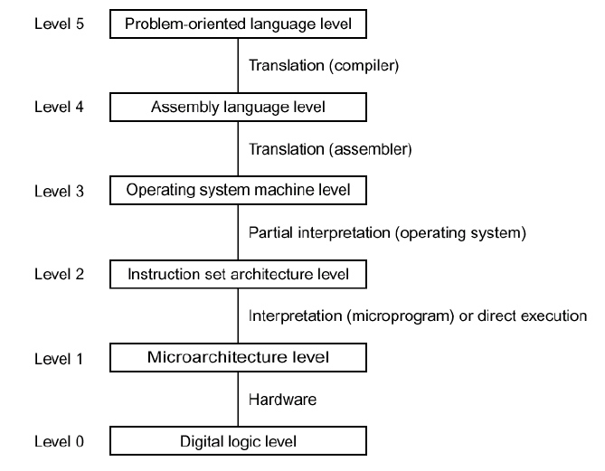
Where We Are

Slide 3
Translation
Code Time
Compile Time
Run Time
Hardware
User
program
in C
C
compiler
Assembler
.c file
.exe file
What makes programs run fast?

Slide 4
Translation Impact Performance
The time required to execute a program depends on:
  The program (as written in C, for instance)
  The compiler: what set of assembler instructions it translates the C program into
  The instruction set architecture (ISA): what set of instructions it makes available to the compiler
  The hardware implementation: how much time it takes to execute an instruction

Slide 5
Instruction Set Architecture
The ISA defines:
  The system’s state (e.g. registers, memory, program counter)
  The instructions the CPU can execute
  The effect that each of these instructions will have on the system state
CPU
PC
Registers
Memory

Slide 6
General ISA Design Decisions
Instructions
  What instructions are available? What do they do?
  How are they encoded?
Registers
  How many registers are there?
  How wide are they?
Memory
  How do you specify a memory location?

Slide 7
x86
Processors that implement the x86 ISA completely dominate the server, desktop and laptop markets
Evolutionary design
  Backwards compatible up until 8086, introduced in 1978
  Added more features as time goes on
Complex instruction set computer (CISC)
  Many different instructions with many different formats
  But, only small subset encountered with Linux programs
  (as opposed to Reduced Instruction Set Computers (RISC), which use simpler instructions)

Slide 8
Intel x86 Evolution
Name Date Transistors MHz
8086 1978 29K 5-10
  First 16-bit processor. Basis for IBM PC & DOS
  1MB address space
386 1985 275K 16-33
  First 32 bit processor, referred to as IA32
  Added “flat addressing”
  Capable of running Unix
  32-bit Linux/gcc targets i386 by default
Pentium 4F 2005 230M 2800-3800
  First 64-bit Intel x86 processor, referred to as x86-64

Slide 9
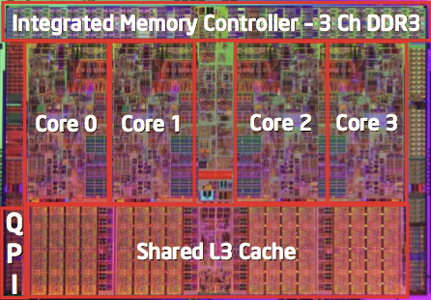
Intel x86 Processors
Intel Core i7
Machine Evolution
  486 1989 1.9M
  Pentium 1993 3.1M
  Pentium/MMX 1997 4.5M
  PentiumPro 1995 6.5M
  Pentium III 1999 8.2M
  Pentium 4 2001 42M
  Core 2 Duo 2006 291M
  Core i7 2008 731M
Added Features
  Instructions to support multimedia operations
  Parallel operations on 1, 2, and 4-byte data
  Instructions to enable more efficient conditional operations
  More cores!

Slide 10
x86 Clone: Advanced Micro Devices (AMD)
Historically
  AMD has followed just behind Intel
  A little bit slower, a lot cheaper
Then
  Recruited top circuit designers from Digital Equipment and other downward trending companies
  Built Opteron: tough competitor to Pentium 4
  Developed x86-64, their own extension of x86 to 64 bits

Slide 11
Issues in new ISA Design and Application
  “Is it compatible with it’s own predecessor?”
  “Can I run my old OS on it?”
  “Will it run existing applications unmodified?”
Backward Compatibility
  Source code compatible
  Machine code compatible
A new ISA will have new features, but what about other aspects of the language!
  What remains and what changes?
  A revolutionary change may make all higher level software change!

Slide 12
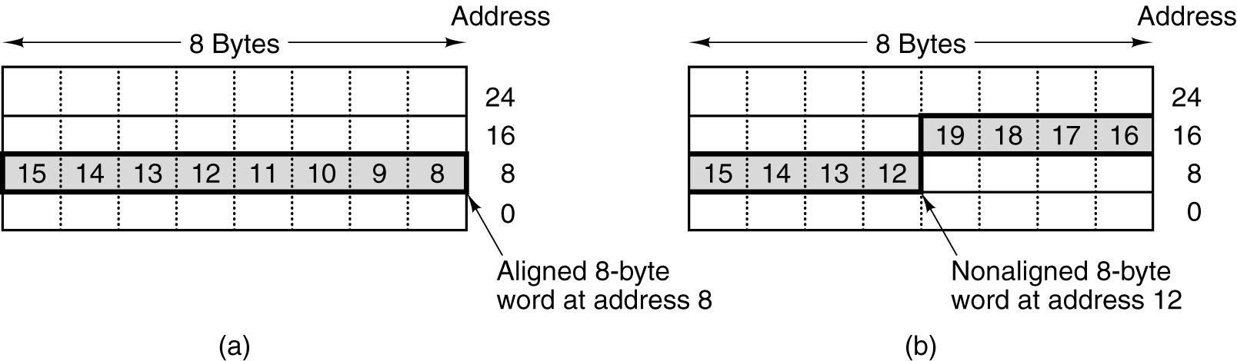
Memory Models
An 8-byte word in a little-endian memory. (a) Aligned. (b) Not
aligned. Some machines require that words in memory be aligned.

Slide 13
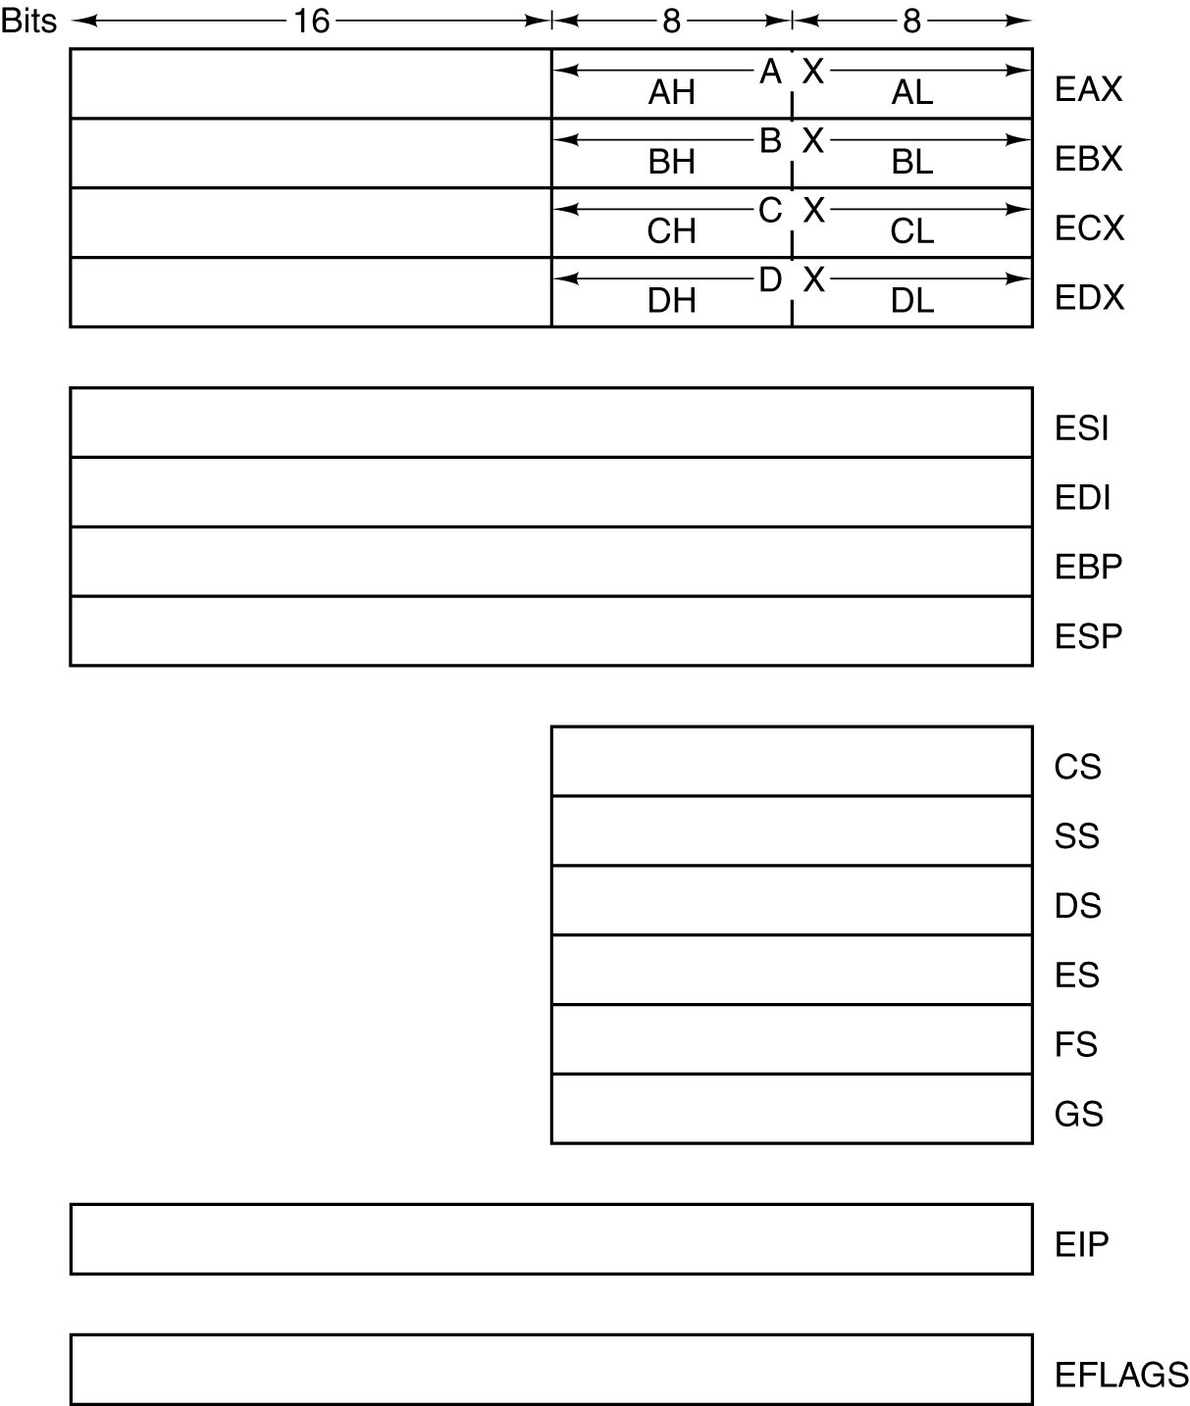
Overview of
the Pentium 4
ISA Level
The Pentium 4’s primary
registers.

Slide 14
Integer Register (IA32)
Origin
(mostly obsolete)
%eax
accumulate
%ecx
counter
%edx
data
general purpose
%ebx
base
%esi
source
index
%edi
destination
index
%esp
stack
pointer
%ebp
base
pointer
32-bit wide

Slide 15
Integer Register (IA32)
Origin
(mostly obsolete)
%eax
%ax
%ah
%al
accumulate
%ecx
%cx
%ch
%cl
counter
%edx
%dx
%dh
%dl
data
general purpose
%ebx
%bx
%bh
%bl
base
%esi
source
index
%si
%edi
destination
index
%di
%esp
stack
pointer
%sp
%ebp
base
pointer
%bp
16-bit virtual registers
(backwards compatibility)

Slide 16
x86-64 Integer Register
64-bits wide
%rax
%r8
%eax
%r8d
%rbx
%r9
%ebx
%r9d
%rcx
%r10
%ecx
%r10d
%rdx
%r11
%edx
%r11d
%rsi
%r12
%esi
%r12d
%rdi
%r13
%edi
%r13d
%rsp
%r14
%esp
%r14d
%rbp
%r15
%ebp
%r15d

Slide 17
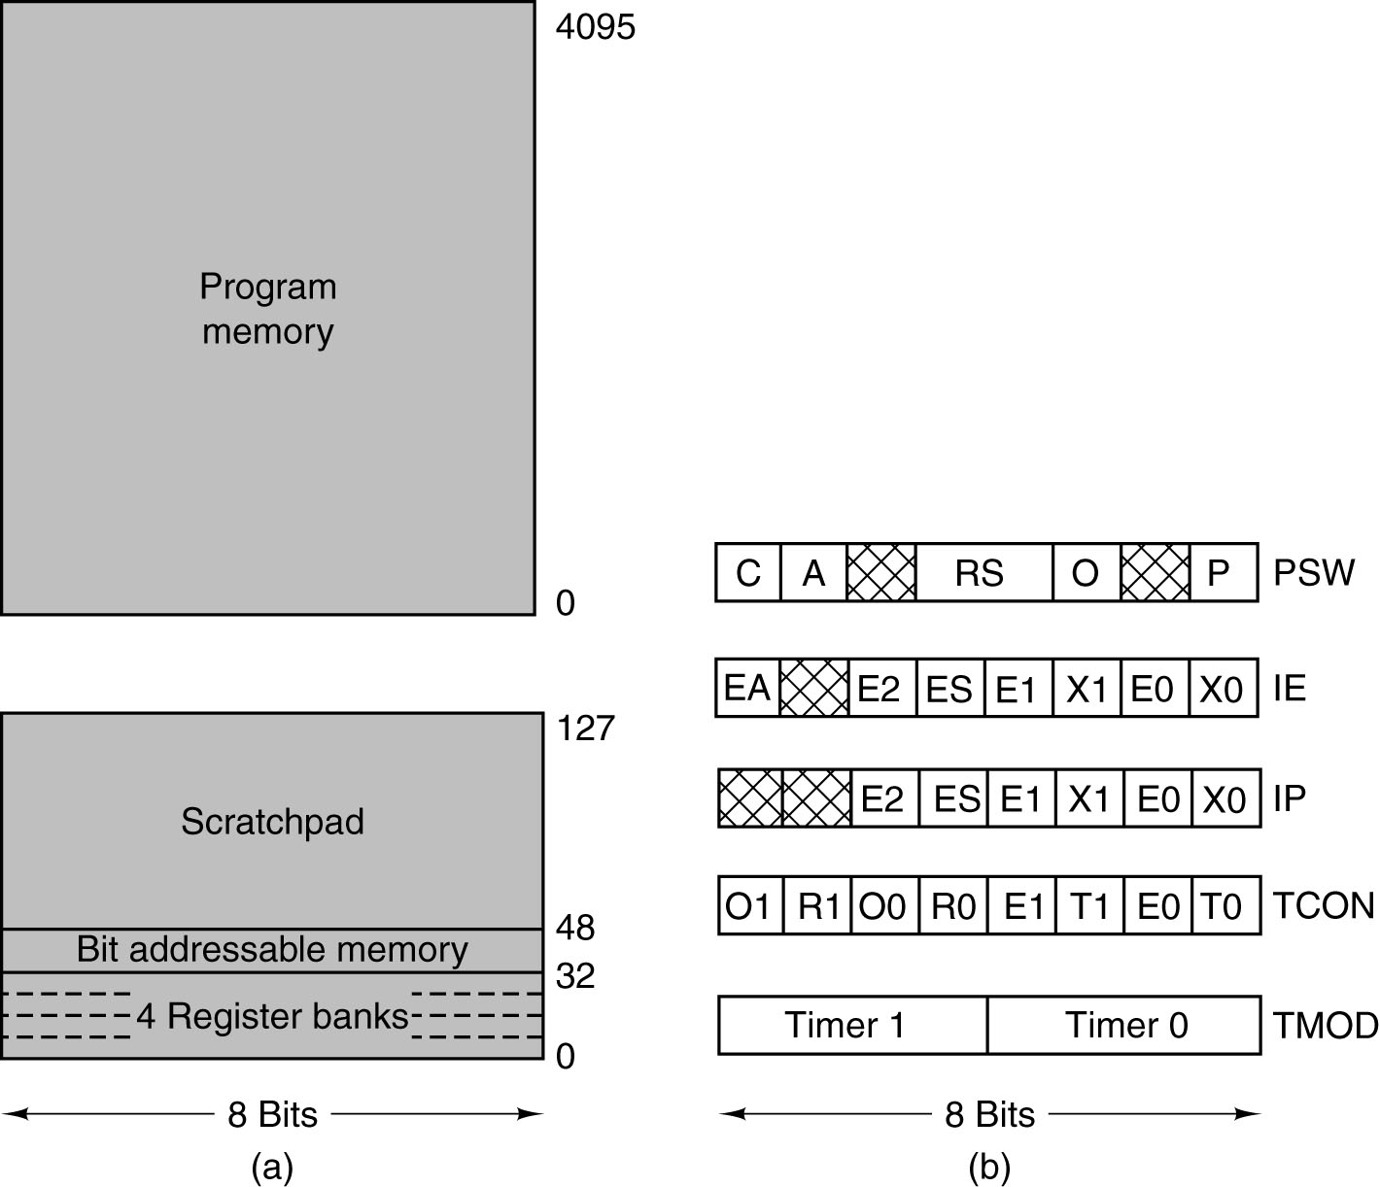
Overview of the
8051 ISA Level
(a) On-chip memory organization for the 8051.
(b) Major 8051 registers.

Slide 18
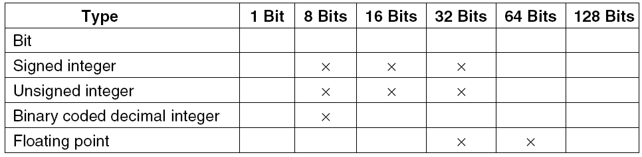
Data Types on the Pentium 4
The Pentium 4 numeric data types.
Supported types are marked with ×.

Slide 19
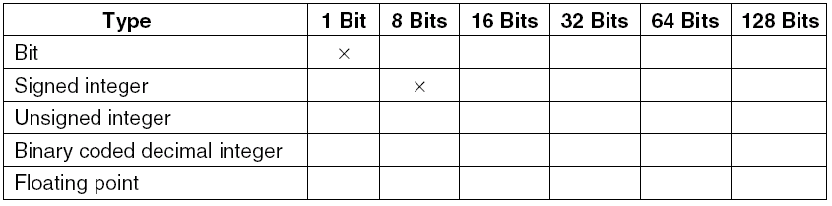
Data Types on the 8051
The 8051 numeric data types.
Supported types are marked with ×.

Slide 20
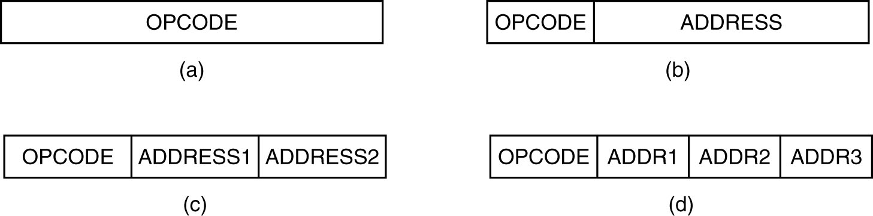
Instruction Format (1)
Four common instruction formats:
(a) Zero-address instruction. (b) One-address instruction
(c) Two-address instruction. (d) Three-address instruction.

Slide 21
Instruction Addressing
4-Address:
Conventional ALU
two addresses for the source
one address for the destination
one address for the next instruction
3-Address:
Conventional ALU
two addresses for the source
one address for the destination
implied next instruction (or an alternate instruction format)
2-Address:
Conventional ALU
two addresses for the source
results overwrite one of the sources
1-Address:
Accumulator Based machines
one address is used for one source
the accumulator provides the other and the destination
0-Address:
Stack Based machines
use the stack as both source and destination

Slide 22
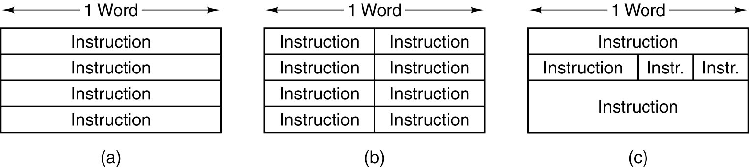
Instruction Format (2)
Simple RISC processors:
  All instructions the same size
  The typical instruction is only one word
CISC processors:
  Variable word size instructions
  Typically 1, 2, 3, or 4 words
Unique Languages:
  Multiple Instructions per word
  ARM core 32-bit machine has some 16-bit instructions
Some possible relationships between instruction and word length.

Slide 23
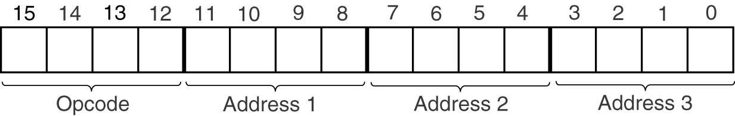
Expanding Opcodes (1)
Assume:
  16-bit instruction
  16 registers (4-bits to ID)
  a mix of 3-, 2-, 1-, and 0-address instructions
An instruction with a 4-bit opcode and three 4-bit address fields.

Slide 24
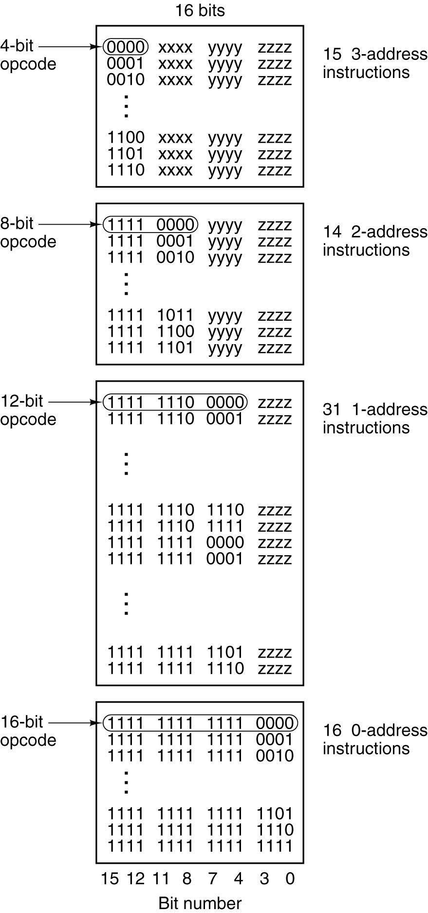
Expanding
Opcodes (2)
An expanding opcode allowing 15 three-address instructions, 14 two-address instructions, 31 one-address instructions, and 16 zero-address instructions. The fields marked xxxx, yyyy, and zzzz are 4-bit address fields.

Slide 25
Expanding Opcodes (3)
Result:
  There are four instruction formats
  One format for 3-, 2-, 1-, and 0- address instructions each
  Formats 1, 2, and 3 have 15 instructions available
  Format 0 has 16 instructions available
Total instructions
  15 3-address instructions
  15 2-address instructions
  15 1-address instructions
  16 0-address instructions
  Total of 61 instructions available

Slide 26
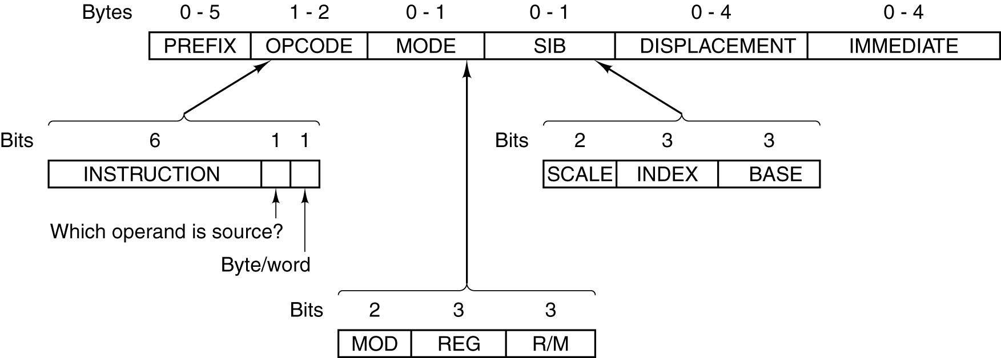
Pentium 4 Instruction Formats

Slide 27
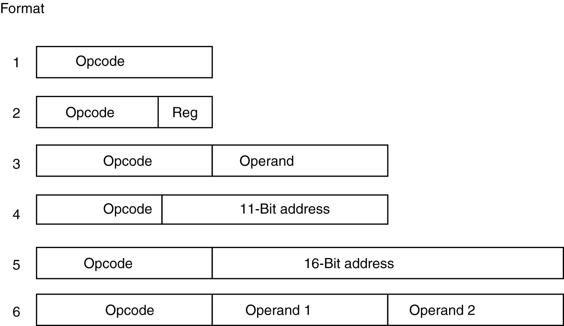
8051 Instruction Format

Slide 28
Addressing
The most significant part of the instruction!

Slide 29
Example (Heuring and Jordan)
Immediate Addressing
Value ← #XXXX
Direct Addressing
Value ← M[ #XXXX ]
Register Addressing
Value ← R( a )
Register Indirect Addressing
Value ← M[ R( a ) ]
Indexed Addressing
Value ← M[ R( a ) + #XXXX]
Based-Indexed Addressing
Value ← M[ R( a ) + R( b ) ]
PC Relative Addressing
NewPC ← PC + #XXXX

Slide 30
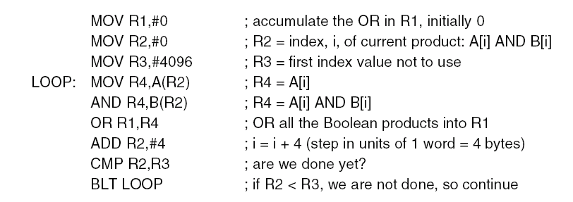
A generic assembly program for computing the R1 OR of (Ai AND Bi) for two 1024-element arrays.
Register, Immediate
Register, Immediate
Register, Immediate
Register, Indexed (Base and displacement)
Register, Indexed (Base and displacement)
Register, Register
Register, Immediate
Register, Register
PC Relative
LOOP:

Slide 31
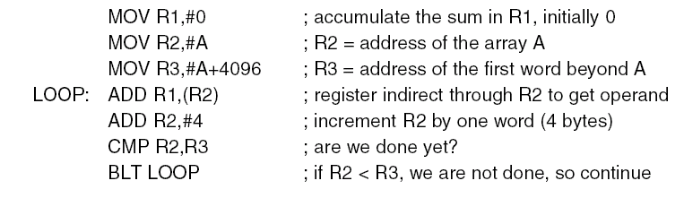
A generic assembly program for computing the sum of the elements of an array.
Q: Find addressing model identification on each line

Slide 32
Reverse Polish Notation (1)

Slide 33
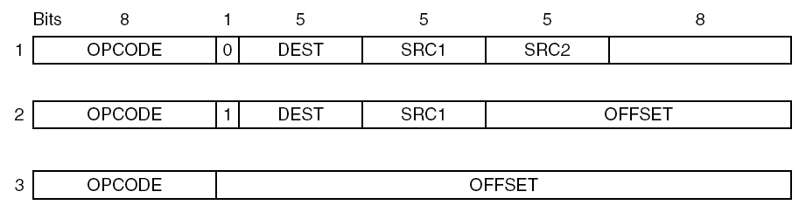
Orthogonality of Opcodes and
Addressing Modes (1)
A simple design for the instruction formats of a three-address machine.

Slide 34
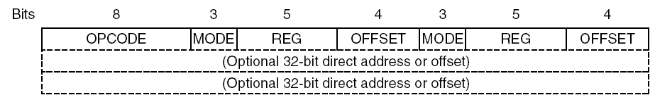
Orthogonality of Opcodes and
Addressing Modes (2)
A simple design for the instruction formats
of a two-address machine.

Slide 35
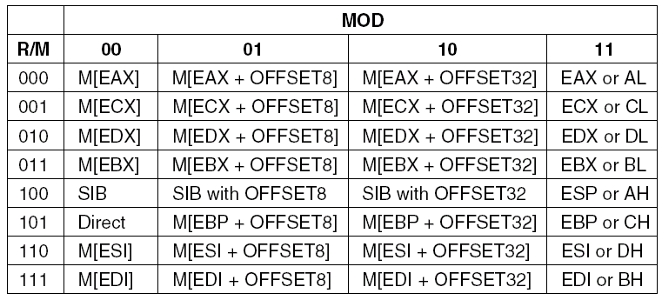
Pentium 4 Addressing Models (1)
The Pentium 4 32-bit addressing modes. M[x]
is the memory word at x.

Slide 36
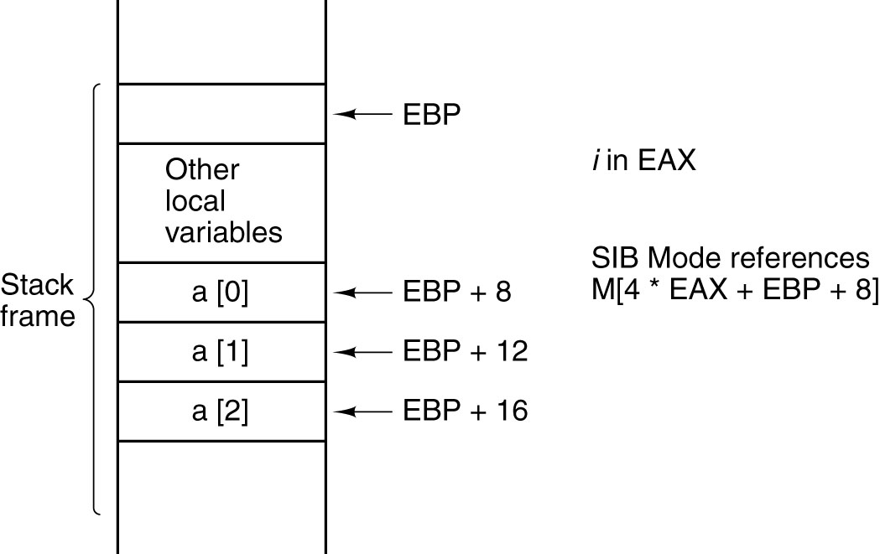
Pentium 4 Addressing Models (2)
Access to a[i].

Slide 37
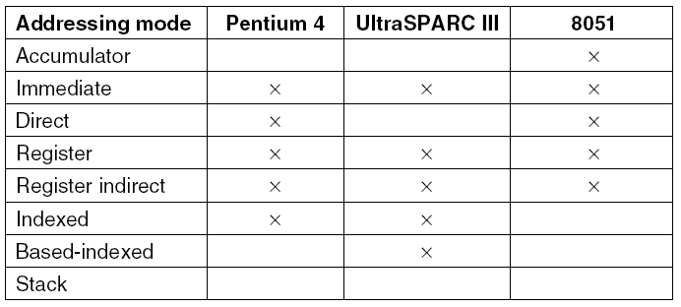
Discussion of Addressing Models
A comparison of addressing modes.

Slide 38
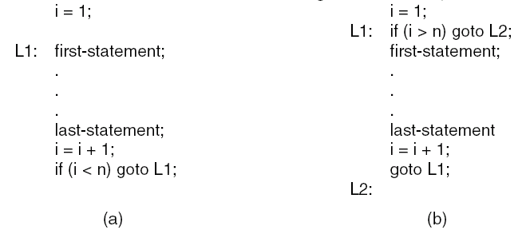
Loop Control
(a) Test-at-the-end loop.
The loop operations will be executed at least once ... is it desirable?
(b) Test-at-the-beginning loop.
The loop instructions will not be executed if the conditional does not pass.

Slide 39
Input/Output Instruction
There are three distinct classes of I/O operations:
  Programmed I/O with busy waiting
  Interrupt-driven I/O
  DMA I/O

Slide 40
Programmed I/O
Commonly used in low-end microprocessors, for example, in embedded systems or in systems that must respond quickly to external changes (real-time)
Data and status are “read” or “written” from defined I/O address locations (typically Memory Mapped I/O addresses).
The normal procedure requires:
  Check a bit in a status register
  If the bit check does not pass defined criteria, keep checking (a loop)
  Once the status passes, read or write the data

Slide 41
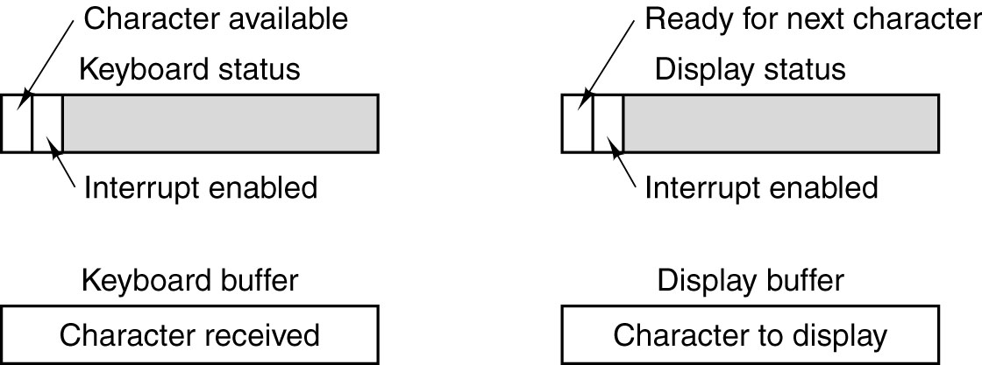
Programmed I/O
Example routines (keyboard, mouse, modem, UART, etc.):
get_character: read a word or character from an I/O device
put_character: write a word or character from an I/O device

Slide 42
Programmed I/O
public static void output_buffer(char buf[ ], int count) {
// Output a block of data to the device
int status, i, ready;
for (i = 0; i < count; i++) {
do {
status = in(display_status_reg);
// get status
ready = (status >> 7) & 0x01;
// isolate ready bit
} while (ready != 1);
out(display_buffer_reg, buf[i]);
}
}
An example of programmed I/O.

Slide 43
Programmed I/O
Disadvantages:
  CPU spends most of its time in a tight loop waiting for the device to become ready, call busy waiting
  If the CPU has nothing else to do (e.g., the CPU in a washing machine), busy waiting may be OK
  if there is other work to do, such as running other programs, busy waiting is wasteful

Slide 44
Interrupt-driven I/O
Instead of waiting for valid status, most processors provide interrupts based on I/O status changes.
Requirements to operate:
  Interrupt capability
  Initialization procedures to initialize the port and interrupt registers
  An Interrupt Service Routine (ISR) for defined/used interrupts
  Interrupt enabling once the processor needs to recognize/execute interrupts

Slide 45
Interrupt-driven I/O
Advantages:
  Interrupts allow the program to execute will waiting for the I/O device or status
  Wasted clock cycles are recovered, if something useful can be accomplished
Disadvantages:
  Interrupts “happen when they happen”
  The processors system must perform “Precise Interrupts” or the program will likely crash
  Interrupts require a large number of clock cycles (wasted overhead) to enter the ISR and return from the ISR

Slide 46
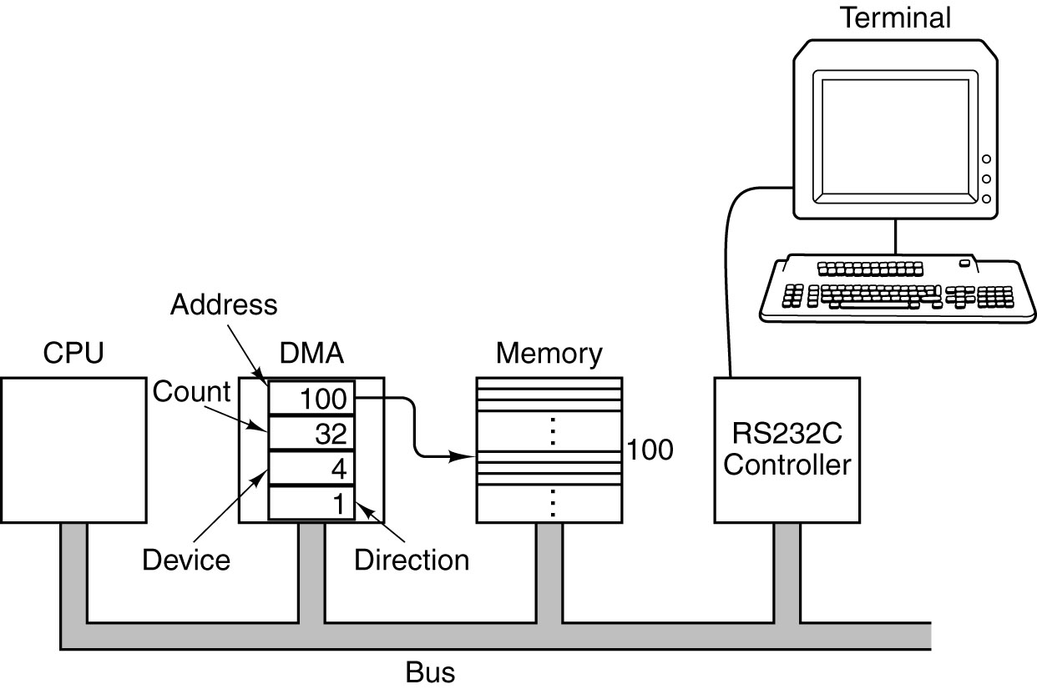
DMA (Direct Memory Access) I/O
A system with a DMA controller. DMA is to write a block of 32 bytes from memory address 100 to a terminal (say, device 4)

Slide 47
DMA Chip
The DMA chip has (at least) four registers inside it, all of which can be loaded by software running on the CPU.
  The first one contains the memory address to be read or written.
  The second one contains the count of how many bytes (or words) are to be transferred.
  The third one specifies the device number or I/O space address to use, thus specifying which I/O device is desired.
  The fourth one tells whether data are to be read from or written to the I/O device.

Slide 48
DMA I/O
Requirements to operate:
DMA processing ability – shared bus with bus request and grants
Initialization procedures to initialize the port, interrupt and DMA registers.
(DMA input address, output address, transfer count)
An Interrupt Service Routine (ISR) for DMA interrupts (when done!)
DMA and interrupt enabling once the processor needs to recognize/execute interrupts

Slide 49
DMA I/O
Advantages:
  DMA allow the program to execute will waiting for the DMA I/O to complete
  Wasted CPU and multiple interrupt clock cycles are recovered.
  A software interrupt or non-wait polling may be used
Disadvantages:
  DMAs use peripherals, the data bus and memory to move data; therefore,
  The CPU must share the bus with the DMA processor
  Bus priority must be defined for CPU and DMA
  (Note: if the DMA is time-critical, it must have priority over CPU bus cycles!)

Slide 50
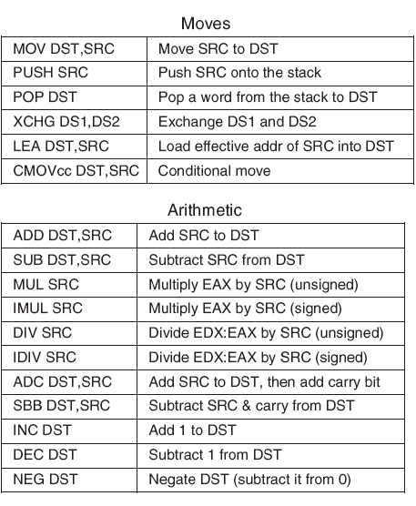
The Pentium 4 Instructions (1)
A selection of the Pentium 4 integer instructions.

Slide 51
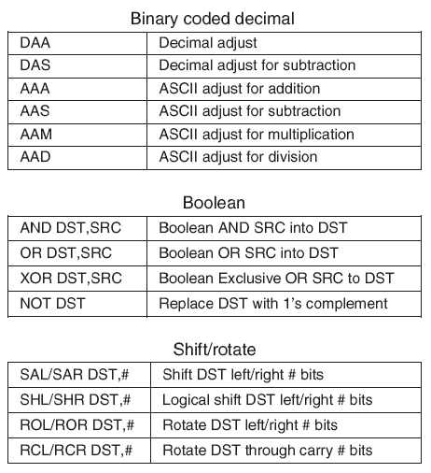
The Pentium 4 Instructions (2)
A selection of the Pentium 4 integer instructions.

Slide 52
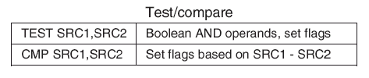
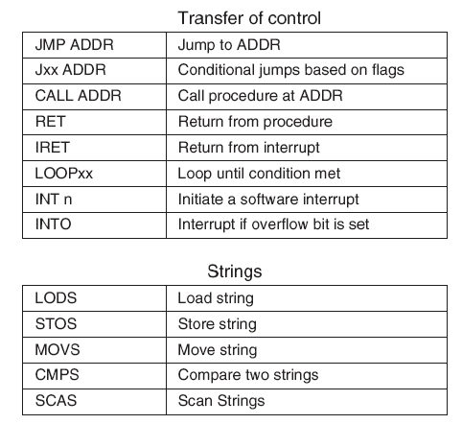
The Pentium 4 Instructions (3)
A selection of the Pentium 4 integer instructions.

Slide 53
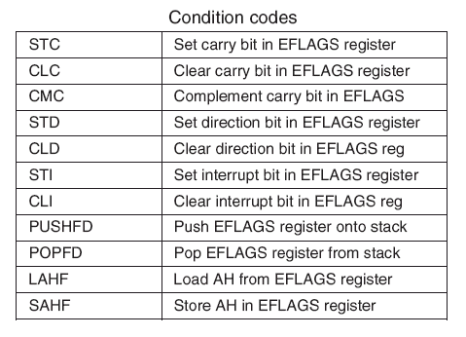
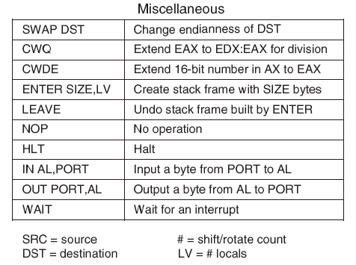
The Pentium 4 Instructions (4)
A selection of the Pentium 4 integer instructions.

Slide 54
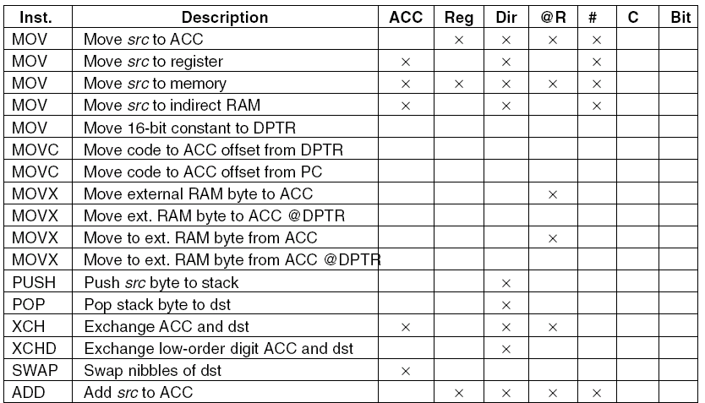
8051 Instructions (1)
The 8051 Instruction set.

Slide 55
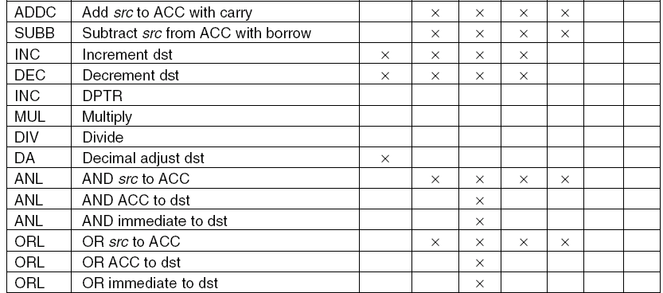
8051 Instructions (2)
The 8051 Instruction set.

Slide 56
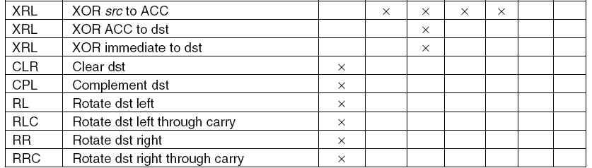
8051 Instructions (3)
The 8051 Instruction set.

Slide 57
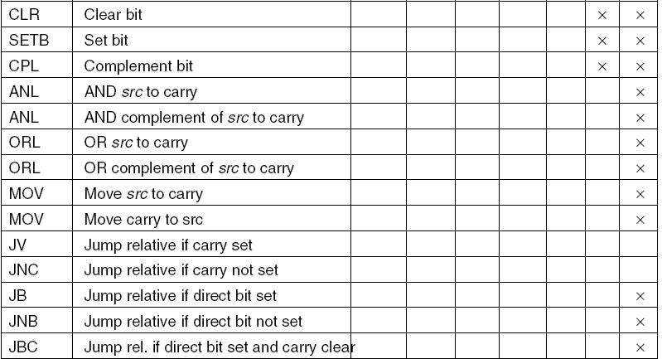
8051 Instructions (4)
The 8051 Instruction set.

Slide 58
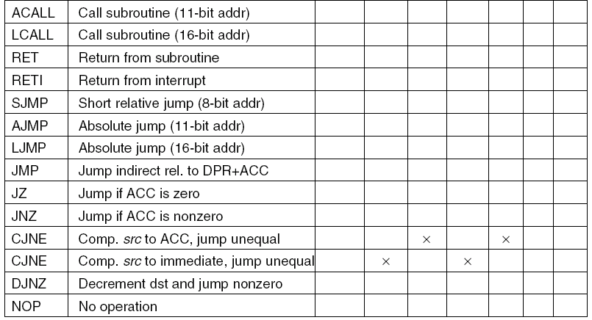
8051 Instructions (5)
The 8051 Instruction set.

Slide 59
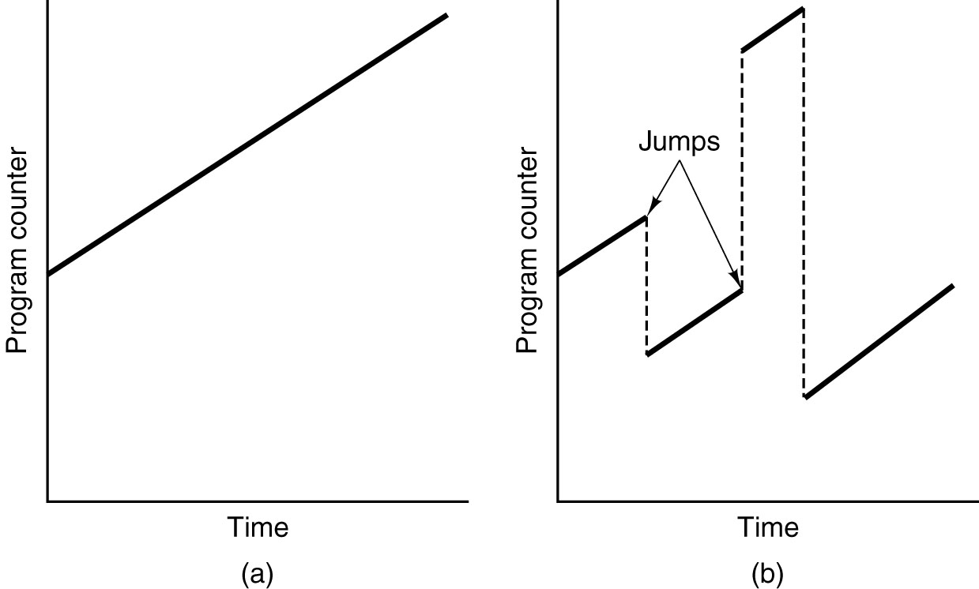
Sequential Flow of Control and Branches
Program counter as a function of time (smoothed).
(a) Without branches. (b) With branches.

Slide 60
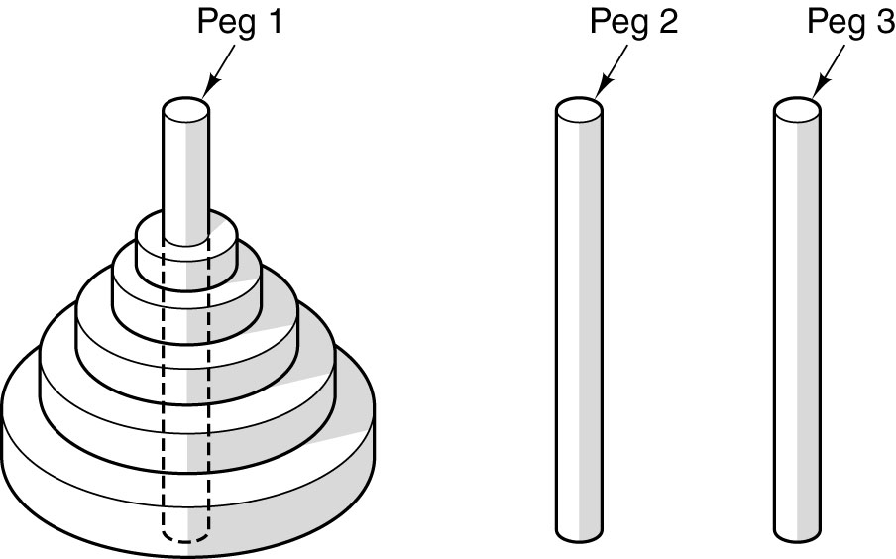
Recursive Procedures (1)
Initial configuration for the Towers of Hanoi problem for five disks.

Slide 61
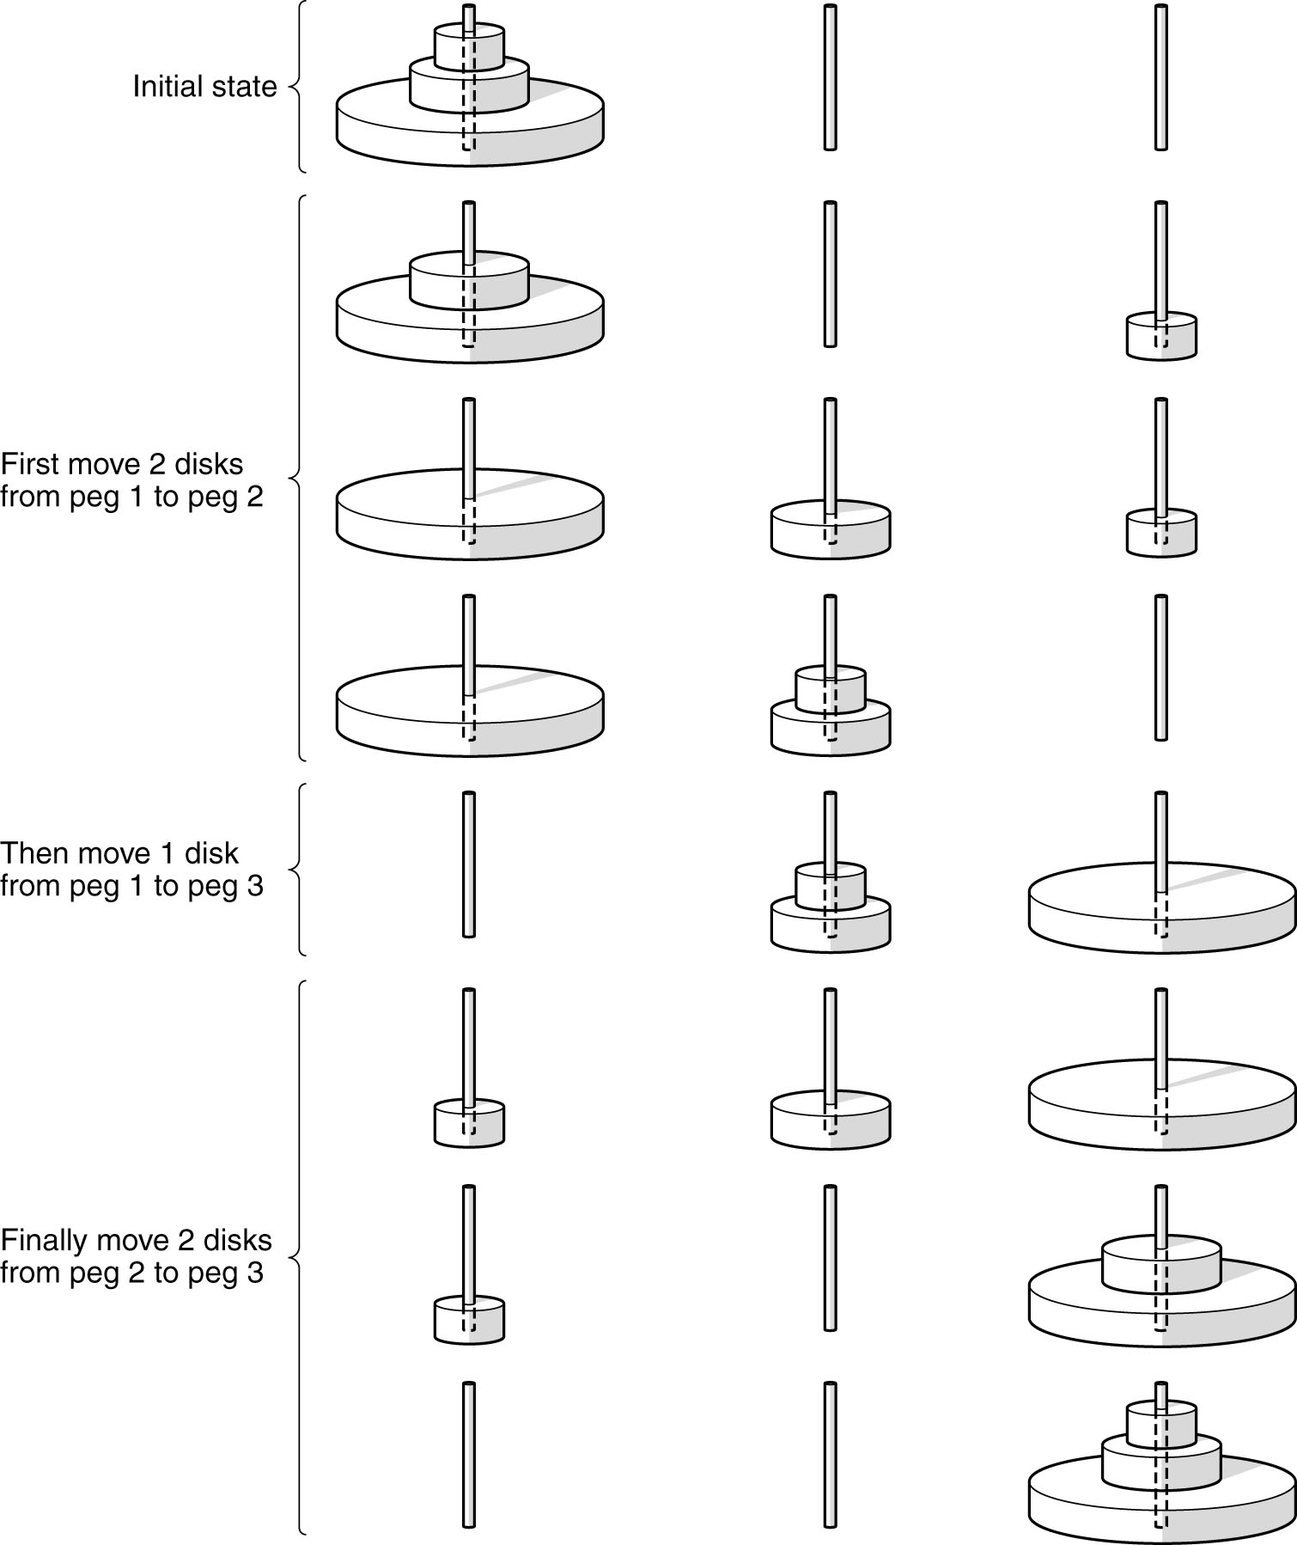
Recursive Procedures (2)
The steps required to solve the Towers of Hanoi for three disks.

Slide 62
Recursive Procedures (3)
The steps required to solve the Towers of Hanoi for three disks.

Slide 63
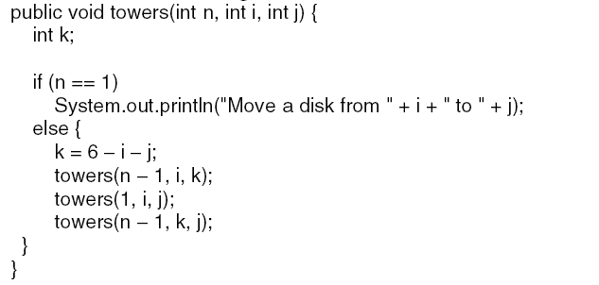
Recursive Procedures (4)
A procedure for solving the Towers of Hanoi.

Slide 64
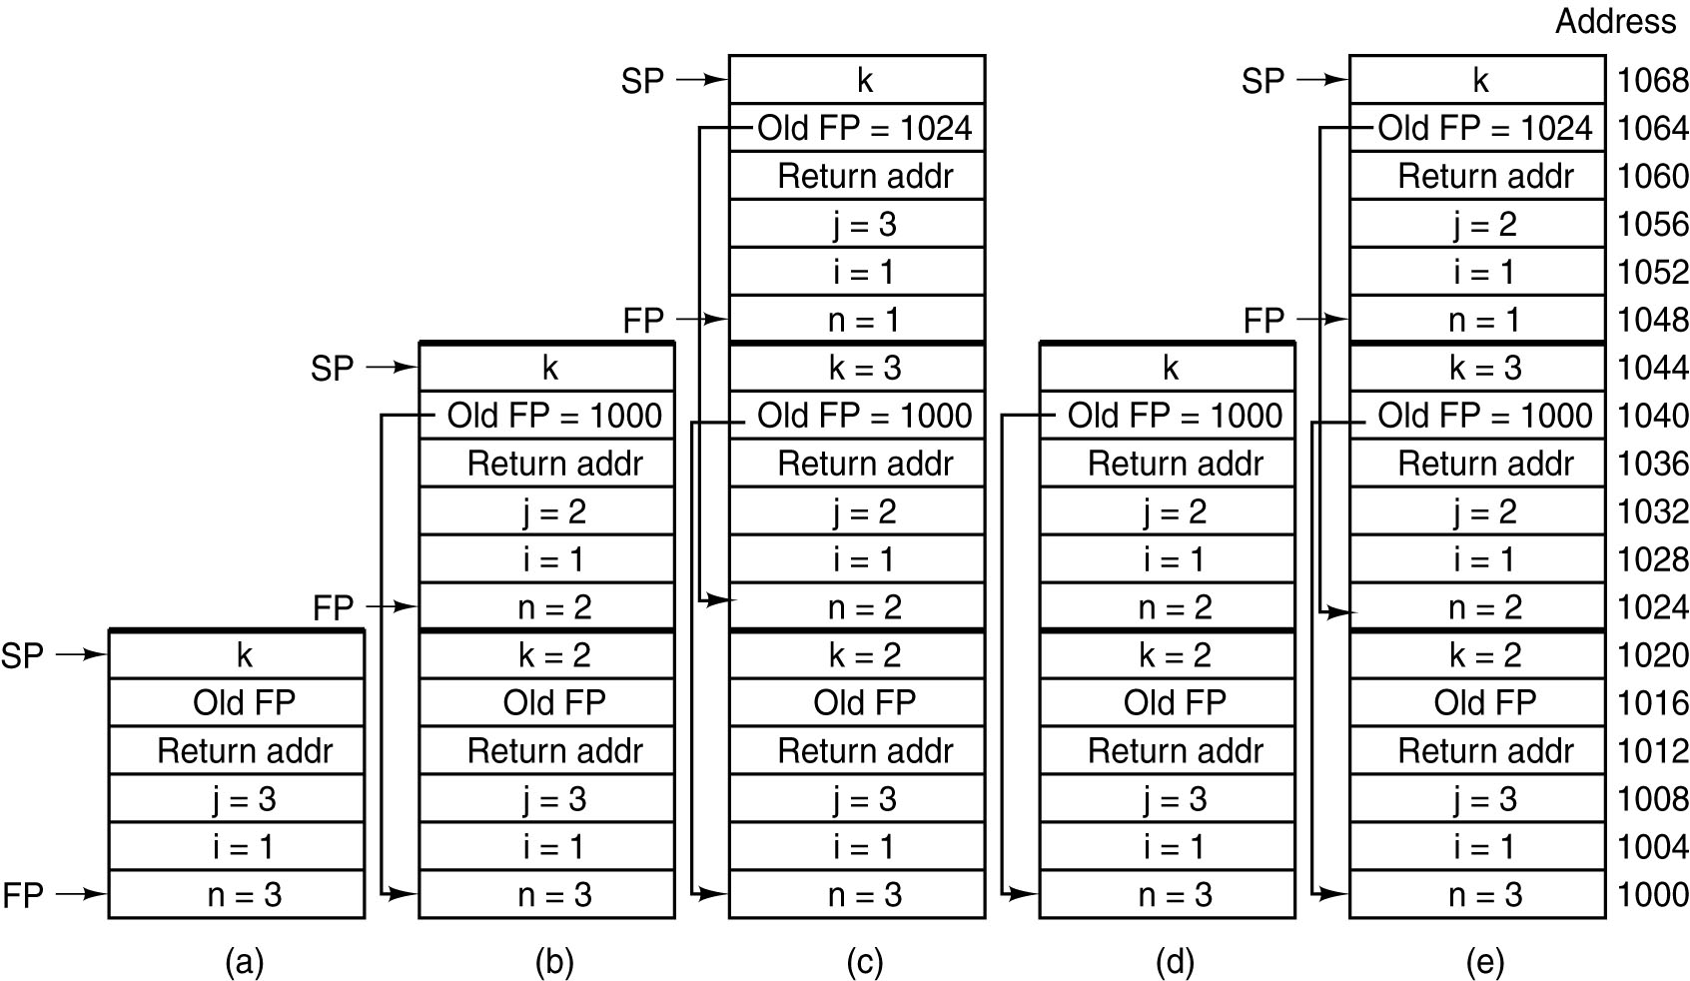
Recursive Procedures (5)
The stack at several points during the execution of Fig. 5-42.

Slide 65
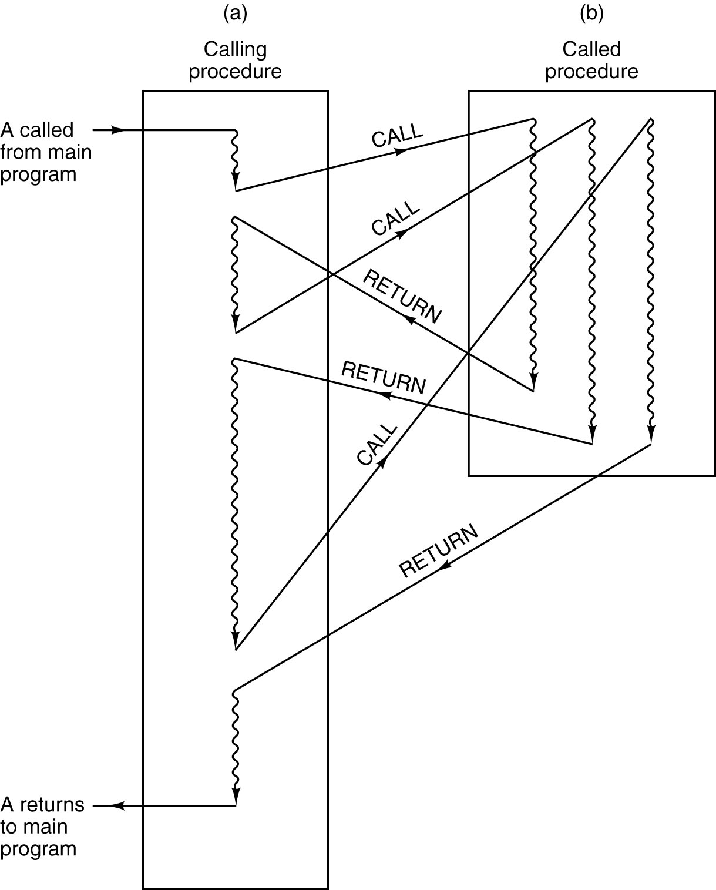
Coroutines (1)
When a procedure is called,
execution of the procedure
always begins at the first
statement of the procedure.

Slide 66
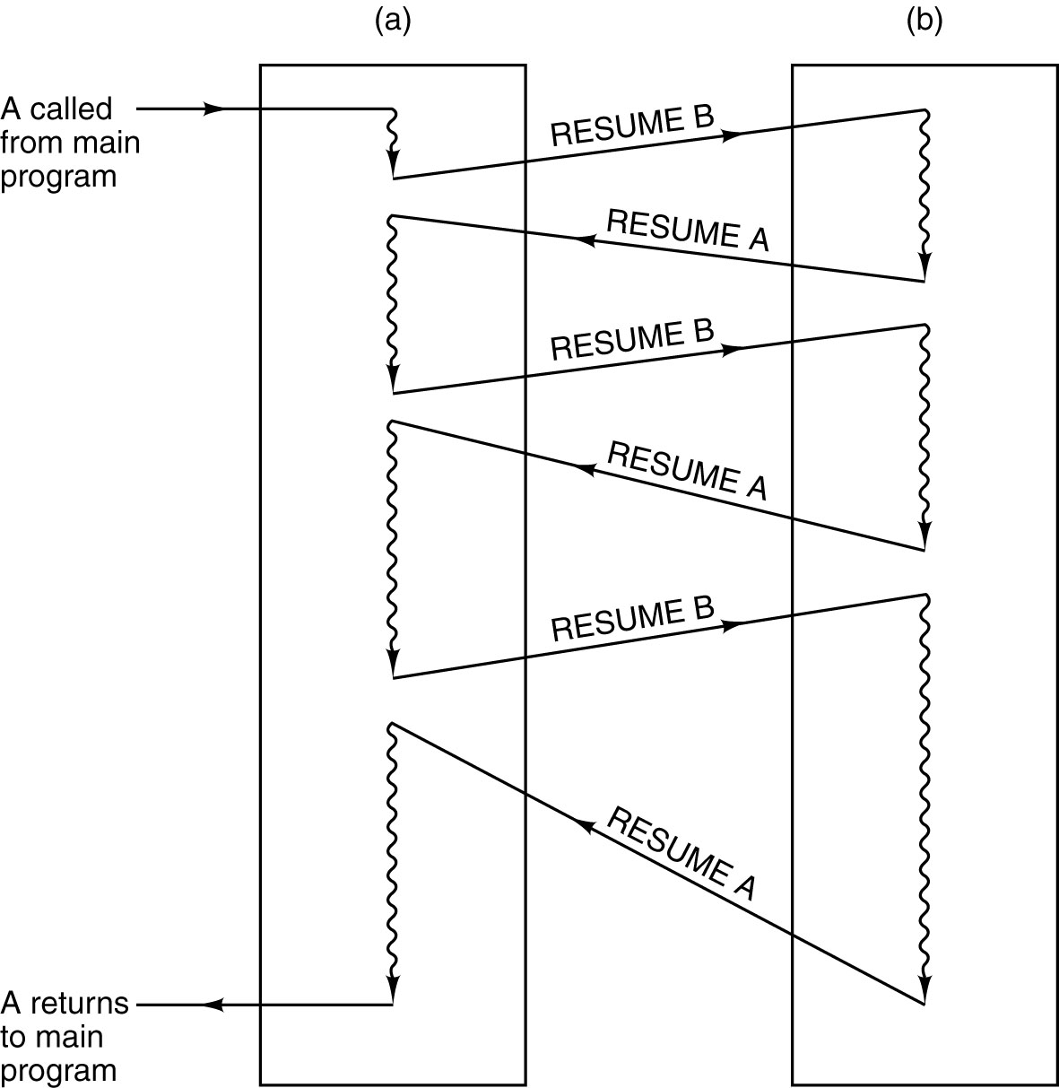
Coroutines (2)
When a coroutine is resumed, execution begins at the
statement where it left off the previous time, not at the beginning.

Slide 67
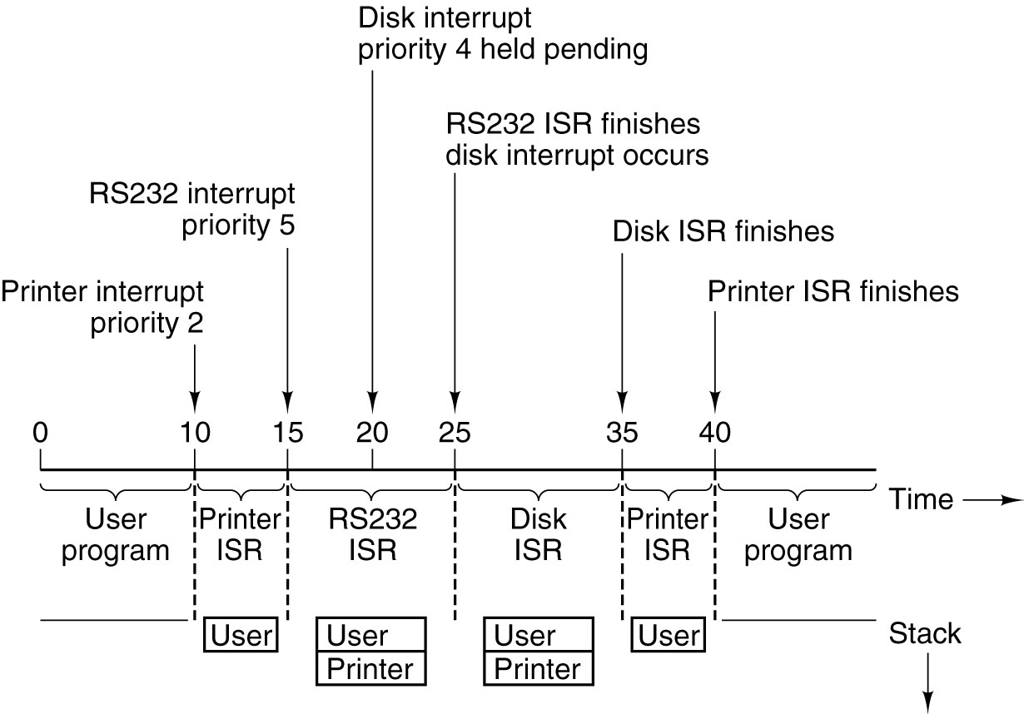
Interrupts
Time sequence of multiple interrupt example.

Slide 68
Copyright note
Slides are adopted form lecture notes of Tanenbaum, Structured Computer Organization, Fifth Edition, (c) 2006 Pearson Education, Inc.

