Slide 1
Computer Architecture
Ch5 – The Assembly Language Level
Nguyen Quoc Dinh, FIT – HUI
HCMC, Aug 2015

Slide 2
Concepts
A pure assembly language is a language in which each statement produces exactly one machine instruction
  One-to-one correspondence
Compiler
  Translate HLL into a “symbolic” language or a numerical machine language
Assembler
  Translate a symbolic representation into a numerical machine language

Slide 3
Writing Code in Assembly Language
Much more tedious than coding in HLL
There are more instruction than in a HLL required to perform the same function

Slide 4
Writing Code in Assembly Language
Why would anyone would ever program in ASM?
  Performance
    The final code is faster and more dense
    Embedded application – where operation rates, memories or registers are at a premium
    The 10-90 relationship
  Access to the machine
    Driver, ISR (interrupt service routine)
    Somethings usually impossible in high-level language

Slide 5
Making Code Run Faster
Relationship
  1% of the program be responsible for 50% of the execution time
  10% of the program be responsible for 90% of the execution time
Wanna speed up the program? Where to start?
  The 1%
  Then the 9%
… but the ASM take longer time to write than HLL

Slide 6
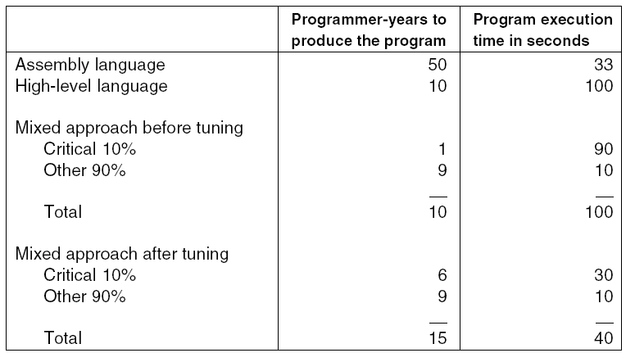
Benchmark Tradeoff
Comparison of assembly language and high-level language
programming, with and without tuning.

Slide 7
It's about Money
Program manager’s software coding estimates
  For complete code with design, documentation, coding, and code test completed.
  HLL: 4-8 lines-of-code (LOC) per hour
  ASM: 8+ LOC per hour but will require 4-8 times the number of lines
  While there is at least a 2x speedup in writing code, the number of lines will expand by a factor of from 4x to 8x (resulting in 2x to 4x longer development times)
Above mentioned statistics are from Dr. Bradley J. Bazuin, Western Michigan University

Slide 8
Practical Business Approach
Steps
  Prototype in a high-level language
  Use a process monitor or trace of the execution to determine execution time and flow
  Rewrite critical or slow segments
Many companies make two versions
  the fast time to market one (sell at a loss or for no profit)
  the slower lower manufacturing cost one (where the profit comes from)

Slide 9
See in Other Places
Another Similar Relationships in Engineering:
  HLL to ASM relationship for software
  VHDL/Verilog Code and Synthesis to custom IC Design and Layout for ICs
  Faster development and delivery, larger product vs.
  Slower development and delivery, smaller more optimized result

Slide 10
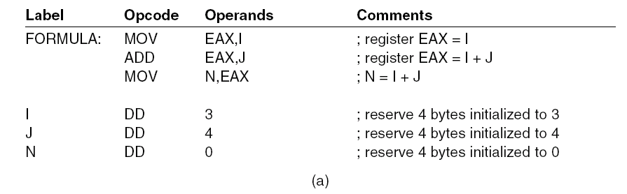
Format of an ASM Language Statement
Fields: (1) Label (2) Opcode (3) Result and Operand Fields (4) Comment
Computation of N = I + J. (a) Pentium 4.

Slide 11
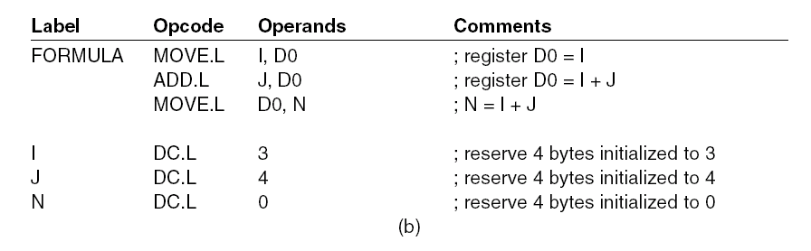
Format of an ASM Language Statement
Fields: (1) Label (2) Opcode (3) Result and Operand Fields (4) Comment
Computation of N = I + J. (b) Motorola 680x0.

Slide 12
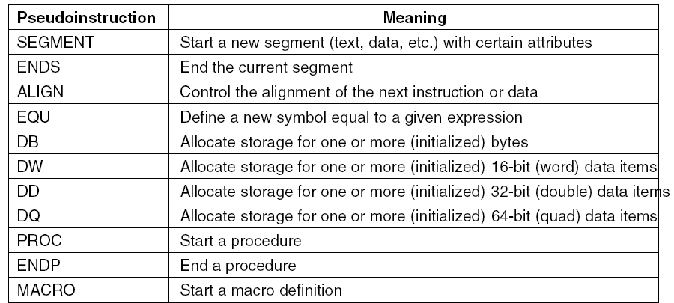
Pseudoinstructions (1)
Some of the pseudoinstructions available in the
Pentium 4 assembler (MASM).

Slide 13
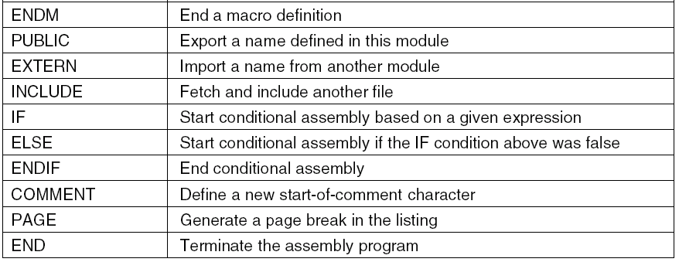
Pseudoinstructions (2)
Some of the pseudoinstructions available in the
Pentium 4 assembler (MASM).

Slide 14
Example of Macro and Function
1 #include <stdio.h>
2 #define swa_mac(a, b) int __x = a; a = b; b=__x
3 void swa_func(int *a, int *b) {
4 int x = *a;
5 *a = *b;
6 *b = x;
7 }
8
9 int main() {
10 int x = 1;
11 int y = 2;
12 printf("x = %d, y = %d \n", x, y);
13 swa_mac(x, y);
14 printf("x = %d, y = %d \n", x, y);
15 swa_func(&x, &y);
16 printf("x = %d, y = %d \n", x, y);
17 }

Slide 15
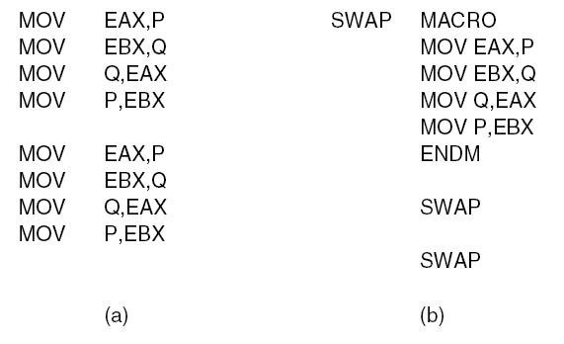
Macro Definition, Call, Expansion
Assembly language code for interchanging P and Q twice.
(a) Without a macro. (b) With a macro.

Slide 16
Macro vs. Procedure
Do you use a macro or make a procedure call?
  Procedure calls are done during execution
  Macros are expanded at time of assembly ... known as a macro call
The output machine code will not distinguish where a macro was use (you can’t tell). After reverse assembly, macros will not exist.
Macros make the machine code longer (require more memory storage space)
Macros execute faster as no branching may be required (procedure calls ... and return overhead)

Slide 17
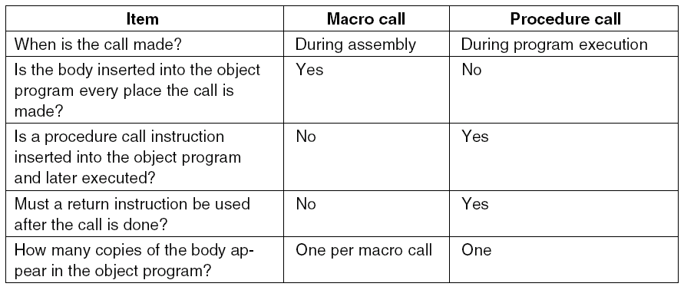
Macro vs. Procedure
Comparison of macro calls with procedure calls.

Slide 18
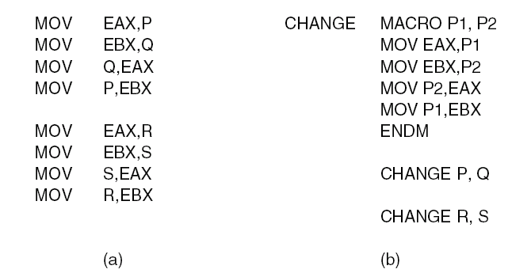
Macros with Parameters
Nearly identical sequences of statements.
(a) Without a macro. (b) With a macro.

Slide 19
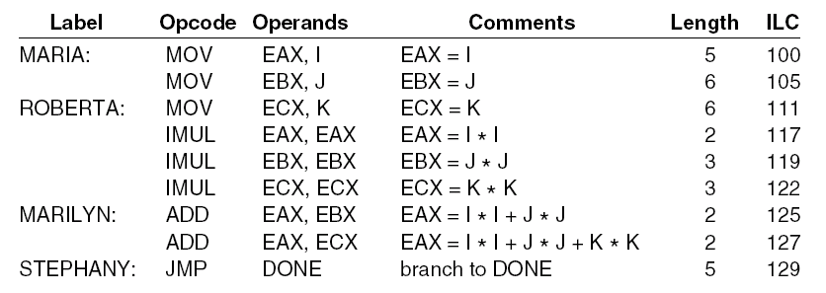
Two-Pass Assemblers (1)
The instruction location counter (ILC) keeps track of the address where the instructions will be loaded in memory. In this example, the statements prior to MARIA occupy 100 bytes.

Slide 20
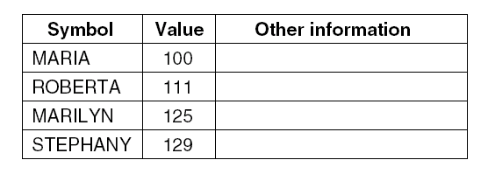
Two-Pass Assemblers (2)
A symbol table for the program in previous slide

Slide 21
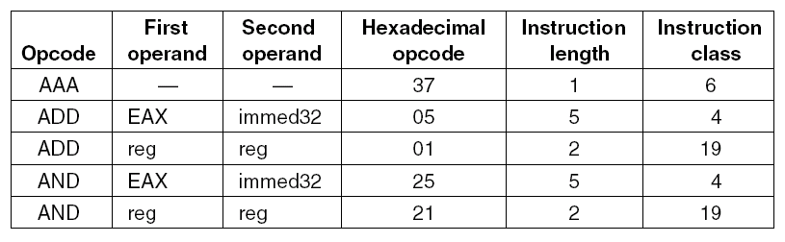
Two-Pass Assemblers (3)
A few excerpts from the opcode table for a Pentium 4 assembler

Slide 22
Pass One & Pass Two

Slide 23
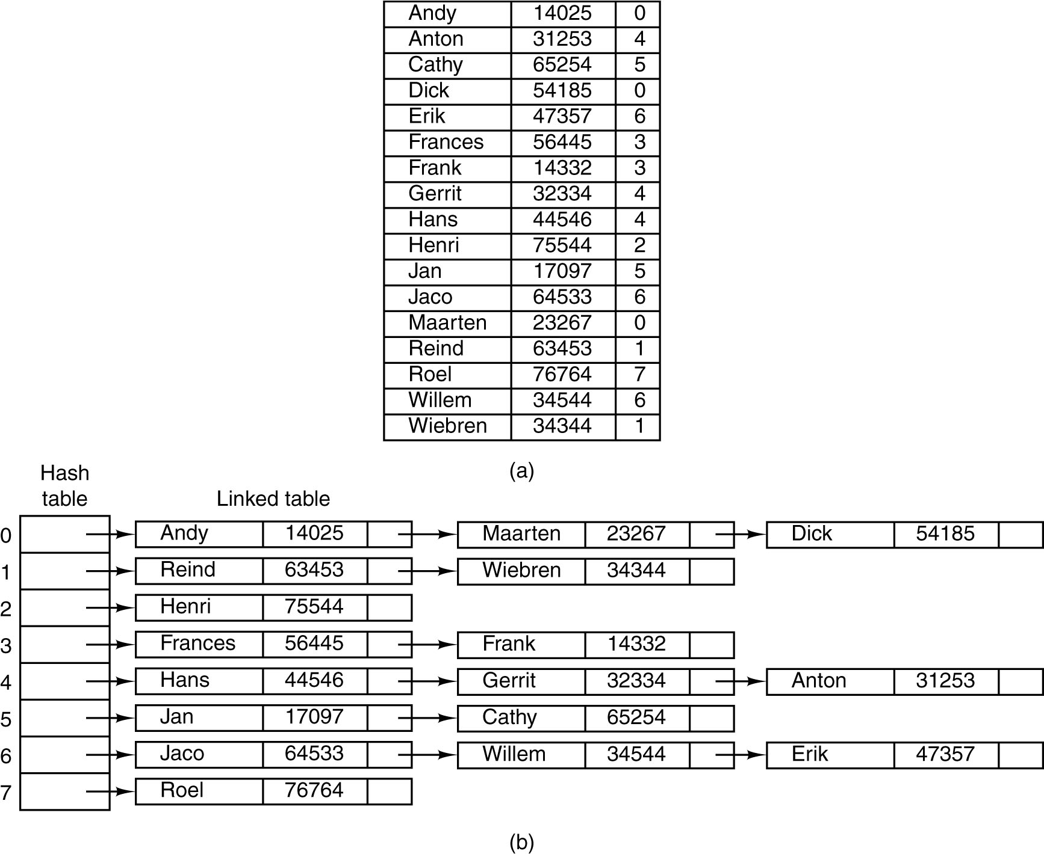
The Symbol Table (1)
Hash coding. (a) Symbols, values, and the hash codes derived from the symbols.

Slide 24
The Symbol Table (2)
Hash coding. (b)
Eight-entry hash table with linked lists of symbols and values.

Slide 25
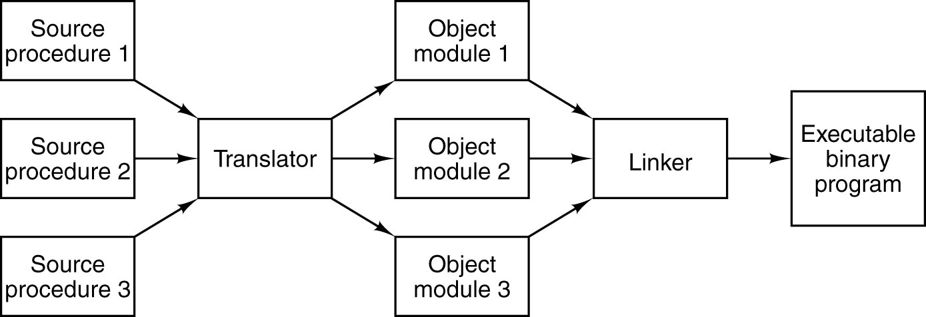
Linking and Loading
Generation of an executable binary program from a collection of independently translated source procedures requires using a linker.

Slide 26
Linking and Loading
The source code is translated into object modules.
  In windows: *.obj
  In Unix: *.o
Object modules may be incrementally compiled. They may be loaded from a library. They consist of sufficient “tables” that can be combined to make an executable.
The resulting executable modules
  In Windows: *.exe
  In Unix: *

Slide 27
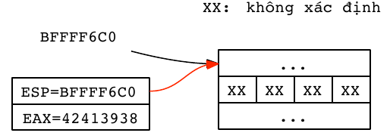
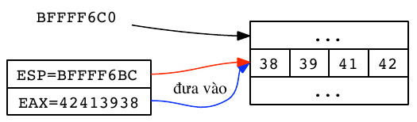
Stack
xx: undefined
Push
Pop
before
push in
after
Before and After PUSH EAX command

Slide 28
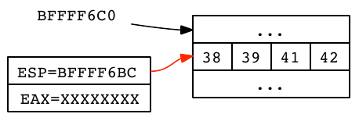
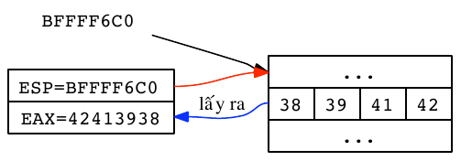
Stack
Push
Pop
before
pop out
after
Before and After POP EAX command

Slide 29
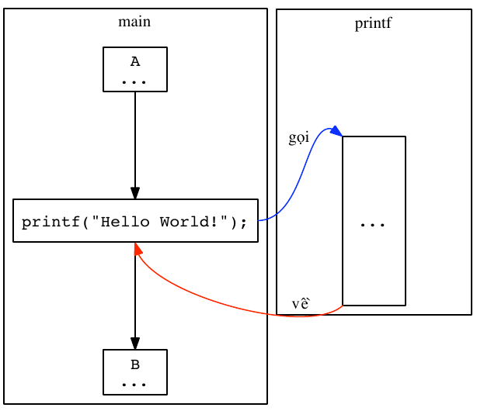
Function Calling
08048449 PUSH 0x08048580
0804844E CALL printf
08048453 ADD ESP, 0x10
calling
return

Slide 30
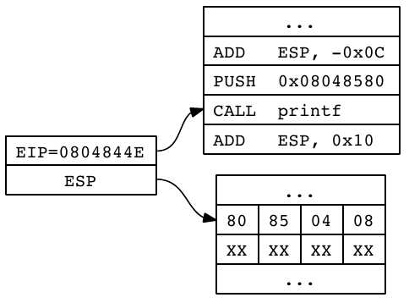
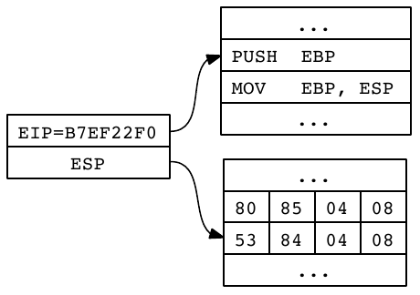
Function Calling
Begin of “printf” function
Before
After
Before and After CALL function

Slide 31
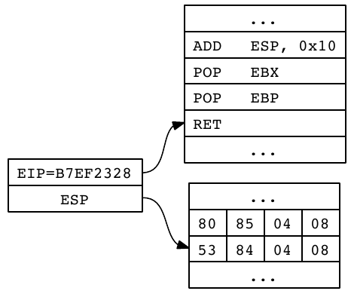
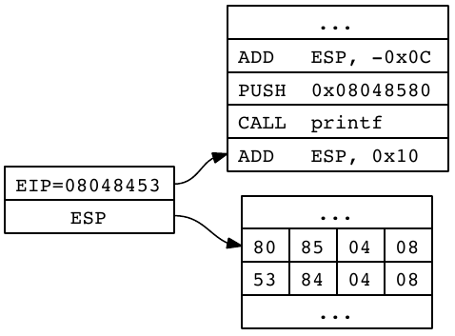
Function Calling
Before
After
Before and After RET function

Slide 32
Copyright note
Slides are adopted form lecture notes of Tanenbaum, Structured Computer Organization, Fifth Edition, (c) 2006 Pearson Education, Inc.

