Slide 1
Computer Architecture
Ch6 – Parallel Computer Architecture
Nguyễn Quốc Đính, FIT – IUH
HCMC, Aug 2015

Slide 2
Significant Architecture Distinction
Multiprocessor
  Many parallel processors
  Shared memory machines
Multicomputer
  Many parallel computers
  Message passing machines (processors pass messages to share data)

Slide 3
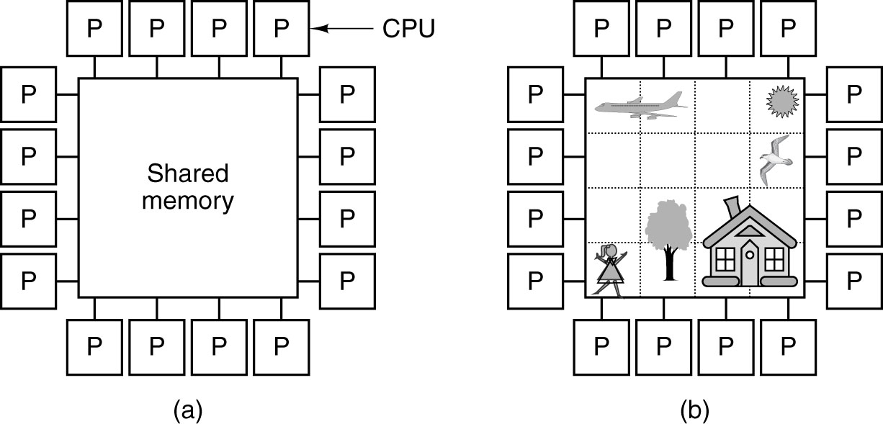
Multiprocessors
(a) A multiprocessor with 16 CPUs sharing a common memory.
(b) An image partitioned into 16 sections, each being analyzed by a different CPU.

Slide 4
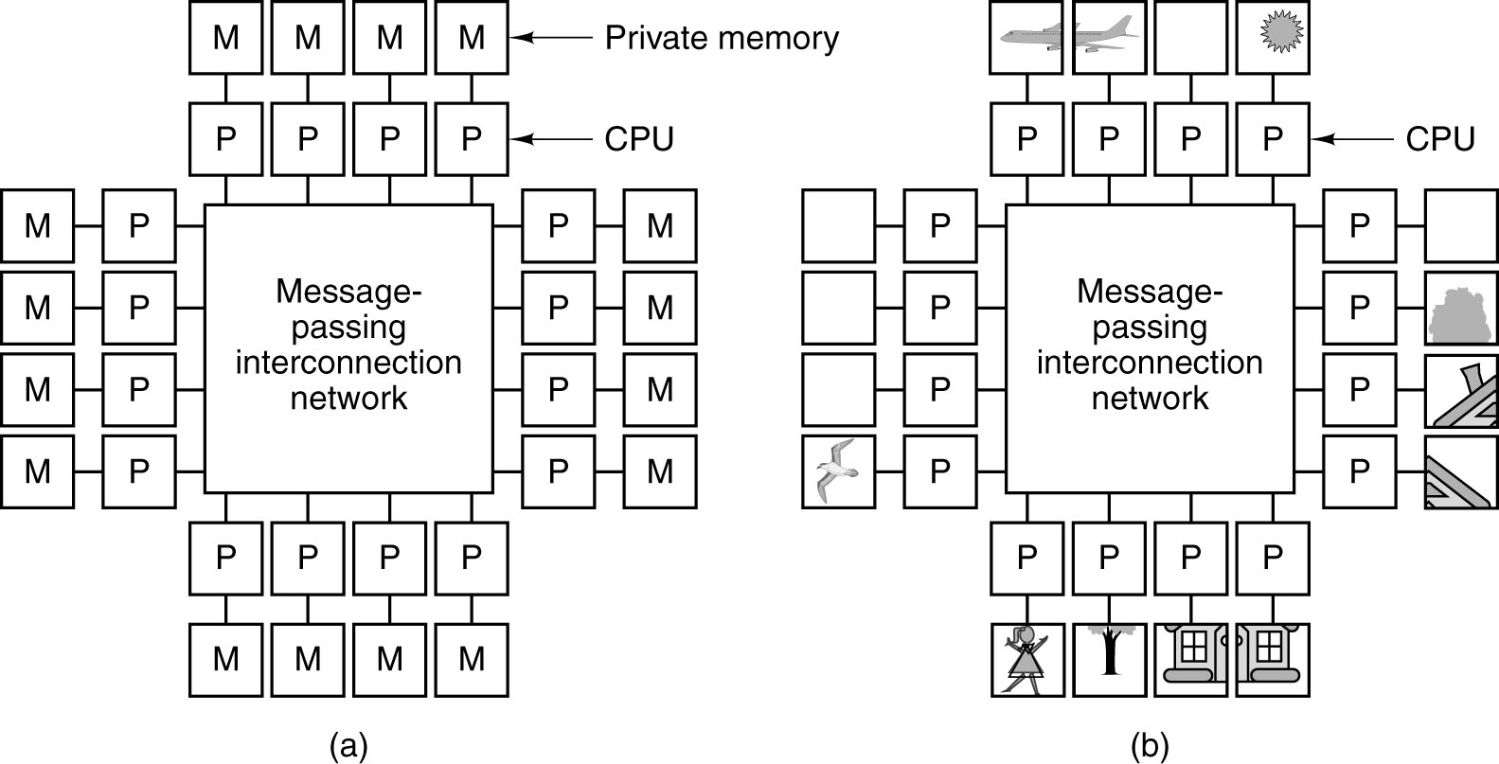
Multicomputers
(a) A multicomputer with 16 CPUs, each with its own private memory.
(b) The bit-map image of Fig. 8-17 split up among the 16 memories.

Slide 5
Multicomputers (cont'd)
Communication between processes often use software primitives such as send and receive.
Correctly dividing up the data and placing them in the optimal locations is a major issue on a multicomputer
Large multicomputers are much simpler and cheaper to build than multiprocessors with the same number of CPUs

Slide 6
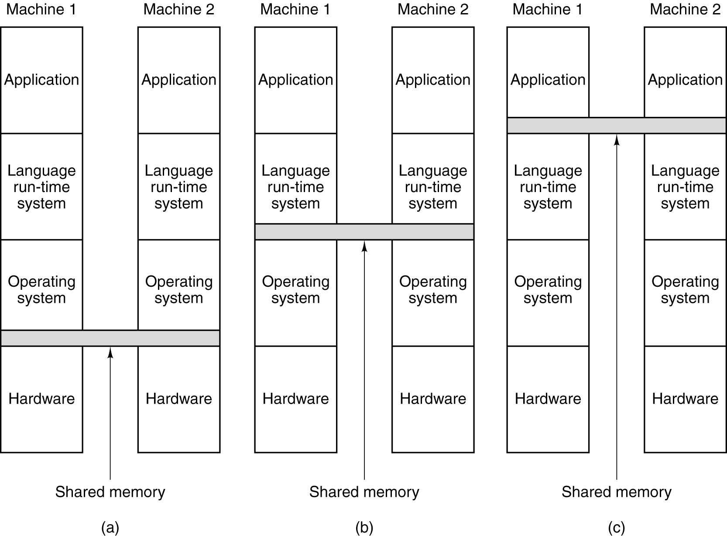
Multicomputers (cont'd)
Various layers where shared memory can be implemented. (a) The
hardware. (b) The operating system. (c) The language runtime system.

Slide 7
The TOP500
The TOP500 project started in 1993.
The best performance on the Linpack Benchmark is used as performance measure for ranking the computer systems http://www.netlib.org/utk/people/JackDongarra/PAPERS/hpl.pdf
Overview of recent supercomputer http://www.top500.org/static/lists/2011/11/TOP500_201111_Poster.png

Slide 8
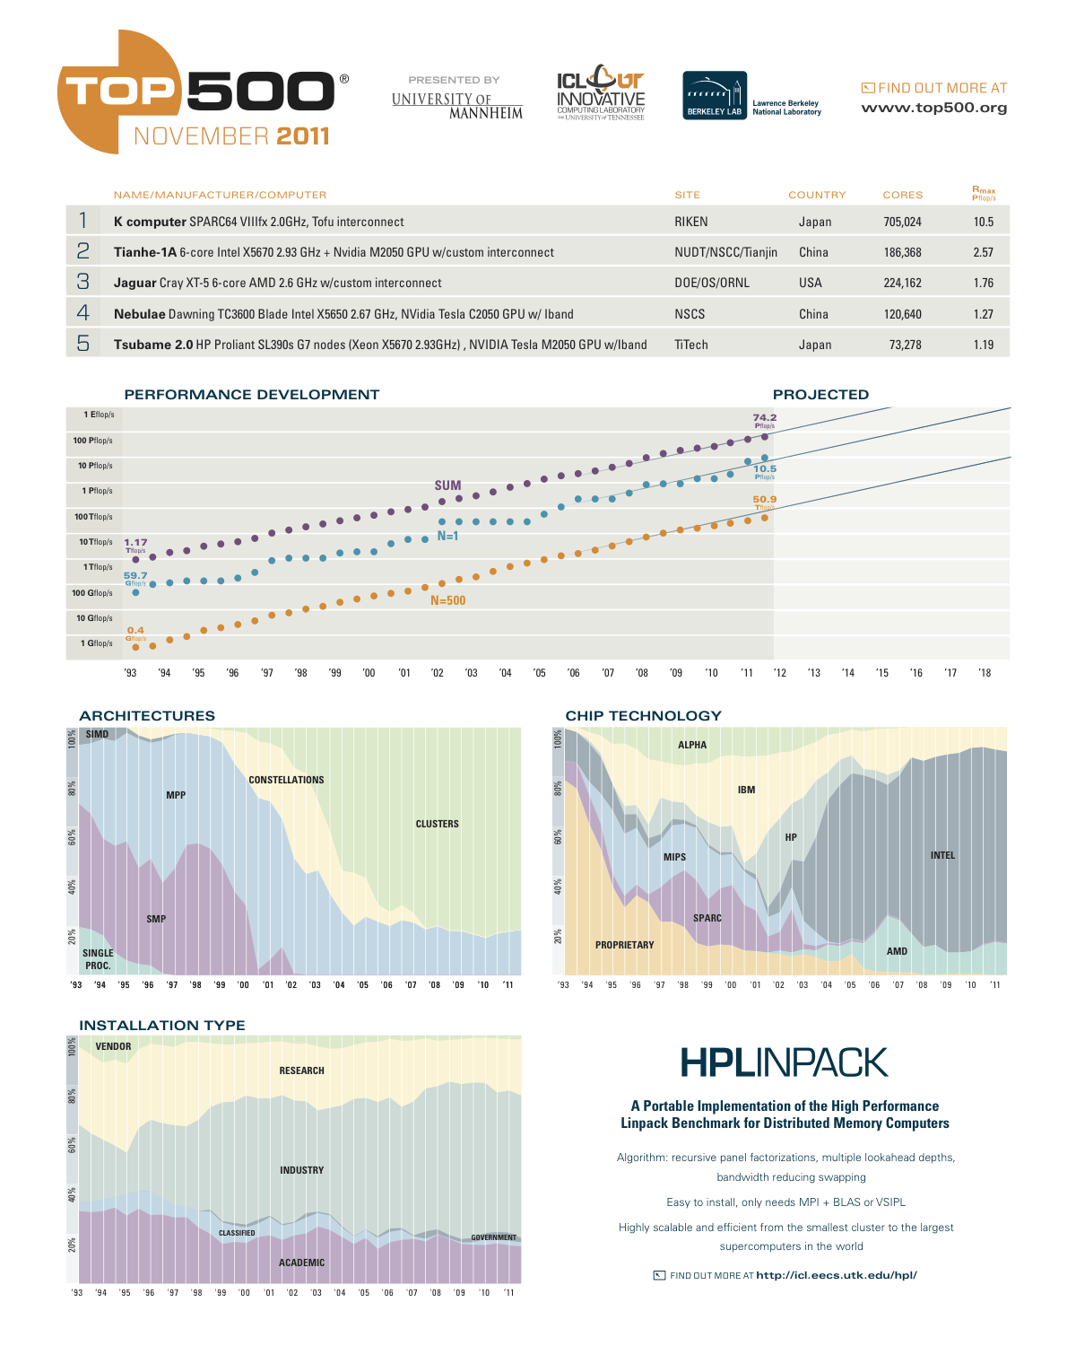

Slide 10
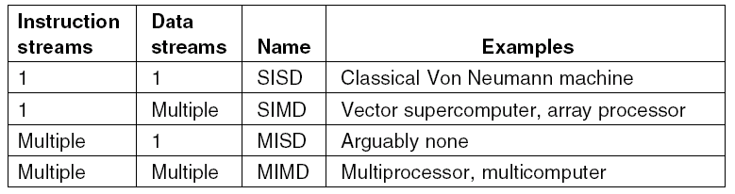
Taxonomy of Parallel Computers
Flynn’s taxonomy of parallel computers.

Slide 11
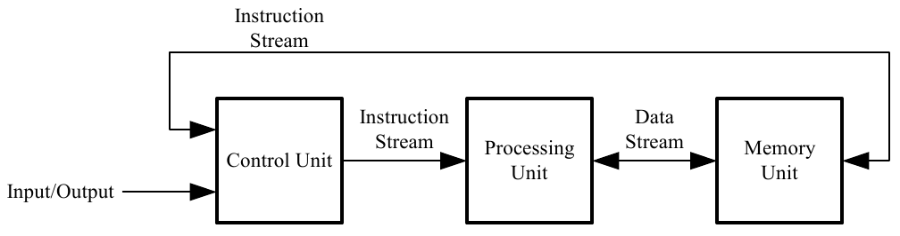
Single Instruction, Single Data (SISD)
Uniprocessor

Slide 12
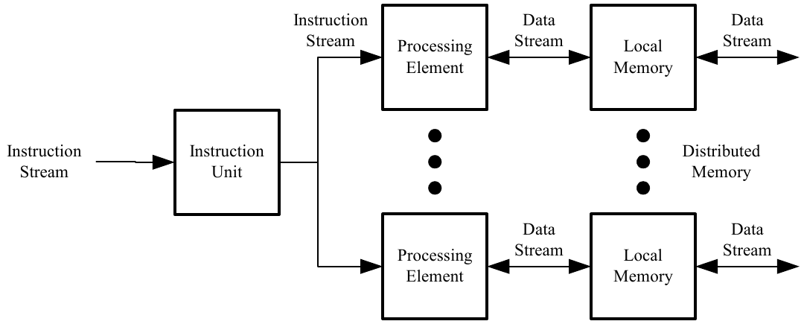
Single Instruction, Multiple Data (SIMD)
Vector Processor, Multiprocessor

Slide 13
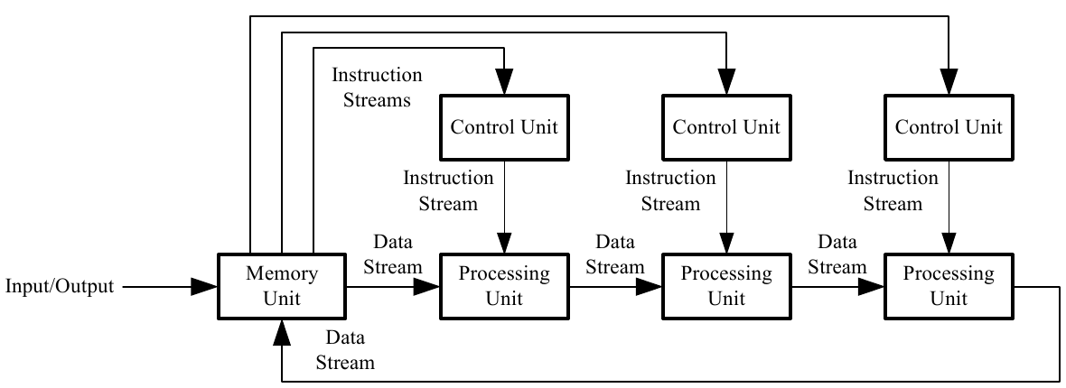
Multiple Instruction, Single Data (MISD)
Pipelined Array Processor, Systolic Array

Slide 14
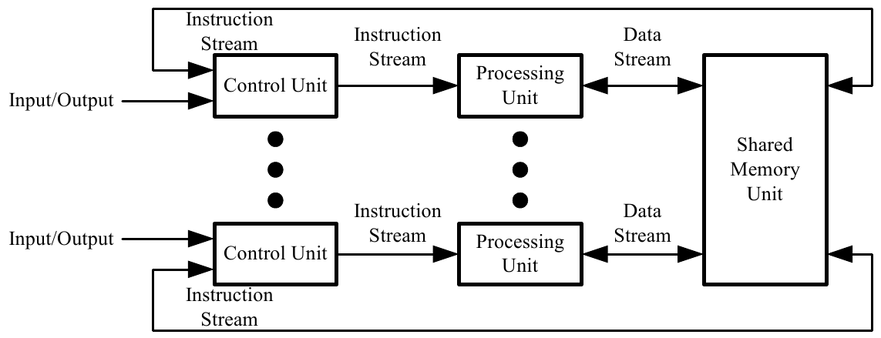
Multiple Instruction, Multiple Data (MIMD)
Multiprocessor, Multicomputer

Slide 15
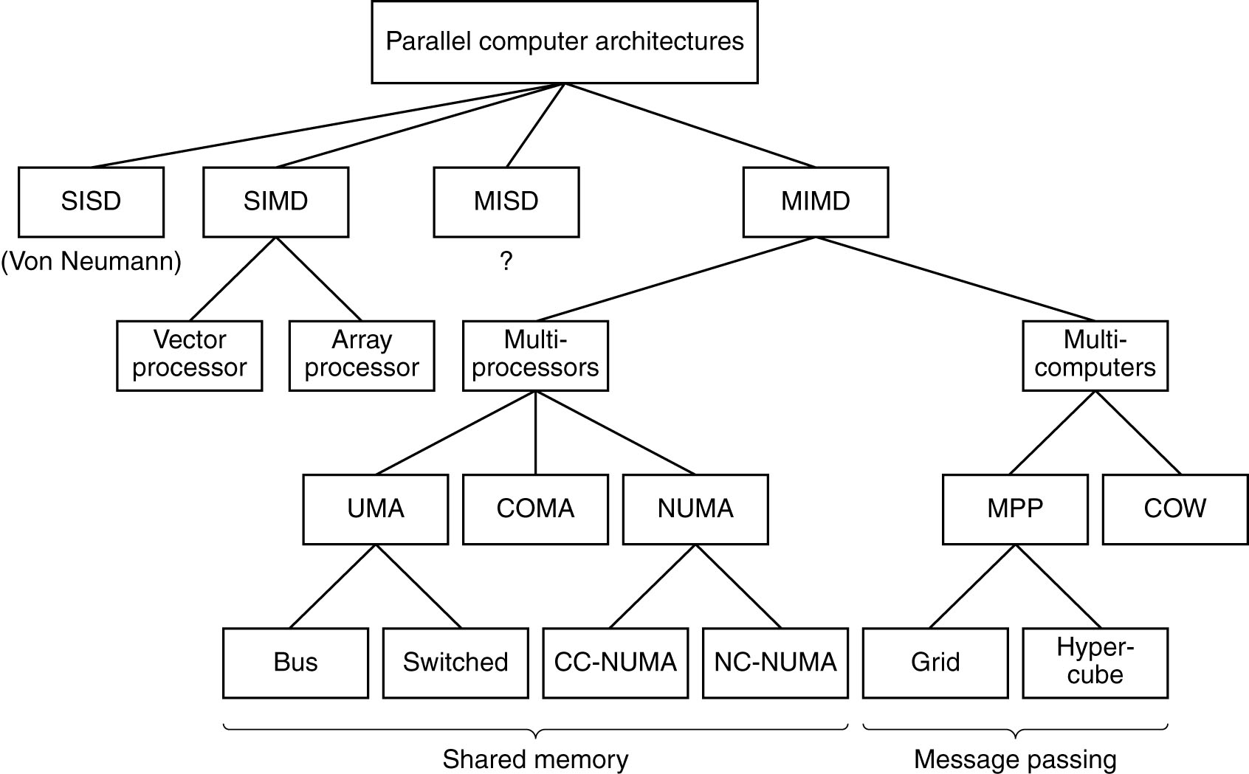
Expanded Computer Taxonomy
Focus here
A taxonomy of parallel computers.

Slide 16
Expanded Computer Taxonomy
A taxonomy of parallel computers.

Slide 17
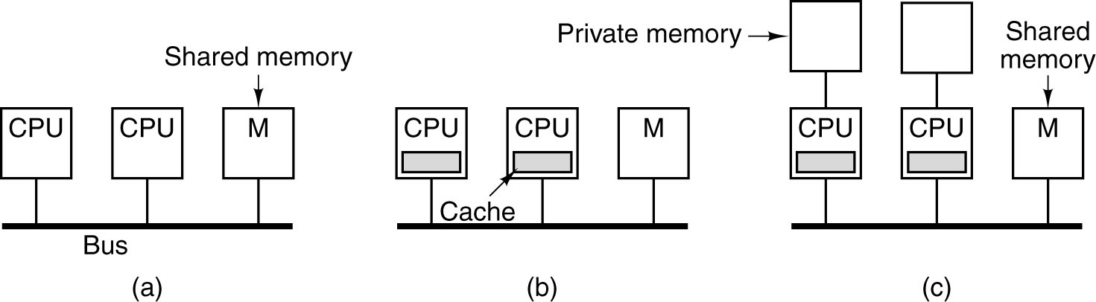
UMA Symmetric Multiprocessor Architecture
(a) limited by the bandwidth of the bus, and most CPU will be idle most of the time
(b) caching is a big win
(c) each CPU has only cache, but private memory.
  Compiler should place all the program text, strings, constants, read-only data, stacks, and local variable in the private memories.

Slide 18
Snooping Caches
Problem: stale data
Solution: snooping caches/snoopy caches
  Cache controller is designed to allow it to eavesdrop on the bus (bus requests from CPUs) and taking action in certain cases
One simplest snooping cache protocol is called write through
→ see next slide

Slide 19
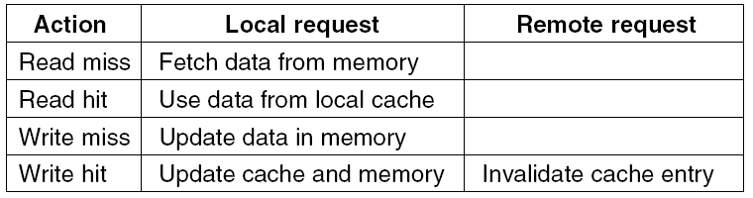
(Simple) Write Through
In write hit:
  when cache 1 writes a word that is present in cache 2's cache, if cache 2 does nothing, it will have stale data
  Hence it marks the cache entry, and perform update strategy or invalidate strategy

Slide 20
Then … Write Back
Write through is simple but … inefficient
  Bus still become a bottleneck since every write operation goes to memory over the bus.
Idea:
  When a cache line is modified, a bit is set inside the cache noting that the cache line is correct but memory is not.
  Not all write go directly through memory
  Known as a write-back protocol
  Popular wire-back protocol called MESI
→ see next slide

Slide 21
The MESI Cache Coherence Protocol
Used by Pentium 4 and many others
Cache lines states
  Invalid: line is not loaded or data is invalid
  Shared: line is being shared by multiple processors
  Modified: the line has been changed in the processor
  Exclusive: the line is exclusively held by the processor cache

Slide 22
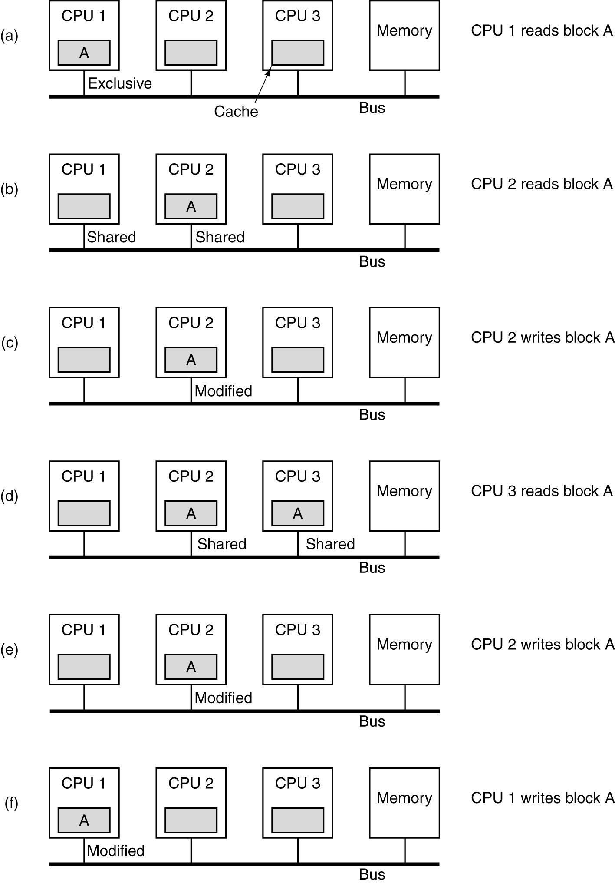
The MESI Cache Coherence Protocol
CPU1 reads the memory
The line referenced is marked as being in the E state
CPU2 also fetch the same line and cache it. By snooping, CPU1 see that it is no longer alone. Both copes are marked as being in the S state
If CPU2 write to the cache line, it puts out an invalidate signal on the bus, telling other CPUs to discard their copies

Slide 23
The MESI Cache Coherence Protocol
When CPU3 reads the line, CPU2 knows that the copy in memory is not valid, so it asserts a signal on the bus telling CPU3 to wait until it writes its line back to memory
CPU2 writes its line again, which invalidates the copy in CPU3's cache
If CPU1 writes to a word in line, CPU2 tells CPU1 to wait and writes its line back to memory. When finished, it marks is own copy as invalid

Slide 24
Different Approaches for Interconnection Network
On the use of bus:
  The use of a single bus limits the size of a UMA multiprocessor to about 16 to 32 CPUs
  To go beyond, different kind of interconnection network is needed.
Others
  Crossbar switch
  Multistage switch

Slide 25
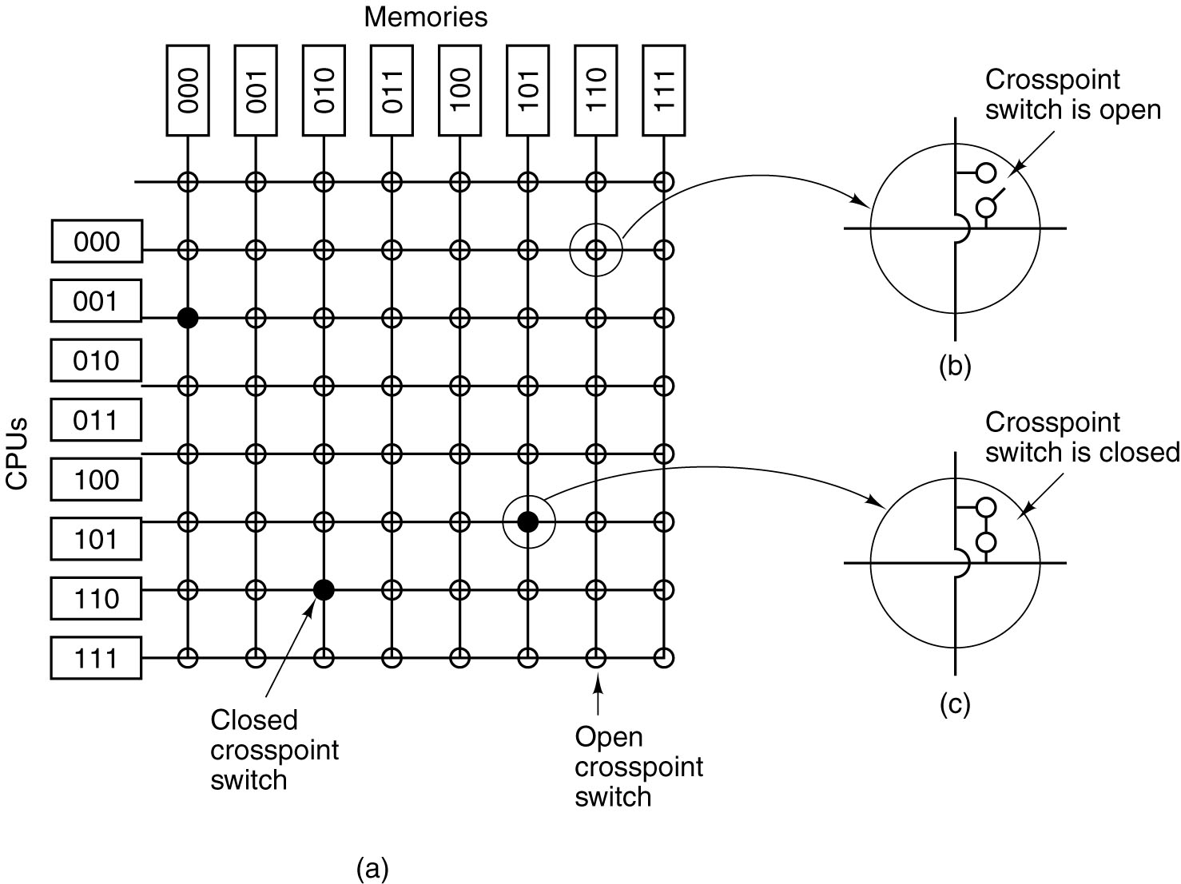
Crossbar Switch
(a) An 8 × 8 crossbar switch.
(b) An open crosspoint.
(c) A closed crosspoint.

Slide 26
Crossbar Switch Properties
Nonblocking network
Number of switch ~ n^2
    e.g. Sun Fire E25K has 1000 CPU and 1000 memory module
    require 10 million switch, such is no feasible

Slide 27
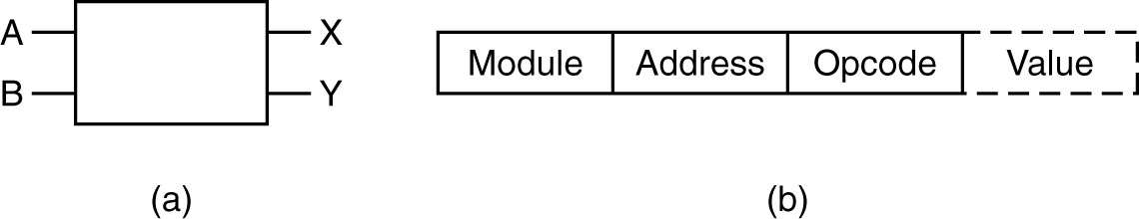
Multistage Switching Networks
(a) A 2 × 2 switch.
(b) A message format.
- Module field tells which memory to use
- Address specifies an address within a module
- Opcode is READ or WRITE
- Value contains an operand

Slide 28
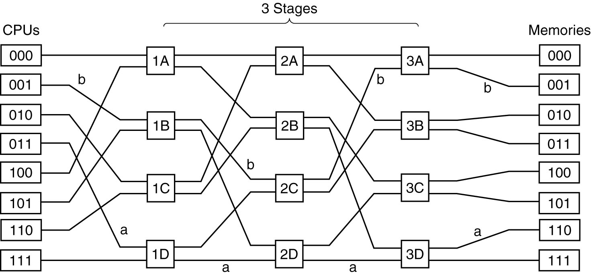
One possibility of building larger multistage switching networks is omega switching networks

Slide 29
Omega Switching Network Properties
The wiring pattern of the omega network is often called the perfect shuffle
Omega switching networks is blocking network
Question: with n CPUs and n memories, how many stages and switches per stage is needed?
  Compare to crosspoint system

Slide 30
NUMA (NonUniform Memory Access) Multiprocessors
Fact
  UMA multiprocessors are limited to no more than few dozen CPUs
To get more than 100 CPUs, idea is
  Access to local memory is faster than access to remote one
  All memory modules have the same access time
  → lead to NUMA

Slide 31
NUMA (NonUniform Memory Access) Multiprocessors
A taxonomy of parallel computers.

Slide 32
NUMA Multiprocessors
NUMA machines have three key characteristics:
  There is single address space visible to all CPUs
  Access to remote memory is done using LOAD and STORE instructions
  Access to remote memory is slower than access to local memory
2 sorts of NUMA
  NC-NUMA (no cache NUMA)
  CC-NUMA (cache coherent)

Slide 33
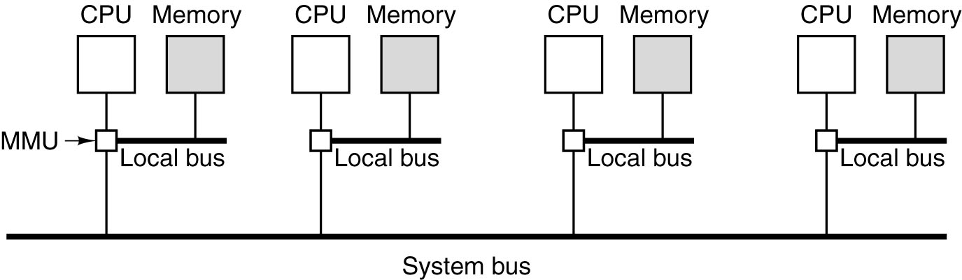
NC-NUMA
MMU: memory management unit
- A NUMA machine based on two levels of buses. The Carnegie-Mellon Cm* was the first multiprocessor to use this design.
- When a memory request come to the MMU, a check was made to see if the word needed was in local memory.
- Page scanner runs every few seconds to examine the usage statistics and move pages around in an attempt to improve performance

Slide 34
CC-NUMA
NC-NUMA have to go to the remote memory every time a nonlocal memory is accessed is a major problem hit.
Idea:
  Caching. Hence cache coherent must also added. Snooping the bus is feasible?
Popular approach for building large CC-NUMA multiprocessors currently is the directory-based multiprocessor
  maintain a database telling where each cache line is and what its status is

Slide 35
CC-NUMA
Consider a 256-node system
Each node consisting of one CPU and 16 MB of RAM connected to the CPU
The total memory is 2^32 bytes, divided up into 2^26 cache lines of 64 bytes each

Slide 36
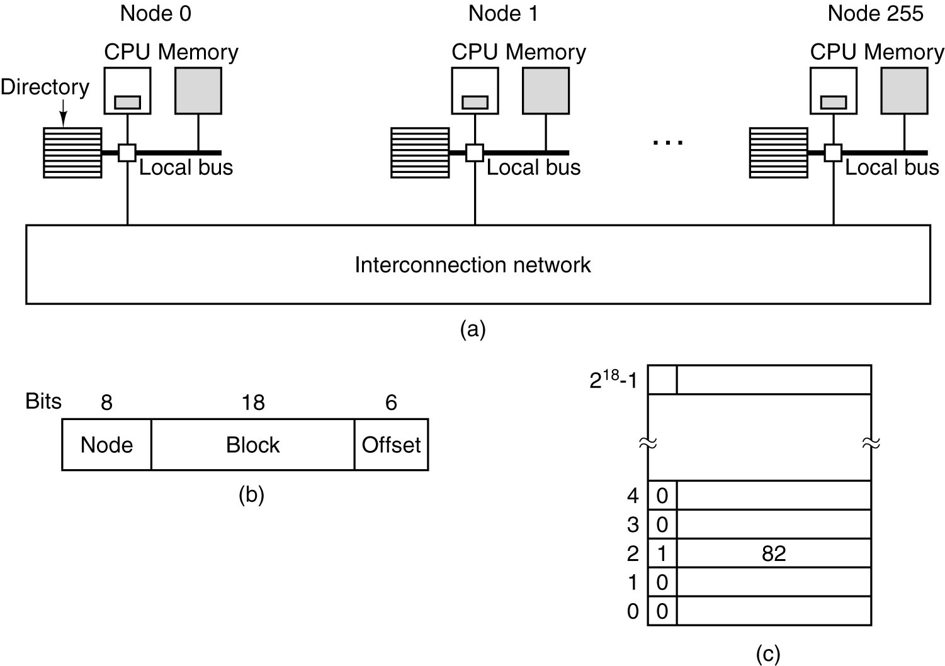
CC-NUMA
Could be grid, hypercube, or others
(a) A 256-node (x16MB) directory-based multiprocessor.
(b) Division of a 32-bit memory address into fields [node, block, offset].
(c) The directory at node 36.

Slide 37
Directory-base Multiprocessor
Idea: maintain a database telling where each cache line is and what its status is
The database must be kept in extremely-fast special-purpose hardware
  can be respond in a fraction of a bus cycle
This model has a lot of message passing in the network

Slide 38
Example (with figure in previous slide)
LOAD instruction from CPU 20 that references a cached line, which physical address is, say, 0x24000108 (by CPU200's MMU)
  Node 36, line 4, offset 8
  CPU 20 send a request to node 36 for line 4
If the line is not cached, the hardware fetches line 4 from local RAM, send back to node 20, and update the directory that the line is now cached at node 20
Assume node 20 send the second request for node 36 line 2. Fig. (c) shows that the line is now at node 82, so node 20 sends a message to node 82 to pass the line to node 20, and invalidate its cache

Slide 39
Overload by Directory
Each node has 16 MB of RAM
2^18 * 9 bit entries to keep tract
  Overhead is about 1.76%
With 32 byte cache lines
  Overhead is about 4%
Remember cache directory must be high-speed memory

Slide 40
Comments
Improvement
  Cached at only one node → cached at multiple nodes
  Keep tract of whether a cache line is is modified
See (*) for other performance optimizations
(*) STENSTROM, P., HAGERSTEN, E., LILJA, D.J., MARTONOSI, M., and VENUGOPAL, M.: “Trends in Shared Memory Multiprocessing,” IEEE Computer Magazine, vol. 30, pp. 44-50, Dec. 1997.

Slide 41
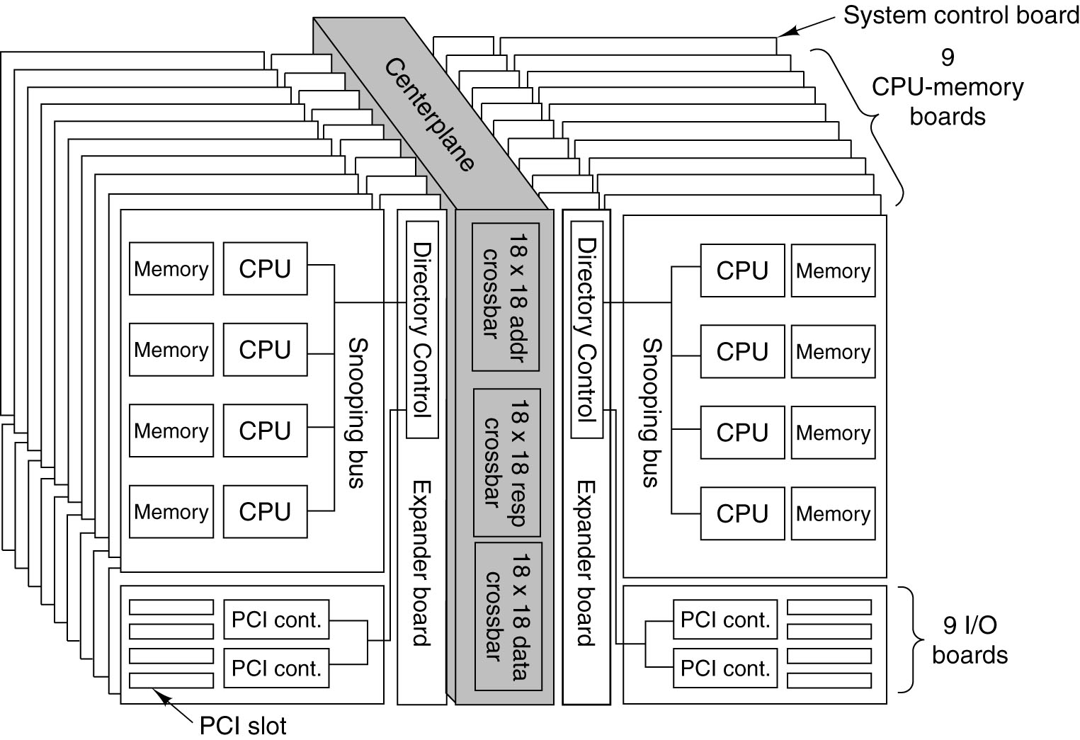
Example of NUMA: The Sun Fire E25K

Slide 42
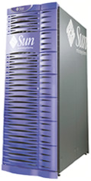
Example of NUMA: The Sun Fire E25K
Sun Fire E25K has
  72 UltraSPARC IV CPU chips (dual processor)
  18 boardsets
  Each memory board contains 4 CPU chips and 4x8 GB RAM modules
Total
  144 CPU, 576 GB RAM, 72 PCI slots

Slide 43
Example of NUMA: The Sun Fire E25K
576 GB of memory is split into 2^29 blocks of 64 bytes each
  When CPU needs to read/write a memory word, it first checks its own cache; if fail, it looks on its own boardset; if not, it send a request over the centerplane to asking where the memory block is.

Slide 44
Expanded Computer Taxonomy
A taxonomy of parallel computers.

Slide 45
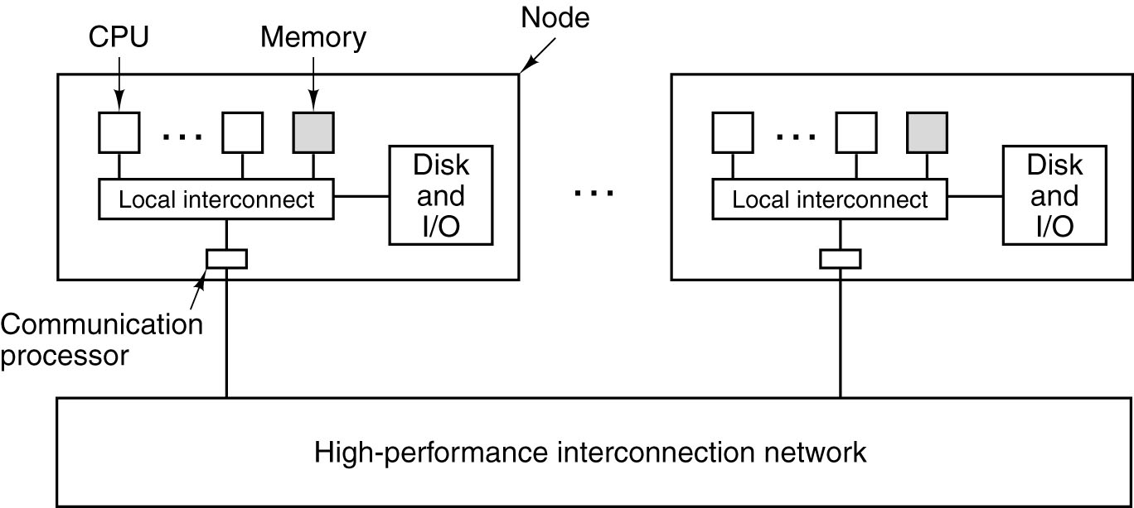
Message-Passing Multicomputers
A generic multicomputer

Slide 46
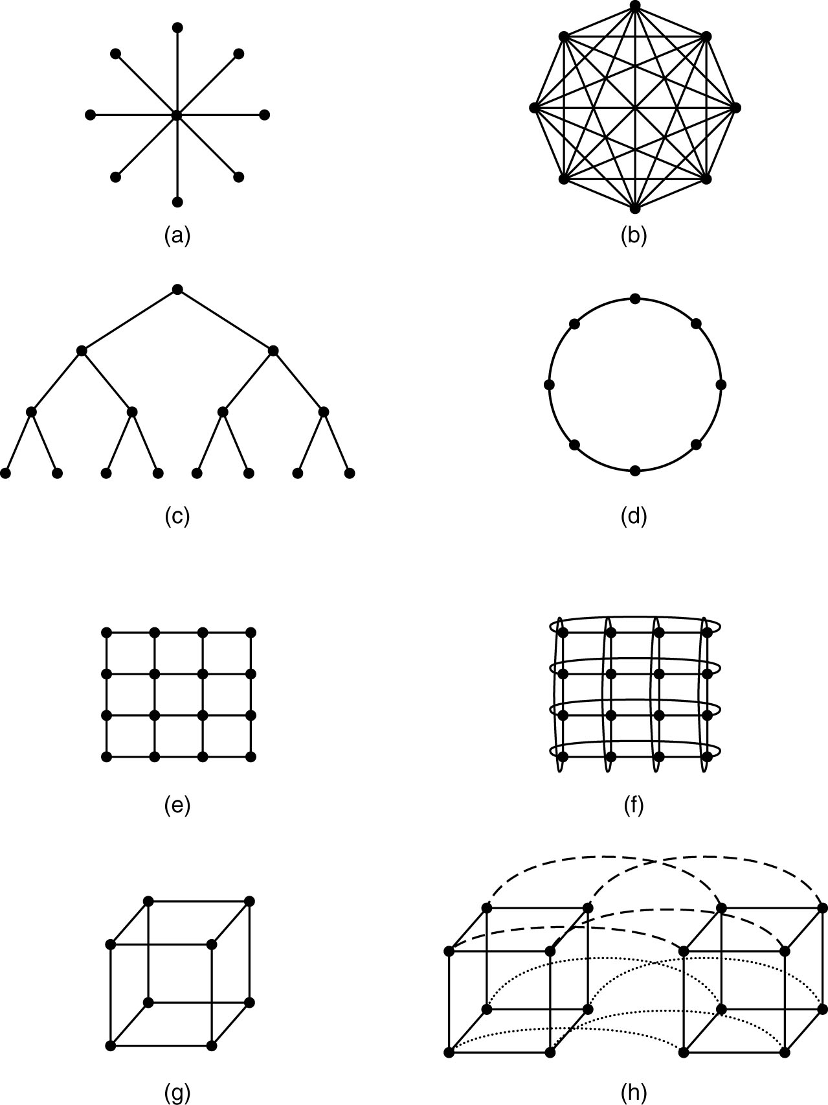
Network Topology (1)
Multiprocessor and multicomputer surprisingly similar in this respect (network).
(a) A star. (b) A complete interconnect.
(c) A tree. (d) A ring.

Slide 47
Network Topology (2)
(e) A grid. (f) A double torus.
(g) A cube. (h) A 4D hypercube.

Slide 48
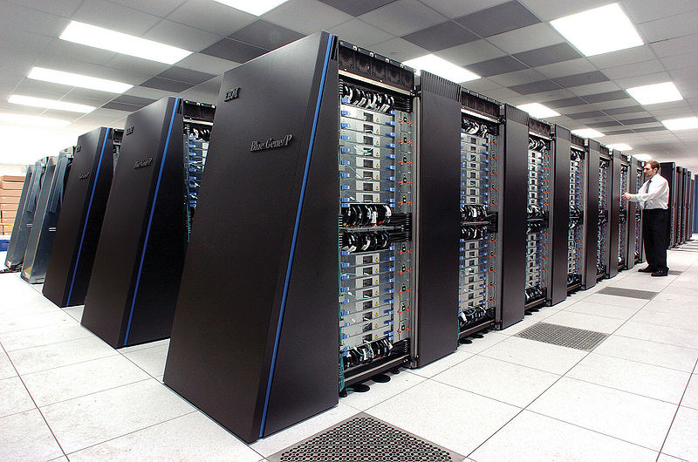
MMP – Massively Parallel Processors
Example 1: Blue Gene (IBM)
Picture copied from http://en.wikipedia.org/wiki/Blue_Gene

Slide 49
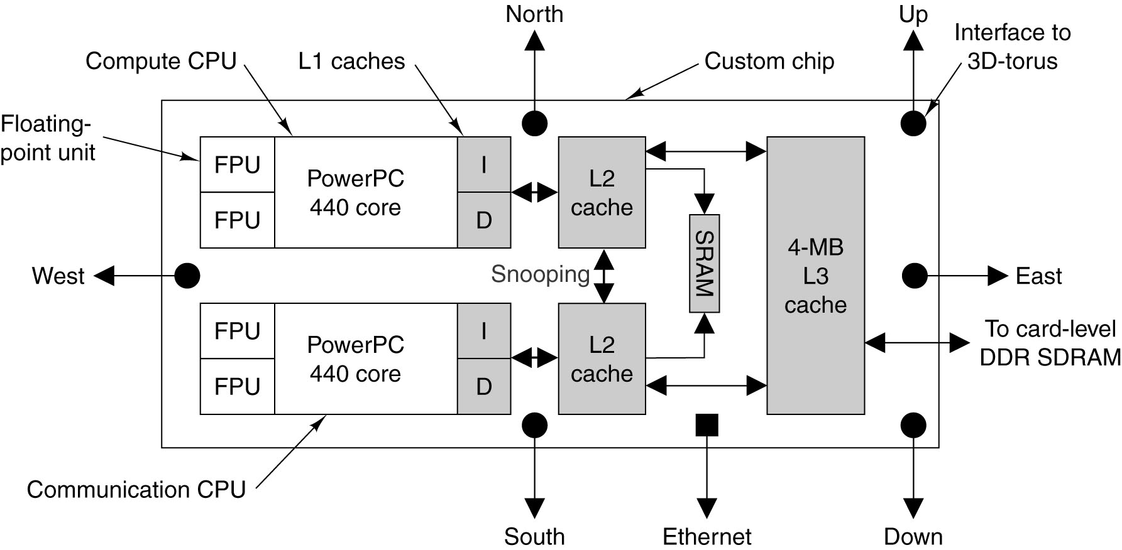
Blue Gene
Release in Nov. 2004.
PowerPC core runs @700Mhz, is a pipelined dual-issue superscalar processor. Each core has a pair of dual-issue floating point units. BG has capability of 71 Teraflops/sec.

Slide 50
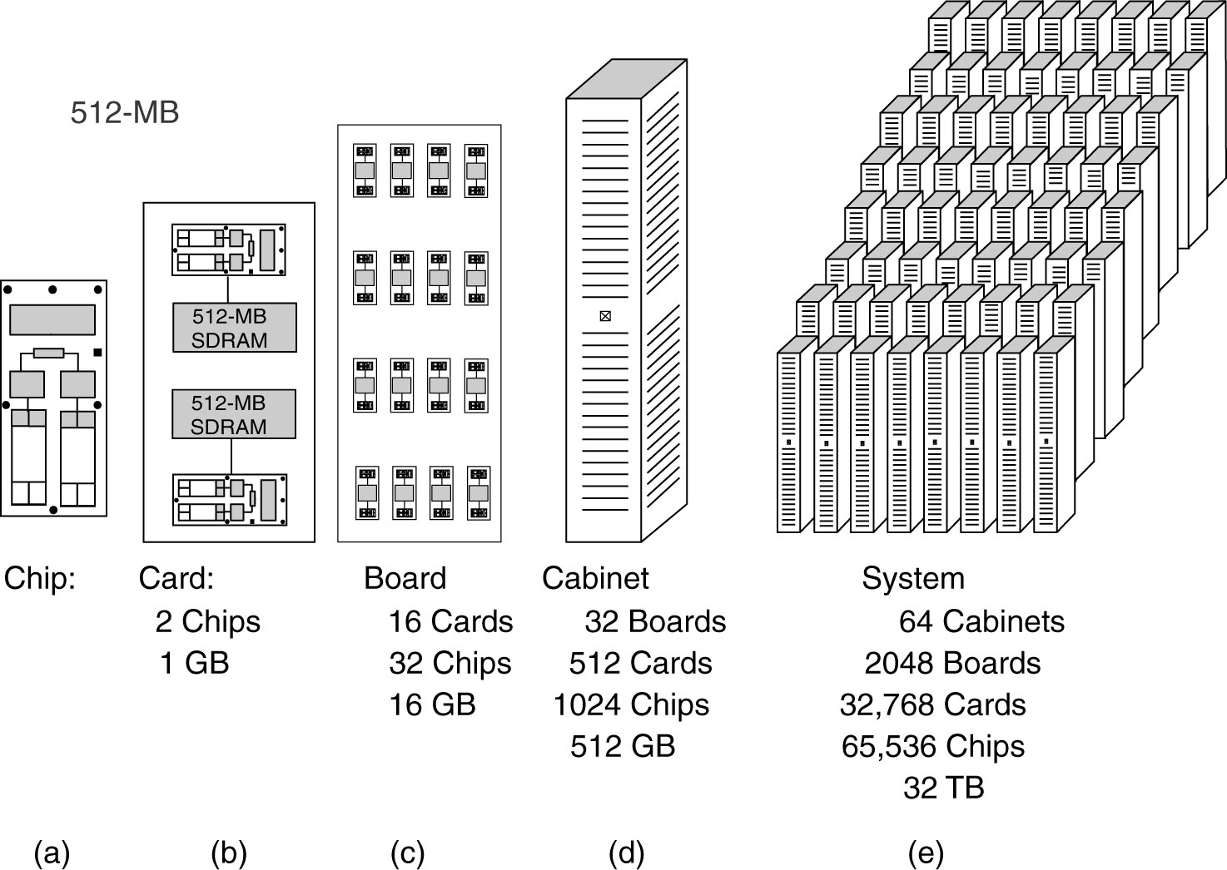
Blue Gene
The BlueGene/L. (a) Chip. (b) Card. (c) Board.
(d) Cabinet. (e) System.

Slide 51
Blue Gene
On the 2 CPU cores, one for computing, the other is for handling communication among the 65536 nodes
Interconnection
  Three-dimensional torus, each CPU needs 6 connection
  Each cabinet has 1024 nodes, connected by 8x8x16 torus
  Final torus: 64 x 32 x 32
  Point-to-point link operates at 1.4 Gbps

Slide 52
Expanded Computer Taxonomy
A taxonomy of parallel computers.

Slide 53
Cluster Computing (COW)
MMPs specialize in their high speed interconnect to Cluster Computer
  But the gap begins to close
COW typically consists of hundred or thousands of Pcs/Workstations connected by a commercially-available network board
2 kind of clusters
  Centralized: machines are homogeneous and have no peripherals other than network cards and disk
  Decentralized: machines are heterogeneous, idle many hours a day, connected by LAN on campus/building

Slide 54
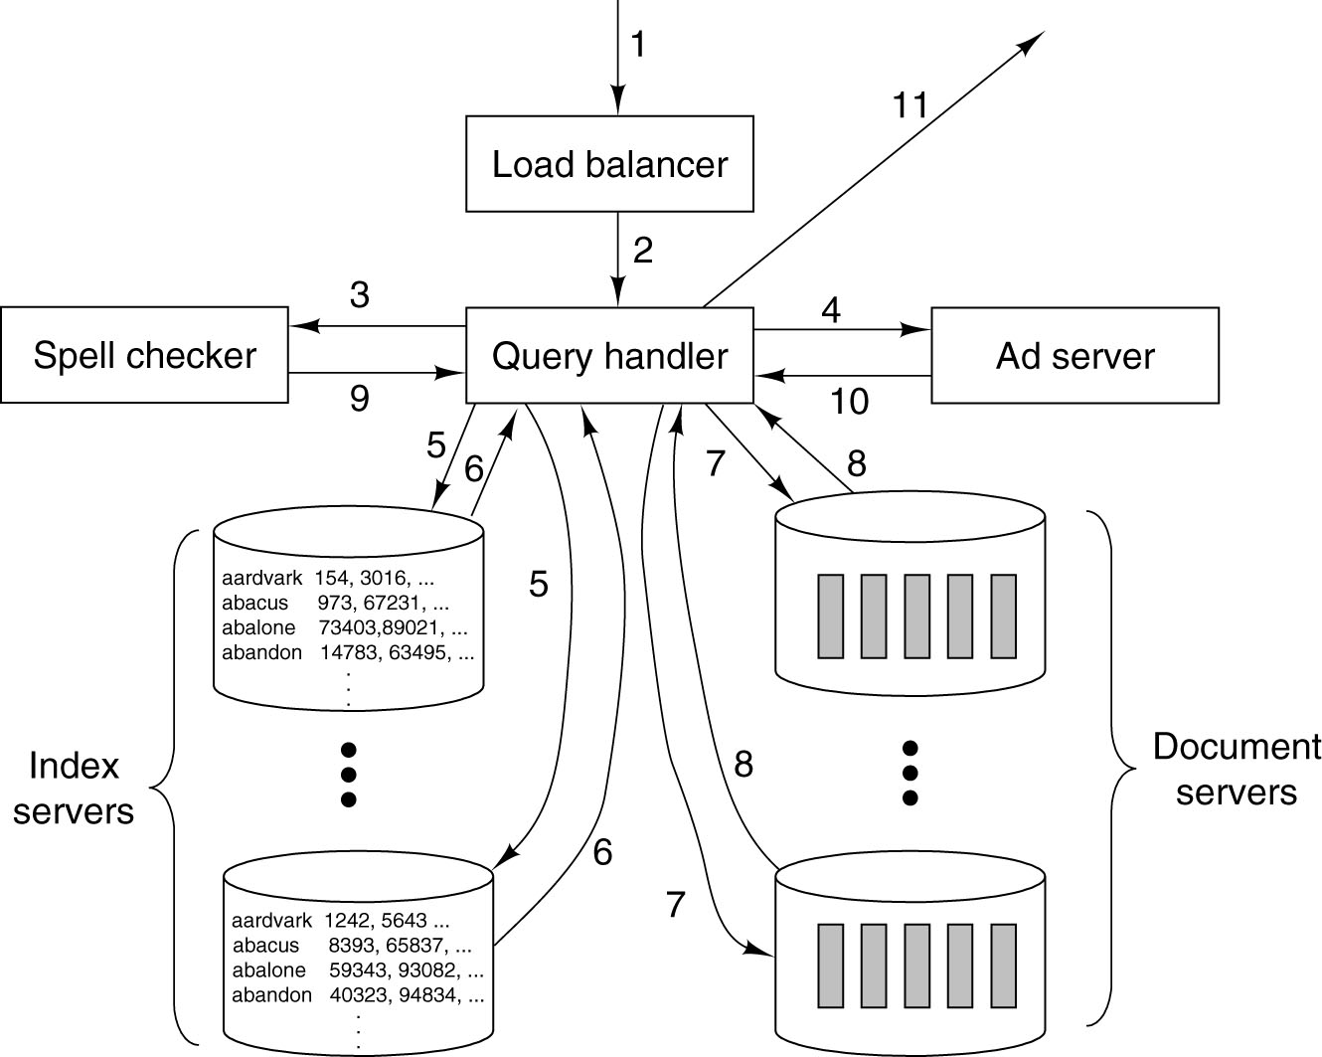
Google
Processing of a Google query.

Slide 55
Google
Google operates multiple data centers around the world. Why?
Google does not buy the biggest, fastest, and most reliable equipment when dealing with huge database, massive transaction rate, and the need for reliability.
  They optimize price/performance, not absolute performance
  Build the largest off-the-shelf cluster

Slide 56
Google
From Wiki http://en.wikipedia.org/wiki/Google_platform
“Servers as of 2009-2010 consisted of a custom made open top systems containing two processors (each with an 2 cores[3]) a considerable amount of RAM spread over 8 DIMM slots housing double height DIMMS and two SATA hard drives connected through a non-standard ATX sized power supply.[4] According to CNET and to book by Hennessy, each server has a novel 12 volt battery to reduce costs and improve power efficiency”

Slide 57
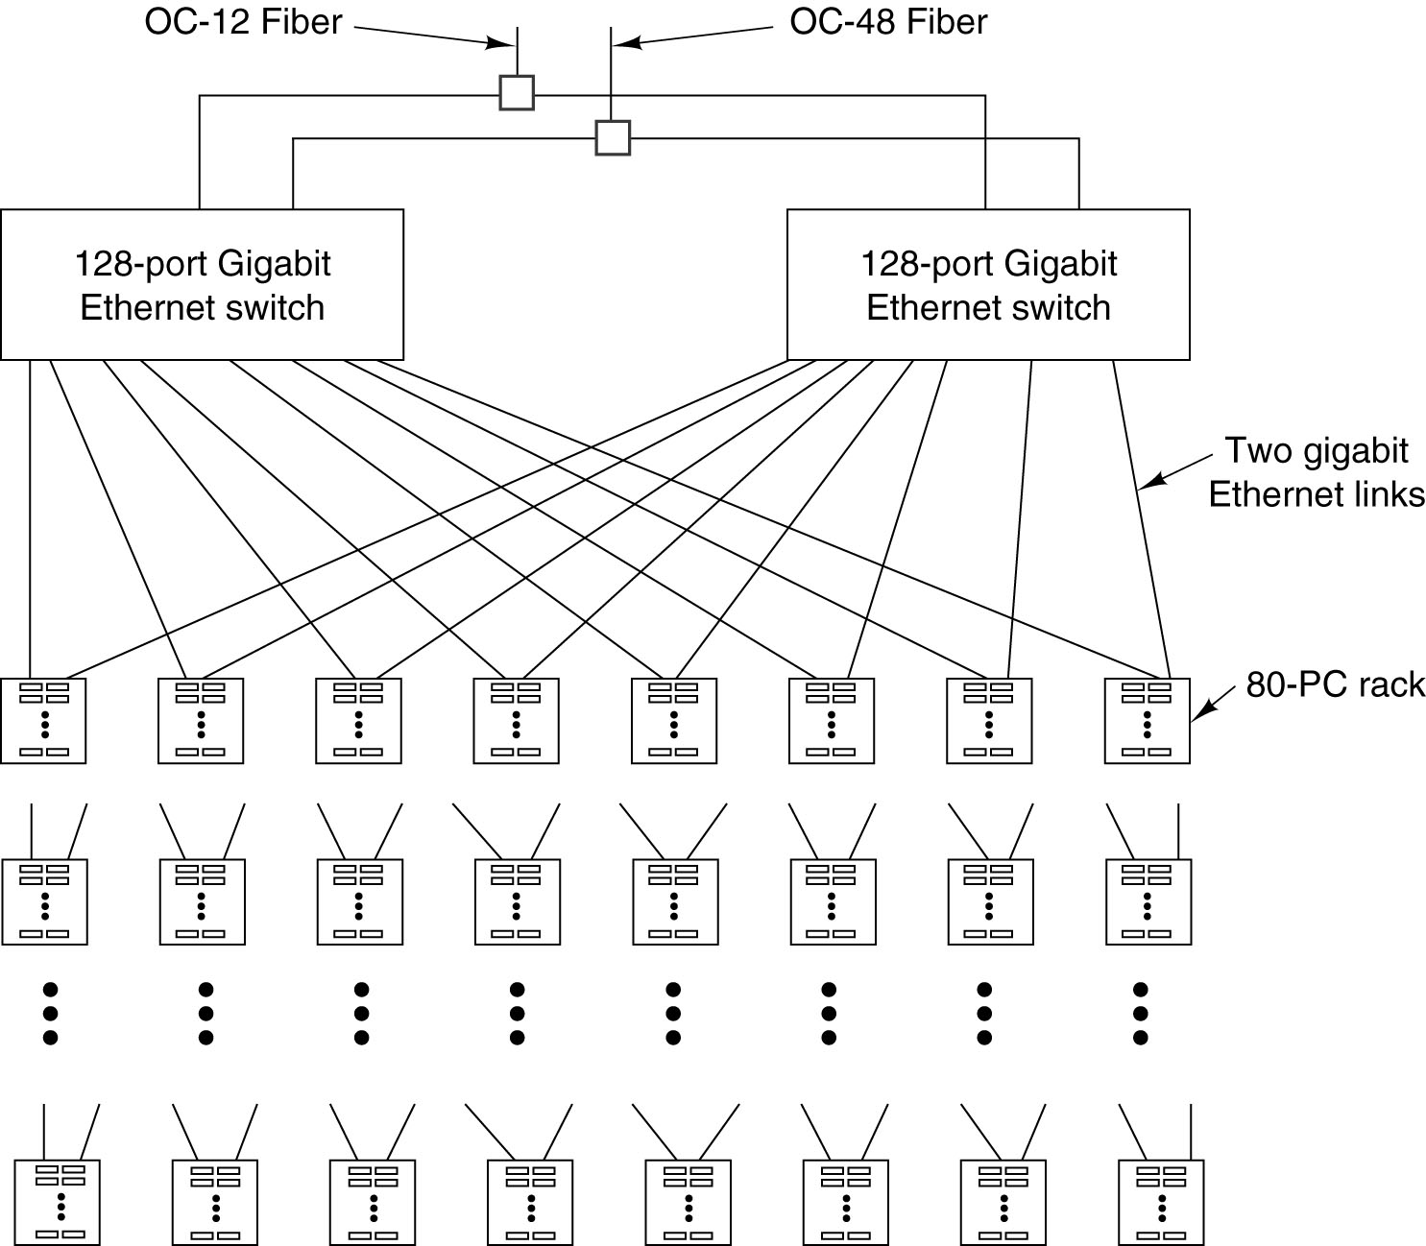
A Typical Google Cluster
Typical value
128 port switch
64 racks
5120 PCs

Slide 58
Lessons from Google
Component will fail, so plan for it
  Event with best equipment it will fail some day no mater 1 time a week or 2 times a week
  Need fault-tolerant software
Replicate everything for throughput and availability
  Both hardware and software have to be highly redundant
  PCs, disks, ables, and switches are all replicated
Optimize price/performance
  If the system has been designed to deal with failure, buying expensive component, e.g. RAIDs with SCSI disk, is a mistake

Slide 59
More about Google
BARROSO, L.A., DEAN, J., HOLZLE, U.: “Web Search for a Planet: The Google Cluster Architecture,” IEEE Micro Magazine, vol. 23, pp. 22-28, March-April 2003.
GHEMAWAT, S., GOBIOFF, H., and LEUNG, S.-T.: “The Google File System,” Proc. 19th Symp. on Operating Systems Principles, ACM, pp. 29-43, 2003.

Slide 60
Communication Software for Multicomputers
MPI – Message Passing Interface
  Your third project (*)

Slide 61
Copyright note
Slides are adopted form lecture notes of Tanenbaum, Structured Computer Organization, Fifth Edition, (c) 2006 Pearson Education, Inc.

