Slide 1

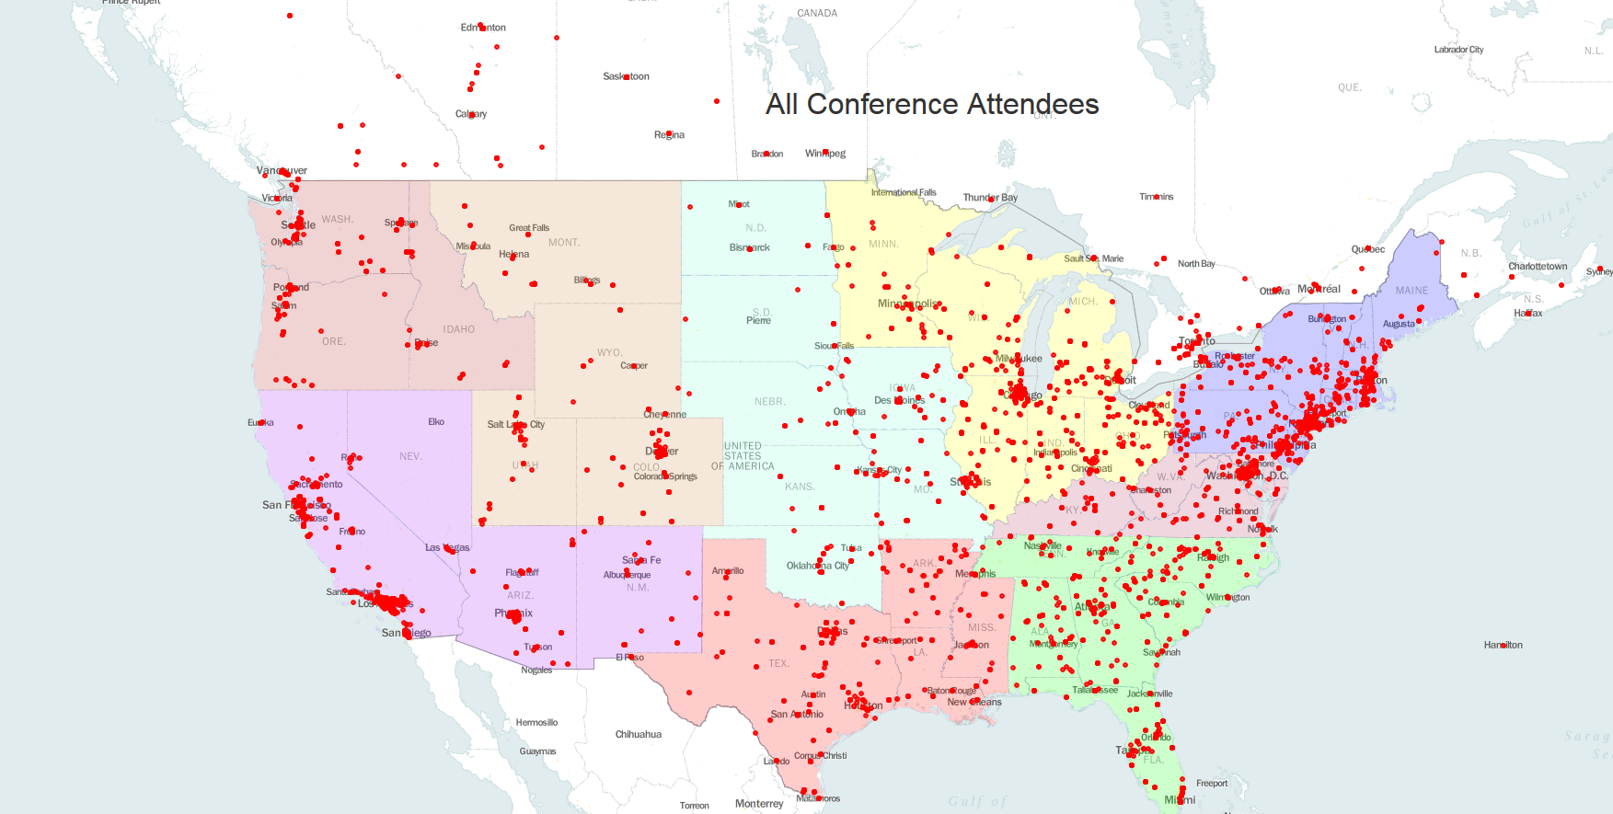
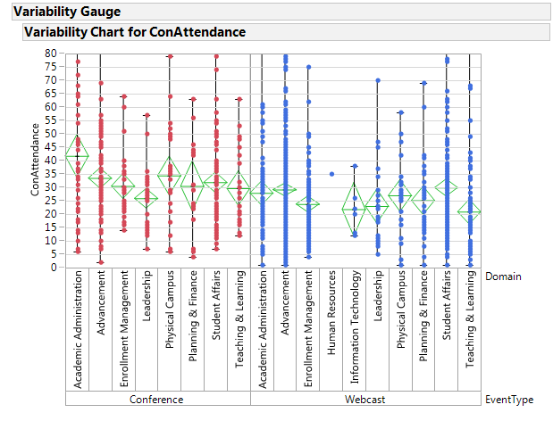
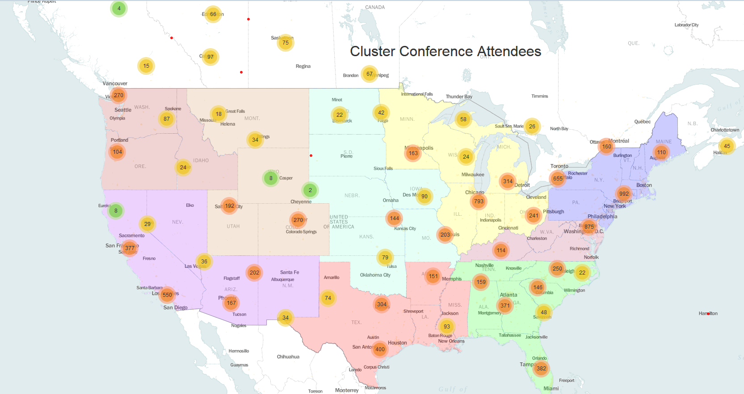
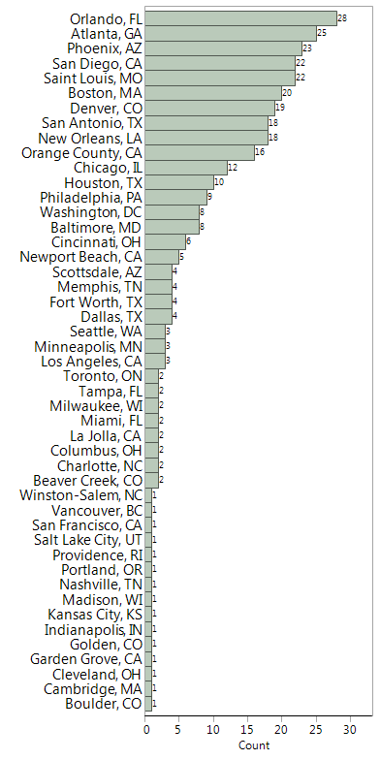
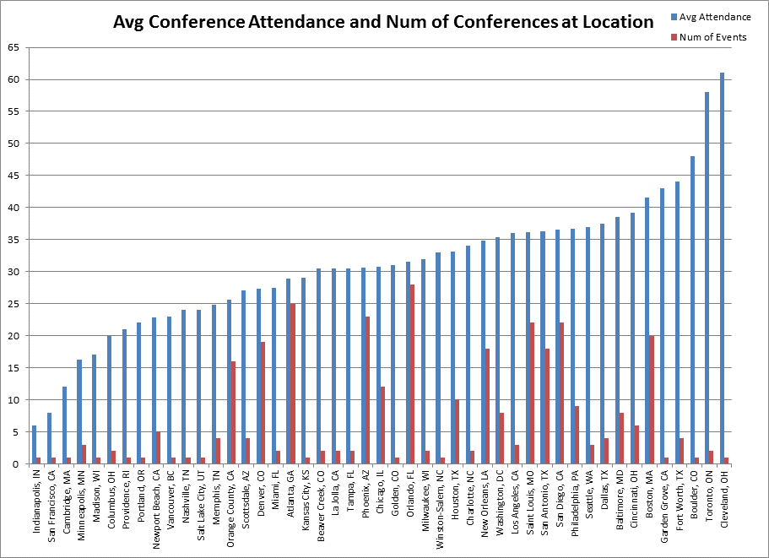
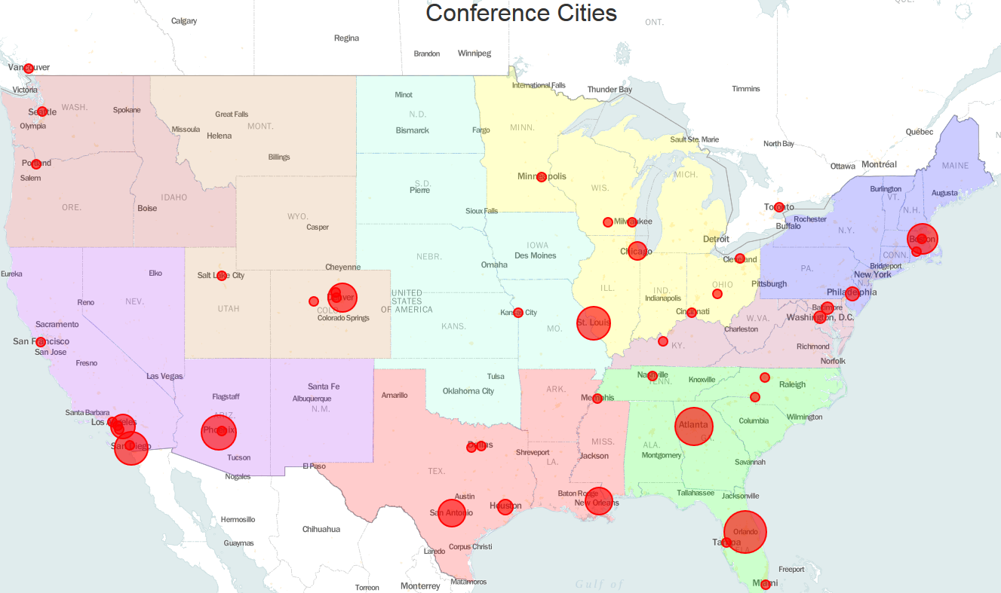
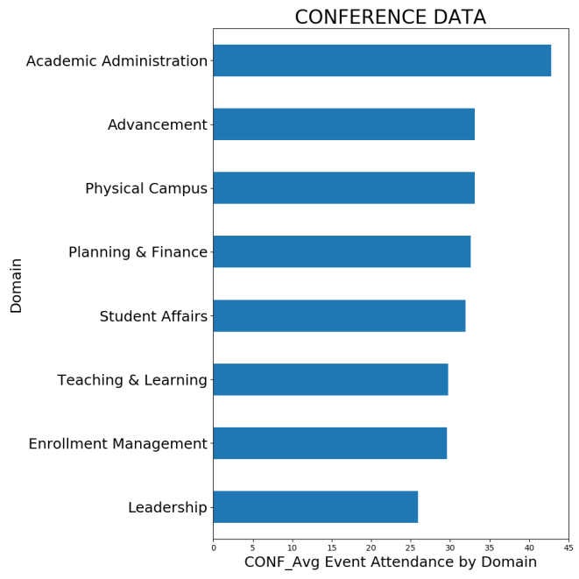
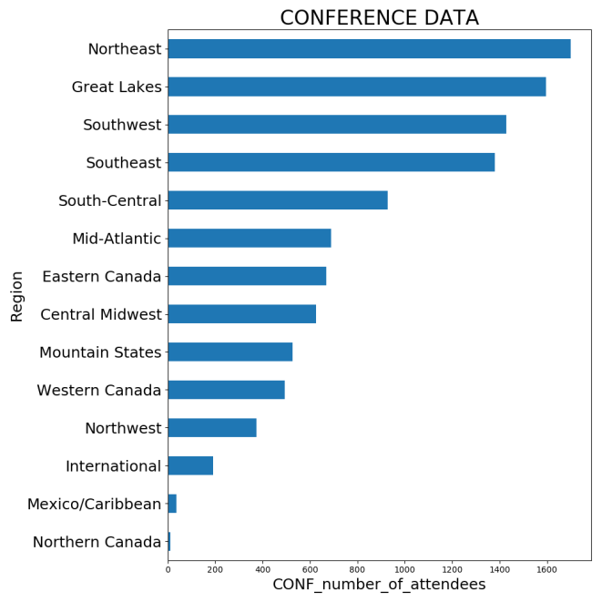
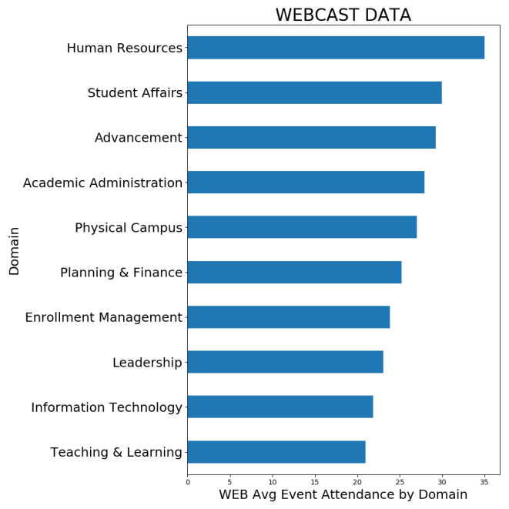
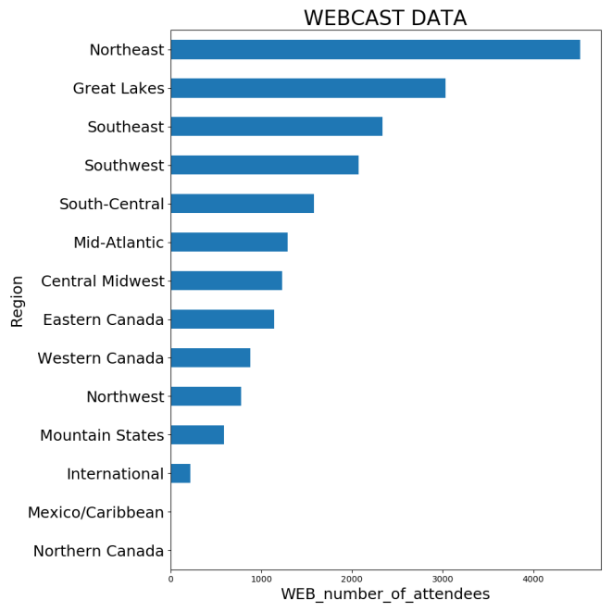
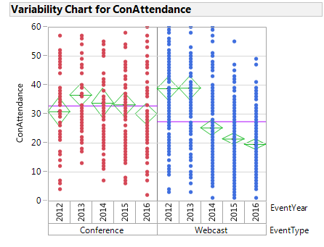
If You Host it, Will They Come?
Steve Kientz
Galvanize, Denver. Data Science, June 2017
Motivation
Methods
Observations
Maps
Conferences and Webcasts are common tools used by university affiliates to improve their knowledge base. Multiple companies cater to these needs by hosting events. Maximizing attendance is crucial for the financial viability of these companies.
A data set was provided from an anonymous company with conference and attendance information from 2012 to the end of 2016.
Python package GeoCode was used to extract the Lat, Long coordinates of each attendee.
Data was carefully cleaned and parsed using pandas.
Folium was used to create interactive maps data visualization.
Random Forest and Linear Models were used to determine important features.
Academic Administration stood out as a domain which generates more attendance than other domains (for conferences)
Visualization
Objectives
Basic Data aggregation
Data will be summarized to display attendance trends
Data will be grouped by geographic region, event year, and event topic (Domain).
Extensive visualization html based tools (maps) will be created to explore the data.
General Recommendation of domain and location region/city to maximize attendance
DOMAIN | Orlando, FL |  | Atlanta, GA |  | Phoenix, AZ |  | Saint Louis, MO |  | San Diego, CA |  | Boston, MA
 | # Conf | Avg Attend | # Conf | Avg Attend | # Conf | Avg Attend | # Conf | Avg Attend | # Conf | Avg Attend | # Conf | Avg Attend
Academic Administration | 3 | 30.7 | 3 | 42.0 | 4 | 23.8 | 1 | 6.0 | 3 | 78.3 | 1 | 68.0
Advancement | 7 | 26.0 | 4 | 34.8 | 3 | 50.0 | 7 | 34.4 | 6 | 39.5 | 8 | 49.6
Enrollment Management | 2 | 20.0 | 3 | 29.3 | 5 | 24.8 | 2 | 46.5 | 1 | 16.0 | 2 | 39.5
Leadership | 4 | 21.8 | 3 | 21.0 | 2 | 22.0 | 3 | 34.0 |  |  | 3 | 22.3
Physical Campus | 2 | 35.0 | 3 | 22.3 |  |  |  |  | 2 | 46.0 | 1 | 49.0
Planning & Finance | 2 | 47.0 | 2 | 13.0 |  |  | 1 | 29.0 | 1 | 56.0 | 1 | 46.0
Student Affairs | 8 | 39.9 | 3 | 30.0 | 5 | 43.4 | 6 | 37.7 | 9 | 18.7 | 2 | 41.5
Teaching & Learning |  |  | 4 | 30.8 | 4 | 18.5 | 2 | 49.0 |  |  | 2 | 21.5
TOTAL | 28 | 31.5 | 25 | 27.5 | 23 | 32.8 | 22 | 31.3 | 22 | 42.4 | 20 | 45.1
Top 5 Cities for # of Conferences and their avg attendance
Average Attendance and total events per city
Total Events per city
325 total
Model Results
Despite 10K data pts – data was sparse and highly variable.
A tuned Random Forest model had the best RMSE for predicting attendance.
Feature Importance showed Academic Administration to be the most significant feature – the location did not significantly influence attendance.
Leadership had a negative affect on attendance. Others were flat.
By the numbers
Interactive HTML maps provided to client - clickable stats
10,648 conference attendees
85% US based, 14% Canadian, 1% international
325 unique conferences in 48 cities
719 Webcasts, 20,100 total viewers
14 Geographic Regions considered
8 Conference Domains provided
Future Work
Improve app functionality
Analyze attendance by region focusing on if more people attend conferences in home region or are they willing to travel for conferences.
Avg attendance is
Declining for both formats.
Conference and Web Attendance Histograms by Attendee Domain and Region

