Slide 1

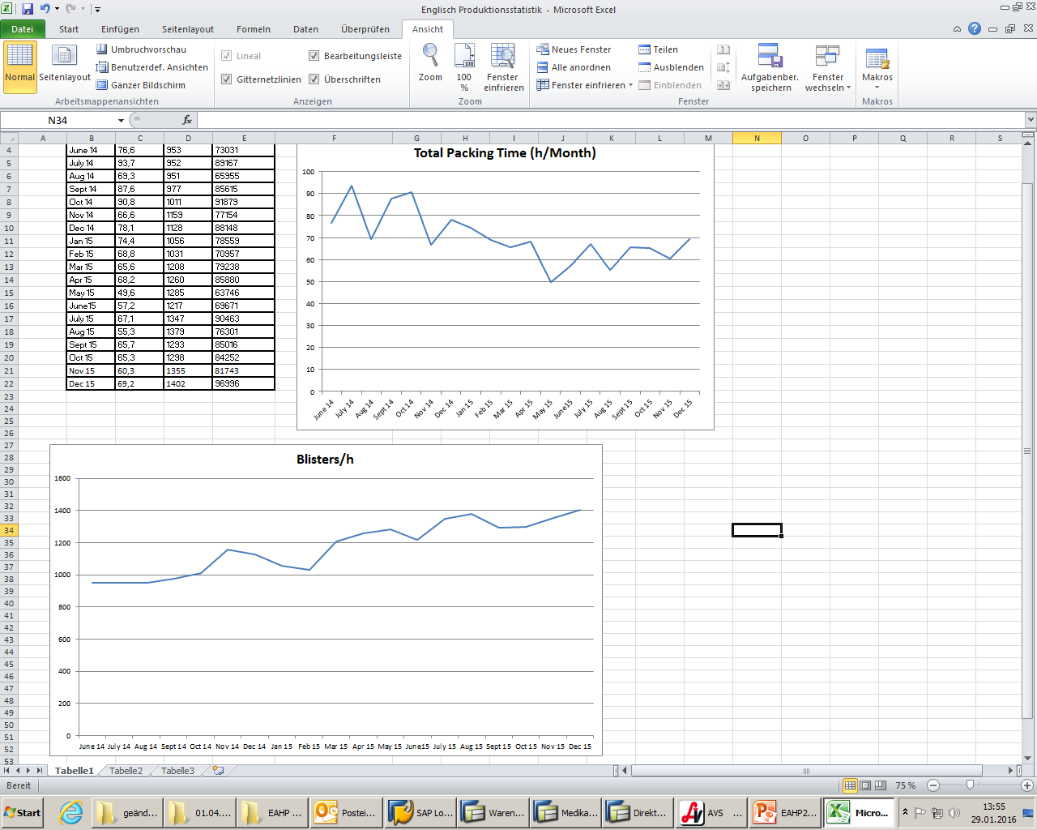
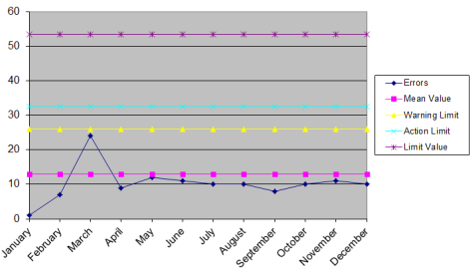
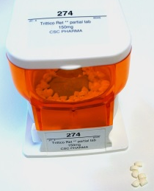
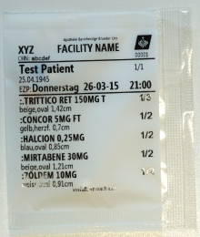
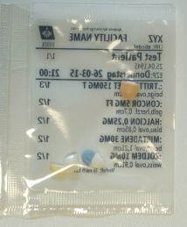
IMPLEMENTATION AND VALIDATION OF CASSETTES FOR PARTIAL TABLETS IN A BLISTER MACHINE FOR IMPROVEMENT OF MULTI-DOSE BLISTER PACKAGING IN A GOOD MANUFACTURING PRACTICE CONFORM SETTING
T. Steindl-Schönhuber , A. Trzaskowski, G. Gittler
Barmherzige Brüder Linz, Hospital Pharmacy, Austria;
theodora.steindl@bblinz.at abstract number DD-005
OBJECTIVES
Blister packaging often involves partial tablets. In our setting partial tablets are inserted manually into the blister machine (Proud model, Baxter) in a personnel- and time-consuming manner via a tray adapter; Dispensing them through cassettes is not intended by the machine manufacturer. Our aim was to
increase productivity by implementing cassettes for the most frequently repackaged partial tablets and
validate this change regarding consistent product quality.
Figure 4 Increased productivity for appr. 78000 blisters (175000 tablets) due to automatic dispensing of partial tablets from cassettes (Oct 2014 – Jan 2015 versus Jul – Oct 2015):
Top: The average monthly repackaging time receded from 78 to 64 hours saving 14 working hours
Bottom: Blisters produced per hour accelerated from 1098 to 1329 bags
METHODS
Cassettes for five partial tablets (Tab 1, Fig 2) were ordered from Baxter in March 2015.
We programmed a workaround for the resulting software limitations.
A trial order was generated to test the software adaptation and functionality of the new cassettes.
We evaluated alterations in production time, visible dust formation and error rates .
Table 1 Partial tables in cassettes
Figure 5 Customer-reported blister misfillings (for 2015; whole production site)
trade name | active substance | dosing | partition
Trittico ret | Trazodon | 150mg | ⅓
Dominal | Prothipendyl | 80mg | ½
Concor | Bisoprolol | 5mg | ½
Lasix | Furosemide | 40mg | ½
Furosemid 1A | Furosemide | 40mg | ½
DISCUSSION
The selected partial tablets constituted almost ⅓ of the workload associated with tray filling. Cassette dispensation brought considerable savings in time and personnel resources. It is, however, not a regular feature in the machine and its software (due to difficulties handling asymmetric parts by cassette rotors, danger of grinding and increased dust). Necessary customisations required change control and extensive validation focussing on
impact of software interferences
ability of the machine to handle tablets with only one symmetry axis
error rates (in-process and end product controls)
machine pollution.
Consistent product quality was thereby established. Higher productivity compensates the slightly increased but still extremely low misfillings by the machine, which are corrected in our final blister controls. Successful implementation and validation led to expansion of the usage of cassettes also for other partial tablets.
Figure 2 Cassette with partial tablets
Figure 3 Blisters with partial tablets (left: front view; right: back view
RESULTS
Partial tablets in the trial order matched the data from the prescription software and were correctly dispensed (Fig 3).
No raise in dust formation was observed.
Productivity increased by approximately 20% (Fig 4).
Inaccurate fillings corrected in internal visual blister controls increased from 0,11% to 0,21%.
Misfillings reported by customers were unchanged (0,003% average for the whole setting) (Fig 5).
CONCLUSIONS
Introducing cassettes for partial tablets presented a major improvement in our blister setting. Its impacts have been extensively validated.

