Slide 1
Presentation
Kieran Patel

Slide 2
Agenda
Transaction data findings
Immediate findings
Detailed findings
Buyer data findings
Recommendations

Slide 3
Transactional findings
Each row is a unique purchase so there's an immediate opportunity to increase basket size.
Buyers aren't making many repeat purchases within 7 day period as seen through median count for purchase_id from abt_buyer table summary statistics. This is reasonable for the apparel industry, so not a major opportunity.
Buyers can purchase from local and non-local currencies. This increases fx risk and pricing rework required, but promotes accessibility and so, broadens consumer base.
Women's apparel is driving sales at a median value of £17.90 but median value of shoes at £35 could further increase order size significantly. Perhaps co-promotion, co-location instore and online, advertising showing the items paired together in an outfit. Perhaps an ide of T&L.
Men's apparel at median value of £24, are comparatively higher vs Women's apparel at £17.9, yet customers are concentrated at Women's. Opportunity to acquire further male customers or leverage exisiting female customers to purchase men's items for gifting.

Slide 4
Transactional findings
Each purchase hold exactly one item and median value is £18.24:
Small basket size
Business model relies on a large footfall to offset small baskets
Median value shows consumer interest is skewed to lower value items. Perhaps a fast fashion retailer
Low repeat purchases, median value of 1 visit:
Reasonable for 7 day period and apparel industry
Potential risk if customers do not return
Buyers can purchase from local and non-local currencies:
Increased fx risk and additional pricing rework to minimise risk
Promotes accessibility and so, broadens consumer base

Slide 5
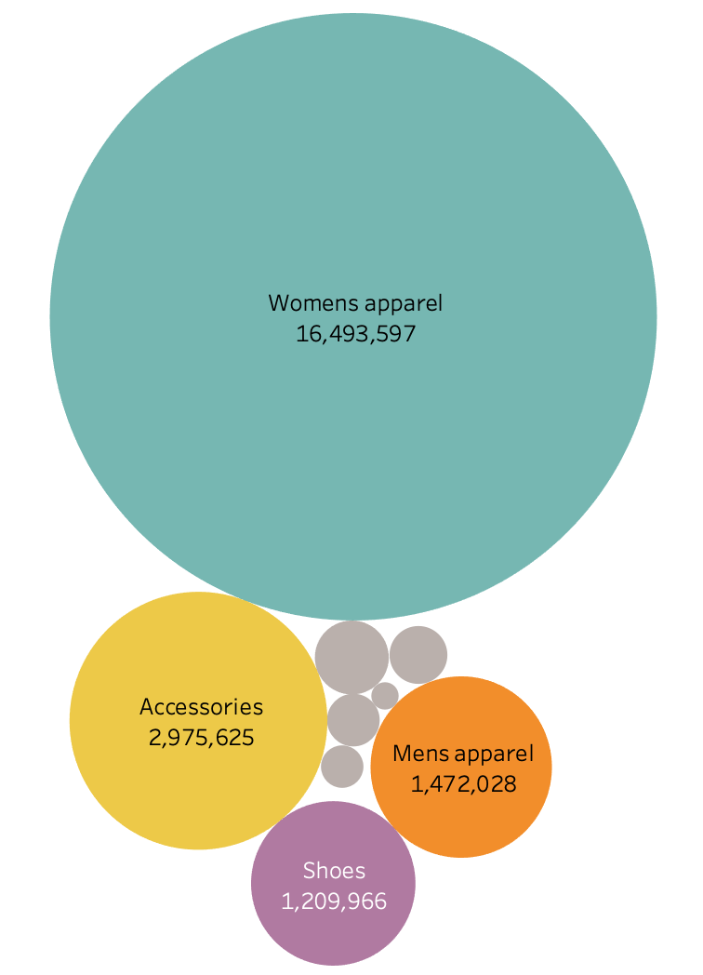
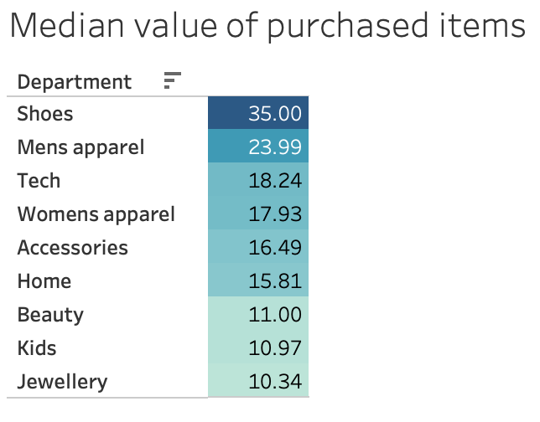
Transactional findings - Basket size growth
Women's apparel is driving total sales at a median item value of £17.93 but median value of shoes at £35 would increase order size significantly.
Opportunity:
Co-advertising e.g. outfits
Co-promotion
Co-location instore and online

Slide 6
Transactional findings - Department growth
Men's apparel at median value of £23.99, are comparatively higher vs Women's apparel at £17.9, yet items are concentrated in Women's apparel department.
Opportunity to:
acquire further male customers
leverage existing customer base to purchase men's items e.g. gifting

Slide 7
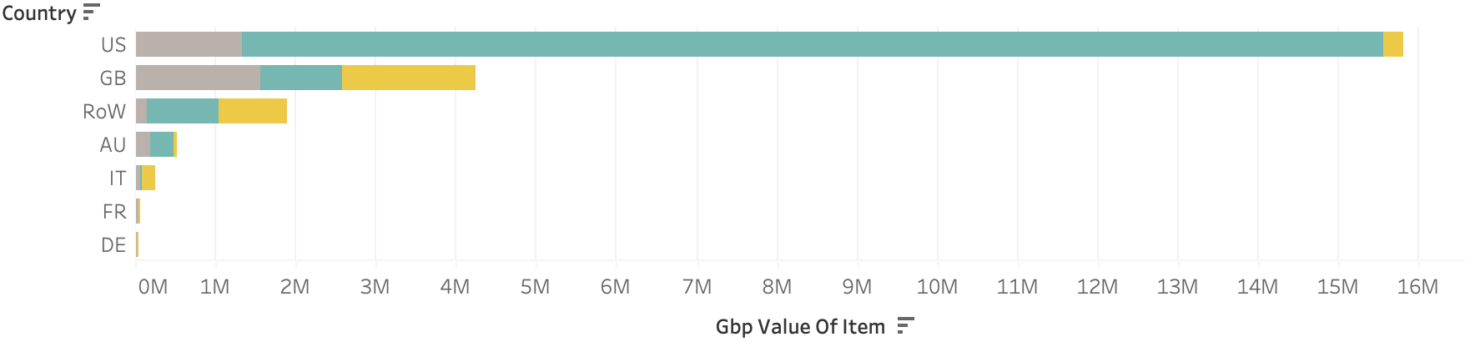
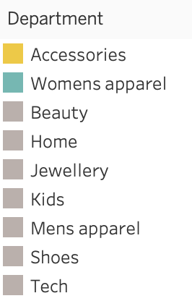
Transactional findings - Market expansion
Sales are
Concentrated in only 2 markets, US and GB: Opportunity to further expand to developing markets and grow in developed markets.
Driven by Women’s apparel, followed by accessories: Opportunity to diversify department engagement.

Slide 8
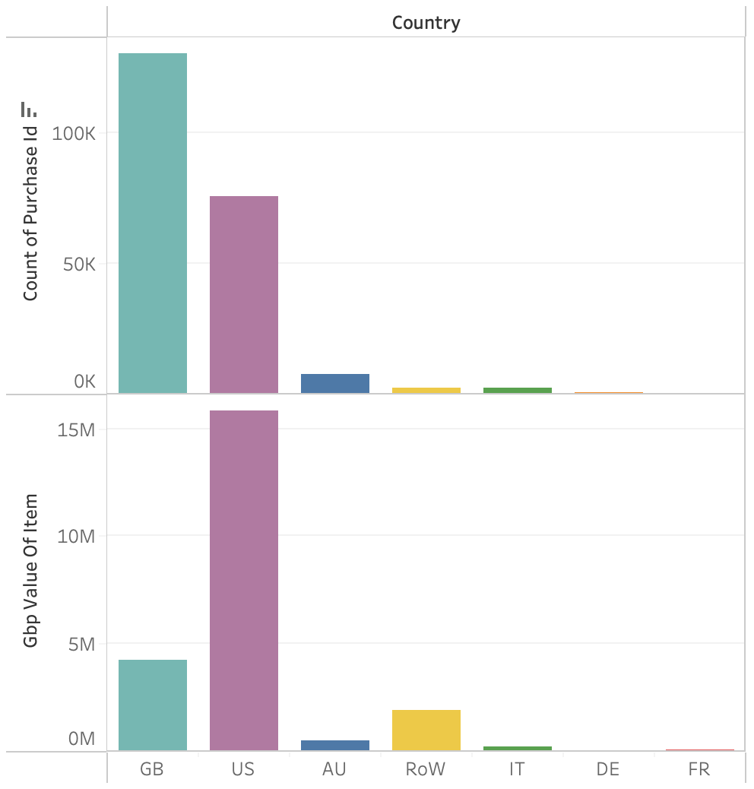
Transactional findings - Premium product line up
US purchases include higher value items than the UK.
Opportunity to explore:
a premium line up to the US consumer
a mid tier for the UK consumer

Slide 9
Buyer findings
170 records, ~99.9%, of data with no customer data, so very high customer data acquisition. Opportunity to leverage this in retargeting.
Purchases by gender is dominated by females at 76%.
Purchases by age group are skewed to younger age group.

Slide 10
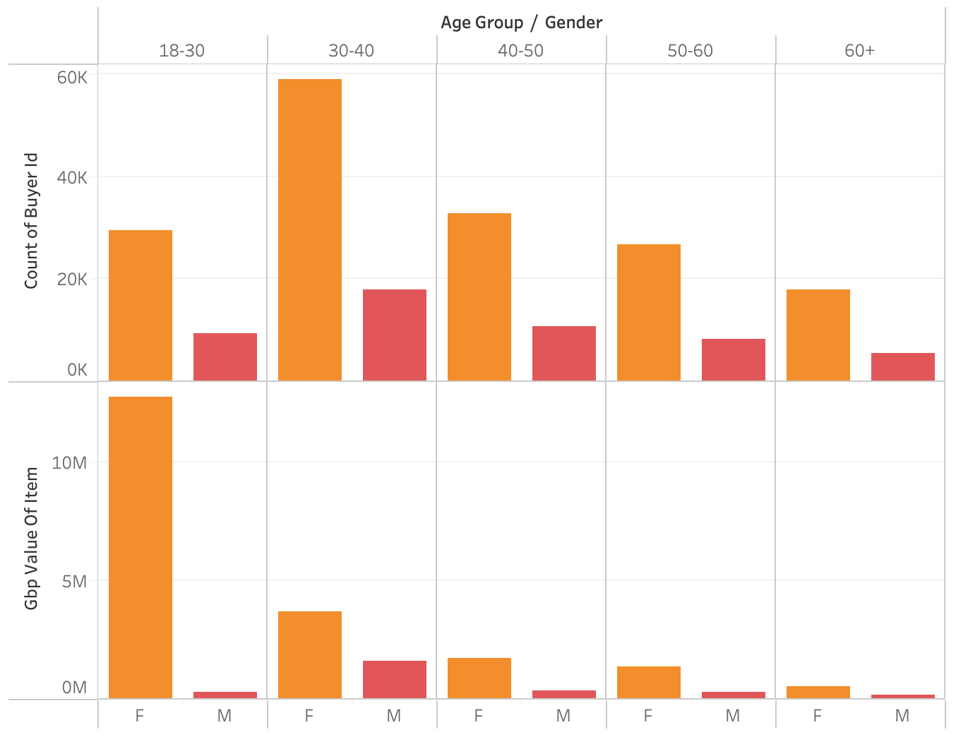
Buyer findings - Consumer demographic
Purchases are driven by females at 76% and further skewed to 18-30 age group. However, largest consumer group is 30-40 females.
Opportunity to:
accommodate this large consumer group
ensure a line up as the 18-30 group age

Slide 11
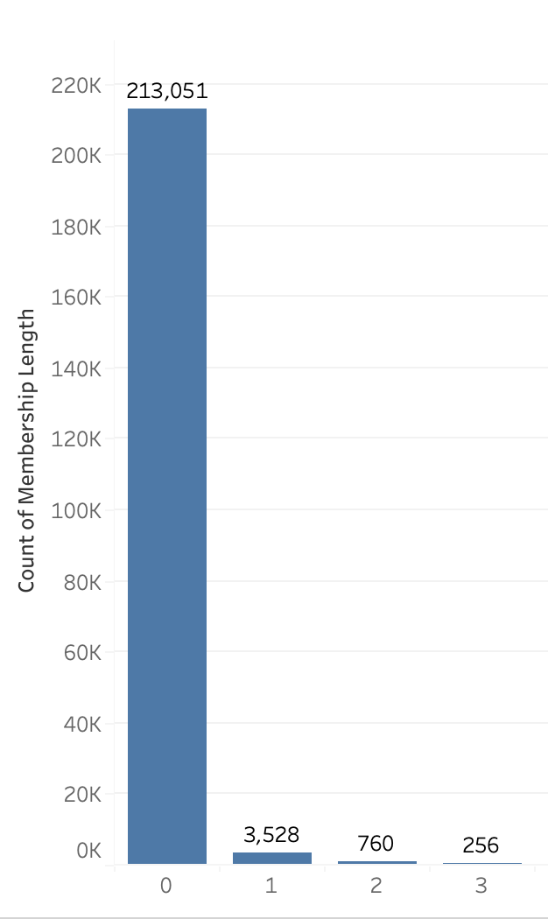
Buyer findings - Membership length
High buyer data acquisition at ~99.9%, but low membership length with majority < 1 year. Perhaps a new data acquisition strategy.
Opportunity to leverage this in CRM retargeting for repeat buyers to increase LTV

Slide 12
Additional info
Product profit margins data: to make profit-driving product recommendations
Existing marketing strategies: to not duplicate or cannibalise
Further sales data over 12 month period: to assess seasonality and variations in demographics

Slide 13
Assumptions
No existing marketing strategies
Fast fashion retailer
Short membership due to recent data acquisition
Week trends reflect a 12 month period

Slide 14
Repeat purchase - Maximise lifetime value
CRM retargeting using e.g. Braze
Target US 18-30 females
Prime audience for fast fashion retailer
To maximise LTV
Will have lower basket size due to affluence but due to market saturation needs a reminder to buy
Active on social channels
Content
Seasonality
Brand partnerships or exclusive collabs
Tailored products based on purchase history
Measurement
Click through rate
Website journey
Conversion and user data acquisition
Size of prize = £1.8 mil in year 1

Slide 15
1834328.7 = 12228858 * 5% * 3

Slide 16
Brand awareness - User acquisition growth
Google/meta paid ads
Target GB 30-40 males
To maximise LTV
Also higher spending power with more disposable income
Active on social channels
Higher male audience than US to test
Content
Test audience specific content and another copy which halos females 30-40 content
A/B testing
Measurement
Reach
Website traffic
Conversion and user data acquisition
Size of prize = £595k
Notes:
900127.408 = (buyer count difference)

Slide 17
594592.14 = (buyer count difference between F and M between 30-40 age group) * (Median value of item for M 30-40)
594592.14 = (35187 - 10402) * 23.99

Slide 18
Basket size - Order value growth
Basket recommendation
Target US 30-40 females
Due to large audience who are already making a purchase
Also higher spending power with more disposable income
Higher spend than UK
Content
Tailored shoes based on basket
Test promotion of the second item
Measurement
Click through rate of incremental item
Incremental item conversion
Order value
Size of prize = £35k

Slide 19
35437.5 = 20251 * 5% * £35

Slide 20
Long term opportunities
Distributor partnerships to cater to new audiences
Retailer partnerships with a larger audience
Improve buyer data specificity: Age group 18-30 spans 3 generations which are different consumer groups
Improve category taxonomy: Improve consumer friction points and to provide tailored recommendations

Slide 21
Recommendation summary
Explore portfolio diversification further across genders
Leverage GB as a test market due to category spread.
Increase GB basket size per purchase
External A/B testing on imaging for categories grouped together
Internal A/B testing on effective promotions
Basket recommendation
CRM retargeting using braze

Slide 22
Pricing Strategy: The wide range in item values suggests a broad product portfolio catering to both budget and high-end customers.
Customer Acquisition & Retention: The short membership length indicates that most customers are relatively new, which might point to effective acquisition strategies but potential challenges in retaining customers long-term.
Geographical Influence: The variance in exchange rates suggests the business operates in multiple regions, which introduces both opportunities and risks related to currency fluctuations.

