Slide 1
Business Decision Making
Paul Brown & Bret Podgorzec
Notes:
Template version: 7/29/2013, for PowerPoint 2010

Slide 2
Warm up exercise!

Slide 3
Session 2
Skill: Memo writing 13:00
Case Study 2 – Excel Modelling 13:15
[Break] 14:30
Skill: Effective presenting 14:45
Case study 3 – Strategic Considerations 15:00
Outline of coursework task 16:30
[End] 17:00

Slide 4
Why write a memo?
Writing in prose helps ensure reasoning is expressed clearly
A presentation is good for showing data but a poor permanent record
A memo will be easier for someone to read in isolation in several years’ time

Slide 5
A good memo is…
Well structured
Clearly laid out
Well articulated argument
Succinct
Focused on key information
Proportional to the complexity of the decision
Balanced
Highlights the key risks and benefits
Uses neutral language when describing the decision

Slide 6
Good memo structure
Background
What key information/context does the decision maker need?
Neutral language: facts not opinions
Description
What is the proposed action?
What are the expected financial impacts?
Neutral language: facts not opinions
Key Risks
What are the top 3 or 4 things that would prevent this being a wise decision?
Are there any proposed mitigations?
Balanced language: reasoned judgment
Evaluation
Balanced argument on why to take this action
Balanced language: reasoned judgment

Slide 7
Session 2
Skill: Memo writing 13:00
Case Study 2 – Excel Modelling 13:15
[Break] 14:30
Skill: Effective presenting 14:45
Case study 3 – Strategic Considerations 15:00
Outline of coursework task 16:30
[End] 17:00

Slide 8
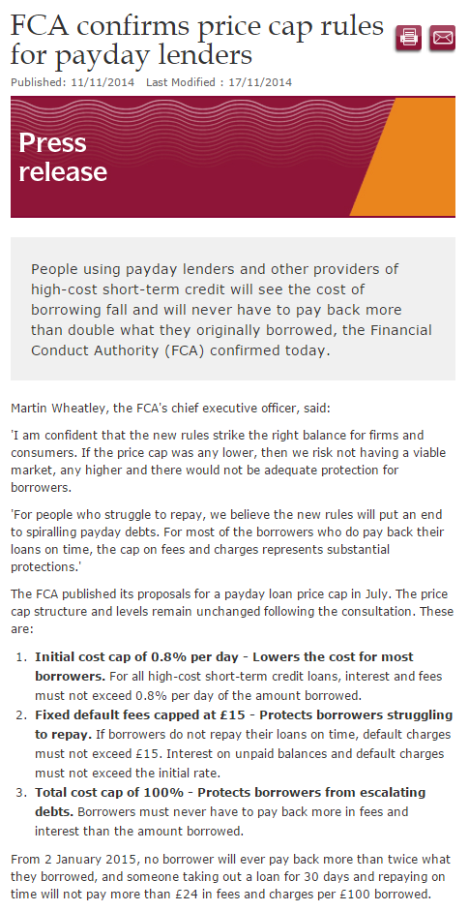
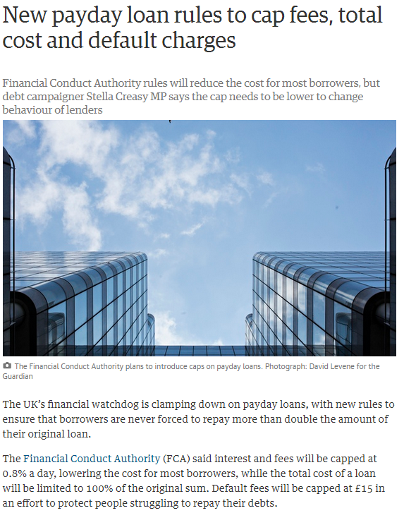
You run a payday loan company…

Slide 9
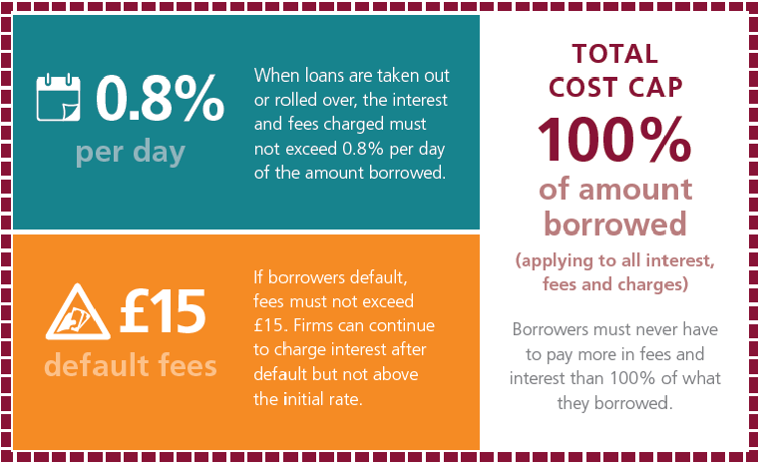
Have a go at building a value model in Excel
When loans are taken out or rolled over, the interest charged most not exceed 0.8% per day of the amount borrowed
If borrowers default, fees must not exceed £15. Firms can continue to charge interest after default but not above the initial rate
Borrowers must never have to pay more in fees and interest than 100% of what they borrowed

Slide 10
Session 2
Skill: Memo writing 13:00
Case Study 2 – Excel Modelling 13:15
[Break] 14:30
Skill: Effective presenting 14:45
Case study 3 – Strategic Considerations 15:00
Outline of coursework task 16:30
[End] 17:00

Slide 11
Session 2
Skill: Memo writing 13:00
Case Study 2 – Excel Modelling 13:15
[Break] 14:30
Skill: Effective presenting 14:45
Case study 3 – Strategic Considerations 15:00
Outline of coursework task 16:30
[End] 17:00

Slide 12
Effective presenting – body language
Legs
feet apart
weight on both legs
Hands
not locked
in a neutral position
Confidence
Movement
hands for emphasis
body for variety

Slide 13
Effective presenting – eye contact
Look at people
don’t stare at the floor or ceiling
Kennedy sweep
engage the audience at the beginning
Connection
Don’t fixate
spare the poor person who nods and smiles

Slide 14
Effective presenting – pauses
Walk don’t run
people can’t absorb fast speech well
Replace “um” with pauses
allows you to breathe
slows you down
increases confidence
Clarity
Pause more
allows emphasis
helps people absorb

Slide 15
Session 2
Skill: Memo writing 13:00
Case Study 2 – Excel Modelling 13:15
[Break] 14:30
Skill: Effective presenting 14:45
Case study 3 – Strategic Considerations 15:00
Outline of coursework task 16:30
[End] 17:00

Slide 16
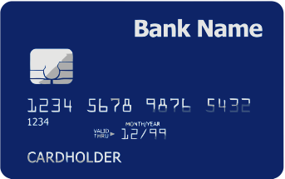
Your company markets a cashback credit card
1% customer cashback on all spend
1.5% interchange revenue on all spend
Marketing cost per new customer: £50
Product Economics
 | Spender | Borrower
% of accounts | 50% | 50%
Total Spend | £10,000 | £2,000
Interest Revenue | £0 | £50
Losses & Costs (excluding marketing costs) | -£20 | -£30
Net Interchange
Net Profit
All metrics are annual
Average customer lifetime 10 years

Slide 17
However EU regulation means interchange rates are likely to go down
Draft legislation published in July 2013 suggests interchange will drop to 0.5% across the EU
The timeframe for this is uncertain – it could be anywhere from 2015-2018
Though it seems unlikely to happen in the first half of 2015
Should we take any action, and if so, when?
Write a memo outlining your recommendation.

Slide 18
Prepare a recommendation to present to the board of your company
Select one or two people from your group to present
Max 5 minutes
2 – 4 slides
Everyone will give feedback on content, structure and delivery

Slide 19
Session 2
Skill: Memo writing 13:00
Case Study 2 – Excel Modelling 13:15
[Break] 14:30
Skill: Effective presenting 14:45
Case study 3 – Strategic Considerations 15:00
Outline of coursework task 16:30
[End] 17:00

Slide 20
Outline of coursework case
Balance transfer cards offer 0% interest for a period of time on balances transferred in from other cards
However a significant proportion of people don’t pay off their balance before the teaser ends
The market is highly competitive
You will be given a simple model of the industry and be asked to make a proposal covering the following things:
What are the key forces in the market?
What strategy should Capital One pursue and why?
What are the key risks of that strategy?

Slide 21
Deadlines and requirements
Drop in session on Tuesday 31st October 4-6pm
Submit the following by 5pm, Friday 3rd November:
Written memo outlining your recommendation [Approx 1000 words] (40%)
Slides for a 10 minute presentation of your recommendation to Capital One Business Decision Makers [Max 10 slides] (10%)
Presentations on Wednesday 8th November
10 min verbal presentation (with slides) to CapitalOne Business Decision Makers (30%)
Reflective log submitted by 5pm, Wednesday 15th November (20%)

Slide 22
Assessment criteria
In the memo and presentation we are looking for:
Insightful use of business data and context
Evidence of a clear and logical thought process
A clear evaluation of the risks and benefits involved
Clarity of written communication
Impact and quality of verbal presentation
Advice:
The model is a tool, not the source of all knowledge
Think about the long term implications of your proposal

Slide 23
Key questions
How would I know whether…
My data are correct, complete, and up-to-date?
I have identified all the key value drivers?
I haven’t neglected important external factors?
My assumptions are reasonable?
I have found all the mistakes in my maths?
My conclusions are reasonable?
What are the…
Long term implications of this strategy?
Biggest areas of uncertainty in the analysis?
Key risks of the strategy?

Slide 24
Session 2
Skill: Memo writing 13:00
Case Study 2 – Excel Modelling 13:15
[Break] 14:30
Skill: Effective presenting 14:45
Case study 3 – Strategic Considerations 15:00
Outline of coursework task 16:30
[End] 17:00

