Slide 1
Executive summary
Logistically maximising profits using the teaser balance model
Justification of the proposed solution
Mitigating risks through alternatives
 | Our product
Teaser Length (months) | 11
BT in fee | 1.1%
Post-Teaser APR | 21.00%
 | Our product
Teaser Length (months) | 12
BT in fee | 1.2%
Post-Teaser APR | 21.00%
 | Our product
Teaser Length (months) | 9
BT in fee | 1.2%
Post-Teaser APR | 23.00%

Slide 2
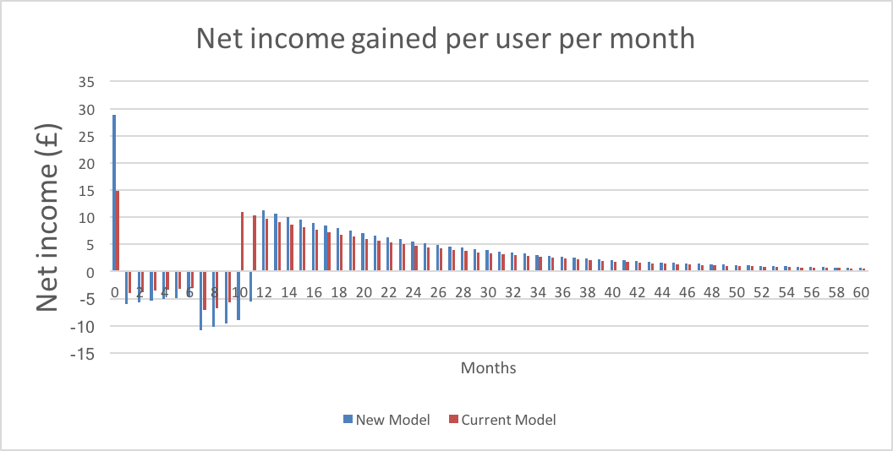
Justification in terms of profit
Positive net income at month zero and from the end of the teaser period.
Initial negative net income due to cost of funds which gradually decreases and then another dip at month 7 due to the beginning of defaults which also gradually decrease.

Slide 3
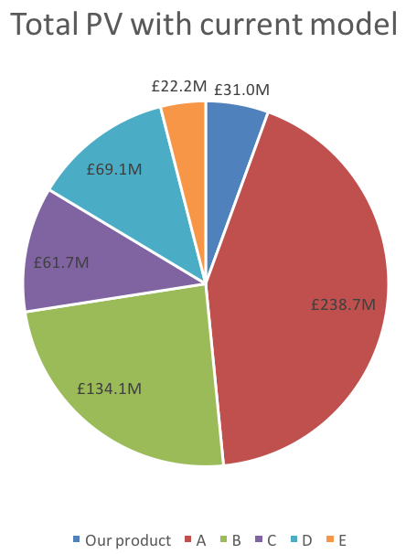
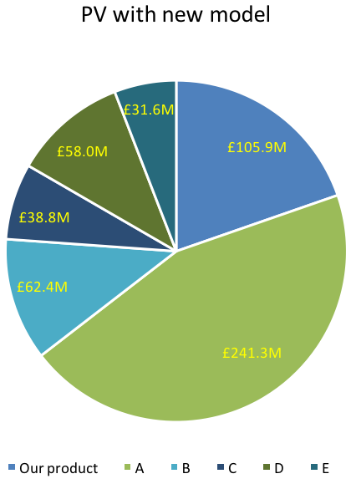
Justification of changes to competitors
Let A retain rank 1 in case of sudden economic impact on the market.
We aim to be ranked 2nd and increase profit by more than double with the new model.
Market is now dominated by 2 giants.

Slide 4
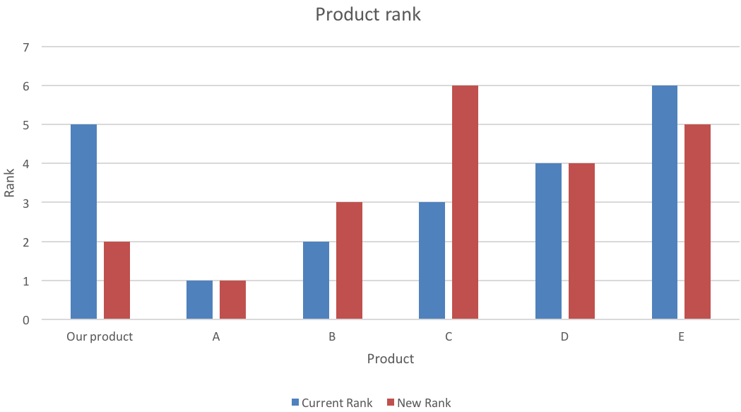
Justification by user numbers
Our product would rank 2nd if we adopted the new model so that competitor A take the brunt of the impact of any market mishaps leaving space for us.
We estimate we can get 1 million customers, 750,000 more than the current model.

Slide 5
Risks - Economic instability
Inflation occurs in the economic cycle but its risk is dependent on the timing.
Inflation depreciates the value of the pound causing an increase in loans, particularly by gamers, and value is lost.
Recession reduces the number of customers spending so interest gained is reduced, meaning profit is reducing and defaults are increasing.

Slide 6
Risks - Strategic change
Mishaps within the organisation such as technical error, where cards are not functioning for a period of time due.
Compensation, unexpected maintenance, negative publicity are potential outcomes which will need to be addressed and maneuvered through.
Regulatory changes could affect the new model within the teaser months and the months before the income exceeds the expenses.

Slide 7
Risks - Model credibility
We assume the core and secondary assumptions of which the model is dependent upon (defaults are subject to change to previous risks mentioned).
% defaults per open increases in month 7
Data used is current but since we are extrapolating, accuracy is curtailed

Slide 8
Risk mitigation
Propose to evaluate the economic situation in depth at month 8 and then change the model for new users.
New proposals are: incentivising and so, with a higher fee (to appeal to new customers) and APR or fewer teaser months and higher fees and APR (to reduce losses as the market may be suffering.
Both can be used if the assumed data for the model is inaccurate.
 | Our product
Teaser Length (months) | 12
BT in fee | 1.2%
Post-Teaser APR | 21.00%
 | Our product
Teaser Length (months) | 9
BT in fee | 1.2%
Post-Teaser APR | 23.00%

Slide 9
Conclusion
Begin with new model and then re-evaluate the profits against model predictions in month 8 and then adopt one of the two proposed models according to arising situations.
 | Our product
Teaser Length (months) | 11
BT in fee | 1.1%
Post-Teaser APR | 21.00%
 | Our product
Teaser Length (months) | 12
BT in fee | 1.2%
Post-Teaser APR | 21.00%
 | Our product
Teaser Length (months) | 9
BT in fee | 1.2%
Post-Teaser APR | 23.00%

