Slide 1
Earthquakes
A data visualisation assignment using a data taken from USGS
(U.S Geological Survey)
Kieran Thakkar

Slide 2
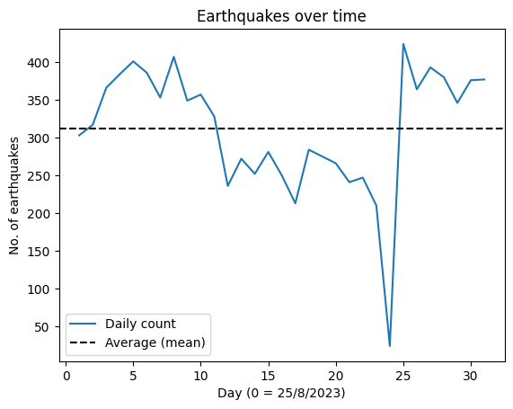
Temporal Trends

Slide 3

Average over 300 earthquakes per day !

Slide 4
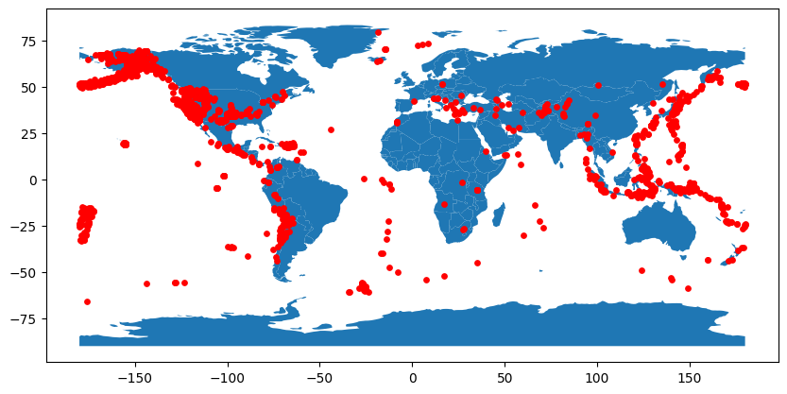
Geographical Distribution

Slide 5
Geographical Distribution

Slide 6
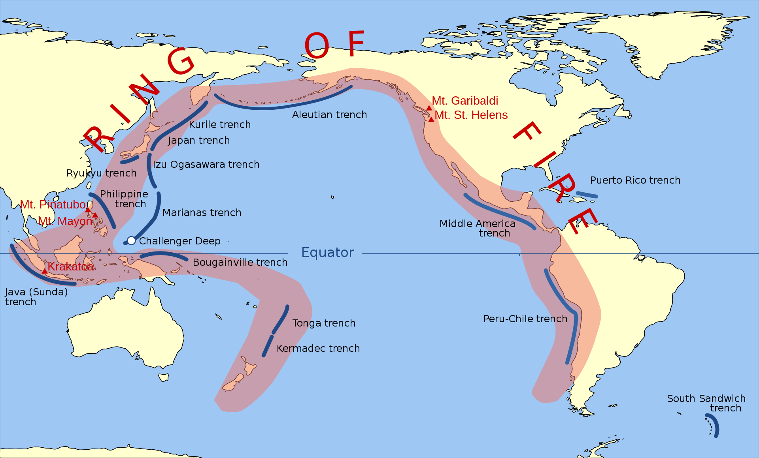
Geographical Distribution - Ring of Fire
Source: Gringer, Wikipedia

Slide 7



What’s the impact?
Notes:
The next section analyses the distribution of earthquake magnitudes to understand the frequency of small, moderate, and large earthquakes.

Slide 8
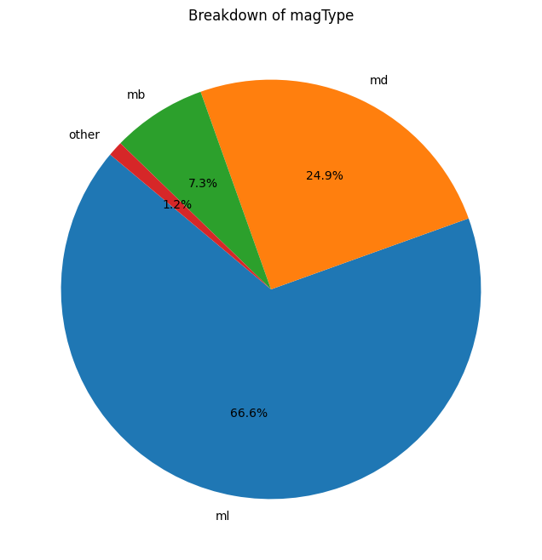
Magnitude Trends
67% measured with ML scale.
25% MD scale
Notes:
As shown in the above Figure, two-thirds (66.6%) of earthquakes in the dataset were measured with an ML scale. The second-most frequently used measurement scale was MD; however, at less than 25% of the data, there is significantly less data to analyse.

Slide 9
Magnitude Trends
To compare damages - we’ll only look at ML values.
Keeps it fair
Notes:
We decide to only look at ML measured earthquakes for a fairer comparison. This is because not all earthquakes are measured using the same scale.

Slide 10
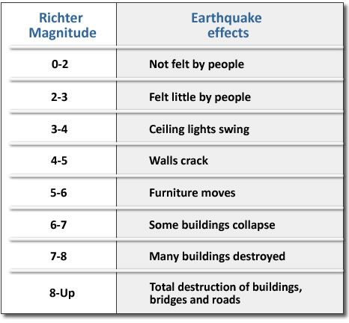
Magnitude Trends
Source: elizabethturp.co.uk

Slide 11
Magnitude Trends
(<2) Unnoticeable
(2-4) Small vibration
(4-6) Medium damage
(6+) Serious
Source: elizabethturp.co.uk
Notes:
Earthquakes have been categorised into groups based on their magnitudes. Unnoticable represents magnitudes below 2, small vibrations are 2-4, medium damage is 4-6, and serious is for magnitudes above 6.

Slide 12
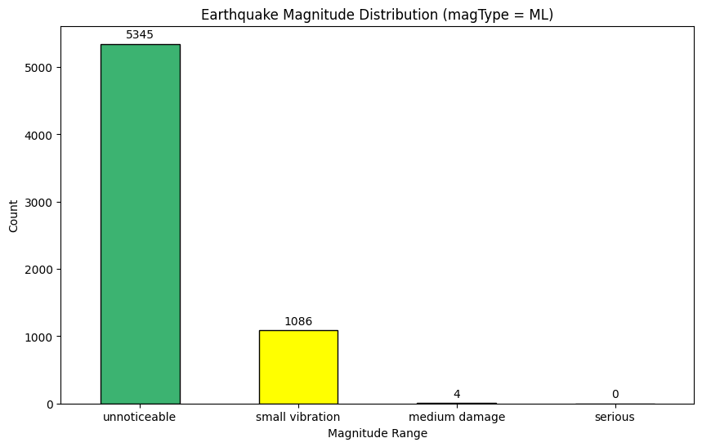
Magnitude Trends
Notes:
It is shown that the majority of earthquakes are unnoticeable to humans.
From the ML-measured earthquakes, there was none that caused any serious damage, and 4 that caused medium damage.

Slide 13


The majority of earthquakes are unnoticeable to humans.
From the ML-measured earthquakes:
0 caused serious damage
4 in medium damage range

Slide 14
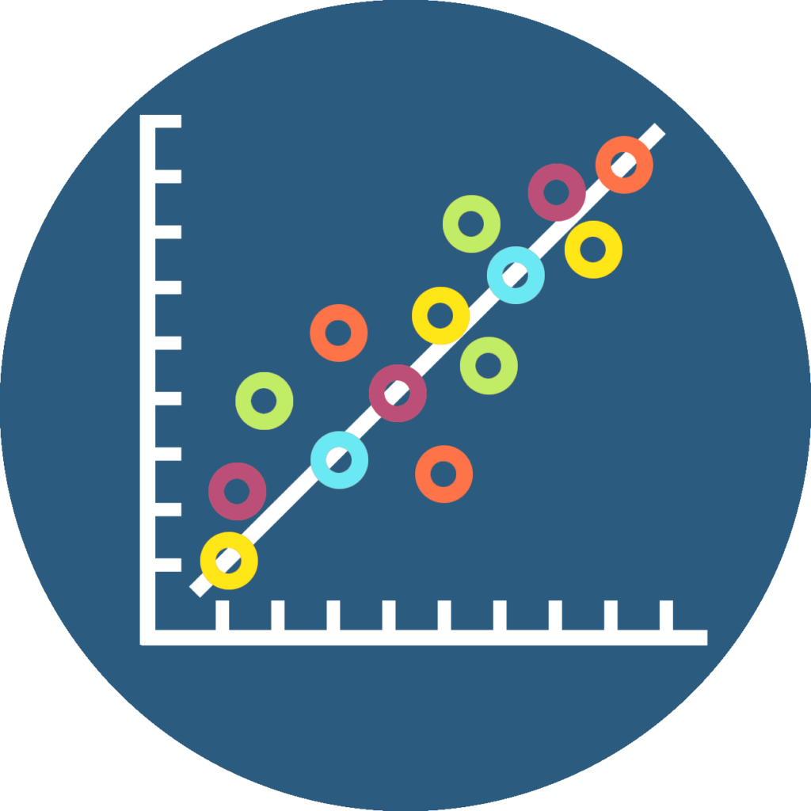
Correlations

Slide 15
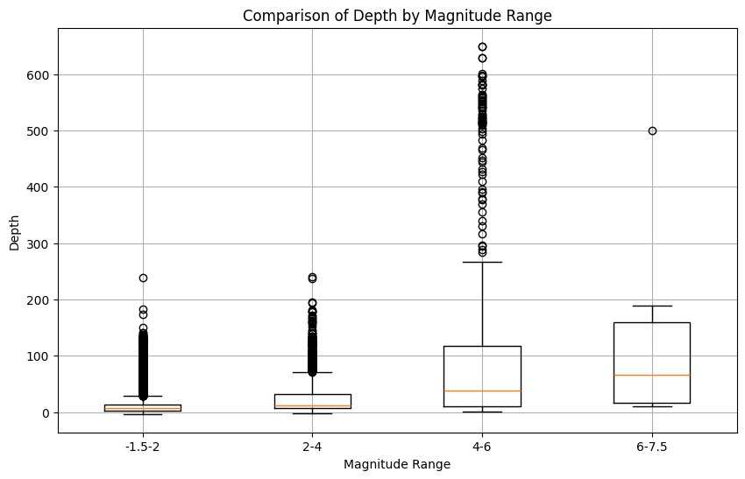
Depth vs Magnitude Analysis
Notes:
In this section, we investigate the depths at which different categories of earthquakes occur to gain insights into their correlation.
This Figure uses the complete data set (all magnitude measurement types). The box plot (above) shows the correlation between increasing depth and magnitude. Outliers are shown as circles. It should be noted that there exists significantly more data points at the lower magnitudes, hence the density of outliers.

Slide 16
Thanks for watching !
Notes:
Self explanatory.

